Slide 1
Querying the Web of Data with SPARQL and XSPARQL
web: www.polleres.net twitter:@AxelPolleres
This tutorial presents partially joint work with: Nuno Lopes (formerly NUI Galway, now IBM), Stefan Bischof (formerly NUI Galway, now Siemens AG), Daniele Dell'Aglio (Politecnico Di Milano)…
… and of course the whole W3C SPARQL WG

Slide 2
Before we start:
What you need for the hands-on parts of this Tutorial?
Find the material at: www.polleres.net/ →Teaching

Slide 3
What do you need?
We need Java installed and a console ... I have Java 1.7 on my machine (Mac OS X)
We need a SPARQL engine:
  Jena/ARQ : http://jena.apache.org/download/ ... Latest version: 2.12.0
  Set path to Jena directory, for me (Linux/Bash) this is:
  export JENAROOT=/Users/apollere/software/apache-jena-2.12.0
  export PATH=$JENAROOT/bin:$PATH
  Test (run from the console):
arq --query http://www.polleres.net/20140826xsparql_st.etienne/sparql/test.rq --data http://www.polleres.net/20140826xsparql_st.etienne/sparql/test.ttl
We need the XSPARQL commandline tool (XSPARQL combines SPARQL & XQuery):
  download: http://sourceforge.net/projects/xsparql/ or simply the link here
  test: download testquery at http://www.polleres.net/20140826xsparql_st.etienne/xsparql/test.xsparql
  java -jar xsparql-cli.jar test.xsparql
We *might* need an XQuery & XSLT processor:
  e.g. Saxon: http://sourceforge.net/projects/saxon/files/Saxon-HE/9.5/SaxonHE9-5-1-7J.zip/download
  (Open Source version, version 9.5.1.7)
  Test: download testquery at http://www.polleres.net/20140826xsparql_st.etienne/xsparql/query1.xq in your current directory, run:
  java -cp /Users/apollere/software/SaxonHE9-5-1-7J/saxon9he.jar net.sf.saxon.Query -q:query1.xq

Slide 4
Quick recap of RDF and Turtle:
https://ai.wu.ac.at/~polleres/20140826xsparql_st.etienne/sparql/SPARQL_simple_step-by-step/
...let's look at the simple*.ttl examples, these are files on Turtle syntax.
You might find commandline tools like curl and wget useful to download Data.
https://ai.wu.ac.at/~polleres/20140826xsparql_st.etienne/sparql/SPARQL_dbpedia_various_examples/example_curl_commands.txt
Another tool you might find useful when working on the commandline with RDF is 'rapper' ... Useful for RDF validation & conversion between different serializations:
  http://librdf.org/raptor/rapper.html
(exists ad Debian, FEDORA packages, also as MacPorts package)
Examples:
rapper --input=turtle –output=rdfxml https://ai.wu.ac.at/~polleres/20140826xsparql_st.etienne/sparql/SPARQL_simple_step-by-step/simple1.ttl

Slide 5
Querying the Web of Data with SPARQL and XSPARQL
Starting again … ;-)
(many slides taken from WWW’2012 Tutorial)
http://polleres.net/WWW2012Tutorial/
This tutorial presents partially joint work with: Nuno Lopes (formerly NUI Galway, now IBM), Stefan Bischof (formerly NUI Galway, now Siemens AG), Daniele Dell'Aglio (Politecnico Di Milano)…
… and of course the whole W3C SPARQL WG

Slide 6
We have heard about RDF and Linked Data already...
Which other Data formats are popular on the Web?
How to query and integrate data in these formats using declarative query languages?
XML, JSON
SPARQL, XQuery, XSPARQL

Slide 7
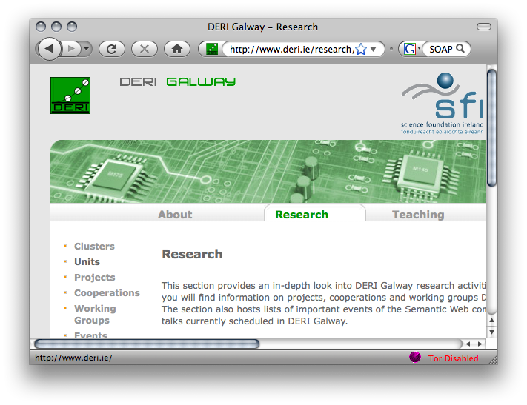









RDF, XML & JSON: one Web of data – various formats
XSLT/XQuery
HTML
RSS
<XML/>
SPARQL
SOAP/WSDL

Slide 8
RDF, XML & JSON: one Web of data – various formats
HTML
RSS
XSPARQL
<XML/>
SOAP/WSDL

Slide 9
A Sample Scenario…

Slide 10




Example: Favourite artists location
Display information about your favourite artists on a map
Last.fm knows what music you listen to, your most played artists, etc. and provides an XML API.
Using RDF allows to combine Last.fm info with other information on the web, e.g. location.
Show your top bands hometown in Google Maps, using KML – an XML format.

Slide 11

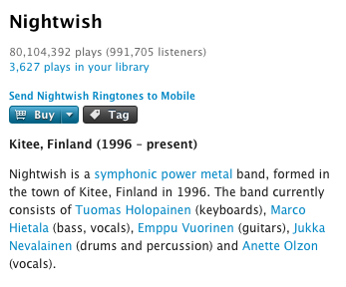
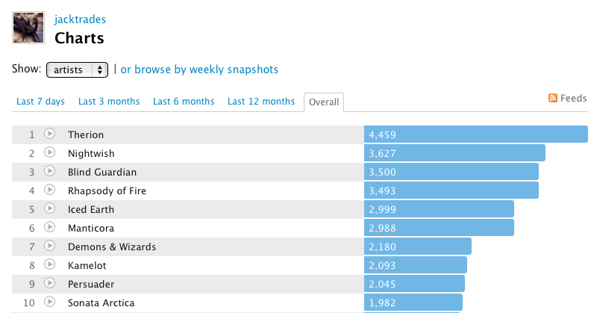
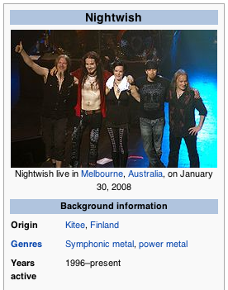
Example: Favourite artists location
How to implement this use case?
Get your favourite bands – from lastfm
Get the hometown of the bands – from Dbpedia
Create a KML file to be displayed in Google Maps
Last.fm shows your most listened bands
Last.fm is not so useful in this step
Last.fm API:
http://www.last.fm/api

Slide 12

Example: Favourite artists location
How to implement this use case?
Get your favourite bands
Get the hometown of the bands, and the geo locations
Create a KML file to be displayed in Google Maps
XQuery
?
XQuery
SPARQL XML Result
SPARQL
XQuery

Slide 13
Transformation and Query Languages
XML world
XML Transformation Language
Syntax: XML
RDF world
XQuery
XML Query Language
non-XML syntax
XSLT
RDF/XML… ambiguous
Query Language for RDF
Pattern based
declarative
XPath
SPARQL
XPath is the common core
Mostly used to select nodes from an XML doc
SPARQL XML Result format

Slide 14
Lecture Overview
Part 1: Data Formats – quick recap (you know already about RDF & Linked Data:)
  XML
  JSON
  XPath & Xquery in a nutshell
Part 2: SPARQL-by-examples (in a bit more detail)
Part 3: XSPARQL: a combined language integrating SPARQL with XQuery
Part 4: more examples & more hands-on (time allowed)

Slide 15
XML & JSON: Back to our Sample Scenario…

Slide 16
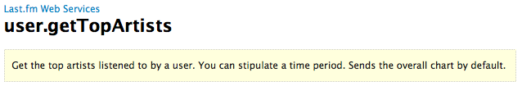
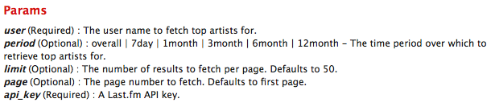
Example: Favourite artists location
Last.fm knows what music you listen to, your most played artists, etc. and provides an XML API, which you can access if you have an account.
http://www.last.fm/api
Sample Call:
http://ws.audioscrobbler.com/2.0/method=user.gettopartists&user=jacktrades&api_key=…

Slide 17
Example: Favourite artists location
Find a sample result here: http://polleres.net/20140826xsparql_st.etienne/xsparql/lastfm_user_sample.xml
<?xml version="1.0" encoding="UTF-8"?>
<lfm status="ok">
<topartists user="jacktrades" type="overall" page="1" perPage="50" totalPages="16" total="767">
<artist rank="1">
<name>Nightwish</name>
<playcount>4958</playcount>
<mbid>00a9f935-ba93-4fc8-a33a-993abe9c936b</mbid>
<url>http://www.last.fm/music/Nightwish</url>
<streamable>0</streamable>
<image size="small">http://userserve-ak.last.fm/serve/34/84310519.png</image>
<image size="medium">http://userserve-ak.last.fm/serve/64/84310519.png</image>
<image size="large">http://userserve-ak.last.fm/serve/126/84310519.png</image>
</artist>
<artist rank="2">
<name>Therion</name>
<playcount>4947</playcount>
<mbid>c6b0db5a-d750-4ed8-9caa-ddcfb75dcb0a</mbid>
…
</artist>
…
</topartists>
</lfm>
Notes:
Check: everybody familiar with XML terminology? Elements, attribute, root element, etc.

Slide 18
JSON
JavaScript Object Notation
Recently becoming even more popular than XML in the context of Web Data APIs
More compact than XML
Directly accessible for Javascript
JSON Objects support simple types (string, number, arrays, boolean)
… if you want a bit like "Turtle" for XML (or tree-shaped, nested data in General)
except: no Namespaces or URIs per se

Slide 19
JSON
JavaScript Object Notation
Syntax
unordered Set of attribute-value pairs.
Each Object enclosed in '{' '}'.
Attribute names followed by ':'
Attribute-Value pairs separated by ' , '
Like elements in XML, JSON Objects can be nested
Arrays as ordered collections of values enclosed in '[' ']'
JSON Example
{
"first": "Jimmy",
"last": "James",
"age": 29,
"sex": "male",
"salary": 63000,
"department": {"id": 1, "name" : "Sales"},
"registered": false,
"lucky numbers": [ 2, 3, 11, 23],
"listofCustomers":[ {"name": "Customer1" },
{"name": "Customer2" } ]
}

Slide 20

Example: Favourite artists location
Last.fm also provides its API in JSON… many other data services nowadays only provide JSON APIs!
http://www.last.fm/api
Sample Call for JSON:
http://ws.audioscrobbler.com/2.0/method=user.gettopartists&user=jacktrades&format=json&api_key=…

Slide 21
Example: Favourite artists location
Find a sample result here: http://polleres.net/20140826xsparql_st.etienne/xsparql/lastfm_user_sample.json
{ "topartists": {
"@attr": { "total": "767",
"user": "jacktrades" },
"artist": [
{ "@attr": { "rank": "1" },
"image": [ { "#text": "http://userserve-ak.last.fm/serve/34/84310519.png", "size": "small" },
{ "#text": "http://userserve-ak.last.fm/serve/64/84310519.png","size": "medium" },
{ "#text": "http://userserve-ak.last.fm/serve/126/84310519.png", "size": "large" } ],
"mbid": "00a9f935-ba93-4fc8-a33a-993abe9c936b",
"name": "Nightwish", "playcount": "4958", "streamable": "0", "url": "http://www.last.fm/music/Nightwish" },
{ "@attr": { "rank": "2" },
"image": [ { "#text": "http://userserve-ak.last.fm/serve/34/2202944.jpg", "size": "small" },
{ "#text": "http://userserve-ak.last.fm/serve/64/2202944.jpg", "size": "medium" },
{ "#text": "http://userserve-ak.last.fm/serve/126/2202944.jpg", "size": "large" } ],
"mbid": "c6b0db5a-d750-4ed8-9caa-ddcfb75dcb0a",
"name": "Therion", "playcount": "4947", "streamable": "0", "url": "http://www.last.fm/music/Therion },
...
]
}
}
Notes:
Check: everybody familiar with XML terminology? Elements, attribute, root element, etc.

Slide 22
Getting back to our goal: How to query that data?
XPath & Xquery in a nutshell…

Slide 23
Querying XML Data from Last.fm: XPath & XQuery 1/2
<lfm status="ok">
<topartists type="overall">
<artist rank="1">
<name>Therion</name>
<playcount>4459</playcount>
<url>http://www.last.fm/music/Therion</url>
</artist>
<artist rank="2">
<name>Nightwish</name>
<playcount>3627</playcount>
<url>http://www.last.fm/music/Nightwish</url>
</artist>
</topartists>
</lfm>
Last.fm API format:
root element: “lfm”, then “topartists”
sequence of “artist”
Querying this document with XPath:
XPath steps:
/lfm
Selects the “lfm” root element
//artist
Selects all the “artist” elements
XPath Predicates:
//artist[@rank = 2]
Selects the “artist” with rank 2
Note: each XPath query is an XQuery... You can execute this:
java -cp /Users/apollere/software/SaxonHE9-5-1-7J/saxon9he.jar net.sf.saxon.Query -q:query2.xq -s:lastfm_user_sample.xml

Slide 24
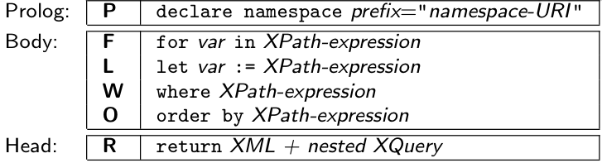
Querying XML Data from Last.fm: XPath & XQuery 2/2
iterate over sequences
assign values to variables
filter expressions
create XML elements
Query:
Retrieve information regarding a users' 2nd top artist from the
Last.fm API
let $doc := "http://ws.audioscrobbler.com/2.0/user.gettopartist"
for $artist in doc($doc)//artist
where $artist[@rank = 2]
return <artistData>{$artist}</artistData>

Slide 25
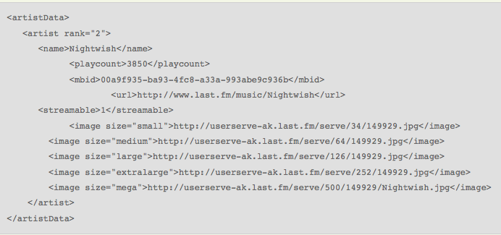
Querying XML Data from Last.fm 2/2
Result for user “jacktrades” looks something like this…
Query:
Retrieve information regarding a users' 2nd top artists from the
Last.fm API
let $doc := "http://ws.audioscrobbler.com/2.0/user.gettopartist"
for $artist in doc($doc)//artist
where $artist[@rank = 2]
return <artistData>{$artist}</artistData>

Slide 26
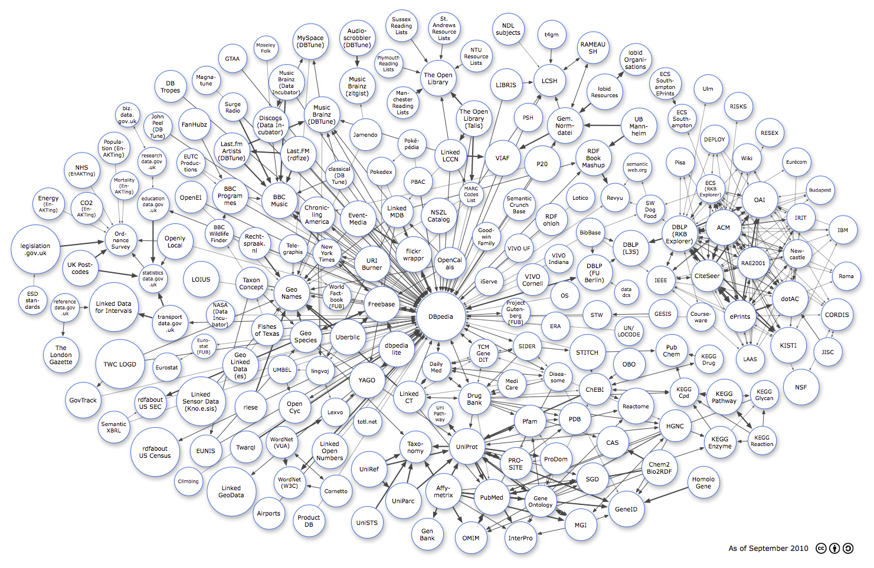

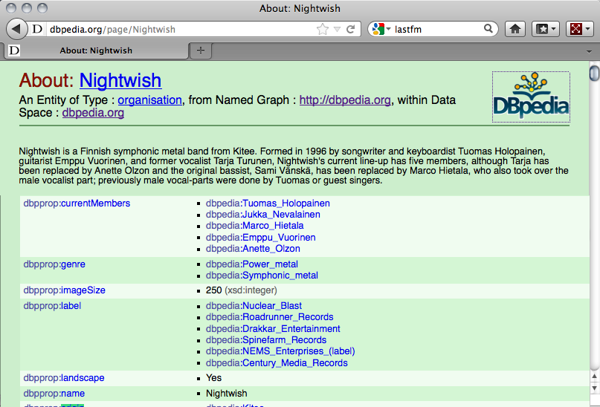
Now what about RDF Data?
RDF is an increasingly popular format for Data on the Web:
… lots of RDF Data is out there, ready to “query the Web”, e.g.:
Linking Open Data cloud diagram, by Richard Cyganiak and Anja Jentzsch. http://lod-cloud.net/

Slide 27
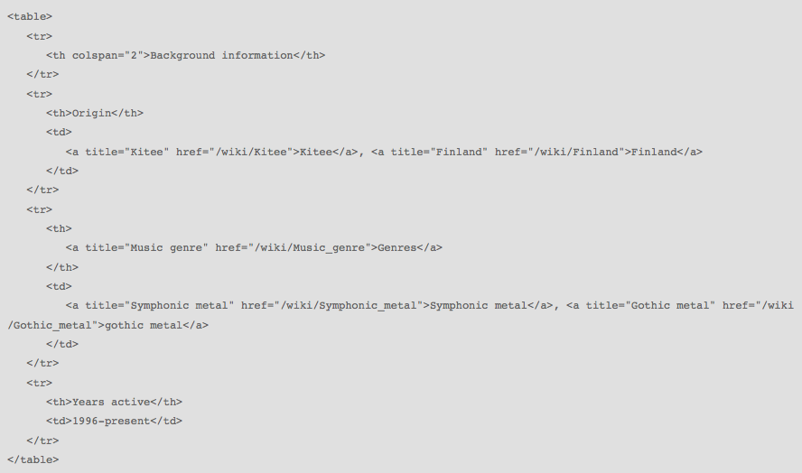
XML vs. RDF
XML: “treelike” semi-structured Data (mostly schema-less, but “implicit” schema by tree structure… not easy to combine, e.g. how to combine lastfm data with wikipedia data?

Slide 28
What's the advantages of RDF against XML (and JSON)?
Simple, declarative, graph-style format
based on dereferenceable URIs (= Linked Data)
Subject Predicate Object
Subject U x B
Predicate U
Object U x B x L
URIs, e.g.
http://www.w3.org/2000/01/rdf-schema#label
http://dbpedia.org/ontology/origin
http://dbpedia.org/resource/Nightwish
http://dbpedia.org/resource/Kitee
Blanknodes:
“existential variables in the data” to express incomplete information, written as _:x or []
Literals, e.g.
“Jacktrades”
”Kitee"@en
"Китеэ”@ru
28

Slide 29
What's the advantages of RDF against XML (and JSON)?
Easily combinable! RDF data can simply be merged!
Finland
“Jacktrades”
country
accountName
likes
Kitee
label
” Kitee”@en
origin
Nightwish
label
“Nightwish”
Various syntaxes, RDF/XML, Turtle, N3, RDFa,…
<http://dbpedia.org/resource/Nightwish> <http://dbpedia.org/property/origin>
<http://dbpedia.org/resource/Kitee> .
<http://dbpedia.org/resource/Kitee> <http://www.w3.org/2000/01/rdf-schema#label>
”Kitee”@es .
_:x <http://xmlns.com/foaf/0.1/accountName> “Jacktrades" .
_:x <http://graph.facebook.com/likes> <http://dbpedia.org/resource/Nightwish> .
29

Slide 30
Could be stored more or less straightforwardly (and naively ;)) stored into a relational DB!
Finland
“Jacktrades”
country
accountName
likes
Kitee
label
” Kitee”@en
origin
Nightwish
label
“Nightwish”
Query: Bands from Finland that user "Jacktrades" likes?
  SELECT T2.Obj
  FROM triples T1, triples T2, triples T3, triples T4
  WHERE
T1.Obj = "Jacktrades" AND T1.Pred = accountname AND
T1.Subj = T2.Subj AND T2.Pred = likes AND
  T3.Obj = T4.Subj AND T3.Pred = origin AND
  T4.Pred = country AND T4.Obj = Finland
RDF Store
Subj | Pred | Obj
_:b | accountname | "Jacktrades"
_:b | likes | Nightwish
Nightwish | origin | Kitee
Nightwish | Label | "Nightwish"
Kitee | Country | Finland
… | … | …
  SQL is not the best solution for this… Fortunately there's something better: SPARQL!

Slide 31
Could be stored more or less straightforwardly (and naively ;)) stored into a relational DB!
Finland
“Jacktrades”
country
accountName
likes
origin
?Band
Query: Bands from Finland that user "Jacktrades" likes?
  SPARQL core Idea: formulate queries as graph patterns
RDF Store
  …where basic graph patterns are just "Turtle with variables":
  SELECT ?Band
  WHERE { ?Band :origin [ :country :Finland ] .
  [] :accountName "jacktrades" ;
  :likes ?Band . }
Subj | Pred | Obj
_:b | accountname | "Jacktrades"
_:b | likes | Nightwish
Nightwish | origin | Kitee
Nightwish | Label | "Nightwish"
Kitee | Country | Finland
… | … | …

Slide 32
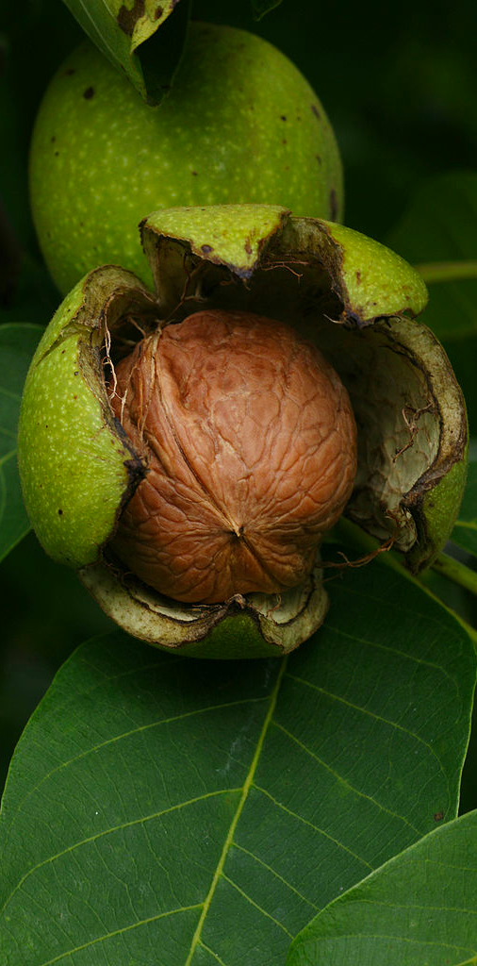
SPARQL in a Nutshell...
How to query RDF?
This Photo was taken by Böhringer Friedrich.

Slide 33
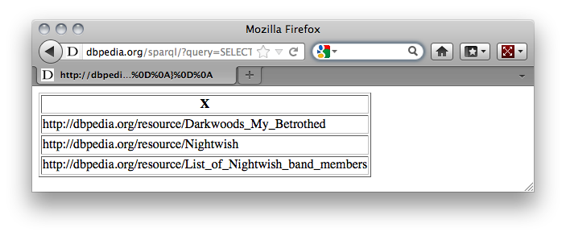
SPARQL + Linked Data give you Semantic search almost “for free”
Which bands origin from Kitee?
Try it out at http://live.dbpedia.org/sparql/
SELECT ?X
WHERE
{
?X <http://dbpedia.org/property/origin> <http://dbpedia.org/resource/Kitee>
}
?X
dbpedia.org/property/origin
dbpedia.org/resource/Kitee

Slide 34
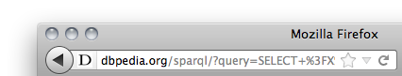
SPARQL – Standard RDF Query Language and Protocol
SPARQL 1.0 ( standard since 2008):
  SQL “Look-and-feel” for the Web
  Essentially “graph matching” by triple patterns
  Allows conjunction (.) , disjunction (UNION), optional (OPTIONAL) patterns and filters (FILTER)
  Construct new RDF from existing RDF
  Solution modifiers (DISTINCT, ORDER BY, LIMIT, …)
  A standardized HTTP based protocol:
SELECT ?X
WHERE
{
?X <http://dbpedia.org/property/origin> <http://dbpedia.org/resource/Kitee>
}

Slide 35
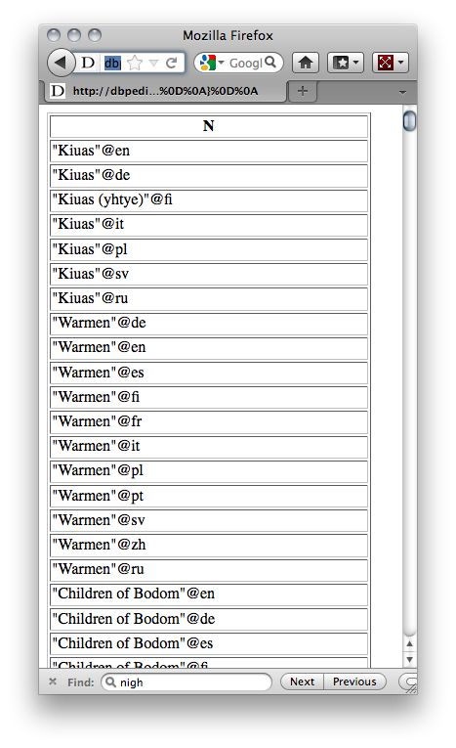
Conjunction (.) , disjunction (UNION), optional (OPTIONAL) patterns and filters (FILTER)
Names of bands from cities in Finland?
PREFIX : <http://dbpedia.org/resource/>
PREFIX dbprop: <http://dbpedia.org/property/>
PREFIX dbont: <http://dbpedia.org/ontology/>
PREFIX category: <http://dbpedia.org/resource/Category:>
PREFIX rdfs: <http://www.w3.org/2000/01/rdf-schema#>
PREFIX dcterms: <http://purl.org/dc/terms/>
SELECT ?N
WHERE
{
?X a dbont:Band ; rdfs:label ?N ;
dbprop:origin [ dcterms:subject category:Cities_and_towns_in_Finland] .
}
SELECT ?N
WHERE
{
?X <http://dbpedia.org/property/origin> ?C.
?C <http://purl.org/dc/terms/subject>
<http://dbpedia.org/resource/Category:Cities_and_towns_in_Finland> .
?X a <http://dbpedia.org/ontology/Band> .
?X <http://www.w3.org/2000/01/rdf-schema#label> ?N .
}
  Shortcuts for namespace prefixes and to
  group triple patterns

Slide 36
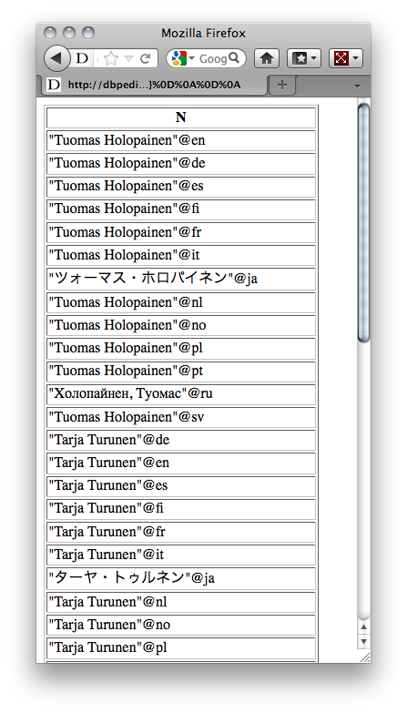
Conjunction (.) , disjunction (UNION), optional (OPTIONAL) patterns and filters (FILTER)
Names of things that origin or were born in Kitee?
SELECT ?N
WHERE
{
{ ?X dbprop:origin <http://dbpedia.org/resource/Kitee> }
UNION
{ ?X dbont:birthPlace <http://dbpedia.org/resource/Kitee> }
?X rdfs:label ?N
}

Slide 37
Conjunction (.) , disjunction (UNION), optional (OPTIONAL) patterns and filters (FILTER)
Cites Finland with a German (@de) name…
SELECT ?C ?N
WHERE
{
?C dcterms:subject category:Cities_and_towns_in_Finland ;
rdfs:label ?N .
FILTER( LANG(?N) = "de" )
}
SPARQL has lots of FILTER functions to filter text with regular expressions (REGEX), filter numerics (<,>,=,+,-…), dates, etc.)

Slide 38
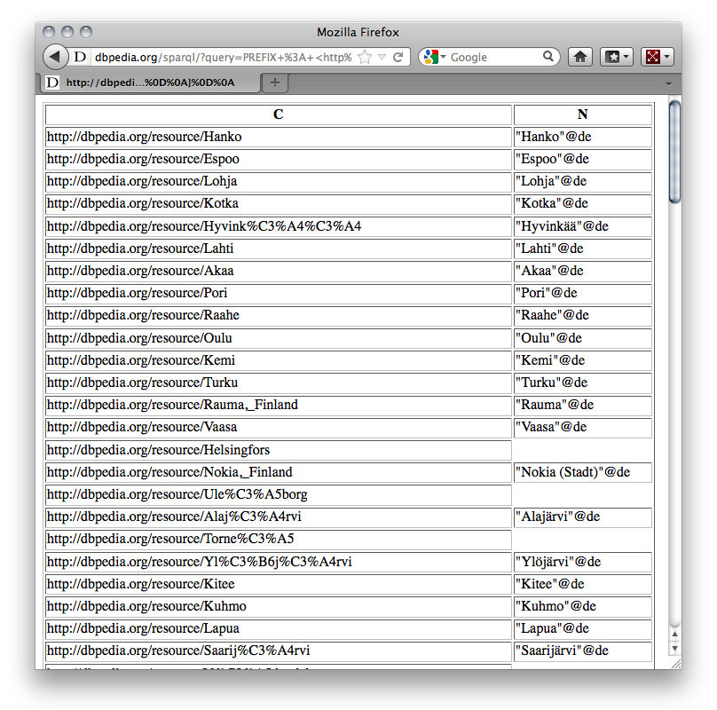
Conjunction (.) , disjunction (UNION), optional (OPTIONAL) patterns and filters (FILTER)
Cites Finland with optionally their German (@de) name
SELECT ?C ?N
WHERE
{
?C dcterms:subject category:Cities_and_towns_in_Finland .
OPTIONAL { ?C rdfs:label ?N . FILTER( LANG(?N) = "de" ) }
}
Note: variables can be
unbound in a result!

Slide 39
CONSTRUCT Queries to create new triples (or to transform one RDF Graph to another)
The members of a Band know each other:
PREFIX dbpedia: <http://dbpedia.org/resource/>
PREFIX dbpedia-owl: <http://dbpedia.org/ontology/>
PREFIX prop: <http://dbpedia.org/property/>
PREFIX foaf: <http://xmlns.com/foaf/0.1/>
CONSTRUCT { ?M1 foaf:knows ?M2 }
WHERE { <http://dbpedia.org/resource/Nightwish> <http://dbpedia.org/ontology/bandMember> ?M1, ?M2 .
FILTER( ?M1 != ?M2 ) }
@prefix foaf: <http://xmlns.com/foaf/0.1/> .
@prefix dbpedia: <http://dbpedia.org/resource/> .
dbpedia:Jukka_Nevalainen foaf:knows dbpedia:Emppu_Vuorinen , dbpedia:Troy_Donockley , dbpedia:Floor_Jansen , dbpedia:Marco_Hietala , dbpedia:Tuomas_Holopainen .
dbpedia:Emppu_Vuorinen foaf:knows dbpedia:Jukka_Nevalainen , dbpedia:Troy_Donockley , dbpedia:Floor_Jansen , dbpedia:Marco_Hietala , dbpedia:Tuomas_Holopainen .
dbpedia:Troy_Donockley foaf:knows dbpedia:Jukka_Nevalainen , dbpedia:Emppu_Vuorinen , dbpedia:Floor_Jansen , dbpedia:Marco_Hietala , dbpedia:Tuomas_Holopainen .
dbpedia:Floor_Jansen foaf:knows dbpedia:Jukka_Nevalainen , dbpedia:Emppu_Vuorinen , dbpedia:Troy_Donockley , dbpedia:Marco_Hietala , dbpedia:Tuomas_Holopainen .
dbpedia:Marco_Hietala foaf:knows dbpedia:Jukka_Nevalainen , dbpedia:Emppu_Vuorinen , dbpedia:Troy_Donockley , dbpedia:Floor_Jansen , dbpedia:Tuomas_Holopainen .
dbpedia:Tuomas_Holopainen foaf:knows dbpedia:Jukka_Nevalainen , dbpedia:Emppu_Vuorinen , dbpedia:Troy_Donockley , dbpedia:Floor_Jansen , dbpedia:Marco_Hietala .

Slide 40
Missing features in SPARQL1.0 (and why SPARQL1.1 was needed)
Based on implementation experience, in 2009 new W3C SPARQL WG founded to address common feature requirements requested urgently by the community: http://www.w3.org/2009/sparql/wiki/Main_Page
  Negation
  Assignment/Project Expressions
  Aggregate functions (SUM, AVG, MIN, MAX, COUNT, …)
  Subqueries
  Property paths
  Updates
  Entailment Regimes
  Other issues for wider usability:
      Result formats (JSON, CSV, TSV),
      Graph Store Protocol (REST operations on graph stores)
      SPARQL 1.1 is a W3C Recommendation since 21 March 2013

Slide 41
1. Negation: MINUS and NOT EXISTS
      Select Persons without a homepage:
      SELECT ?X
      WHERE{ ?X rdf:type foaf:Person
      OPTIONAL { ?X foaf:homepage ?H }
      FILTER( !bound( ?H ) ) }
SPARQL1.1 has two alternatives to do negation
  NOT EXISTS in FILTERs
    detect non-existence
      SELECT ?X
      WHERE{ ?X rdf:type foaf:Person
      FILTER ( NOT EXISTS { ?X foaf:homepage ?H } ) }
41

Slide 42
1. Negation: MINUS and NOT EXISTS
      Select Persons without a homepage:
      SELECT ?X
      WHERE{ ?X rdf:type foaf:Person
      OPTIONAL { ?X foaf:homepage ?H }
      FILTER( !bound( ?H ) ) }
SPARQL1.1 has two alternatives to do negation
  NOT EXISTS in FILTERs
    detect non-existence
  (P1 MINUS P2 ) as a new binary operator
    “Remove rows with matching bindings”
    only effective when P1 and P2 share variables
      SELECT ?X
      WHERE{ ?X rdf:type foaf:Person
      FILTER ( NOT EXISTS { ?X foaf:homepage ?H } ) }
      SELECT ?X
      WHERE{ ?X rdf:type foaf:Person
      MINUS { ?X foaf:homepage ?H } ) }
42

Slide 43
2. Assignment/Project Expressions
Assignments, Creating new values… now available in SPARQL1.1
PREFIX : <http://www.example.org/>
PREFIX foaf: <http://xmlns.com/foaf/0.1/>
SELECT (strbefore(?Name," ") AS ?firstname)
(strafter(?Name," ") AS ?lastname)
WHERE { ?X foaf:name ?Name . }
PREFIX : <http://www.example.org/>
PREFIX foaf: <http://xmlns.com/foaf/0.1/>
SELECT ?firstname ?lastname
WHERE { ?X foaf:name ?Name .
FILTER (?firstname = strbefore(?Name," ") &&
?lastname = strafter(?Name," ")) }
Data:
Results:
:klaus foaf:knows :karl ;
foaf:nickname "Niki".
:alice foaf:knows :bob , :karl ;
foaf:name "Alice Wonderland" .
:karl foaf:name "Karl Mustermann" ;
foaf:knows :joan.
:bob foaf:name "Robert Mustermann" ;
foaf:nickname "Bobby" .
?firstname | ?lastname
?firstname | ?lastname
Alice | Wonderland
Karl | Mustermann
Bob | Mustermann

Slide 44
2. Assignment/Project Expressions
Assignments, Creating new values… now available in SPARQL1.1
PREFIX : <http://www.example.org/>
PREFIX foaf: <http://xmlns.com/foaf/0.1/>
SELECT ?firstname ?lastname
WHERE { ?X foaf:name ?Name .
BIND (strbefore(?Name," ") AS ?firstname)
BIND (strafter(?Name," ") AS ?lastname) }
Data:
Results:
:klaus foaf:knows :karl ;
foaf:nickname "Niki".
:alice foaf:knows :bob , :karl ;
foaf:name "Alice Wonderland" .
:karl foaf:name "Karl Mustermann" ;
foaf:knows :joan.
:bob foaf:name "Robert Mustermann" ;
foaf:nickname "Bobby" .
?firstname | ?lastname
?firstname | ?lastname
Alice | Wonderland
Karl | Mustermann
Bob | Mustermann
44

Slide 45
3. Aggregates
“How many different names exist?”
PREFIX ex: <http://example.org/>
SELECT (Count(DISTINCT ?Name) as ?NamesCnt)
WHERE { ?P foaf:name ?Name }
Data:
Result:
:klaus foaf:knows :karl ;
foaf:nickname "Niki".
:alice foaf:knows :bob , :karl ;
foaf:name "Alice Wonderland" .
:karl foaf:name "Karl Mustermann" ;
foaf:knows :joan.
:bob foaf:name "Robert Mustermann" ;
foaf:nickname "Bobby" .
? NamesCnt
3

Slide 46
3. Aggregates
“How many people share the same lastname?”
SELECT ?lastname (count(?lastname) AS ?count)
WHERE {
?X foaf:name ?Name .
BIND (strbefore(?Name," ") AS ?firstname)
BIND (strafter(?Name," ") AS ?lastname)
}
GROUP BY ?lastname
Data:
Result:
:klaus foaf:knows :karl ;
foaf:nickname "Niki".
:alice foaf:knows :bob , :karl ;
foaf:name "Alice Wonderland" .
:karl foaf:name "Karl Mustermann" ;
foaf:knows :joan.
:bob foaf:name "Robert Mustermann" ;
foaf:nickname "Bobby" .
?lastname | ?count
"Mustermann" | 2
"Wonderland" | 1

Slide 47
3. Aggregates
“How many people share the same lastname?”
SELECT ?lastname (count(?lastname) AS ?count)
WHERE {
?X foaf:name ?Name .
BIND (strbefore(?Name," ") AS ?firstname)
BIND (strafter(?Name," ") AS ?lastname)
}
GROUP BY ?lastname
HAVING (?count > 1 )
Data:
Result:
:klaus foaf:knows :karl ;
foaf:nickname "Niki".
:alice foaf:knows :bob , :karl ;
foaf:name "Alice Wonderland" .
:karl foaf:name "Karl Mustermann" ;
foaf:knows :joan.
:bob foaf:name "Robert Mustermann" ;
foaf:nickname "Bobby" .
?lastname | ?count
"Mustermann" | 2

Slide 48
4. Subqueries
    How to create new triples that concatenate first name and last name?
    Possible with SELECT sub-queries or BIND
PREFIX foaf: <http://xmlns.com/foaf/0.1/>
PREFIX fn: <http://www.w3.org/2005/xpath-functions#>
CONSTRUCT{ ?P foaf:name ?FullName }
WHERE {
SELECT ?P ( fn:concat(?F, " ", ?L) AS ?FullName )
WHERE { ?P foaf:firstName ?F ; foaf:lastName ?L. }
}
48

Slide 49
4. Subqueries
    How to create new triples that concatenate first name and last name?
    Possible with SELECT sub-queries or BIND
PREFIX foaf: <http://xmlns.com/foaf/0.1/>
PREFIX fn: <http://www.w3.org/2005/xpath-functions#>
CONSTRUCT{ ?P foaf:name ?FullName }
WHERE {
SELECT ?P ( fn:concat(?F, " ", ?L) AS ?FullName )
WHERE { ?P foaf:firstName ?F ; foaf:lastName ?L. }
}
?P foaf:firstName ?F ; foaf:lastName ?L.
BIND ( fn:concat(?F, " ", ?L) AS ?FullName )
49

Slide 50
5. Property Path expressions
Arbitrary Length paths, Concatenate property paths, etc.
E.g. transitive closure of foaf:knows:
if 0-length paths should not be considered, use '+':
SELECT *
WHERE {
?X foaf:knows* ?Y .
}
SELECT *
WHERE {
?X foaf:knows+ ?Y .
}
50

Slide 51
5. Property Path expressions
Arbitrary Length paths, Concatenate property paths, etc.
E.g. Implement RDFS reasoning: All employees (using rdfs:subClassOf reasoning) that alice knows (using rdfs:subPropertyOf reasoning)?
PREFIX : <http://www.example.org/>
PREFIX foaf: <http://xmlns.com/foaf/0.1/>
PREFIX rdfs: <http://www.w3.org/2000/01/rdf-schema#>
SELECT *
WHERE {
:alice ?P ?X .
?P rdfs:subPropertyOf* foaf:knows .
?X rdf:type/rdfs:subClassOf* :Employee .
}
For details on the limits of this approach, cf.
  S. Bischof, M. Krötzsch, A. Polleres, S. Rudolph. Schema-agnostic query rewriting in SPARQL 1.1. ISWC2014
Small detail: We found out that the DBPedia "ontology" is inconsistent: every library is inferred to belong to the mutually disjoint classes “Place” and “Agent”…. Cf. http://stefanbischof.at/publications/iswc14/
51

Slide 52
5. Property Path expressions
Arbitrary Length paths, Concatenate property paths, etc.
E.g.
Names of people Tim Berners-Lee transitively co-authored papers with…
SELECT DISTINCT ?N
WHERE { <http://dblp…/Tim_Berners-Lee>
(^foaf:maker/foaf:maker)+/foaf:name ?N
}
52

Slide 53
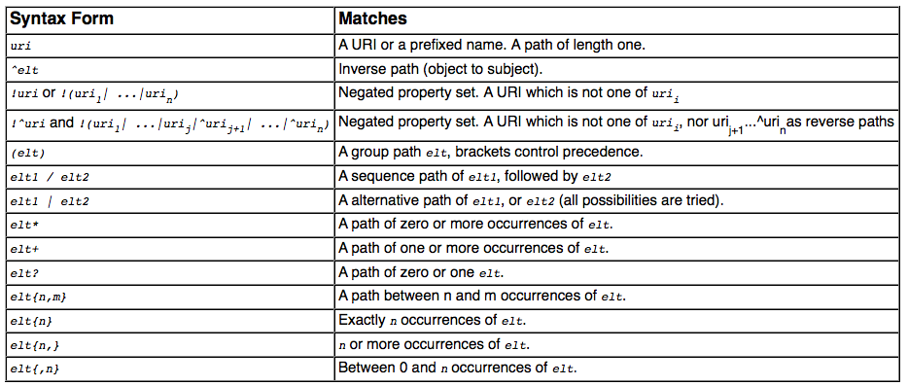
Path expressions full list of operators
elt … Path Element
Details: http://www.w3.org/TR/sparql11-query/#propertypaths
53

Slide 54
Hands-on time! Let's come up with some queries ourselves!
Let's first quickly run through some very simple example queries to recap the concepts...
DBPedia SPARQL endpoint ...
http://live.dbpedia.org/sparql
Bands that origin in St.Etienne and their members?
  How do we proceed building such a query?
  What can we observe on the result?

Slide 55
Hands-on time! Let's come up with some queries ourselves!
http://www.polleres.net/20140826xsparql_st.etienne/sparql/
Let's first quickly run through some very simple example queries to recap the concepts... SPARQL_simple_step-by-step/
Sample queries to a remote SPARQL endpoint ... http://live.dbpedia.org/sparql
  Sample Queries: SPARQL_dbpedia_various_examples/
Think about how to solve e.g. the following example: Bands that origin in St.Etienne and their members?
Population-density of all EU member countries?
  How do we proceed building such a query?
  What are the challenges?

Slide 56
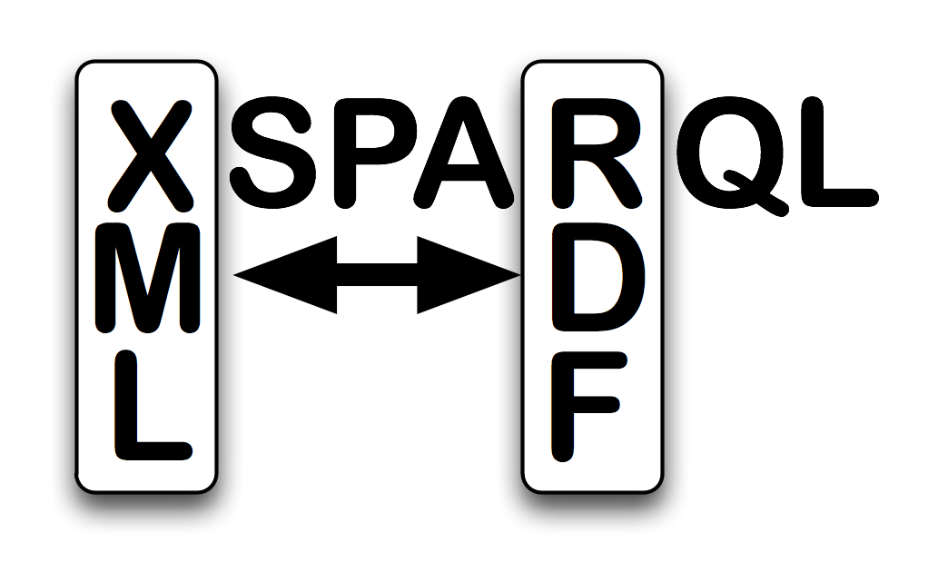
XSPARQL
Idea: One approach to conveniently query XML, JSON and RDF side-by-side: XSPARQL
Transformation language
Consume and generate XML and RDF
Syntactic extension of XQuery, ie.
XSPARQL = XQuery + SPARQL

Slide 57
Recall: XQuery 2/2
Example Query:
Retrieve information regarding a users' 2nd top artist from the
Last.fm API
let $doc := "http://ws.audioscrobbler.com/2.0/user.gettopartist"
for $artist in doc($doc)//artist
where $artist[@rank = 2]
return <artistData>{$artist}</artistData>

Slide 58
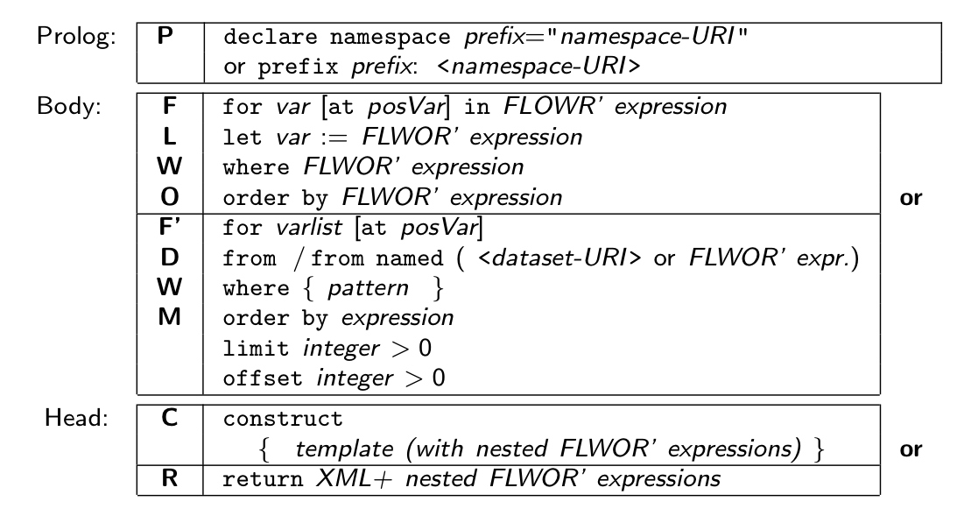
XSPARQL: Syntax overview (I)
Prefix declarations
Data Input (XML or RDF)
Data Output (XML or RDF)

Slide 59
XSPARQL Syntax overview (II)
XQuery or SPARQL prefix declarations
Any XQuery query
SPARQLFORClause represents a SPARQL query
construct allows to create RDF
Page 59
59

Slide 60
Back to our original use case
Page 60

Slide 61
XSPARQL: Convert XML to RDF
Query:
Convert Last.fm top artists of a user into RDF
prefix lastfm: <http://xsparql.deri.org/lastfm#>
let $doc := "http://ws.audioscrobbler.com/2.0/?method=user.gettopartists"
for $artist in doc($doc)//artist
where $artist[@rank < 6]
construct { [] lastfm:topArtist {$artist//name};
lastfm:artistRank {$artist//@rank} . }
Result:
@prefix lastfm: <http://xsparql.deri.org/lastfm#> .
[ lastfm:topArtist "Therion" ; lastfm:artistRank "1" ] .
[ lastfm:topArtist "Nightwish" ; lastfm:artistRank "2" ] .
[ lastfm:topArtist "Blind Guardian" ; lastfm:artistRank "3" ] .
[ lastfm:topArtist "Rhapsody of Fire" ; lastfm:artistRank "4" ] .
[ lastfm:topArtist "Iced Earth" ; lastfm:artistRank "5" ] .
XSPARQL construct generates valid Turtle RDF
Page 61

Slide 62
Back to our original use case
Page 62

Slide 63
XSPARQL: Integrate RDF sources
Query:
Retrieve the origin of an artist from DBPedia: Same as the SPARQL query
prefix dbprop: <http://dbpedia.org/property/>
prefix foaf: <http://xmlns.com/foaf/0.1/>
construct { $artist foaf:based_near $origin }
from <http://dbpedia.org/resource/Nightwish>
where { $artist dbprop:origin $origin }
Issue: determining the artist identifiers
DBPedia does not have the map coordinates
Page 63

Slide 64
XSPARQL: Integrate RDF sources
Query:
Retrieve the origin of an artist from DBPedia including map coordinates
prefix wgs84_pos: <http://www.w3.org/2003/01/geo/wgs84_pos#>
prefix dbprop: <http://dbpedia.org/property/>
for * from <http://dbpedia.org/resource/Nightwish>
where { $artist dbprop:origin $origin }
return
let $hometown :=
fn:concat("http://api.geonames.org/search?type=rdf&q=",fn:encode-for-uri($origin))
for * from $hometown
where { [] wgs84_pos:lat $lat; wgs84_pos:long $long }
limit 1
construct { $artist wgs84_pos:lat $lat; wgs84_pos:long $long }
DBPedia does not have the map coordinates
Page 64

Slide 65
Use case
Page 65

Slide 66
Output: KML XML format
<kml xmlns="http://www.opengis.net/kml/2.2">
<Document>
<Placemark>
<name>Hometown of Nightwish</name>
<Point>
<coordinates>
30.15,62.1,0
</coordinates>
</Point>
</Placemark>
</Document>
</kml>
KML format:
root element: “kml”, then “Document”
sequence of “Placemark”
Each “Placemark” contains:
  “Name” element
  “Point” element with the “coordinates”
Page 66

Slide 67
XSPARQL: Putting it all together
Query: Display top artists origin in a map
prefix dbprop: <http://dbpedia.org/property/>
<kml><Document>{
let $doc := "http://ws.audioscrobbler.com/2.0/?method=user.gettopartists”
for $artist in doc($doc)//artist
return let $artistName := fn:data($artist//name)
let $uri := fn:concat("http://dbpedia.org/resource/", $artistName)
for $origin from $uri
where { [] dbprop:origin $origin }
return
let $hometown := fn:concat("http://api.geonames.org/search?type=rdf&q=",
fn:encode-for-uri($origin))
for * from $hometown
where { [] wgs84_pos:lat $lat; wgs84_pos:long $long }
limit 1
return <Placemark>
<name>{fn:concat("Hometown of ", $artistName)}</name>
<Point><coordinates>{fn:concat($long, ",", $lat, ",0")}
</coordinates></Point>
</Placemark>
}</Document></kml>
Page 67

Slide 68
Last, but not least: Consuming JSON with XSPARQL:
XSPARQL can handle JSON by transforming it to a canonical XML format using the custom XSPARQL function:
  xsparql:json–doc( URI-to-json-file )
Example: return names of bands user jacktrades likes fromlastfm (json):
declare namespace rdfs="http://www.w3.org/2000/01/rdf-schema#";
for $m in xsparql:json-doc("http://polleres.net/20140826xsparql_st.etienne/xsparql/lastfm_user_sample.json")//artist
return $m//name

Slide 69
Producing Json with XSPARQL
No syntactic sugar specifically for that, but can be done with "onboard" means of Xquery and some special functions of XSPARQL
  xsparql:isBlank()
  xsparql:isIRI()
  xsparql:isLiteral()
Example: convert RDF to JSON-LD:
http:www.polleres.net/20140826xsparql_st.etienne/xsparql/query1_json-ld.xsparql

Slide 70
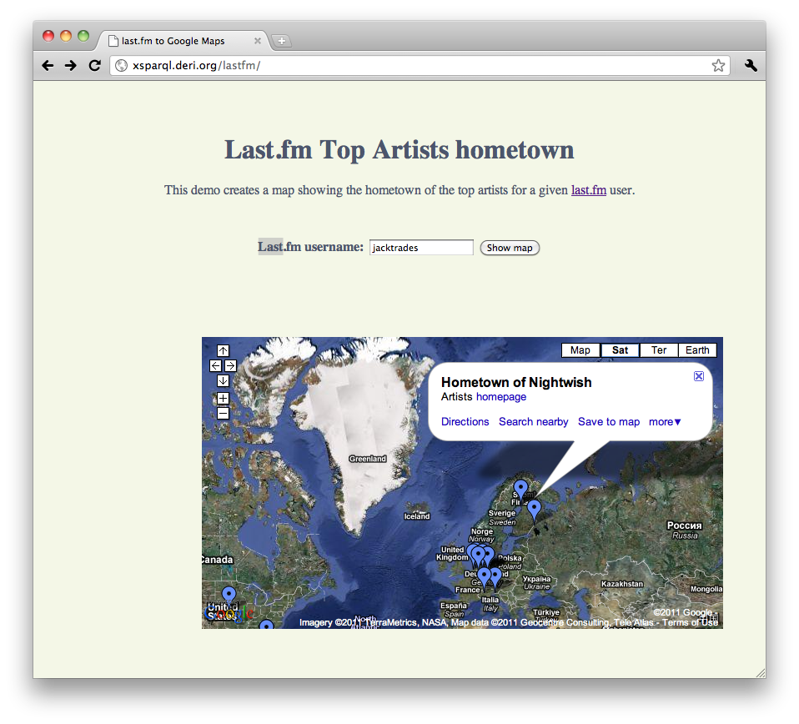
XSPARQL: Demo
http://xsparql.deri.org/lastfm
Page 70

Slide 71
XSPARQL: more examples

Slide 72

XSPARQL: Convert FOAF to KML
RDF (FOAF) data representing your location … in different ways
Show this information in a Google Map embedded in your webpage
Page 72

Slide 73
XSPARQL: Convert FOAF to KML
http://nunolopes.org/foaf.rdf
<foaf:based_near>
<geo:Point>
<geo:lat>53.289881</geo:lat><geo:long>-9.073849</geo:long>
</geo:Point>
</foaf:based_near>
Display location in Google Maps based on your FOAF file
prefix foaf: <http://xmlns.com/foaf/0.1/>
prefix geo: <http://www.w3.org/2003/01/geo/wgs84_pos#>
<kml xmlns="http://www.opengis.net/kml/2.2">{
for $name $long $lat
from <http://nunolopes.org/foaf.rdf>
where { $person a foaf:Person; foaf:name $name;
foaf:based_near [ a geo:Point; geo:long $long;
geo:lat $lat ] }
return <Placemark>
<name>{fn:concat("Location of ", $name)}</name>
<Point>
<coordinates>{fn:concat($long, ",", $lat, ",0")}
</coordinates>
</Point>
</Placemark>
}</kml>
Page 73

Slide 74
XSPARQL: Convert FOAF to KML
Different location representation in different foaf files…
http://polleres.net/foaf.rdf
<foaf:based_near rdf:resource="http://dbpedia.org/resource/Galway"/>
prefix foaf: <http://xmlns.com/foaf/0.1/>
prefix georss: <http://www.georss.org/georss/>
<kml><Document>{
for * from <http://polleres.net/foaf.rdf>
where { $person a foaf:Person; foaf:name $name;
foaf:based_near $point. }
return for * from $point
where { $c georss:point $latLong }
return let $coordinates := fn:tokenize($latLong, " ")
let $lat1 := $coordinates[1]
let $long1 := $coordinates[2]
return <Placemark>
<name>{fn:concat("Location of ", $name)}</name>
<Point><coordinates>{fn:concat($long1, ",", $lat1, ",0")}
</coordinates></Point>
</Placemark>
}</Document></kml>
We can handle different representations of locations in the FOAF files
Page 74

Slide 75
XSPARQL: Convert FOAF to KML you can cater for different representations in one query…
http://polleres.net/foaf.rdf
<foaf:based_near rdf:resource="http://dbpedia.org/resource/Galway"/>
Previous 2 queries can be easily combined into one… see:
http://xsparql.deri.org/foaf2kml/foaf2kml.xsparql
http://nunolopes.org/foaf.rdf
<foaf:based_near>
<geo:Point>
<geo:lat>53.289881</geo:lat><geo:long>-9.073849</geo:long>
</geo:Point>
</foaf:based_near>
Page 75

Slide 76
Obtaining locations in RDF
Update or enhance your FOAF file with your current location based on a Google Maps search:
Find the location in Google Maps and get the result as KML
prefix foaf: <http://xmlns.com/foaf/0.1/>
prefix geo: <http://www.w3.org/2003/01/geo/wgs84_pos#>
prefix kml: <http://earth.google.com/kml/2.0>
let $loc := "Hilton San Francisco Union Square, San Francisco, CA"
for $place in doc(fn:concat("http://maps.google.com/?q=",
fn:encode-for-uri($loc),
”&num=1&output=kml"))
let $geo := fn:tokenize($place//kml:coordinates, ",")
construct { <nunolopes> foaf:based_near [ geo:long {$geo[1]};
geo:lat {$geo[2]} ] }
Result:
@prefix geo: <http://www.w3.org/2003/01/geo/wgs84_pos#> .
@prefix foaf: <http://xmlns.com/foaf/0.1/> .
@prefix kml: <http://earth.google.com/kml/2.0> .
<nunolopes> foaf:based_near [ geo:long "-122.411116" ;
geo:lat "37.786000" ] .
Page 76

Slide 77
XSPARQL vs. SPARQL for “pure RDF” queries

Slide 78
Extending SPARQL1.0: Computing values
Computing values is not possible in SPARQL 1.0:
prefix foaf: <http://xmlns.com/foaf/0.1/>
prefix geo: <http://www.w3.org/2003/01/geo/wgs84_pos#>
prefix : <http://xsparql.deri.org/geo#>
construct { $person :latLong $lat; :latLong $long }
from <http://nunolopes.org/foaf.rdf>
where { $person a foaf:Person; foaf:name $name;
foaf:based_near [ geo:long $long;
geo:lat $lat ] }
While XSPARQL allows to use all the XPath functions:
prefix foaf: <http://xmlns.com/foaf/0.1/>
prefix geo: <http://www.w3.org/2003/01/geo/wgs84_pos#>
prefix : <http://xsparql.deri.org/geo#>
construct { $person :latLong {fn:concat($lat, " ”, $long }}
from <http://nunolopes.org/foaf.rdf>
where { $person a foaf:Person; foaf:name $name;
foaf:based_near [ geo:long $long;
geo:lat $lat ] }
Note: SPARQL1.1 allow that (BIND)
Page 78

Slide 79
Federated Queries in SPARQL1.1
Find which persons in DBPedia have the same birthday as Axel (foaf-file):
SPARQL 1.1 has new feature SERVICE to query remote endpoints
PREFIX dbpedia2: <http://dbpedia.org/property/>
PREFIX foaf: <http://xmlns.com/foaf/0.1/>
SELECT ?N ?MyB
FROM <http://polleres.net/foaf.rdf>
{ [ foaf:birthday ?MyB ].
SERVICE <http://dbpedia.org/sparql> { SELECT ?N WHERE {
[ dbpedia2:born ?B; foaf:name ?N ]. FILTER ( Regex(Str(?B),str(?MyB)) ) } }
}
PREFIX dbpedia2: <http://dbpedia.org/property/>
PREFIX foaf: <http://xmlns.com/foaf/0.1/>
SELECT ?N ?MyB
FROM <http://polleres.net/foaf.rdf>
{ [ foaf:birthday ?MyB ].
SERVICE <http://dbpedia.org/sparql> { SELECT ?N WHERE {
[ dbpedia2:born ?B; foaf:name ?N ]. FILTER ( Regex(str(?B),str(?MyB)) ) } }
}
Doesn’t work!!! ?MyB unbound in SERVICE query
Page 79

Slide 80
Federated Queries in SPARQL1.1
Find which persons in DBPedia have the same birthday as Axel (foaf-file):
SPARQL 1.1 has new feature SERVICE to query remote endpoints
PREFIX dbpedia2: <http://dbpedia.org/property/>
PREFIX foaf: <http://xmlns.com/foaf/0.1/>
SELECT ?N ?MyB
FROM <http://polleres.net/foaf.rdf>
{ [ foaf:birthday ?MyB ].
SERVICE <http://dbpedia.org/sparql> { SELECT ?N WHERE {
[ dbpedia2:born ?B; foaf:name ?N ]. FILTER ( Regex(Str(?B),str(?MyB)) ) } }
}
PREFIX dbpedia2: <http://dbpedia.org/property/>
PREFIX foaf: <http://xmlns.com/foaf/0.1/>
SELECT ?N ?MyB
FROM <http://polleres.net/foaf.rdf>
{ [ foaf:birthday ?MyB ].
SERVICE <http://dbpedia.org/sparql> { SELECT ?N ?B WHERE {
[ dbpedia2:born ?B; foaf:name ?N ]. } }
FILTER ( Regex(Str(?B),str(?MyB)) )
}
Doesn’t work either in practice ☹ as SERVICE endpoints often only returns limited results…
Page 80

Slide 81
Federated Queries
Find which persons in DBPedia have the same birthday as Axel (foaf-file):
In XSPARQL:
prefix dbprop: <http://dbpedia.org/property/>
prefix foaf: <http://xmlns.com/foaf/0.1/>
prefix : <http://xsparql.deri.org/bday#>
let $MyB := for * from <http://polleres.net/foaf.rdf>
where { [ foaf:birthday $B ]. }
return $B
for *
where { service <http://live.dbpedia.org/sparql> {[ dbprop:birthDate $B; foaf:name $N ].
filter ( regex(str($B),str($MyB)) ) } }
construct { :me :sameBirthDayAs $N }
You can use SERVICE from SPARQL1.1 in a for loop!
Works! In XSPARQL bound values (?MyDB) are injected into the SPARQL subquery
→ More direct control over “query execution plan”
Page 81

Slide 82
What's missing?
No full control flow:
  XQuery/XSPARQL e.g. don't allow you to specify politeness (e.g. crawl delays between doc() calls.
Only doc() function, but no custom HTTP request
  Some Xquery implementations have additional built-in functions for that (e.g. MarkLogic)
Bottomline:
  For many use cases (e.g. in the Hackathon) you'll still be ending up doing scripting, but declarative Query languages help you to get the necessary data out for these scripts!

Slide 83
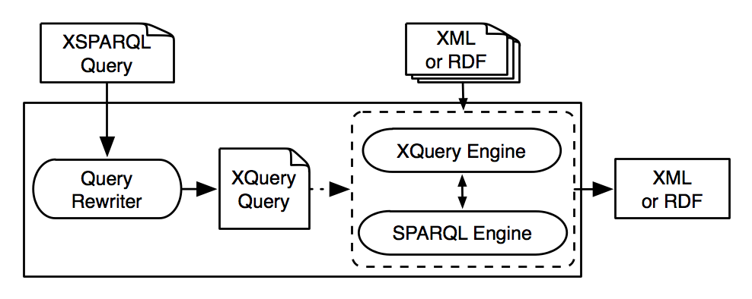
XSPARQL Implementation
Each XSPARQL query is translated into a native XQuery
SPARQLForClauses are translated into SPARQL SELECT clauses
Uses off the shelf components:
  XQuery engine: Saxon
  SPARQL engine: Jena / ARQ
Page 83

Slide 84
Example:
Page 84

Slide 85
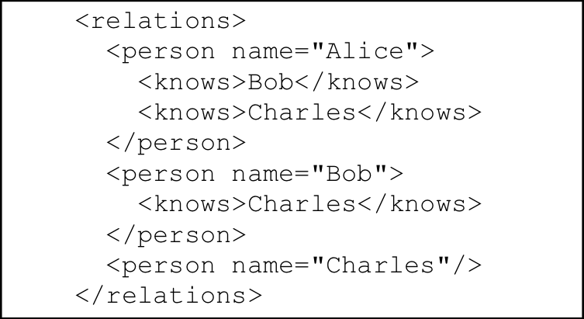
Example: Mapping from RDF to XML
<relations>
{ for $Person $Name
from <relations.rdf>
where { $Person foaf:name $Name }
order by $Name
return
<person name="{$Name}">
{for $FName
from <relations.rdf>
where {
$Person foaf:knows $Friend .
$Person foaf:name $Name .
$Friend foaf:name $Fname }
return <knows>{$FName}</knows>
} </person>
}</relations>
Page 85

Slide 86
Example: Adding value generating functions to SPARQL (using XSPARQL to emulate a SPARQL1.1 feature)
construct { :me foaf:knows _:b .
_:b foaf:name {fn:concat("""",?N," ",?F,"""")} }
from <MyAddrBookVCard.rdf>
where {
?ADDR vc:Given ?N .
?ADDR vc:Family ?F .
}
…
:me foaf:knows _:b1. _:b1 foaf:name “Peter Patel-Schneider” .
:me foaf:knows _:b2. _:b2 foaf:name “Stefan Decker” .
:me foaf:knows _:b3. _:b3 foaf:name “Thomas Eiter” .
…
Page 86

Slide 87
XSPARQL Implementation … very simplified…
Rewriting XSPARQL to XQuery…
construct { _:b foaf:name {fn:concat($N," ",$F)} } from <vcard.rdf>
where { $P vc:Given $N . $P vc:Family $F . }
let $aux_query := fn:concat("http://localhost:2020/sparql?query=", fn:encode-for-uri(
"select $P $N $F from <vcard.rdf>
where {$P vc:Given $N. $P vc:Family $F.}"))
for $aux_result at $aux_result_pos
in doc($aux_query)//sparql_result:result
1. Encode SPARQL in HTTP call SELECT Query
let $P_Node := $aux_result/sparql_result:binding[@name="P"]
let $N_Node := $aux_result/sparql_result:binding[@name="N"]
let $F_Node := $aux_result/sparql_result:binding[@name="F"]
let $N := data($N_Node/*)let $N_NodeType := name($N_Node/*)
let $N_RDFTerm := local:rdf_term($N_NodeType,$N)
...
2. Execute call, via fn:doc function
return ( fn:concat("_:b",$aux_result_pos," foaf:name "),
( fn:concat("""",$N_RDFTerm," ",$F_RDFTerm,"""") ), "." )
3. Collect results from SPARQL result format (XML)
4. construct becomes return that outputs triples (slightly simplified)
Page 87

Slide 88
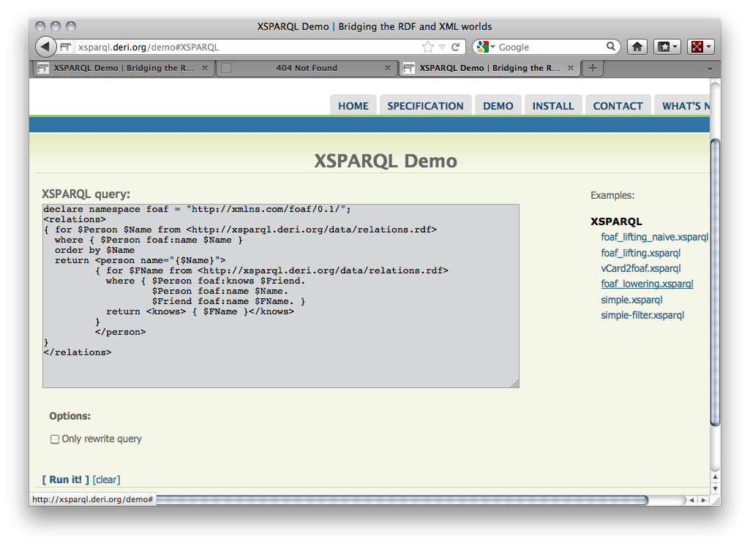
Test Queries and show rewriting…
http://xsparql.deri.org/demo

Slide 89
Details about XSPARQL semantics and implementation (also about some optimizations)
Check our Journal paper:
Stefan Bischof, Stefan Decker, Thomas Krennwallner, Nuno Lopes, Axel Polleres: Mapping between RDF and XML with XSPARQL. J. Data Semantics 1(3): 147-185 (2012) http://link.springer.com/article/10.1007%2Fs13740-012-0008-7
Demo/Hand-on: Some more XSPARQL examples
https://ai.wu.ac.at/~polleres/20140826xsparql_st.etienne/xsparql/
(release should be made available on sourceforge by end of Sept., hopefully… check: http://sourceforge.net/projects/xsparql/ )
Page 89

Slide 90


Slide 91
Additional material and references:
Excellent SPARQL Tutorial by Lee Feigenbaum & Eric Prud'Hommeaux: http://www.cambridgesemantics.com/semantic-university/sparql-by-example
Other related tutorials s on my Web page (including many references): http://www.polleres.net/presentations/
  SPARQL 1.1 Tutorial (focusing on theoretical aspects, but also corner cases I didn't cover here)
  Tutorial: "How (well) do Datalog, SPARQL and RIF interplay?" (focusing on foundations and translatability of SPARQL1.1 to deductive databases)
  Tutorial "Querying and Exchanging XML and RDF on the Web" (together with Sherif Sakr, from WWW2012)
  Tutorial "RDFS & OWL Reasoning for Linked Data" (together with A. Hogan, ReasoningWeb 2013)
5 recent/forthcoming papers on aspects related to SPARQL:
  A. Ahmeti, D. Calvanese, A. Polleres. Updating RDFS ABoxes and TBoxes in SPARQL. ISWC2014
  C. Buil-Aranda, A. Polleres, J. Umbrich. Strategies for executing federated queries in SPARQL1.1. ISWC2014
  S. Bischof, M. Krötzsch, A. Polleres, S. Rudolph. Schema-agnostic query rewriting in SPARQL 1.1. ISWC2014
  A. Polleres, A. Hogan, R. Delbru, J. Umbrich. RDFS & OWL reasoning for linked data. In ReasoningWeb 2013, Springer.
  A. Polleres , J. Wallner. On the relation between SPARQL1.1 and answer set programming. Journal of Applied Non-Classical Logics (JANCL), 23(1-2):159-212, 2013.
all available (and more ;-)) on http://www.polleres.net/publications.html

Slide 92
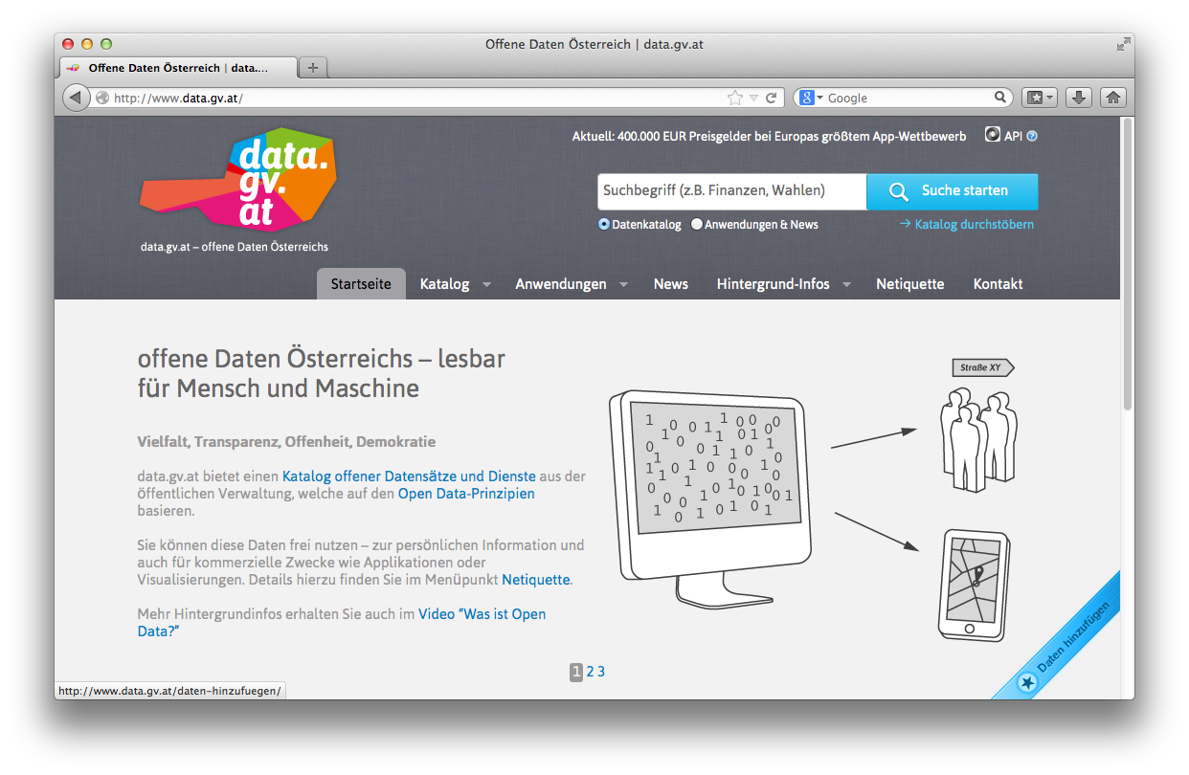


Looking for BSc, MSc, PhD topics? Please check: http://www.polleres.net/ or talk to me after the lecture!
We're always looking for interested students for internships or to work on various exciting projects with partners in industry and public administration that involve:
Solving Data Integration tasks using (X)SPARQL
Querying Linked Data and Open Data
  Integrating Open Data and making it available as Linked Data
  Linked and Open Data Quality
Foundations and extensions of SPARQL
  Extending XSPARQL
  SPARQL and Entailments, etc.
Page 92

