Slide 1
XSPARQL: What’s next? Axel Polleres Digital Enterprise Research Institute, NUI Galway joint work with: Nuno Lopes, Stefan Bischof, Thomas Krennwallner, Stefan Decker … (see supporters of the W3C member submission)

Slide 2
Disclaimer… 15min, Uh?
I have planned two routes through this talk…
Alternative 1: Introducing XSPARQL, but will not get to the new features/interesting issues…
Alternative 2: For those who know XSPARQL: new features/extensions…
(BTW: Alternative 3: I just talk very fast… also an option…)
You chose (or just give me a bit more time ☺)?

Slide 3
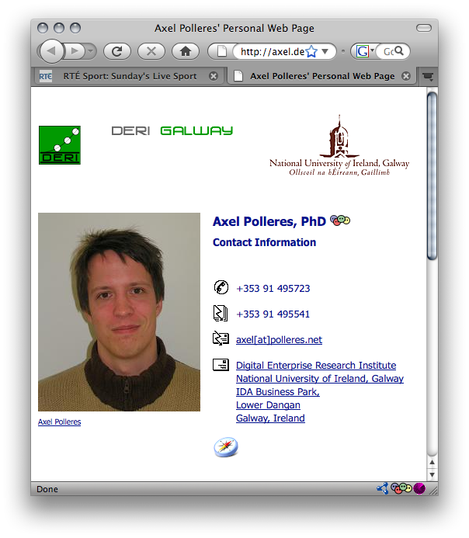
Semantic Data Access… … that would be the vision
RDF: common simple Data format underlying the Semantic Web
Queries (SPARQL1.1)
Ontologies (OWL2)
Rules (RIF)
<s1:messages>
<s1:msg id=“m1” format=“bin”>
<s1:sendername>3PO</s1:sendername>
<s1:receivername>R2D2<s1:receivername>
<s1:payload>0111010001</s1:payload>
</s1:msg>
<s1:msg id=“m2” format=“text”>
<s1:sendername>Obiwan</s1:sendername>
<s1:receivername>Luke<s1:receivername>
<s1:payload>Use the force</s1:payload>
</s1:msg>
<s1:messages>
id | FNAME | LNAME | AGE
1 | Bob | McBob | 42
2 | John | Johnson | 24
3 | Steve | Smith | 38
<www>
RDBMS
<XML>

Slide 4
Semantic Data Access… … that would be the vision
Queries
<emp:#1> a <emp:Employee>
<emp:#1> <name> “Bob McBob”.
…
<s1:3PO> a <s1:Agent>
<s1:3PO> <name> “3PO”.
<s1:3PO> <sent> <m1> . <m1> <format> <binary>.
<s1:Obiwan> a <s1:Agent>
<s1:Obiwan> <name> “Obiwan Kenobi”.
<s1:Obiwan> <sent> <m2> . <m2> <format> <text>.
…
<axel> a <Person>
<axel <name> “Axel Polleres”.
Ontologies
Rules
<s1:messages>
<s1:msg id=“m1” format=“bin”>
<s1:sendername>3PO</s1:sendername>
<s1:receivername>R2D2<s1:receivername>
<s1:payload>0111010001</s1:payload>
</s1:msg>
<s1:msg id=“m2” format=“text”>
<s1:sendername>Obiwan</s1:sendername>
<s1:receivername>Luke<s1:receivername>
<s1:payload>Use the force</s1:payload>
</s1:msg>
<s1:messages>
id | FNAME | LNAME | AGE
1 | Bob | McBob | 42
2 | John | Johnson | 24
3 | Steve | Smith | 38
<www>
RDBMS
<XML>

Slide 5
Semantic Data Access… … that would be the vision
Queries (SPARQL)
<emp:#1> a <emp:Employee>
<emp:#1> <name> “Bob McBob”.
<s1:3PO> a <s1:Agent>
<s1:3PO> <name> “3PO”.
<s1:3PO> <sent> <m1> . <m1> <format> <binary>.
<s1:Obiwan> a <s1:Agent>
<s1:Obiwan> <name> “Obiwan Kenobi”.
<s1:Obiwan> <sent> <m2> . <m2> <format> <text>.
<axel> a <Person>
<axel <name> “Axel Polleres”.
That part was handled in our Tutorial this morning… (sorry, if you weren’t there, won’t talk about it here…)
<emp:#1> a <Person>
Ontologies
(OWL2)
Rules
(RIF)
<s1:Obiwan> a <Person>
Query (SPARQL): “Give me all Persons”
SELECT ?X WHERE { ?X a <Person> }
Ontologies (OWL2, DL): “<emp:Employee> is a subclass of <Person>”
Rules (RIF, LP): “<s1:Agents> who never sent binary are Persons”

Slide 6
Bridging Gaps to the data “below”:
Queries
(SPARQL)
Can’t we just query “in one go”?
Rules
(RIF)
Ontologies
(OWL)
SQL (RDB2RDF)
XQuery/XSLT (GRDDL)
<www>
RDBMS
<XML>

Slide 7
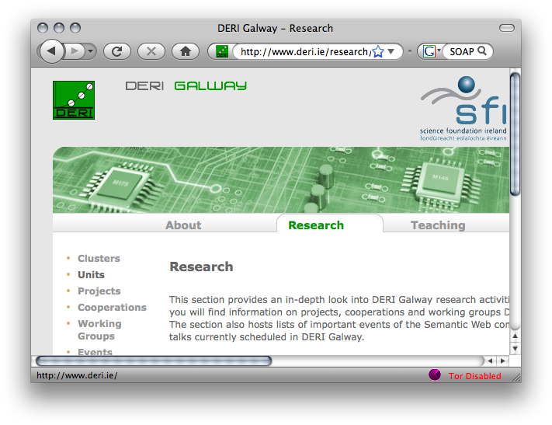
Our starting motivation (2008):
XSLT/XQuery
HTML
RSS
<XML/>
XSPARQL
SPARQL
SOAP/WSDL
7

Slide 8
Concrete motivation: The idea of Semantic Web Services…
SOAP/
REST
XML

Slide 9
Example:

Slide 10
So, why are XSLT, XQuery not enough?
Because RDF ≠ RDF/XML !!!
1) many different RDF/XML representations…
2) … and actually a lot of RDF data residing in RDF stores, accessible via SPARQL endpoints already, rather than in RDF/XML

Slide 11
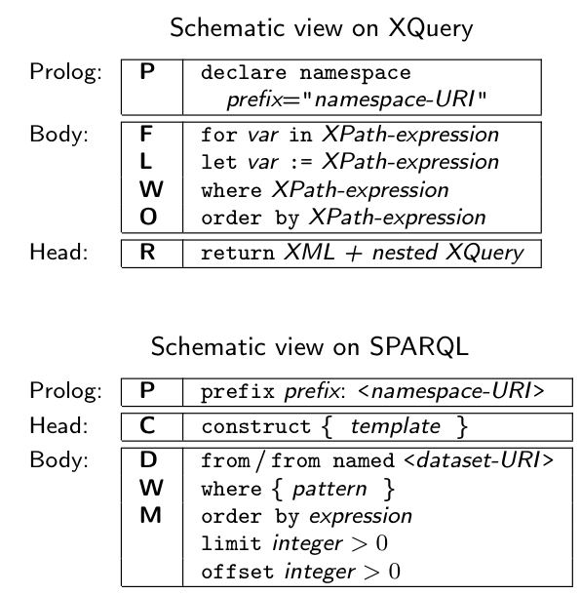
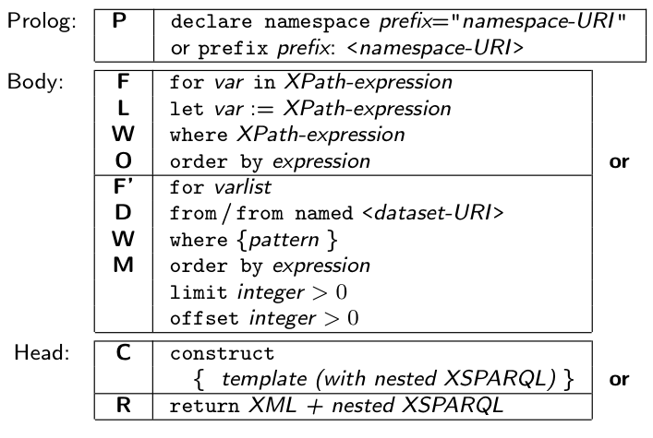
Our approach: XSPARQL (W3C submission)
New query language… but don’t reinvent!
XQuery + SPARQL = XSPARQL

Slide 12
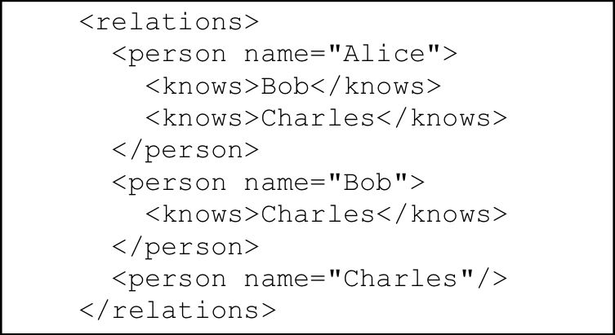
Example: Mapping from RDF to XML
<relations>
{ for $Person $Name
from <relations.rdf>
where { $Person foaf:name $Name }
order by $Name
return
<person name="{$Name}">
{for $FName
from <relations.rdf>
where {
$Person foaf:knows $Friend .
$Person foaf:name $Name .
$Friend foaf:name $Fname }
return <knows>{$FName}</knows>
} </person>
}</relations>

Slide 13
Example: Adding value generating functions to SPARQL
construct { :me foaf:knows _:b .
_:b foaf:name {fn:concat("""",?N," ",?F,"""”)} }
from <MyAddrBookVCard.rdf>
where {
?ADDR vc:Given ?N .
?ADDR vc:Family ?F .
}
…
:me foaf:knows _:b1. _:b1 foaf:name “Peter Patel-Schneider” .
:me foaf:knows _:b2. _:b2 foaf:name “Stefan Decker” .
:me foaf:knows _:b3. _:b3 foaf:name “Thomas Eiter” .
…

Slide 14
Implementation and semantics:
Formal Semantics (XSPARQL1.0):
Based on XQuery formal Semantics
Can be implemented based on rewriting to XQuery
Challenges/Limitations:
Nesting, scope of RDF dataset…
different “type systems” of RDF/XML (sequences)
adding ontological inference (to resolve heterogeneities)
We are working on this in XSPARQL1.1!

Slide 15
Formal Semantics:
Initial idea (and formalised in XSPARQL1.0):
extension of the XQuery semantics by plugging in SPARQL semantics in a modular way
Rewriting algorithm is defined for embedding XSPARQL into native XQuery plus interleaved calls to a SPARQL endpoint

Slide 16
Rewriting XSPARQL to XQuery…
construct { _:b foaf:name {fn:concat("""",$N," ",$F,"""")} } from <vcard.rdf>
where { $P vc:Given $N . $P vc:Family $F . }
let $aux_query := fn:concat("http://localhost:2020/sparql?query=", fn:encode-for-uri(
"select $P $N $F from <vcard.rdf>
where {$P vc:Given $N. $P vc:Family $F.}"))
for $aux_result at $aux_result_pos
in doc($aux_query)//sparql_result:result
let $P_Node := $aux_result/sparql_result:binding[@name="P"]
let $N_Node := $aux_result/sparql_result:binding[@name="N"]
let $F_Node := $aux_result/sparql_result:binding[@name="F"]
let $N := data($N_Node/*)let $N_NodeType := name($N_Node/*)
let $N_RDFTerm := local:rdf_term($N_NodeType,$N)
...
1. Encode SPARQL in HTTP call SELECT Query
2. Execute call, via fn:doc function
return ( fn:concat("_:b",$aux_result_pos," foaf:name "),
( fn:concat("""",$N_RDFTerm," ",$F_RDFTerm,"""") ), "." )
3. Collect results from SPARQL result format(XML)
4. construct becomes return that outputs triples.

Slide 17
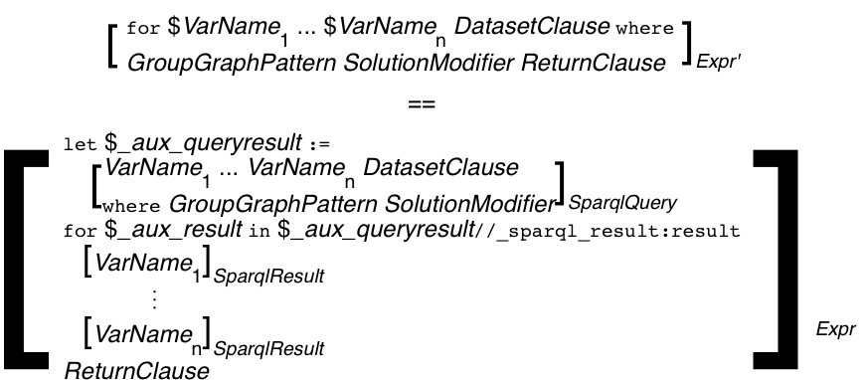
Formalisation
Current formalisation embeds rewriting in the functional semantics of XQuery:
http://xsparql.deri.org/spec/xsparql-semantics.html#id:flwor-expressions
mapping rules [·]_{Expr'} inherit from the definitions of XQuery's [·]_{Expr}

Slide 18
Next Steps:
Simple rewriting semantics has some limitations, which we are currently working on:
Adding ontological inference (to resolve heterogeneities)
Nesting,scope of RDF dataset…
Different “type systems” of RDF/XML (sequences)…
Optimisations…
Integrate RDB Querying (SQL), Json, etc.
XSPARQL1.1
GiaBATA

Slide 19
Nesting,scope of RDF dataset…
Remember the query from before…. We were slightly cheating:
<relations>
{ for $Person $Name
from <relations.rdf>
where { $Person foaf:name $Name }
order by $Name
return
<person name="{$Name}">
{for $FName
from <relations.rdf>
where {
$Person foaf:knows $Friend .
$Person foaf:name $Name .
$Friend foaf:name $Fname }
return <knows>{$FName}</knows>
} </person>
}</relations>

Slide 20
Nesting,scope of RDF dataset…
Remember the query from before…. This is what one would rather expect
<relations>
{ for $Person $Name
from <relations.rdf>
where { $Person foaf:name $Name }
order by $Name
return
<person name="{$Name}">
{for $FName
where {
$Person foaf:knows $Friend .
$Friend foaf:name $Fname }
return <knows>{$FName}</knows>
} </person>
}</relations>
The nested query should be over the same Dataset as the outer query, bindings to bnodes should be preserved
Two separate, independent SPARQL calls don’t work anymore
Solution:
We need to add Dataset to the dynamic environment in the semantics.
We need a special SPARQL implementation that allows several calls to the same active graph.

Slide 21
Different “type systems” of RDF/XML (e.g. sequences)…
Social Graph queries a la [1]:
Give me all pairs of co-authors and their joint publications.
Assignment of graphs to variables needs new datatype RDFGraph
prefix foaf: <http://xmlns.com/foaf/0.1/>
prefix dc: <http://purl.org/dc/elements/1.1/>
let $ds := for *
from <http://dblp.l3s.de/d2r/resource/authors/Axel_Polleres>
where { $pub dc:creator [] }
construct {
{ for * from $pub where { $p dc:creator $o . }
construct {$p dc:creator <{$o}>} } }
let $allauthors :=
distinct-values(for $o from $ds where {$p dc:creator $o}
order by $o
return $o)
for $auth at $auth_pos in $allauthors
for $coauth in $allauthors[position() > $auth_pos]
let $commonPubs := count(
{ for $pub from $ds where { $pub dc:creator $auth, $coauth } return $pub }
)
where ($commonPubs > 0)
construct { [ :author1 $auth; :author2 $coauth; :commonPubs $commonPubs ] }
Nested CONSTRUCTs queries
Lists of RDFTerms need new datatype RDFTerm
1. Mauro San Martín, Claudio Gutierrez: Representing, Querying and Transforming Social Networks with RDF/SPARQL. ESWC 2009: 293-307

Slide 22
Optimisations
E.g. dependent Join… i.e.
<relations>
{ for $Person $Name
from <relations.rdf>
where { $Person foaf:name $Name }
order by $Name
return
<person name="{$Name}">
{for $Fname
where {
$Person foaf:knows $Friend .
$Friend foaf:name $Fname }
return <knows>{$FName}</knows>
} </person>
}</relations>
<relations>
{ let $aux := select $Person $Name $FName
from <relations.rdf>
where { $Person foaf:name $Name .
$Person foaf:knows $Friend .
$Friend foaf:name $Fname }
for $Name in $aux.Name
return
<person name="{$Name}">
{ for $FName in $aux.Fname
where $aux.Name = $Name
return <knows>{$FName}</knows>
} </person>
}</relations>
Only one SPARQL query

Slide 23
RDB Querying sketch
Use as an RDB2RDF exporter
Extract foaf:knows relations from a RDB with two tables: containing persons and their knows relations
RDBForClause to specify input from RDB tables
prefix foaf: <http://xmlns.com/foaf/0.1/>
for p1.name as $x, p2.name as $y
from person as p1, person as p2, relation as r
where { p1.name = r.person and
p2.name = r.knows }
construct { $x foaf:knows $y }
SQL Where pattern
Output RDF (or XML)

Slide 24
Semantic Data Integration: The bigger picture

Slide 25
Optimisations
Benchmark suite for XML
http://www.xml-benchmark.org/
Provides data generator and 20 benchmark queries
Data simulates an auction website, containing people, items and auctions
Converted XML data to RDF
Queries written using XSPARQL

Slide 26
Query example
Q: List the names of persons and the number of items they bought
XQuery
let $auction := doc(input.xml) return
for $p in $auction/site/people/person
let $a :=
for $t in $auction/site/closed_auctions/closed_auction
where $t/buyer/@person = $p/@id
return $t
return <item person="{$p/name/text()}">{count($a)}</item>
XSPARQL
for $id $name from <input.rdf>
where { $person a foaf:Person ; :id $id ; foaf:name $name . }
return <item person="{$name}”>{
let $x := for * from $graph
where { $ca a :ClosedAuction ; :buyer [ :id $id ] . }
return $ca
return count($x)
}</item>

Slide 27
Rewritting to XQuery
Unoptimised version:
Optimised version:
let $_aux_results0 := sparql("SELECT $id $name from <input.rdf> where { $person a foaf:Person ; :id $id; foaf:name $name. } ")
for $_aux_result0 at $_aux_result0_pos in _xsparql:_sparqlResults( $_aux_results0 )
let $id := _xsparql:_resultNode( $_aux_result0, "id" )
let $name := _xsparql:_resultNode( $_aux_result0, "name" )
return
<item person="{$name}">
{ let $x :=
let $_aux_results2 := _xsparql:_sparql( fn:concat("SELECT $ca
from <input.rdf>
where { $ca :ClosedAuction;
:buyer [ :id", $id, ”] . } " ) )
for $_aux_result2 at $_aux_result2_pos in _xsparql:_sparqlResults( $_aux_results2 )
let $ca := _xsparql:_resultNode( $_aux_result2, "ca" )
return $ca
return count( $x )}
</item>
let $_aux_results4 := _xsparql:_sparql("SELECT $ca $id from <input.rdf> WHERE { $ca a :ClosedAuction; :buyer [ :id $id ]. } ")
let $_aux_results0 := _xsparql:_sparql( "SELECT $id $name
from <input.rdf> WHERE { $person a foaf:Person; :id $id;
foaf:name $name . } " )
for $_aux_result0 at $_aux_result0_pos
in _xsparql:_sparqlResults( $_aux_results0 )
let $id := _xsparql:_resultNode( $_aux_result0, "id" )
let $name := _xsparql:_resultNode( $_aux_result0, "name" )
return <item person="{$name}">
{let $x := for $_aux_result4 at $_aux_result4_pos in
_xsparql:_sparqlResults( $_aux_results4 )
where $id = _xsparql:_resultNode( $_aux_result4, "id" )
return _xsparql:_resultNode( $_aux_result4, "ca" )
return count( $x )}
</item>
SPARQL Query inside nested loop
SPARQL queries outside nested loop
nested loop joins the variables

Slide 28
Preliminary results
input size of approx. 275,000 triples
further optimisations are possible, e.g. joining the variables in SPARQL
 | Unoptimised | Optimised
query08 | 25906 | 186
query09 | 25750 | 69
query10 | 1443 | 406

