Slide 1
OWL vs. Linked Data: Experiences and Directions
Axel Polleres
Siemens AG Österreich
27/05/2013

Slide 2
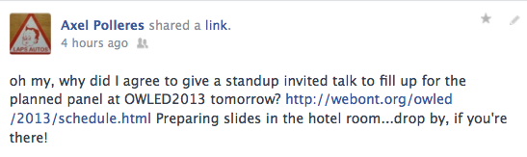

Disclaimer: this is not the panel you were looking for
Will try to touch upon the following questions:
  Which parts of OWL are used within Linked Data?
  Which parts of OWL2 could be useful for Linked Data ?
  Which reasoning techniques can be applied to handle the scale,
  messiness, and dynamicity of Linked Data?
  Which reasoning beyond RDFS and OWL is necessary for Linked Data?
I don’t have complete solutions to all these questions, but some on how OWL can be applied to Linked Data collected over the past view years.
Special thanks to my co-authors: Aidan Hogan, Jürgen Umbrich, Stefan Bischof, Andreas Harth, Birte Glimm, Markus Krötzsch, etc.

Slide 3

Let’s start from the beginning…
  “If HTML and the Web made all the online documents look like one huge book, RDF, schema and inference languages will make all the data in the world look like one huge database” Tim Berners-Lee, Weaving the Web, 1999
Great! We have 2013, this should work by now, shouldn‘t it? Let‘s try that on google!
Scenario: “Market research” on the Web, (no FOAF today, sorry)
“Latest news on NYT about technology companies
with a revenue greater than 10B EUR”
“Which city of Montpellier and Vienna has the higher population density?”

Slide 4
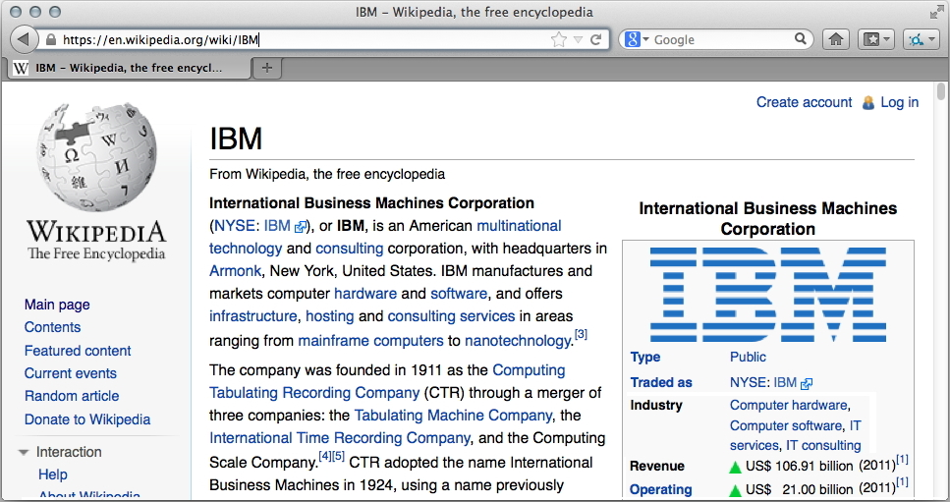
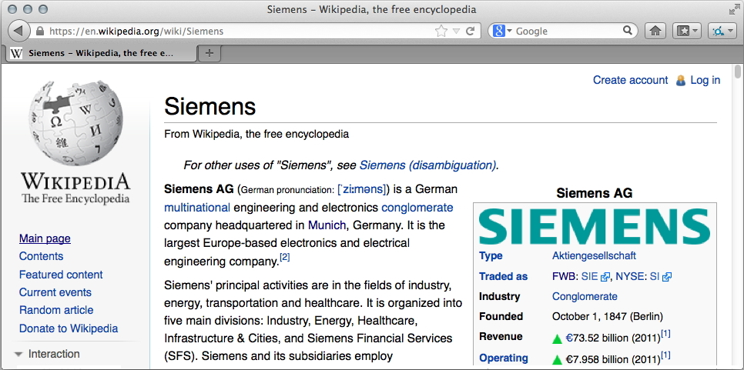
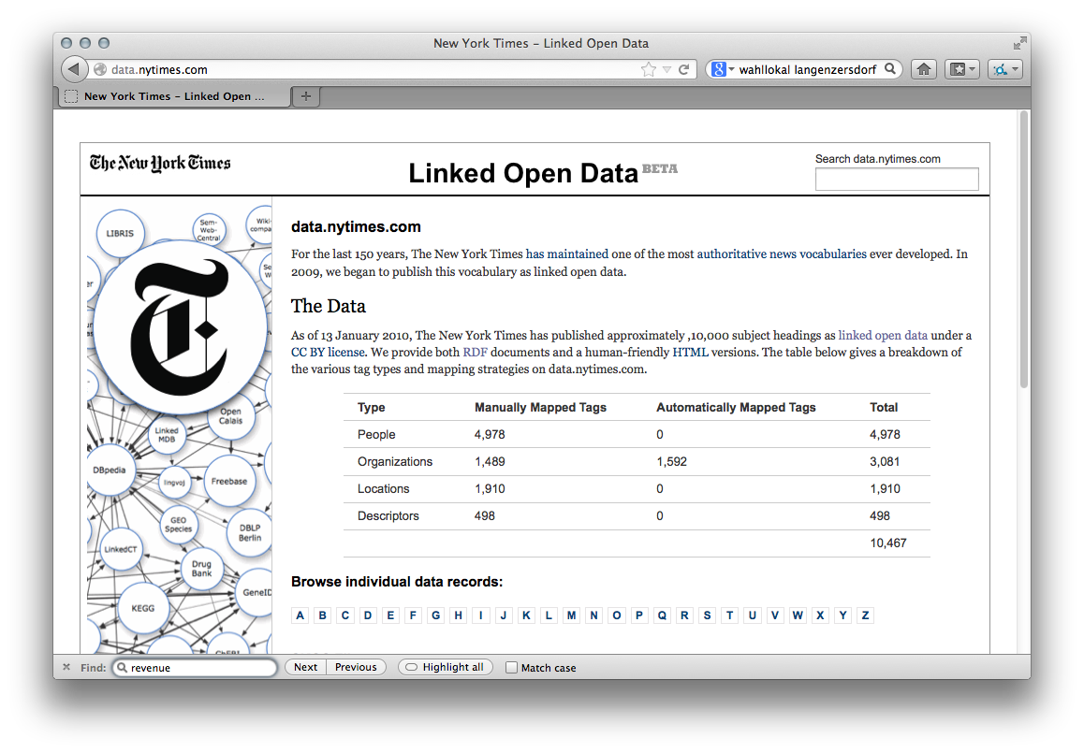
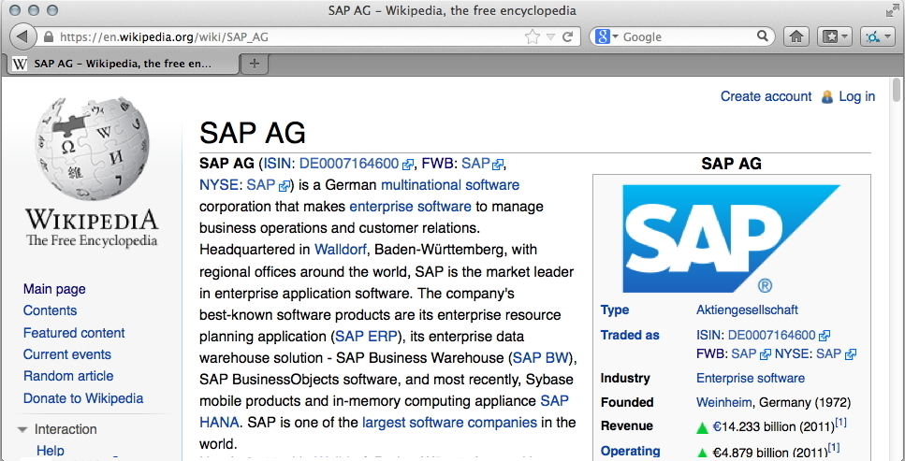
“Latest News on NYT about technology companies with a revenue greater than 10B EUR”
The data is there!
Wikipedia
New York Times thesaurus
and article search API

Slide 5
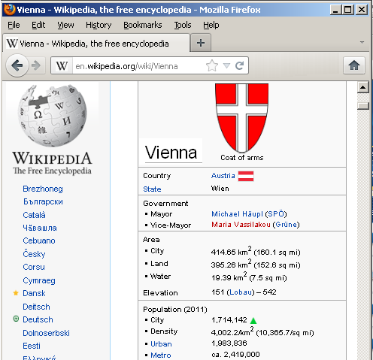

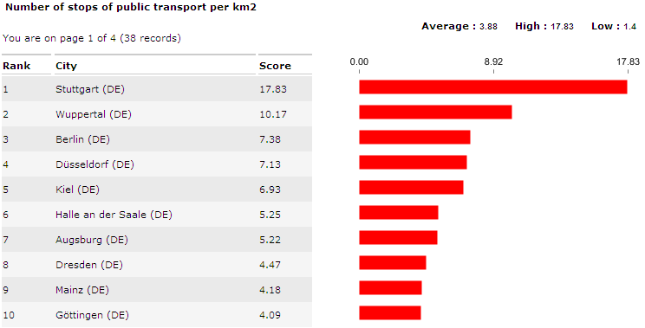
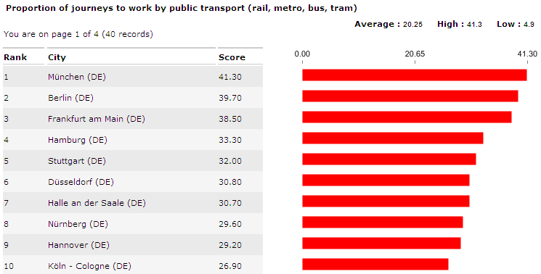

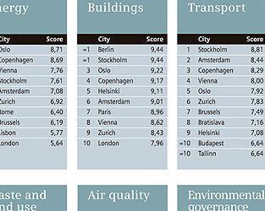
“Which city of Montpellier and Vienna has the higher population density?”
Again:
The data is there!
Wikipedia
Eurostat
Urban Audit
(ca. 300 indicators for ~500 European cities)
or also inside Siemens!

Slide 6
Emerging trend: Linked data
Vienna is identified on Eurostat as AT001C
http://dbpedia.org/ resource/Vienna
href
http://eurostat.linked-statistics.org/cities#AT001C
owl:sameAs
City
City
Use URIs as names for things
Use HTTP URIs so that people can look up those names.
When someone looks up a URI, provide useful information, using the standards
(RDF, OWL)
Include links to other URIs. so that they can discover more things.
http://www.w3.org/DesignIssues/LinkedData.html

Slide 7

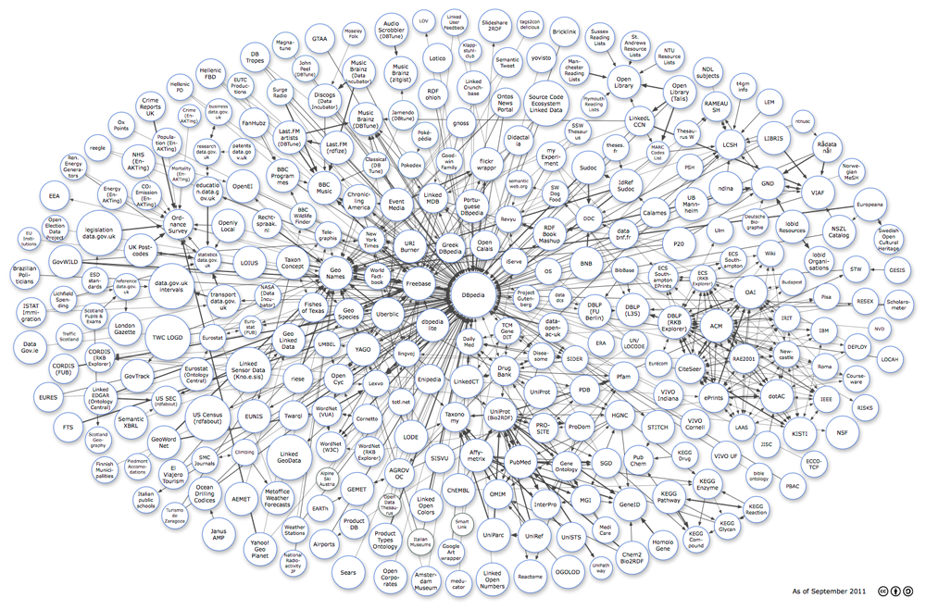









Linked Data on the Web: Adoption

Slide 8
Example: Using OWL and SPARQL to query Linked data
dbpedia:Vienna
owl:sameAs
eurostat:AT001C
Article
name
country
population
eurostat:EN5101I
label
area
“Vienna”
dbpedia:Austria
3855.25
“Wien”
414.65
1714142
eurostat:EN5101I rdfs:subPropertyOf dbpedia:populationDensity
“Which city of Montpellier and Vienna has the higher population density?”
  SELECT ?DM ?DV
  WHERE { dbpedia:Montpellier :populationDensity ?DM .
  dbpedia:Vienna :populationDensity ?DV .
  }

Slide 9
The Semantic promise…
  “If HTML and the Web made all the online documents look like one huge book, RDF, schema and inference languages will make all the data in the world look like one huge database” Tim Berners-Lee, Weaving the Web, 1999
Great! We have 2013, this should work by now, shouldn‘t it? Let‘s try that on google!
Scenario: “Market research” on the Web,
“Latest news on NYT about technology companies
with a revenue greater than 10B EUR”
“Cities in France with a higher population density than Montpellier?”
  SELECT * WHERE
  { ?C rdf:type NYT:Org .
  ?C dbpedia:revenue ?R .
  ?C NYT:latestArticle ?A .
  FILTER( ?R > 10000000000 ) }

Slide 10
The Semantic promise…
  “If HTML and the Web made all the online documents look like one huge book, RDF, schema and inference languages will make all the data in the world look like one huge database” Tim Berners-Lee, Weaving the Web, 1999
Great! We have 2013, this should work by now, shouldn‘t it? Let‘s try that on google!
Scenario: “Market research” on the Web,
“Latest news on NYT about technology companies
with a revenue greater than 10B EUR”
“Cities in France with a higher population density than Montpellier?”
  SELECT ?DM ?DV
  WHERE { dbpedia:Montpellier :populationDensity ?DM .
  dbpedia:Vienna :populationDensity ?DV .
  }

Slide 11
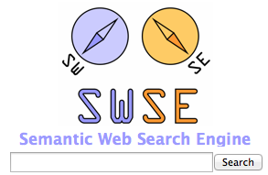
So, all we need to do:
… is to through together a crawler, an RDF Store, some OWL inference and a SPARQL engine? Unfortunately it’s not that easy…
SPARQL
  SELECT ?DM ?DV WHERE { dbpedia:Montpellier :populationDensity ?DM .
  dbpedia:Vienna :populationDensity ?DV . }
Crawling
Indexing
OWL inference…
How?

Slide 12
Obstacles/prejudices:
OWL is too hard to learn?
OWL is too expensive?

Slide 13
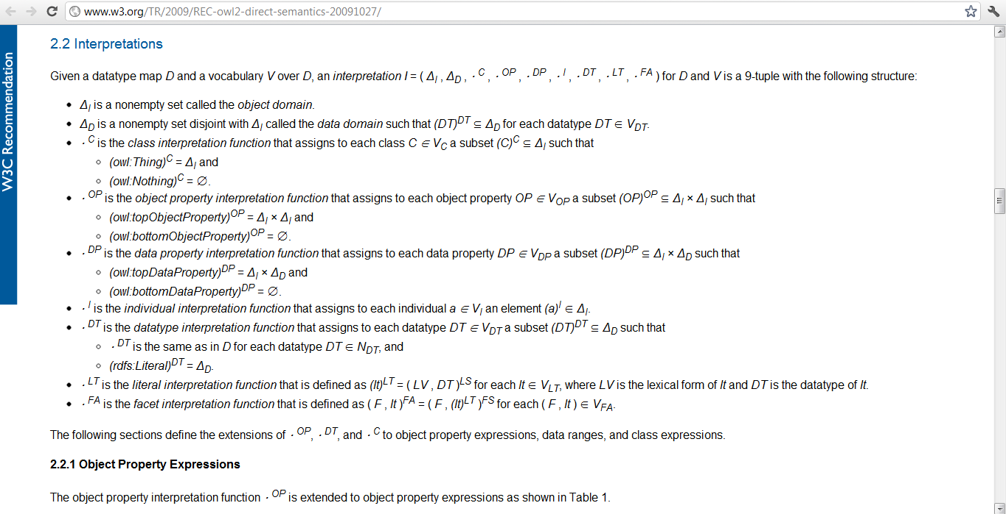

…OWL iS HARD
Linked Data publishers…
(…to learn, to understand, to implement, to compute, to teach, to represent in RDF, to publish, to parse, to use appropriately...)
  Corollary1: Linked Data publishers only use a little bit of OWL …
  Corollary2: … they still manage to make mistakes ☺

Slide 14
14
  Corollary1: Linked Data publishers only use a little bit of OWL …
Proof

Slide 15
How much OWL is used in Linked Data? [LDOW’12]
Looked at Billion Triple Challenge 2011 Dataset (BTC2011)
  2.1 billion quadruples, crawled from…
  7.4 million RDF/XML documents, covering…
  791 (pay-level) domains
Count OWL features used in the dataset:
  Per use
  Per document
  Per domain
  Can be skewed by data
Ranked OWL features using PageRank:
  Rank documents based on dereferenceable links
  For each OWL feature, sum the rank of documents using it
  Intuition: Approximates probability of encountering an OWL feature during a random walk of the data

Slide 16
Results of ranking (see LDOW’12 paper details)
1 rdf:Property 5.74E-1
2 rdfs:range 4.67E-1
3 rdfs:domain 4.62E-1
4 rdfs:subClassOf 4.60E-1
5 rdfs:Class 4.45E-1
6 rdfs:subPropertyOf 2.35E-1
7 owl:Class 1.74E-1
8 owl:ObjectProperty 1.68E-1
9 rdfs:Datatype 1.68E-1
10 owl:DatatypeProperty 1.65E-1
11 owl:AnnotationProperty 1.60E-1
12 owl:FunctionalProperty 9.18E-2
13 owl:equivalentProperty 8.54E-2
14 owl:inverseOf 7.91E-2
15 owl:disjointWith 7.65E-2

Slide 17
Results of ranking (see LDOW’12 paper details)
…
16 owl:sameAs 7.29E-2
17 owl:equivalentClass 5.24E-2
18 owl:InverseFunctionalProperty 4.79E-2
19 owl:unionOf 3.15E-2
20 owl:SymmetricProperty 3.13E-2
21 owl:TransitiveProperty 2.98E-2
22 owl:someValuesFrom 2.13E-2
23 rdf:_* 1.42E-2
24 owl:allValuesFrom 2.98E-3
25 owl:minCardinality 2.43E-3
26 owl:maxCardinality 2.14E-3
27 owl:cardinality 1.75E-3
28 owl:oneOf 4.13E-4
29 owl:hasValue 3.91E-4
owl:intersectionOf 3.37E-4
31 owl:NamedIndividual 3.37E-4

Slide 18
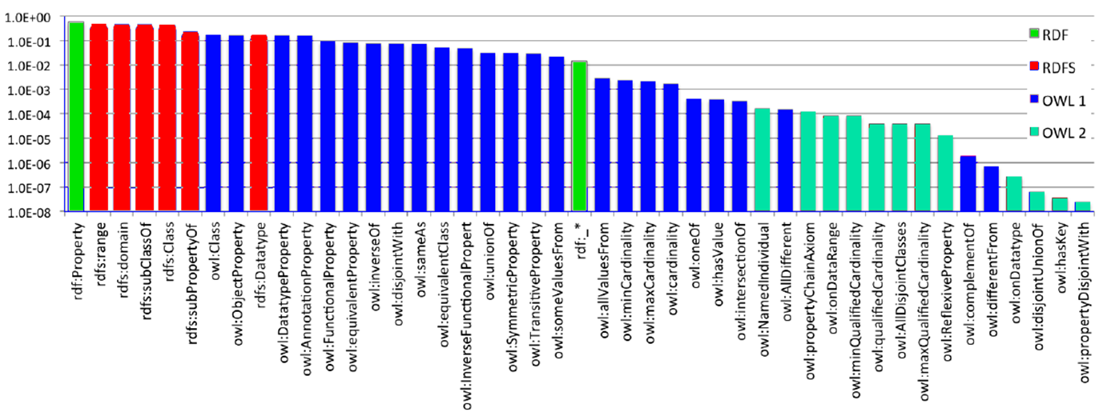
How much OWL is used in Linked Data? [LDOW’12]
RDF Schema features amongst the most prominently used
OWL 2 features not yet used prominently
RDF | RDFS | OWL | OWL 2
log-scale

Slide 19
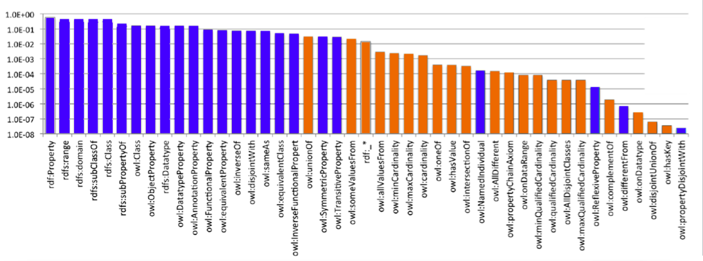
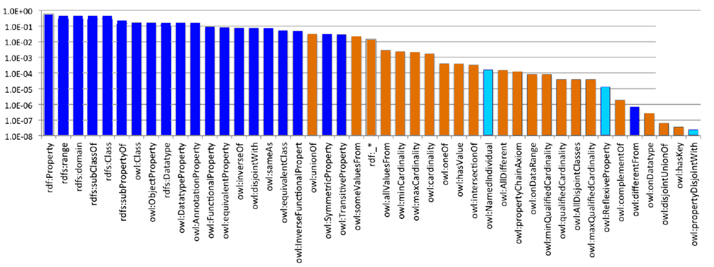
Main insight:
RDF Schema features amongst the most prominently used
OWL 2 features not yet used prominently
Most used features can be implemented efficiently using parallelizable, rule-based inference. [IJSWIS’09]
log-scale

Slide 20
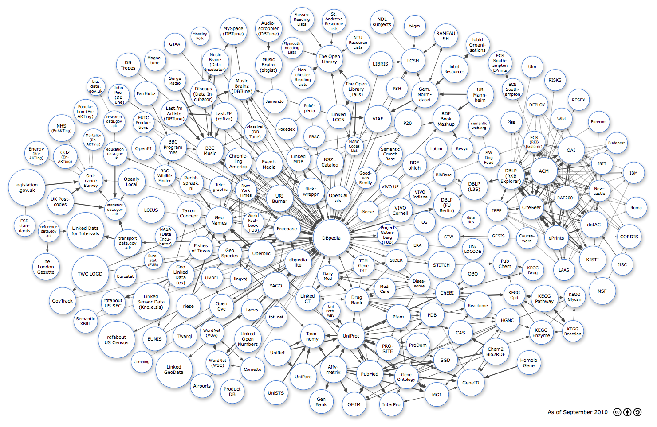


Intuition: MAYBE LINKED DATA only NEEDS a LITTLE OWL…
(…for now) [Hendler, ‘98]

Slide 21
How much OWL is used in Linked Data? [LDOW’12]
RDF Schema features amongst the most prominently used
OWL 2 features not yet used prominently
In all fairness:
This is only a snapshot…
… some OWL2 features could be quite useful to enrich current Linked Data vocabularies, see also [RR’09]

Slide 22
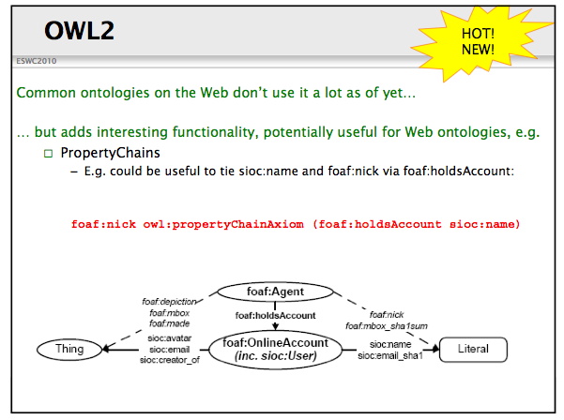
We presented this 3 years ago at ESWC… still only little OWL2 adoption in LOD vocabs since then…

Slide 23
23
  Corollary2: … publishers still manage to make mistakes.
Examples…

Slide 24
Inconsistencies/wrong inferences on Web Data
4 main conjectures for possible reasons:
  Publishers deliberately publish spoilt data (“SPAM”)
  Opinions differ
  “URI-sense” ambiguities
  Accidently wrong/inconsistent
Least common?
Most common?

Slide 25
Publishers deliberately publish spoilt data (“SPAM”)
Examples:
  a owl:differentFrom a .
  foaf:knows rdfs:subPropertyOf owl:sameAs .
  http://www.polleres.net/nasty.rdf
Can occur for “testdata” being published, deliberate SPAM might become an issue, as the SW grows!

Slide 26



Opinions differ
Fictitous Example Ontology:
Originofthings.example.org:
o1:surpremePower owl:disjointWith o1:naturalPhenomenom.
o1:originsFrom rdf:type owl:functionalProperty.
o1:god rdf:type o1:surpremePower.
o1:evolution rdf:type o1:naturalPhenomenom.
darwin.example.org:
ex:mankind o1:originsFrom o1:evolution .
creationism.example.org:
ex:mankind o1:originsFrom o1:god
FlyingSpaghettimonster.org
fsm:theSpaghettiMonster rdf:type surpremePower.
ex:mankind o1:originsFrom fsm:theSpaghettiMonster.

Slide 27
“URI-sense” ambiguities
<http://www.polleres.net>
foaf:knows <http://apassant.net>
i.e., why do I have to use a different URI for myself and my homepage?
Many people don’t understand/like this and make mistakes.
But is this really a mistake or a design error?

Slide 28
Accidentially inconsistent data
This appeared a while ago in our crawls:
Source1 (faulty):
TimBL foaf:homepage <http://www.w3.org>
TimBL rdf:type foaf:Person.
W3.org:
W3C foaf:homepage <http://www.w3.org>
W3C rdf:type foaf:Organisation.
Did occur in our Web crawls at some point, sometimes people don’t have the right semantics in mind!
Suspiciously resembles problems with e.g. flawed HTML … browsers, normal search engines still have to deal with it...

Slide 29
Accidently wrong (non-inconsistent data)
FOAF Ontology:
  foaf:mbox rdf:type owl:InverseFunctionalProperty .
Careless FOAF exporters produce something like this for any empty email address:
ex:alice foaf:mbox “mailto:”
ex:bob foaf:mbox “mailto:”
…
Consequence: InverseFunctionalProperty reasoning on Web Data potentially equates too many things! Dangerous!
Not all of these were real examples, of course, for a more systematic analysis of Linked Data conformance, see [JWS’12a,LDOW’10]
BTW, Didn’t even mention ill-typed datatype literals here (very common…)

Slide 30
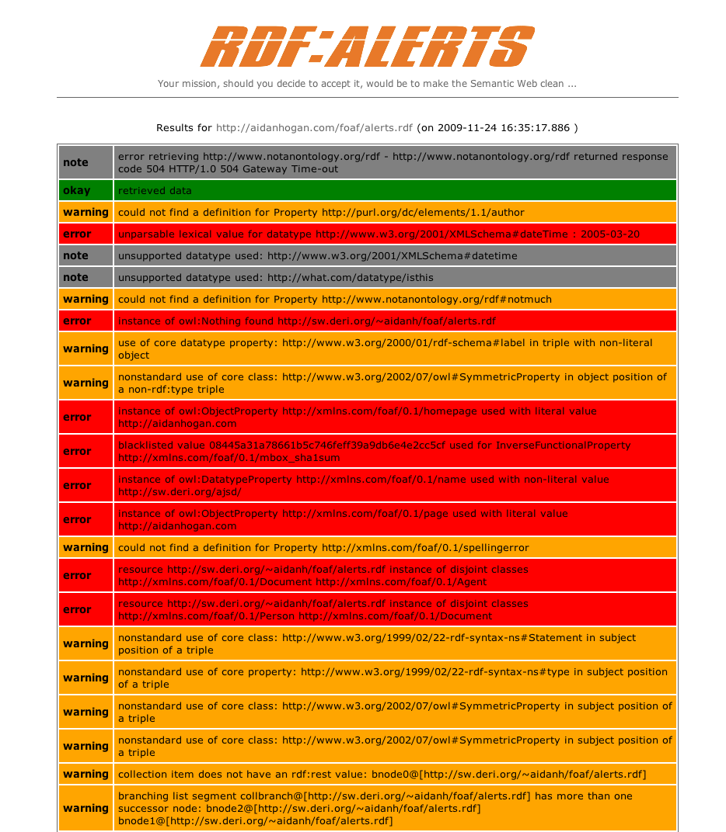
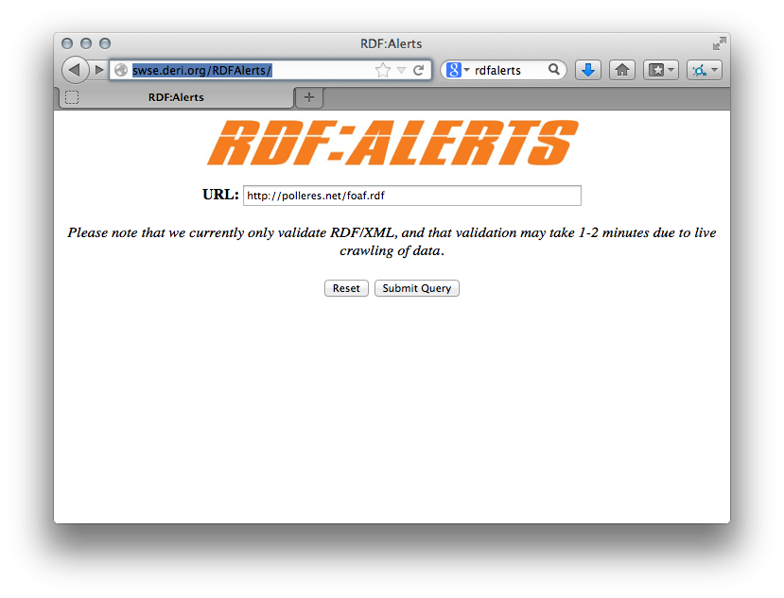

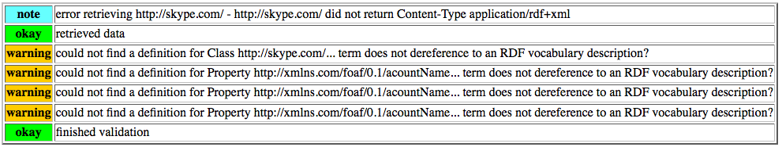
RDFAlerts
http://swse.deri.org/RDFAlerts/
Checks and analyses common mistakes
  http://swse.deri.org/RDFAlerts/
  Short Demo.

Slide 31
Conclusion: This won’t scale to the Web…
SPARQL
  SELECT ?DM ?DV WHERE { dbpedia:Montpellier :populationDensity ?DM .
  dbpedia:Vienna :populationDensity ?DV . }
Crawling
Indexing
OWL inference…
How?

Slide 32


How to possibly avoid nasty inferences?
dbpedia:Vienna
owl:sameAs
eurostat:AT001C
Article
name
country
population
eurostat:EN5101I
label
area
“Vienna”
dbpedia:Austria
3855.25
“Wien”
414.65
1714142
eurostat:EN5101I rdfs:subPropertyOf dbpedia:populationDensity
SPAM
owl:sameAs
Scalable Authoritative OWL Reasoning [IJSWIS’09] to the rescue!
fakedbpedia.org
rdfs:subPropertyOf
dbpedia:populationDensity
… Goal:make inference robust & scalable to Web data.
  SELECT ?DM ?DV
  WHERE { dbpedia:Montpellier :populationDensity ?DM .
  dbpedia:Vienna :populationDensity ?DV .
  }

Slide 33
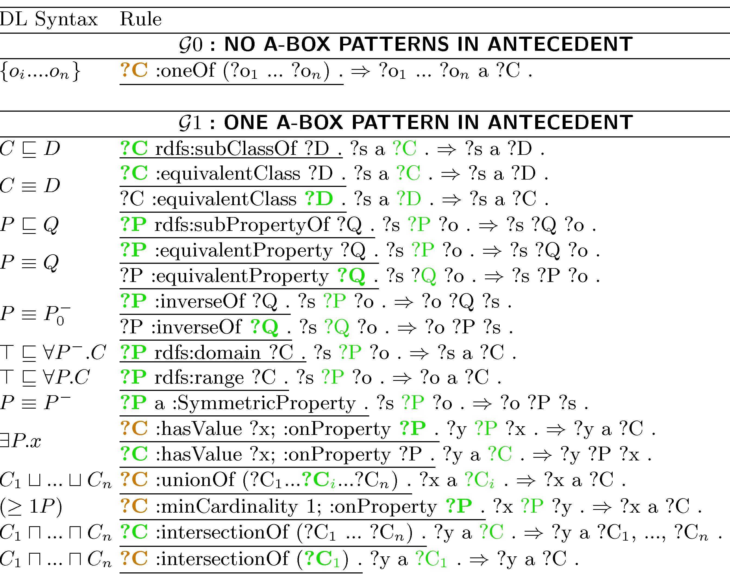
Scalabe Reasoning: Focus on Rules without ABox joins
From [ IJSWIS’09] The rules applied including statements considered to be T-Box, elements which must be authoritatively spoken for (including for bnode OWL abstract syntax), and output count.
Abox inferences only! Can be distributed! Several Optimizations in [ISWC2010]

Slide 34
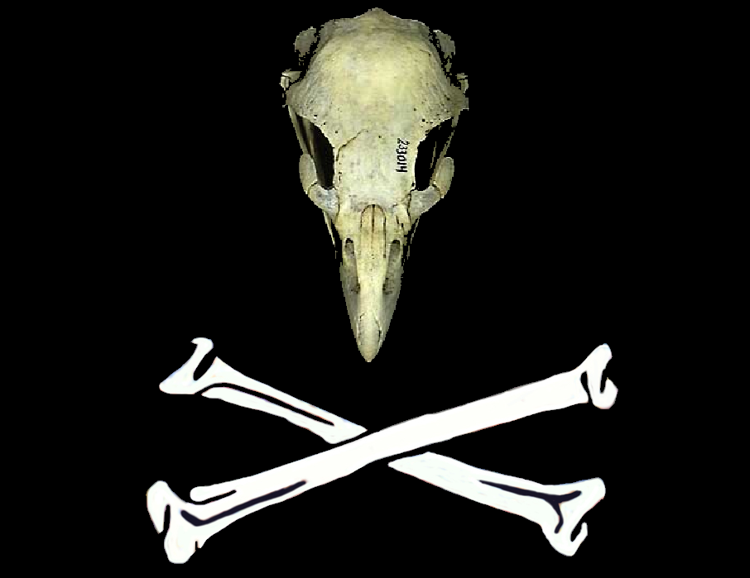
Authoritative Reasoning
Document D authoritative for concept C iff:
  C not identified by a URI
    OR
  De-referenced URI of C coincides with or redirects to D
  FOAF spec authoritative for foaf:Person ✓
  MY Ont not authoritative for foaf:Person ✘
Only allow extension in authoritative documents
  my:Person rdfs:subClassOf foaf:Person . (MY Ont) ✓
BUT: Reduce obscure memberships
  foaf:Person rdfs:subClassOf my:Person . (MY Ont) ✘
Similarly for other T-Box statements.
In-memory T-Box stores authoritative values for rule execution
Ontology “Hijacking”

Slide 35
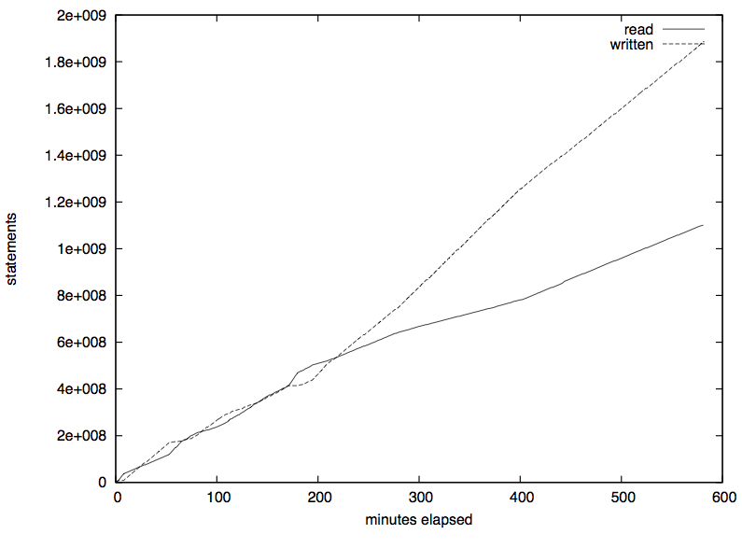
  A Semantic Web Search Engine
… based on these insights we have implemented SWSE [JWS’11]
SAOR makes inference robust & scalable to Web data:
SPARQL
On disk
RAM
(on a single machine, goes down near linear in parallel mode)
Crawling
Indexing
Scalable Authoritative
OWL Reasoner (SAOR)

Slide 36



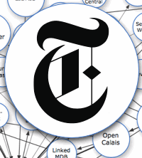
Are we done?
Similar in spirit to SAOR: “Quarantined Reasoning”, cf. [RR’11]
  SELECT * WHERE
  { ?C rdf:type NYT:Org .
  ?C dbpedia:revenue ?R .
  ?C NYT:latestArticle ?A .
  FILTER( ?R > 10000000000 ) }
Can’t keep up with changes!
Crawling
Indexing
Reasoning

Slide 37
Idea: “Live”-Linked Data Querying
Basic idea (originally proposed by Hartig & Bizer)
  Start with URIs in a SPARQL query
  Interleave crawl + query processing
  SELECT * WHERE
  { ?C rdf:type NYT:Org .
  ?C dbpedia:revenue ?R .
  ?C NYT:latestArticle ?A.
  FILTER (?R > €10000000000 ) }
  ?C rdf:type
NYT:Org
?C NYT:latestArticle ?A.
HTTP GET NYT:Org
→ HTTP GET NYT:SAP
→ HTTP GET NYT:article20130128_1
NYT:Org
dbpedia:SAP_AG
rdf:type
owl:sameAs
Stop. No new query relevant results found
?C
NYT:SAP
NYT:latestArticle
NYT:article20130110
?A

Slide 38
Improved “Live”-Linked Date Querying
Our approach [RR’12]
Basic idea:
  Start with URIs in a SPARQL query
  Interleave crawl + query processing
  + Lightweight OWL Reasoning
  SELECT * WHERE
  { ?C rdf:type NYT:Org .
  ?C dbpedia:revenue ?R .
  ?C NYT:latestArticle ?A.
  FILTER (?R > €10000000000) }
  SELECT * WHERE
  { ?C rdf:type NYT:Org .
  ?C dbpedia:revenue ?R .
  ?C NYT:latestArticle ?A.
  FILTER (?R > €10000000000) }
  ?C rdf:type
NYT:Org
?C NYT:latestArticle ?A.
HTTP GET NYT:Org
→ HTTP GET NYT:SAP
→ HTTP GET dbpedia:SAP
NYT:Org
?C
dbpedia:SAP_AG
dbpedia:revenue
€14233000000
?R
rdf:type
owl:sameAs
owl:sameAs
?C
NYT:SAP
NYT:latestArticle
NYT:article20130110
?A

Slide 39
Again: Does this work “in the wild”?
1) Benchmark generation:
3
4
BTC 2011
1100 queries
100 each for 11 “typical” shapes
QWalk:
Random walk based query generation.
4
2) Results:
RDFS reasoning: many queries with average impact
  In 8/11 query classes more than 50% avg. result increase
  in 4/11 query classes a time increase of 50%
OWL sameAs: view queries with high impact
  In 2/11 query classes more than 50% avg. result increase
  In 2/11 query classes a time increase of 50%
Overall our reasoning extensions improved in 8 of 11 query classes the average result/time ratio (throughput)

Slide 40
Are we done?
Depends on the point of view…
… e.g.: What is the sweetspot between centralised &
decentralised/live Linked Data querying approaches?
Plus…

Slide 41
… Actually, we were cheating:
dbpedia:Vienna
owl:sameAs
eurostat:AT001C
Article
name
country
population
eurostat:EN5101I
label
area
“Vienna”
dbpedia:Austria
3855.25
“Wien”
414.65
1714142
eurostat:EN5101I rdfs:subPropertyOf dbpedia:populationDensity
“Which city of Montpellier and Vienna has the higher population density?”
  SELECT ?DM ?DV
  WHERE { dbpedia:Montpellier :populationDensity ?DM .
  dbpedia:Vienna :populationDensity ?DV .
  }

Slide 42
Example: Actually, we were cheating…
Data looks rather like this…
dbpedia:Vienna
eurostat:AT001C
Article
name
country
observation
population
label
area
“Vienna”
dbpedia:Austria
eurostat:obs1
“Wien”
“414.65”^^unit:km2
indicator
year
1714142
value
2010
eurostat:TT1066I
1.83
“Which city of Montpellier and Vienna has the higher population density?”
Can’t we still answer this query? Just using the Dbpedia data?
We know: dbpedia:opulationDensity = dbpedia:population / dbpedia:area
Another example is unit conversion from this morning:
elephantWeight = elphantWeightImperial * 2.204
or priceUSD = priceEUR * 1.2850
We call these “propery equation” … stay tuned for the main track [ESWC’13]

Slide 43
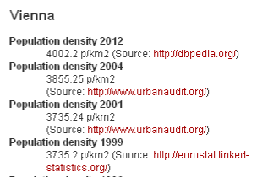

Take-home messages:
  Lots of interesting real-world Datasets out there as Linked Data!
  - can benefit from OWL and Reasoning
  - (even more Open Data in other formats, BTW)
  Structured Query anwsering over Linked Data needs:
    Robust & Scalable Reasoning (à la SAOR)
    Both centralised & decentralised approaches
    Maybe more than OWL (e.g. something like property equations)?

Slide 44
References:
[RR’12] Jürgen Umbrich, Aidan Hogan, Axel Polleres, Stefan Decker: Improving the Recall of Live Linked Data Querying through Reasoning. In 6th International Conference on WebReasoning and Rule Systems (RR2012)
[LDOW’12] Birte Glimm, Aidan Hogan, Markus Krötzsch, Axel Polleres: OWL: Yet to arrive on the Web of Data? In Linked Data on the Web (LDOW2012)
[JWS’11] Aidan Hogan, Andreas Harth, Jürgen Umbrich, Sheila Kinsella, Axel Polleres, Stefan Decker: Searching and browsing Linked Data with SWSE: The Semantic Web Search Engine. JWS. 9(4): 365-401 (2011)
[LDOW’10] Aidan Hogan, Andreas Harth, Alexandre Passant, Stefan Decker, Axel Polleres: Weaving the Pedantic Web. LDOW 2010.
[JWS’12a] Aidan Hogan, Jürgen Umbrich, Andreas Harth, Richard Cyganiak, Axel Polleres, Stefan Decker: An empirical survey of Linked Data conformance. J. Web Sem. 14: 14-44 (2012)
[ESWC’13] Stefan Bischof, Axel Polleres: RDFS with Attribute Equations via SPARQL Rewriting. ESWC 2013: 335-350
[RR’11] Renaud Delbru, Giovanni Tummarello, Axel Polleres: Context-Dependent OWL Reasoning in Sindice - Experiences and Lessons Learnt. RR 2011: 46-60
[ISWC’10] Aidan Hogan, Jeff Z. Pan, Axel Polleres, Stefan Decker: SAOR: Template Rule Optimisations for Distributed Reasoning over 1 Billion Linked Data Triples. ISWC (1) 2010: 337-353
[RR’09] Aidan Hogan, Stefan Decker: On the Ostensibly Silent 'W' in OWL 2 RL. RR 2009: 118-134
[IJSWIS’09] Aidan Hogan, Andreas Harth, Axel Polleres: Scalable Authoritative OWL Reasoning for the Web. Int. Journal On Semantic Web & Information Systems 5(2): 49-90 (2009)
…(more on www.polleres.net/publications.html )

Slide 45
Backup-slides

Slide 46


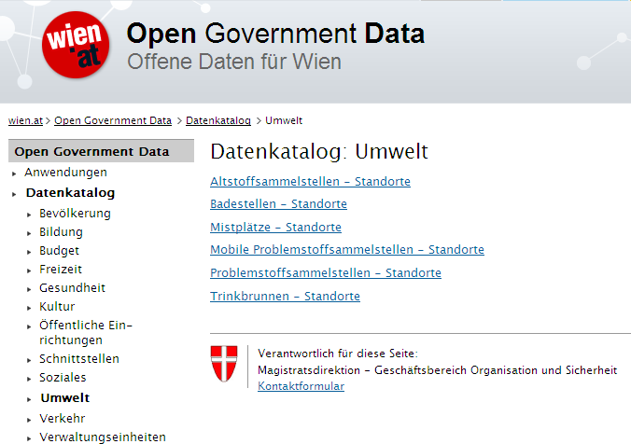
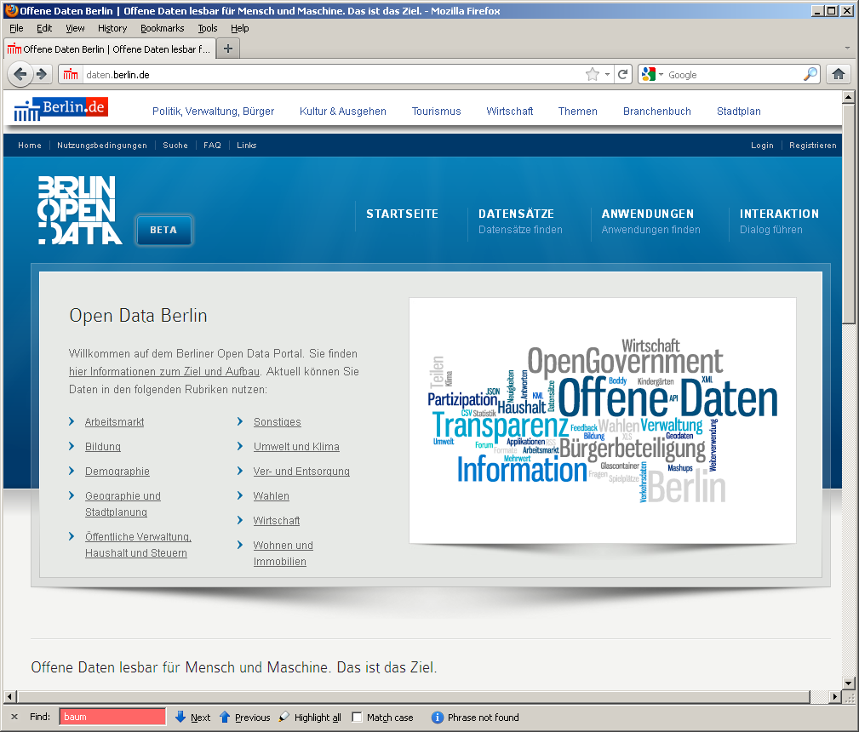

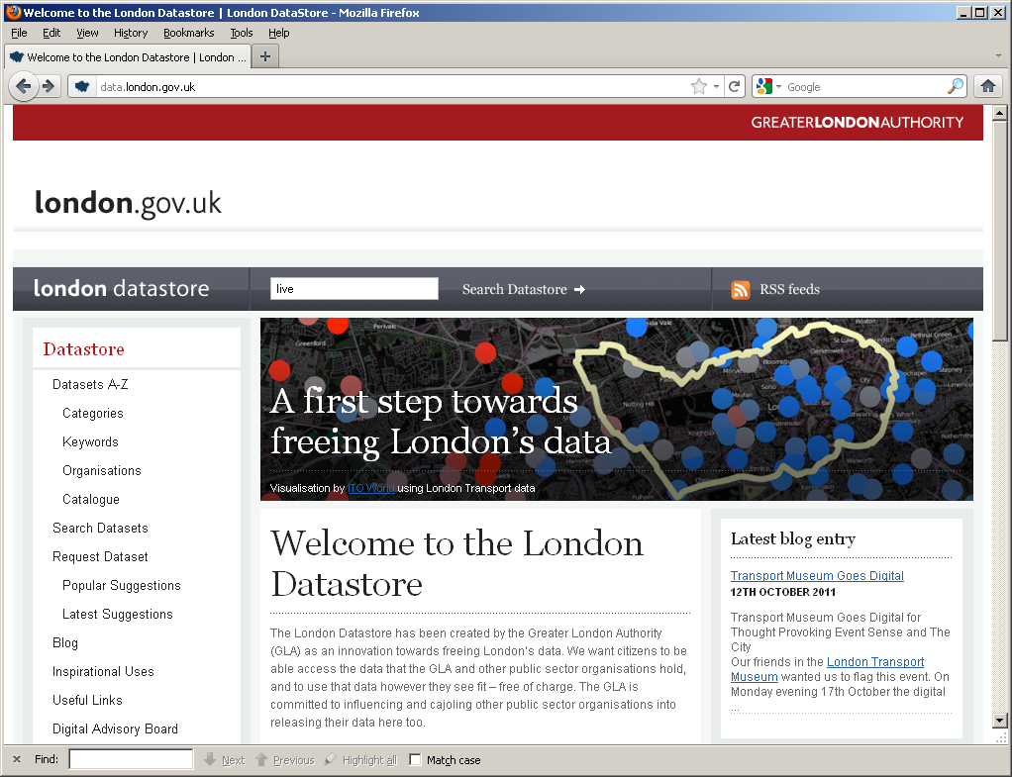
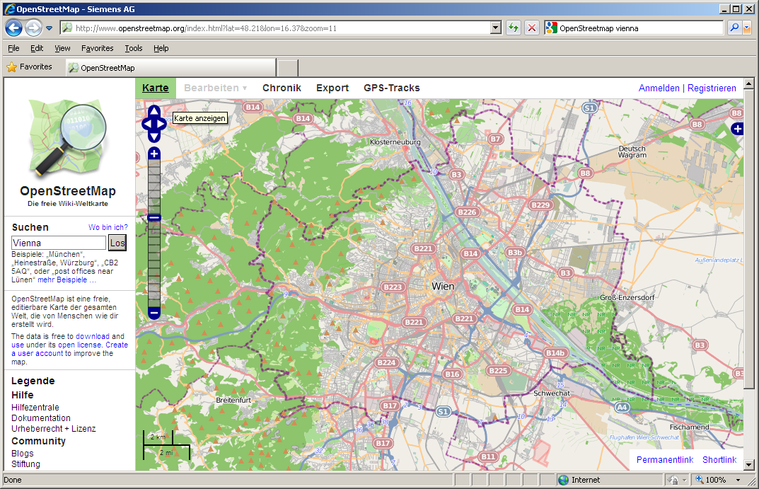



Open Data
Trends & Future
DIRECTIVE 2007/2/EC INSPIRE
Open Data: Typically very liberal licenses (variants of CC)
Many formats, varying quality, harmonization starting
Mostly by online communities or public bodies (cities, communities, governments, UN,…)
  Currently focused mostly in SMEs to take advantage of that data
vs. Publicly available data: e.g. NYT is public but not free/not license free
vs. Enterprise (Linked) Data

Slide 47




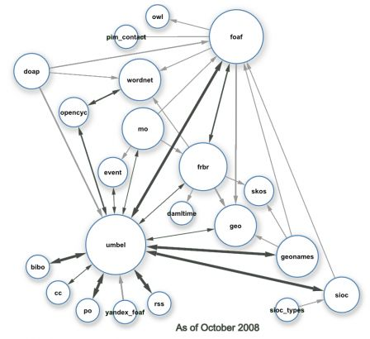







Linked Data Ontologies =
RDF Vocabularies (OWL, RDFS)
FOAF
DublinCore
SKOS
…
Image from http://blog.dbtune.org/public/.081005_lod_constellation_m.jpg:; Giasson, Bergman
Side remark: Only a small fraction of Linked data is OWL/RDFS ontologies
(less than ~0.1% [IJSWIS’2009, Hogan 2010])

Slide 48
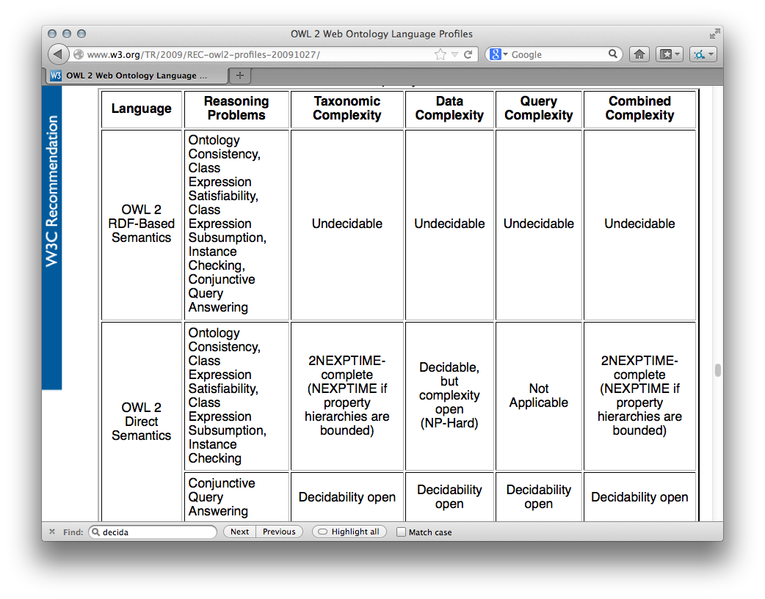
OWL Reasoning: Complexity
http://www.w3.org/TR/2009/REC-owl2-profiles-20091027/
And even for OWL RL PTIME-complete…. i.e., often too expensive.

Slide 49
Related Works:
RDFS only, syntactic data. Nice hardware.
Scalable OWL Reasoning
  Jesse Weaver, James A. Hendler: Parallel Materialization of the Finite RDFS Closure for Hundreds of Millions of Triples. International Semantic Web Conference 2009: 682-697
  Vladimir Kolovski, Zhe Wu, George Eadon: Optimizing Enterprise-Scale OWL 2 RL Reasoning in a Relational Database System. International Semantic Web Conference (1) 2010: 436-452
  Jacopo Urbani, Spyros Kotoulas, Jason Maassen, Frank van Harmelen, Henri E. Bal: WebPIE: A Web-scale Parallel Inference Engine using MapReduce. J. Web Sem. 10: 59-75 (2012)
Live Linked Data Querying
  Olaf Hartig, Christian Bizer, Johann Christoph Freytag: Executing SPARQL Queries over the Web of Linked Data. International Semantic Web Conference 2009: 293-309
  Günter Ladwig, Thanh Tran: Linked Data Query Processing Strategies. International Semantic Web Conference (1) 2010: 453-469
Similar ideas to ours in terms of rule optimization by ORACLE (parallel to our results)
Similar parallelization techniques to ours, 100b triples, but confined data with small ontologies. No Web Data. Nice: exchange of results for joins in Map-reduce jobs.
No reasoning considered. 4 fixed queries, result throughput not considereed
Confined Data, no
reasoning considered. 8 fixed queries, needs a source index

