Slide 1
SPARQL1.1 Updates and Entailment - Why the specification is silent about their interaction
Based on joint work with: Albin Ahmeti, Diego Calvanese, Vadim Savenkov
Axel Polleres
web: http://polleres.net twitter: @AxelPolleres

Slide 2
Outline
RDF & Linked Data – as a Data abstraction layer of Databases published on the Web
SPARQL - Data – as an abstraction layer of Data services on the Web
Two new features in SPARQL 1.1:
  Entailment regimes
  SPARQL Update
How do they interact?
  Possible Semantics & Examples
Discussion

Slide 3
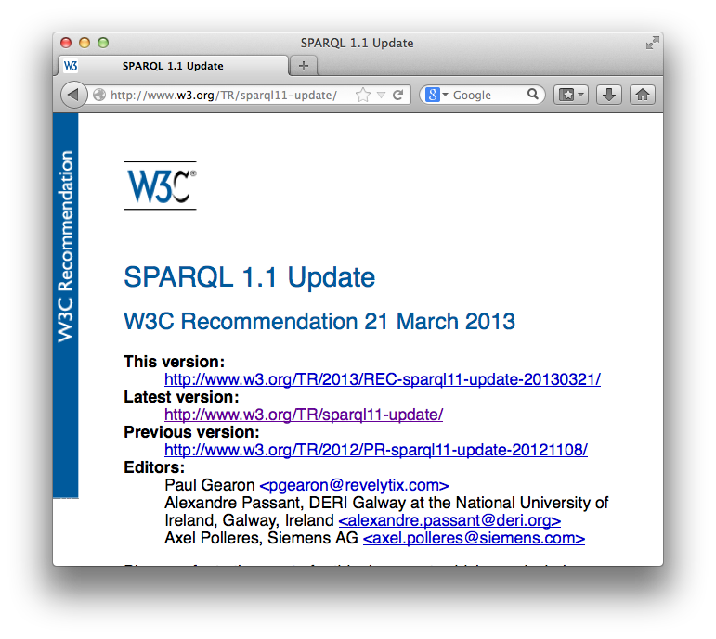
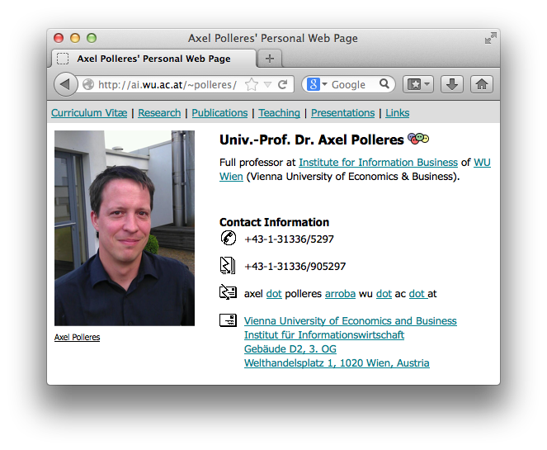
From the HTML Web…
Globally Unique identifiers
Links between Documents (href)
A common protocol
URIs
HTTP
href

Slide 4
… towards a Web of (Linked) Data
From the HTML Web…
Globally Unique identifiers
Typed Links (=relations) between Entities
A common protocol
URIs
RDF
HTTP
Axel Polleres edited SPARQL1.1 Update spec .
xmlns.com/foaf/0.1/made
polleres.net#me
w3.org/TR/sparql11-update
href
Person
Article
a universal graph-based data format…
(note that e.g. any relational data can be decomposed into such triples)

Slide 5
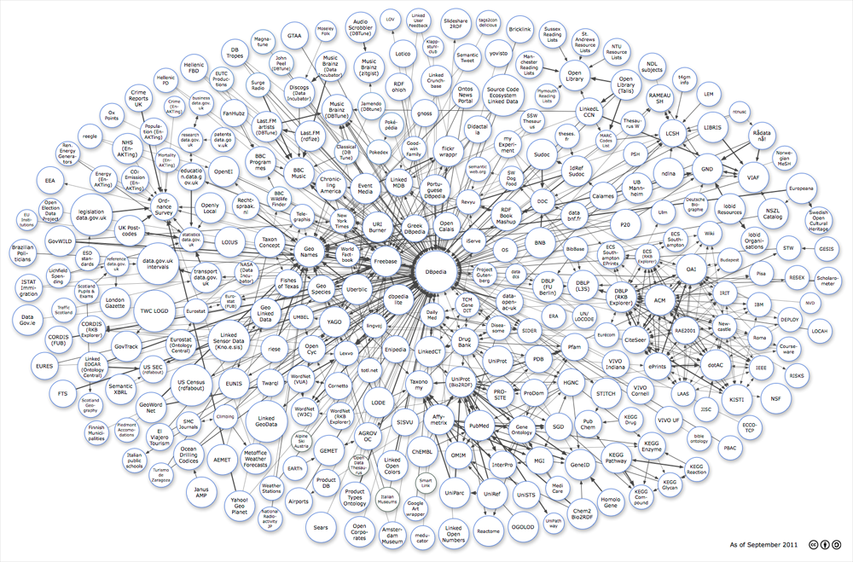








Any data can be represented and linked using RDF
Image from: http://lod-cloud.net/
5

Slide 6







Linked Data has moved from academia to industry over the last few years…
Watson

Slide 7
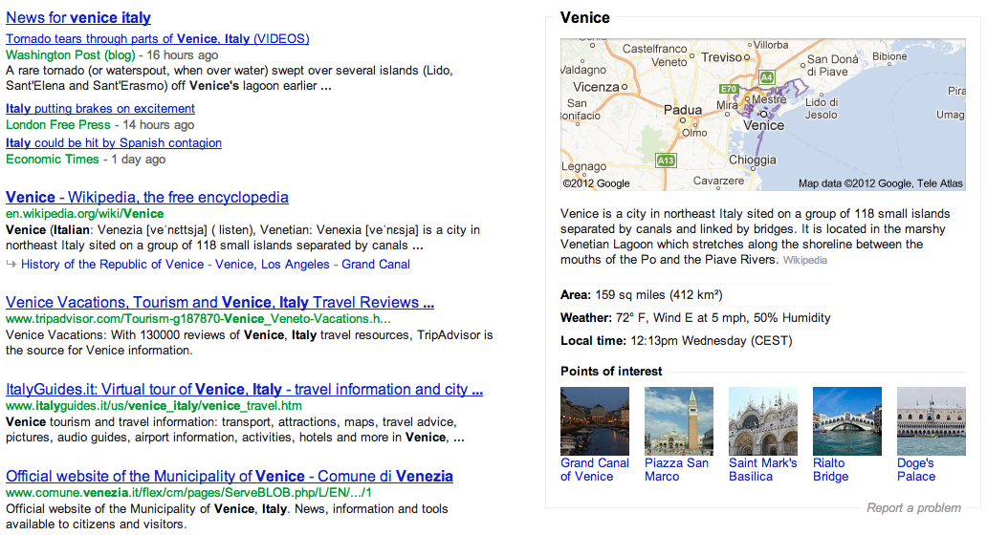
Google Knowledge Graph

Slide 8
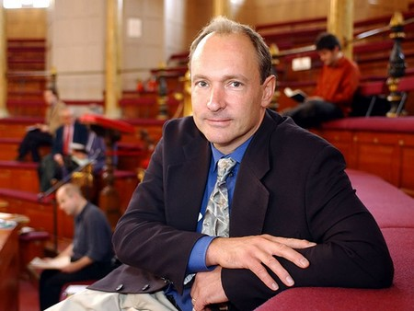


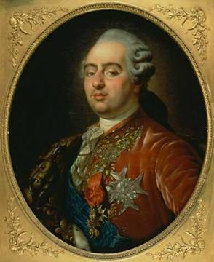
The “Semantic Web” promise…
  “If HTML and the Web made all the online documents look like one huge book, RDF, schema and inference
  languages will make all the data in the world look like one
  huge database” Tim Berners-Lee, 1999
Try the following in google:
“Children of Austrian rulers married to French rulers…?”
Notes:
Te explain what I mean here, let me start with a quote, which at the same time is one of the “big promises” of the Semantic Web and what its technologies shall enable. In 1999 Tim-Berners Lee, the creator of the Web wrote: “If HTML … “ Well, it’s almost 15 years from that now and so it should work by now, shouldn’t it? So let’s try that on google! Unfortunately google doesn’t answer these questions, because google doesn’t allow structured query answering…
For instance, take some market research questions such as the following:
What are the latest news on the new York times about companies with a revenue of over 10b EUR?
Or for my own preparation to this talk, I might have asked myself questions like the following: Who of my peers may have published with colleagues from WU Wien and how do these colleagues look like, such that I recognize them when I stand here in front of you today.

Slide 9
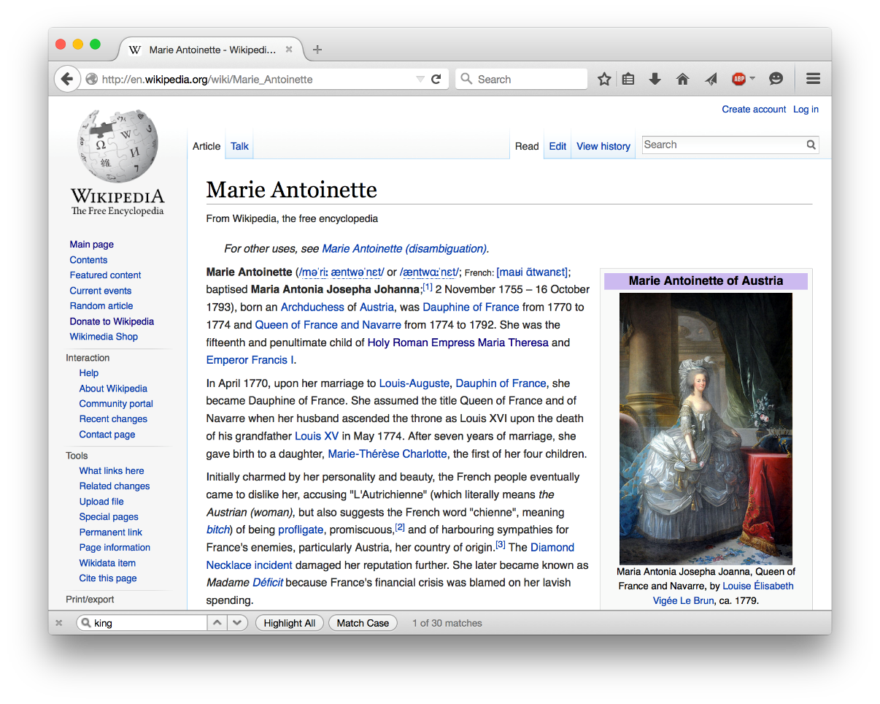
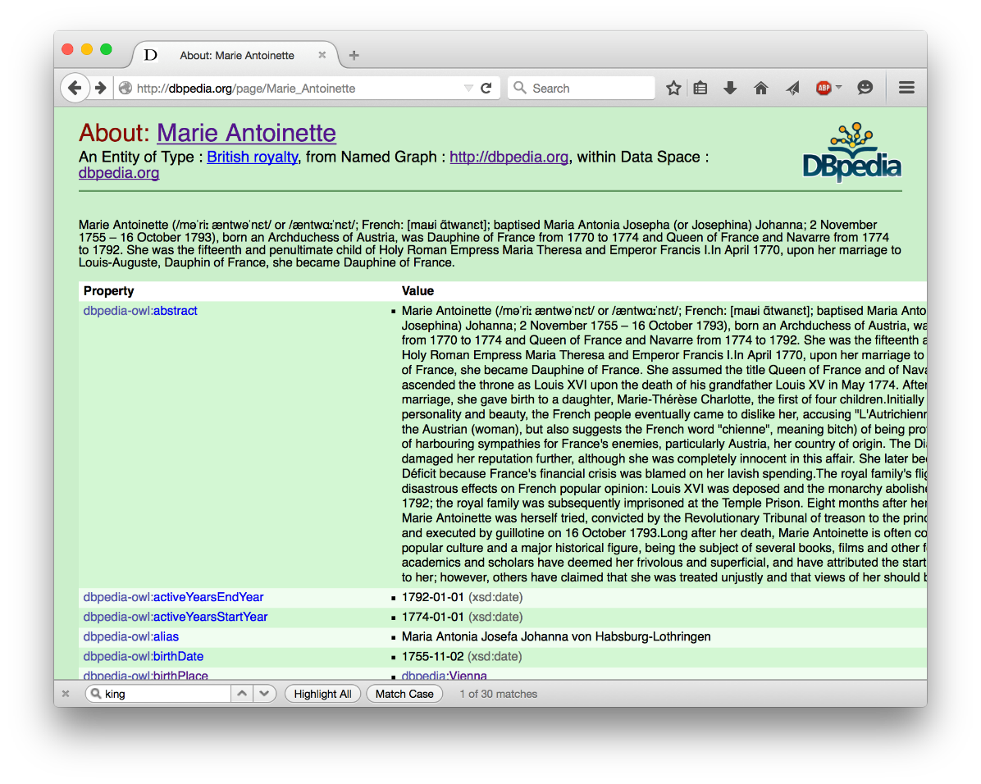
The necessary information is available in RDF – Dbpedia: Wikipedia as a Data Service...
S | P | O
:marie | :hasMother | :maria_t
:marie | :hasSpouse | :louis
:maria_t | a | :RulerOfAustria
:louis | a | :DauphinOfFrance

Slide 10
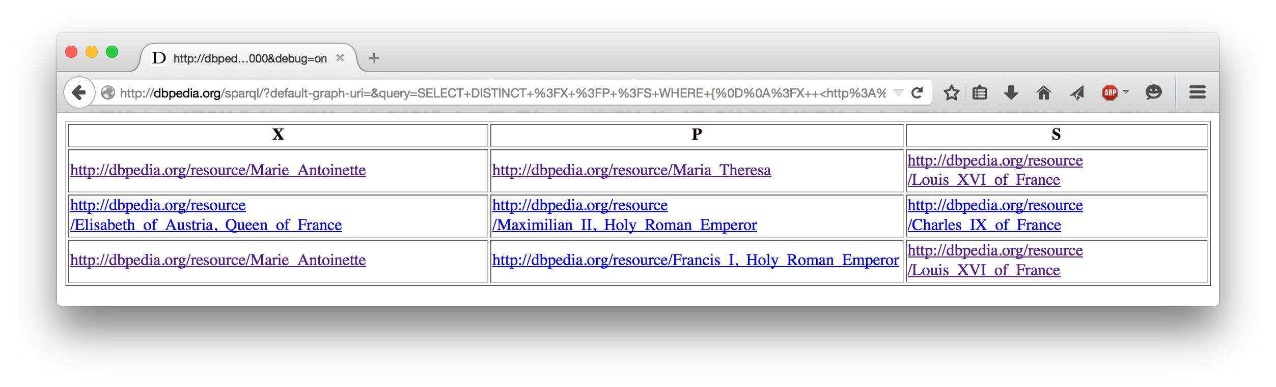
SPARQL: query language for RDF
SPARQL offers a standard protocol/service interface to data offering services like DBPedia!
SPARQL endpoint
→ Query request encoded in a HTTP request
← Query result in various formats (CSV, RDF, JSON, ...)
SELECT ?X ?P ?S WHERE {
?X :hasMother ?P . ?X :hasSpouse ?S .
?P a RulerOfAustria . ?S a :DauphinsOfFrance .
}

Slide 11
SPARQL 1.1
SPARQL 1.0 (2008): SQL "look-and-feel" for RDF and Linked data
SPARQL 1.1 (2013): adding demanded features
Added two new features:
  Use of implicit information: SPARQL 1.1Entailment regimes
  Provide an update interface: SPARQL 1.1 Update

Slide 12
SPARQL1.1 Entailment Regimes:
Make use of ontological meta-information (RDFS and OWL):
SELECT ?X ?P ?S WHERE {
?X :hasMother ?P . ?X :hasSpouse ?S .
?P a RulerOfAustria . ?S a :DauphinsOfFrance .
}
SELECT ?X ?P ?S WHERE {
?X :hasParent ?P . ?X :hasSpouse ?S .
?P a RulerOfAustria . ?S a :RulerOfFrance .
}
S | P | O
:marie | :hasMother | :maria_t
:marie | :hasSpouse | :louis
:maria_t | rdf:type | :RulerOfAustria
:louis | rdf:type | :DauphinOfFrance
S | P | O
:hasMother | rdfs:subPropertyOf | :hasParent
:DauphinOfFrance | rdfs:subClassOf | :RulerOfFrance

Slide 13
How are Entailment Regimes typically implemented in SPARQL engines?

Slide 14
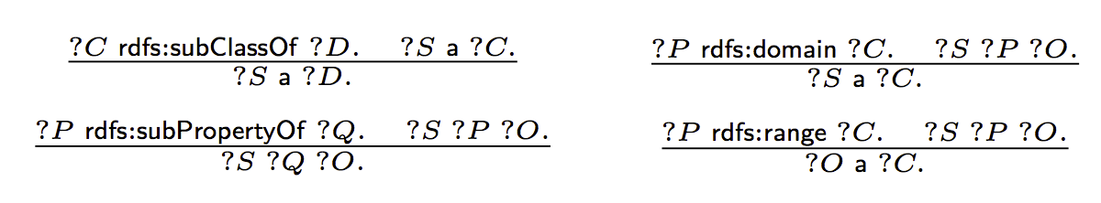
SPARQL Query answering under (RDFS) Entailment:
S | P | O
:Mother | rdfs:subClassOf | :Parent
:hasMother | rdfs:subPropertyOf | :hasParent
:hasMother | rdfs:range | :Mother
:hasParent | rdfs:domain | :Child
:hasParent | rdfs:range | :Parent
...
...
S | P | O
:marie | :hasMother | :maria_t
:marie | :hasParent | :maria_t
[Munoz et al., ESWC2007] Minimal RDFS (ABox-) Inference Rules
S | P | O
:marie | :hasMother | :maria_t
:marie | a | :Child
:marie | :hasParent | :maria_t
:maria_t | a | :Mother
:maria_t | a | :Parent
materialize(G)

Slide 15
SPARQL Query answering under RDFS Entailment:
SELECT ?Y
WHERE {
{ :marie :hasParent ?Y . }
UNION
{:marie :hasMother ?Y . }
UNION
{:marie :hasFather ?Y . }
[Bischof et al., ISWC2014] Schema-Agnostic Query Rewriting in SPARQL 1.1
S | P | O
:Mother | rdfs:subClassOf | :Parent
:hasMother | rdfs:subPropertyOf | :hasParent
:hasMother | rdfs:range | :Mother
:hasParent | rdfs:domain | :Child
:hasParent | rdfs:range | :Parent
...
DELETE {?S1 a ?D1. ?S2 a ?C2. ?S3 ?Q3 ?O3. ?O4 a ?C4.}
WHERE {
{ ?C1 sc+ ?D1. ?S1 a ?C1. }
UNION { ?P2 dom/sc* ?C2. ?S2 ?P2 ?O2. }
UNION { ?P3 sp+ ?Q3. ?S3 ?P3 ?O3. }
UNION { ?P4 rng/sc* ?C4. ?S4 ?P4 ?O4. }
}
rewrite(q,T)
...
S | P | O
:marie | :hasMother | :maria_t
S | P | O
:marie | :hasMother | :maria_t
:marie | :hasParent | :maria_t
ans(rewrite(q, T), G)
=
ans(q, materialize(G))
Well known:
ans(rewrite(q, T), reduce(G))
=
ans(q, materialize(reduce(G)))
reduce(G)
S | P | O
:marie | :hasMother | :maria_t
:marie | a | :Child
:marie | :hasParent | :maria_t
:maria_t | a | :Mother
:maria_t | a | :Parent
SELECT ?Y
WHERE { :marie :hasParent ?Y . }
materialize(G)
Notes:
We may assume this is "on-board" functionality of RDF stores...

Slide 16
SPARQL 1.1
SPARQL 1.0 (2008): SQL "look-and-feel" for RDF and Linked data
SPARQL 1.1 (2013):
Added two new features:
  Use of implicit information: SPARQL 1.1Entailment regimes
  Provide an update interface: SPARQL 1.1 Update
Many off-the-shelf engines support at least RDFS in one or the other way

Slide 17

Data Services on the Web allow updates:
Examples:
INSERT { :marie :hasChild :marie_therese_of_France .}
What do these updates mean in a materialized or reduced store?
DELETE { ?X ?P ?O .}
WHERE { ?X :hasParent :maria_t}
DELETE {?X :hasParent :maria_t .}
INSERT { ?X :hasMother :maria_t. }
WHERE { ?X :hasParent :maria_t. }

Slide 18

Status:
Standardization of SPARQL 1.1 Update, and SPARQL 1.1 Entailment Regimes with triple stores implementing those standards (rewriting- or materialization-based)
Emerging need for a more systematic approach of dealing with SPARQL 1.1 Update over ABoxes & Tboxes
This Talk: We have run into different directions, but we haven't reached the goal yet!
Nothing endures but change. - Heraclitus

Slide 19
What's been done already?
What do off-the-shelf triple stores do?
  Entailment typically handled
    at (bulk) loading by materialization , or
    at query time by rewriting
  but not in the context of Updates.
  no “standard” behavior for Delete & Insert upon materialized stores.
  interplay of Entailments and Update left out in the SPARQL 1.1 spec.
What does the literature say?
Approaches in the literature on updates and RDFS (or also DLs) limited to atomic update operations…
  [Gutierrez et al., ESWC2011] ABox deletions in the context of RDFS
  [Calvanese et al., ISWC2010] ABox & TBox insertions in the context of DL-Lite (incl. inconsistency repair)
Also related:
  Deductive DBs: [Gupta et al., SIGMOD93]: DRed (delete and re-derive), applied by [Kotowski et al.2011] and [Urbani et al. 2013] in the contet of RDF/RDFS…
  KB evolution, Belief revision, etc.: Various works in classical AI and philosophy
Particularly, none of these considers the interplay between DELETE, INSERT based on a joint WHERE clause as in SPARQL

Slide 20
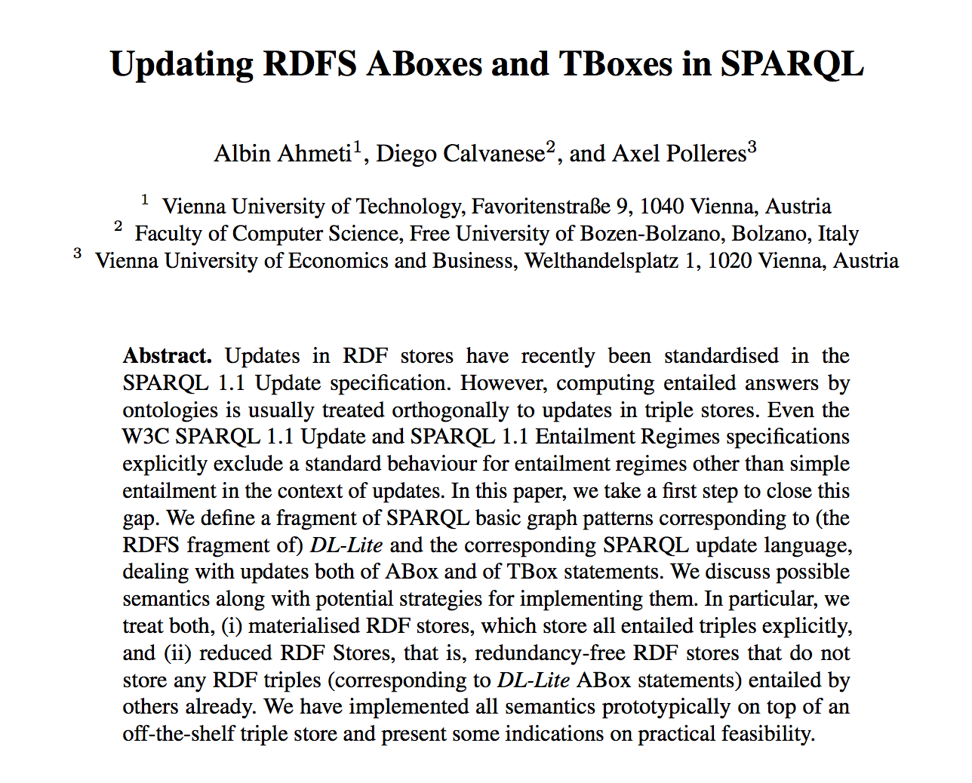
Our initial thoughts on this problem...

Slide 21
Let's start with a minimizing expectations:
Discuss possible update semantics in the context of materialized and reduced stores & RDFS:
  Only ABox updates, TBox fixed
  Use "minimal" RDFS as TBox language (without axiomatic triples, blank nodes) … i.e., DL-Lite_{RDFS}
  Restrict on BGPs to only allow ABox Insert/Deletes
Even in this restricted setting (RDFS) defining a reasonable update semantics under entailments turns out to be challenging!
INSERT {:marie :hasMother ?Y }
WHERE
{:marie :hasParent ?Y }
INSERT {:marie ?Y :foo}
WHERE
{:marie rdf:type ?Y }
Notes:
After this slide, add a slide which shows the Abox RDFS rules. (with a hint to Muñoz et al. Paper), i.e. subclass, subpropertz, domain, range inferences

Slide 22
Exploring possible ABox update semantics for SPARQL+RDFS
Materialized-preserving semantics
  Sem₀^{mat} … baseline semantics
  Sem_{1a}^{mat}
  Sem_{1b}^{mat}
  Sem₂^{mat} … delete incl. causes and rewrite upon inserts
Reduced-preserving semantics
  Sem₀^{red} ... baseline semantics
  Sem₁^{red} … delete incl. causes followed by reduce
}
inspired by DRed: delete (incl. effects) and re-derive new effects upon inserts
Notes:
Jump over this slide quickly!

Slide 23
Baseline semantics for materialized stores:
Sem₀^{mat}
  Naïve Update followed by re-materialization

Slide 24
  Sem₀^{mat}: Naïve Update followed by re-materialization
DELETE { ?X a :Child . }
INSERT { ?Y a :Mother . }
WHERE { ?X :hasParent ?Y . }
S | P | O
:Mother | rdfs:subClassOf | :Parent
:hasMother | rdfs:subPropertyOf | :hasParent
:hasMother | rdfs:range | :Mother
:hasParent | rdfs:domain | :Child
:hasParent | rdfs:range | :Parent
...
...
DELETE { :marie a :Child . }
INSERT { :maria_t a :Mother . }
?X=:marie
?Y=:maria_t
S | P | O
:marie | :hasMother | :maria_t
:marie | :hasParent | :maria_t
:maria_t | a | :Mother
:maria_t | a | :Parent
S | P | O
:marie | :hasMother | :maria_t
:marie | a | :Child
:marie | :hasParent | :maria_t
:maria_t | a | :Mother
:maria_t | a | :Parent
S | P | O
:marie | :hasMother | :maria_t
:marie | a | :Child
:marie | :hasParent | :maria_t
:maria_t | a | :Mother
:maria_t | a | :Parent
No effect!
materialize(G)

Slide 25
Alternative Materialized-pres. semantics
Sem_{1a}^{mat}
  “(Over-)delete and rederive”
1. DELETEs triples incl. Effects
2. INSERT triples
3. Re-materialize
Notes:
delete the instantiations of P_{d} plus “dangling” effects, i.e., effects of deleted triples that after deletion are not implied any longer by any non-deleted triples;
insert the instantiations of P_{i} plus all their effects

Slide 26
  Sem_{1a}^{mat}: Delete and rederive
DELETE { :marie :hasMother :maria_t. }
S | P | O
:Mother | rdfs:subClassOf | :Parent
:hasMother | rdfs:subPropertyOf | :hasParent
:hasMother | rdfs:range | :Mother
:hasParent | rdfs:domain | :Child
:hasParent | rdfs:range | :Parent
...
DELETE { :marie :hasMother :maria_t .
:marie :hasParent :maria_t .
:marie a Child .
:maria_t a Mother.
:maria_t a Parent. }
...
S | P | O
:marie | :hasMother | :maria_t
:marie | a | :Child
:marie | :hasParent | :maria_t
:maria_t | a | :Mother
:maria_t | a | :Parent
S | P | O
S | P | O
May be viewed quite "radical"
materialize(G)

Slide 27
  Sem_{1a}^{mat}: Delete and rederive
DELETE { :marie :hasParent :maria_t. }
S | P | O
:Mother | rdfs:subClassOf | :Parent
:hasMother | rdfs:subPropertyOf | :hasParent
:hasMother | rdfs:range | :Mother
:hasParent | rdfs:domain | :Child
:hasParent | rdfs:range | :Parent
...
DELETE { :marie :hasParent :maria_t .
:marie a Child .
:maria_t a Parent. }
...
S | P | O
:marie | :hasMother | :maria_t
:maria_t | a | :Mother
S | P | O
:marie | :hasMother | :maria_t
:marie | a | :Child
:marie | :hasParent | :maria_t
:maria_t | a | :Mother
:maria_t | a | :Parent
S | P | O
:marie | :hasMother | :maria_t
:marie | a | :Child
:marie | :hasParent | :maria_t
:maria_t | a | :Mother
:maria_t | a | :Parent
Again: no effect!
materialize(G)

Slide 28
Alternative Materialized-pres. semantics
Sem_{1b}^{mat}
  Variant of Sem_{1a}, that makes a distinction between explicit and implicit triples.
  Re-materialization from scratch from

Slide 29
  Sem_{1b}^{mat}: Delete and rederive with separating "explicit" and "implicit" ABox
DELETE { :marie :hasParent :maria_t. }
S | P | O
:Mother | rdfs:subClassOf | :Parent
:hasMother | rdfs:subPropertyOf | :hasParent
:hasMother | rdfs:range | :Mother
:hasParent | rdfs:domain | :Child
:hasParent | rdfs:range | :Parent
...
...
ABox_{expl}
S | P | O
:marie | :hasMother | :maria_t
S | P | O
:marie | :hasMother | :maria_t
:marie | :hasParent | :maria_t
ABox_{impl}
Abox'_{impl}
Again: no effect!
S | P | O
:marie | :hasMother | :maria_t
:marie | a | :Child
:marie | :hasParent | :maria_t
:maria_t | a | :Mother
:maria_t | a | :Parent
S | P | O
:marie | :hasMother | :maria_t
:marie | a | :Child
:marie | :hasParent | :maria_t
:maria_t | a | :Mother
:maria_t | a | :Parent
materialize(G)

Slide 30
Alternative Materialized-pres. semantics
Sem₂^{mat}
  Delete the instantiations of 𝑃_{𝑑} plus all their causes;
  Insert the instantiations of 𝑃_{𝑖} plus all their effects.
Notes:
Say that set of causes in RDFS (if you assume acyclic Tbox) is uniquely determined.

Slide 31
DELETE { ?X a :Child . }
INSERT { ?Y a :Mother . }
WHERE { ?X :hasMother ?Y . }
S | P | O
:Mother | rdfs:subClassOf | :Parent
:hasMother | rdfs:subPropertyOf | :hasParent
:hasMother | rdfs:range | :Mother
:hasParent | rdfs:domain | :Child
:hasParent | rdfs:range | :Parent
...
rewrite(u,T)
DELETE { ?X a :Child. ?X :hasFather ?x1.
?X :hasMother ?x2. ?X :hasParent ?x3. }
INSERT { ?Y a :Mother. ?Y a :Parent. }
WHERE { { ?X :hasMother ?Y. }
{ ?x1 a rdfs:Resource. ?x2 a rdfs:Resource.
?x3 a rdfs:Resource.} }
S | P | O
:marie | :hasMother | :maria_t
:marie | :hasParent | :maria_t
DELETE {:marie a :Child.
:marie :hasFather :maria_t, :marie, :louis … .
:marie :hasMother :maria_t, :marie, :louis … .
:marie :hasParent :maria_t, :marie, :louis … … }
INSERT { :maria_t a :Mother . :maria_t a Parent . }
materialize(G)
S | P | O
:marie | :hasMother | :maria_t
:marie | a | :Child
:marie | :hasParent | :maria_t
:maria_t | a | :Mother
:maria_t | a | :Parent
S | P | O
:maria_t | a | :Mother
:maria_t | a | :Parent
?X=:marie ?Y=:maria_t
?x1=?x2=?x3=*

Slide 32
DELETE {}
INSERT {:marie :hasMother :maria_t;:hasFather :louis}
WHERE {};
S | P | O
:Mother | rdfs:subClassOf | :Parent
:hasMother | rdfs:subPropertyOf | :hasParent
:hasMother | rdfs:range | :Mother
:hasParent | rdfs:domain | :Child
:hasParent | rdfs:range | :Parent
...
DELETE {:marie :hasMother :maria_t;:hasFather :louis }
INSERT{}
WHERE{};
rewrite(u1,T)
rewrite(u2,T)
DELETE {}
INSERT {:marie :hasMother :maria_t;:hasFather :louis,
:hasParent :maria_t, :hasParent :louis.
:marie a :Child . :maria_t a :Mother, :Parent.
:louis a :Father, Parent.} WHERE {};
S:ja | P | O
:marie | a | :Child
:maria_t | a | :Mother
:maria_t | a | :Parent
:marie | :hasParent | :maria_t
:louis | a | :Father
:marie | :hasParent | :louis
DELETE {:marie :hasMother :maria_t;:hasFather :louis }
INSERT {}
WHERE {};
DELETE following INSERT is NOT idempotent!
→ Leaves "Dangling effects"
Notes:
Dangling effects not easy to deal with, some intuition given in the paper, but again we find unintuitive examples in the end...

Slide 33

Baseline semantics
Sem₀^{red}
  Naïve Update followed by re-reduce

Slide 34
  Sem₀^{red}: Naïve Update followed by re-reduce
DELETE { ?X a :Child . }
INSERT { ?Y a :Mother . }
WHERE { ?X :hasMother ?Y . }
S | P | O
:Mother | rdfs:subClassOf | :Parent
:hasMother | rdfs:subPropertyOf | :hasParent
:hasMother | rdfs:range | :Mother
:hasParent | rdfs:domain | :Child
:hasParent | rdfs:range | :Parent
...
DELETE { :marie a :Child . }
INSERT { :maria_t a :Mother . }
?X=:marie
?Y=:maria_t
S | P | O
:marie | :hasMother | :maria_t
:maria_t | a | :Mother
S | P | O
:marie | :hasMother | :maria_t
S | P | O
:marie | :hasMother | :maria_t
No effect!
reduce(G)
Notes:
Maybe add the Abox and reduce operator…

Slide 35

Alternative Reduced-pres. semantics
Sem₁^{red}
  Delete the instantiations of 𝑃_{𝑑} plus all their causes;
  Insert the instantiations of 𝑃_{𝑖}.
  Followed by re-reduce
Notes:
Say that set of causes in RDFS (if you assume acyclic Tbox) is uniquely determined.

Slide 36
  Sem₁^{red}: Re-written Update followed by re-reduce
DELETE { ?X a :Child . }
INSERT { ?Y a :Mother . }
WHERE { ?X :hasMother ?Y . }
S | P | O
:Mother | rdfs:subClassOf | :Parent
:hasMother | rdfs:subPropertyOf | :hasParent
:hasMother | rdfs:range | :Mother
:hasParent | rdfs:domain | :Child
:hasParent | rdfs:range | :Parent
...
rewrite(u,T)
DELETE { ?X a :Child. ?X :hasFather ?x1.
?X :hasMother ?x2. ?X :hasParent ?x3. }
INSERT { ?Y a :Mother. }
WHERE { { ?X :hasMother ?Y. }
{ ?x1 a rdfs:Resource. ?x2 a rdfs:Resource.
?x3 a rdfs:Resource.} }
S | P | O
:maria_t | a | :Mother
S | P | O
:marie | :hasMother | :maria_t
DELETE {joe a :Child.
:marie :hasMother :maria_t, :louis, ….
:marie :hasParent :maria_t, :louis, …. … }
INSERT { :maria_t a :Mother. }
reduce(G)
?X=:marie ?Y=:maria_t
?x1=?x2=?x3=*
S | P | O
:maria_t | a | :Mother

Slide 37
Extensions
TBox updates
(ABox) Updates in the presence of ontologies beyond RDFS: dealing with inconsistencies.
Experiments & Use cases
  Bring mappings into play: Ontology-based data management

Slide 38
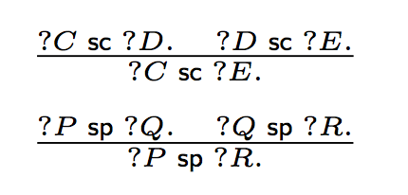
Extension 1: TBox updates
In this setting
  We expand BGPs to take into account TBox Inserts/Deletes – general BGPs
  Tbox inserts are trivial in this setting of RDFS.
  TBox deletions for RDFS are ambiguous
  (need minimal cuts) [Gutierrez et al., ESWC2011]
Opens various degrees of freedom… What if we consider a materialized (acyclic) Tbox?
  We also use two RDFS rules for TBox materialization.
DELETE {:A rdfs:subClassOf ?C . }

Slide 39
Minimal cuts are ambiguous!

Slide 40
Proposed TBox update semantics
Outbound cut: Intuition
DELETE { :A rdfs:subClassOf ?X. }
WHERE
{ :A rdfs:subClassOf ?X .
?X rdfs:subClassOf* :F. }
DELETE { :A rdfs:subClassOf :F. }
Idea: Can be implemented with SPARQL 1.1 property paths

Slide 41
Analogous alternative: Sem_{incut}
Inbound cut: Intuition
DELETE { ?X rdfs:subClassOf :F. }
WHERE
{ :A rdfs:subClassOf* ?X .
?X rdfs:subClassOf :F. }
Downside of incut/outcut:
Only works for acyclic Tboxes
Minimality of cut only guaranteed for single atomic updates

Slide 42

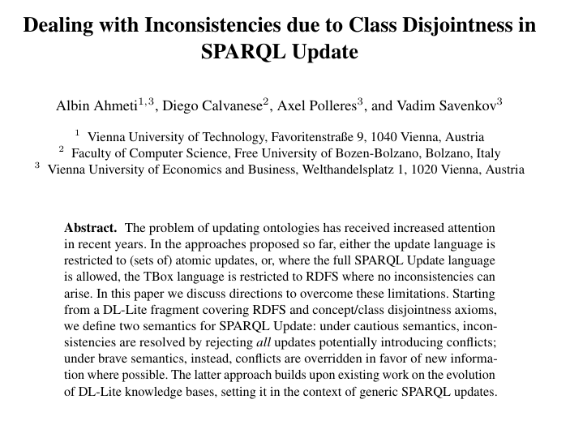
Extension 2: Beyond RDFS
DL 2015
Minimal ontology language extension: RDFS + class disjointness.

Slide 43
SPARQL updates: deal with inconsistency within new knowledge
:Monarch owl:disjointWith :Regent
:hasRegent rdfs:domain :Monarch
:hasRegent rdfs:range : Regent
"Unsafe" update → intrinsically inconsistent:
INSERT {?X :hasRegent ?Y} WHERE {?Y :signsDecreeInNameOf ?X}

Slide 44
SPARQL updates: deal with inconsistency within new knowledge
:Monarch owl:disjointWith :Regent
:hasRegent rdfs:domain :Monarch
:hasRegent rdfs:range : NonRoyalRuler
"Unsafe" update:
INSERT {?X :hasRegent ?Y} WHERE {?Y :signsDecreeInNameOf ?X}
intrinsically Inconsistencies can be caught by "safe rewriting"
INSERT{?X :hasRegent ?Y}
WHERE{?Y :signsDecreeInNameOf ?X
MINUS{ {?X1 :signsDecreeInNameOf ?Y}
UNION {?X :signsDecreeInNameOf ?Y2}}}
Copies of the WHERE clause, variables renamed appropriately.

Slide 45
Rewritings: MINUS vs. FILTER NOT EXISTS
Safe rewriting via FILTER NOT EXISTS doesn't work:
DELETE{?Z a :Regent} INSERT{?X :hasRegent ?Y}
WHERE{ {?Y :signsDecreeInNameOf ?X}
UNION {?V :signsDecreeInNameOf ?Z}}

Slide 46
Rewritings: MINUS vs. FILTER NOT EXISTS
Safe rewriting via FILTER NOT EXISTS doesn't work:
DELETE{?Z a :Regent} INSERT{?X :hasRegent ?Y}
WHERE{ {?Y :signsDecreeInNameOf ?X}
UNION {?V :signsDecreeInNameOf ?Z}}
disjoint sets of variables
FILTER NOT EXISTS{
{?X1 :signsDecreeInNameOf ?Y} UNION {?V1 :signsDecreeInNameOf ?Z1}
}}
FILTER NOT EXISTS{
{?X :signsDecreeInNameOf ?Y2} UNION {?V2 :signsDecreeInNameOf ?Z2}
}}
Exists whenever the WHERE clause is satisfied!
Simply renaming the whole WHERE clause is not possible.

Slide 47
Rewritings: MINUS vs. FILTER NOT EXISTS
Safe rewriting via MINUS: works!
DELETE{?Z a :Regent} INSERT{?X :hasRegent ?Y}
WHERE{ {?Y :signsDecreeInNameOf ?X}
UNION {?V :signsDecreeInNameOf ?Z}}
MINUS{
{?X1 :signsDecreeInNameOf ?Y} UNION {?V1 :signsDecreeInNameOf ?Z1}
}}
MINUS{
{?X :signsDecreeInNameOf ?Y2} UNION {?V2 :signsDecreeInNameOf ?Z2}
}}
Extra union branches do not matter!
MINUS removes variable bindings of the WEHRE clause that can be combined with
some result of the query in its right-hand side.
Only variables from the left-hand side of MINUS are "visible" in ist right-hand side:
great for our case!

Slide 48
SPARQL updates: deal with inconsistency w.r.t. the old knowledge
Adapt the Sem₂^{mat} (rewriting-based) semantics
Brave: when in conflict, prefer new knowledge (cf. FastEvol [Calvanese et al 2010])
Cautious: when in conflict, stick to the old knowledge
  In batch updates, allow variable bindings only where the insert clause does not clash.
Fainthearted: relaxation of cautious semantics
  The same batch update might resolve clashes by deleting conflicting parts of the old knowledge!
Notes:
Check which paper!

Slide 49
Example: Brave Sem₂^{mat}
:Monarch owl:disjointWith :Regent
:hasRegent rdfs:domain :Monarch
:hasRegent rdfs:range : NonRoyalRuler
INSERT{?X :hasRegent ?Y} WHERE{?Y :signsDecreeInNameOf ?X}
Preprocess: safe rewriting
INSERT{?X :hasRegent ?Y}
WHERE{?Y :signsDecreeInNameOf ?X
MINUS{ {?Y1 :signsDecreeInNameOf ?X}
UNION {?Y :signsDecreeInNameOf ?X2}}}

Slide 50
Example: Brave Sem₂^{mat}
:Monarch owl:disjointWith :Regent
:hasRegent rdfs:domain :Monarch
:hasRegent rdfs:range : NonRoyalRuler
INSERT{?X :hasRegent ?Y} WHERE{?Y :signsDecreeInNameOf ?X}
Brave Sem₂^{mat}
DELETE {?X a :Regent . ?X3 :hasRegent ?X .
?Y a :Monarch . ?Y :hasRegent ?Y3 }
Potential clashes
INSERT{?X :hasRegent ?Y}
WHERE{?Y :signsDecreeInNameOf ?X
MINUS{ {?Y1 :signsDecreeInNameOf ?X}
UNION {?Y :signsDecreeInNameOf ?X2}}
OPTIONAL{?X3 :hasRegent ?X}
OPTIONAL {?Y :hasRegent ?Y3}}
. ?X a :Monarch . ?Y a :Regent}
Bind variables in DELETE

Slide 51
Example: Cautious Sem₂^{mat}
:Monarch owl:disjointWith :Regent
:hasRegent rdfs:domain :Monarch
:hasRegent rdfs:range : NonRoyalRuler
INSERT{?X :hasRegent ?Y} WHERE{?Y :signsDecreeInNameOf ?X}
Cautious Sem₂^{mat}
INSERT{?X :hasRegent ?Y . ?X a :Monarch . ?Y a :Regent}
WHERE{?Y :signsDecreeInNameOf ?X
MINUS{ {?Y1 :signsDecreeInNameOf ?X}
UNION {?Y :signsDecreeInNameOf ?X2}}
MINUS {{?X a :Regent} UNION {?Y a :Monarch}}}
Do inserts only with non-clashing variable bindings
(assuming materialized store!)
Notes:
We could maybe use NOT EXISTS here?

Slide 52

Example: Fainthearted Sem₂^{mat}
:Monarch owl:disjointWith :Regent
:hasRegent rdfs:domain :Monarch
:hasRegent rdfs:range : NonRoyalRuler
Removes some clashes!
DELETE{?X :Regent}
INSERT{?X :hasRegent ?Y} WHERE{?Y :signsDecreeInNameOf ?X}
Fainthearted Sem₂^{mat}
DELETE{?X :Regent}
INSERT{?X :hasRegent ?Y . }
WHERE{?X :signsDecreeInNameOf ?Y
MINUS{ {?X1 :signsDecreeInNameOf ?X}
UNION {?Y :signsDecreeInNameOf ?Y2}}
MINUS {{?X a :Regent} UNION {?Y a :Monarch}}}
Handled by delete
Notes:
Our query is much longer ... Nested MINUS.... Do we still stay within well-designedness?

Slide 53
Fainthearted semantics: pitfalls, e.g. clashes removed by different bindings
μ₂ = […,?Z ↦ :Arthur,..]: Clears the clash!
DELETE {?Z a :Regent}
INSERT {?X :hasRegent ?Y}
WHERE { … }
:Arthur a :Regent
μ₁ = [?X ↦ :Arthur,…]: clash
Atomic updates: for each variable binding μ of the WHERE clause either both delete and insert or none.
Insert with μ₁ depends on the deletion with μ₂.
By atomiticy, μ₁ also causes insertion (which might depend on the deletion with some μ₃ etc).
Idea: give up update atomicity. Delete for all μ_{i} of the WHERE pattern, insert only where not clashing; for this we have to "separate" DELETE and INSERT...
Notes:
Needs some extra work in the rewriting, it's getting nasty... Not details, but can be also done with rewriting

Slide 54
Breaking atomicity by rewriting
DELETE{?X :Regent}
INSERT{?X :hasRegent ?Y}
WHERE{?Y :signsDecreeInNameOf ?X}
DELETE{?X :Regent}
INSERT{?X1 :hasRegent ?Y1}
WHERE{ {?Y :signsDecreeInNameOf ?X}
OPTIONAL { … bind ?X1 and ?Y1 "as needed" } }
Details in a forthcoming paper... The rewriting is involved...
Notes:
In the optional you need copied of the where clause, it's involved.

Slide 55
Breaking atomicity using transactions
ALTERNATIVE: Split DELETE and INSERT into two queries.
Step 1: Prepare the bindings for insertions and deletions in a temporary graph.
DELETE{?Z a :Regent}
INSERT{?X :hasRegent ?Y}
WHERE{?Y :signsDecreeInNameOf ?X … }
Step 2: Run insert and delete separately, but in a single transaction.
INSERT{?Z a :Regent_del,
?X :hasRegent_ins ?Y}
WHERE{?Y :signsDecreeInNameOf ?X…}
Modified Cautious rewriting needed (not shown)
DELETE{?Z a :Regent} WHERE {?Z a Regent_del};
Step 2b:
INSERT{?X :hasRegent ?Y} WHERE {?X :hasRegent_ins ?Y};
Step 2a:
Notes:
Example?

Slide 56
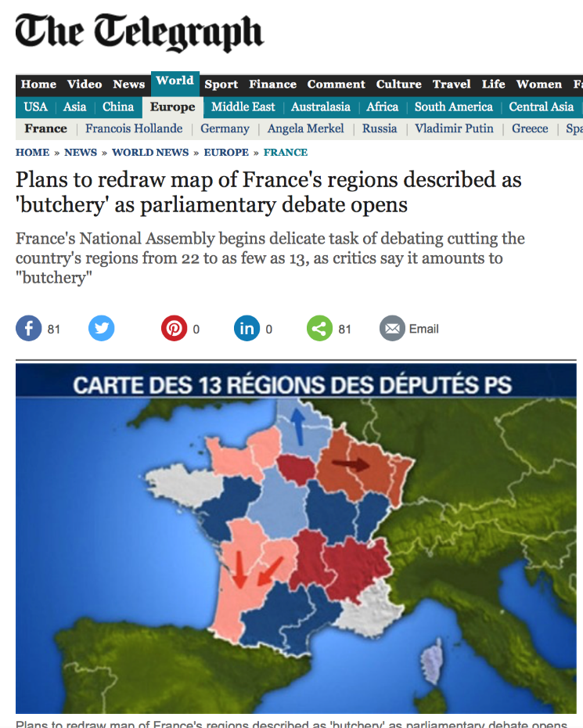
Maintaining Wikipedia:
Dbpedia & SPARQL Update to the rescue!
Use case idea:
Use mappings to update infoboxes and track pages that need updating.

Slide 57
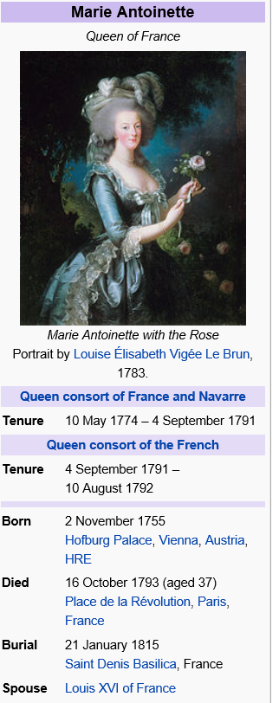
Import data from infoboxes using declarative mappings.
Respecting additional taxonomy.

Slide 58
DBPedia Mapping Types:
Page title corresponds to the subject URI.
PropertyMapping: translate infobox property names to RDF predicate names.
IntermediateNodeMapping: create auxiliary resources.
ConditionalMapping: select concept and predicate names based on a condition.
GeocoordinateMapping
DateIntervalMapping split a “from-to” string.
TableMapping (very rarely used).
Notes:
Add syntax here….

Slide 59
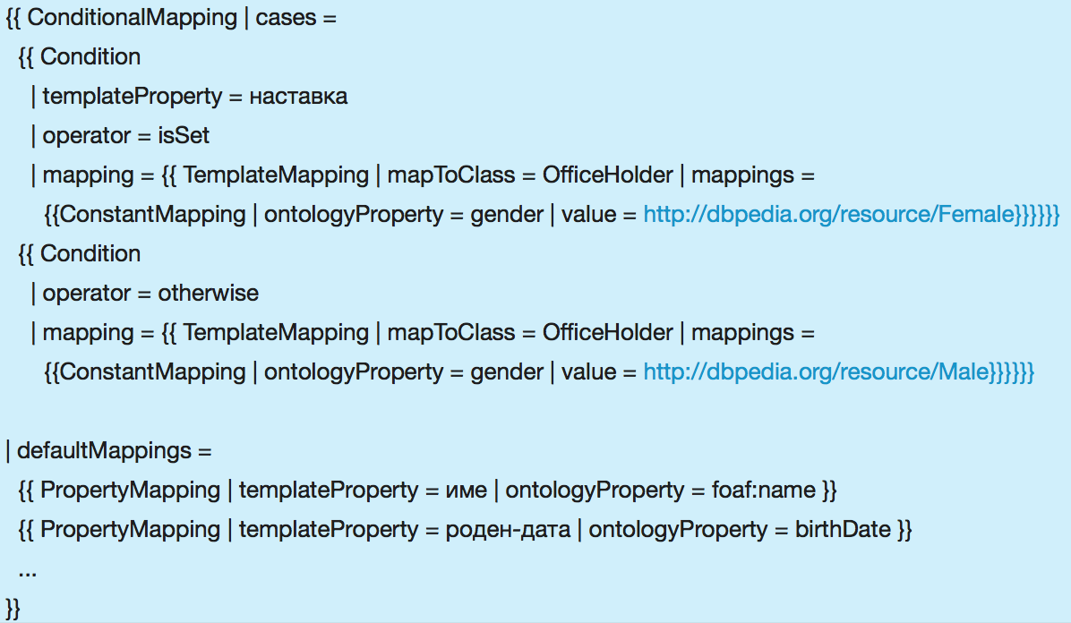
Conditional Mapping: Example
Notes:
Nastavka ... Suffix
Ime ... Name
Roden-data ... Date of birth
Mapping from Bulgarian wikipedia for persons
Like TGDs

Slide 60
Use Case 1: Translating Updates
Questions/Problems:
Does an edit lead to inconsistencies on other pages?
Is there a DBpedia update equivalent to this edit?
If yes: under which semantics?

Slide 61
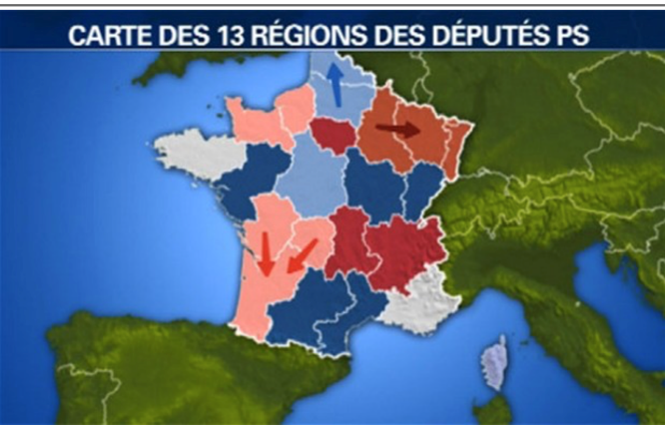
ON wikiPage=https://en.wikipedia.org/wiki/Caen
UPDATE InfoboxTemplate(French commune).region=NULL
WHERE InfoboxTemplate(French commune).region=[[Lower_Normandy]]
Use Case 2:
Batch update of wiki pages using DBpedia
DELETE { ?X :region :Upper_Normandy .
?Y :region :Lower_Normandy .}
INSERT { ?X :region :Normandy . ?Y :region :Normandy}
WHERE
{ { ?X :region :Upper_Normandy . } UNION
{ ?Y :region :Lower_Normandy . }
}
ON wikiPage=https://en.wikipedia.org/wiki/Caen
INSERT InfoboxTemplate(French commune).region=[[Normandy]]
translateDML
Match update and template properties
Dbpedia SPARQL endpoint
eval(WHERE)
Mapping en:Infobox French commune
{{TemplateMapping
| mapToClass = Settlement
| mappings =
{{ConstantMapping | ontologyProperty = country | value = France }} {{PropertyMapping | templateProperty = name | ontologyProperty = foaf:name }} {{PropertyMapping | templateProperty = region | ontologyProperty = region }} {{PropertyMapping | templateProperty = area km2 | ontologyProperty = area
| unit = squareKilometre }}
{{PropertyMapping | templateProperty = population | ontologyProperty = populationTotal }}
{{GeocoordinatesMapping | latitude = latitude | longitude = longitude }}}}
Group triples by subject
DELETE { :Rouen :region :Upper_Normandy .
:Le_Havre :region :Upper_Normandy . …
:Caen :region :Lower_Normandy .
:Bayeux :region :Lower_Normandy . … }
INSERT { :Rouen :region Normandy .
:Le_Havre :region :Normandy . …
:Caen :region :Normandy .
:Bayeux :region :Normandy . … }
Separate updates
Apply Mapping
DELETE { :Rouen :region :Upper_Normandy .
:Le_Havre :region :Upper_Normandy . …
:Caen :region :Lower_Normandy .
:Bayeux :region :Lower_Normandy . … }
{{Infobox French commune
|name = Caen
|region = Lower-Normandie
|department = Calvados
|longitude = -0.37
|latitude = 49.18
|area km2 = 25.70
|population = 108365}}
getTemplates(‘Caen’)
INSERT { :Rouen :region :Normandy .
:Le_Havre :region :Normandy . …
:Caen :region :Normandy .
:Bayeux :region :Normandy . … }

Slide 62
Conclusions
First steps to close the gap left by the current standards
(SPARQL1.1 Update vs. SPARQL1.1 Entailment Regimes)
We looked into materialized-preserving and also reduced-preserving semantics
  Focus on implementability in off-the-shelf SPARQL engines with "on-board" means
  Seemingly no “one-size fits all” semantics
  Even for RDFS only
  → Bad news: adding OWL features makes things probably worse!
  E.g. adding class inconsistency handling adds even more degrees of freedom.
  Non-intuitive corner cases in each semantics
  → depends on use case?
  Which Semantics works in practice for which use case?
    DBpedia/wikipedia updates as "real use case" is only a sketch so far.
  Which postulates are satisfied by which semantics?
    Yet Other possible semantics?
  All our semantics so far are formula-based, can a model-based semantics also be implemented in a triple store (e.g. by storing models in different named graphs?)
Take-home: SPARQL 1.1 Update, i.e. pairing DELETE and INSERT templates with a common WHERE clause (BGP matching) imposes a non-trivial challenge!

Slide 63
Prototype & Evaluation
A prototype in Java using Jena API implementing the proposed update semantics
  http://dbai.tuwien.ac.at/user/ahmeti/sparqlupdate-rewriter/index.html

