Slide 1
Integrating Open Data:
(How) Can Description Logics Help me?
Axel Polleres
web: http://polleres.net twitter: @AxelPolleres

Slide 2

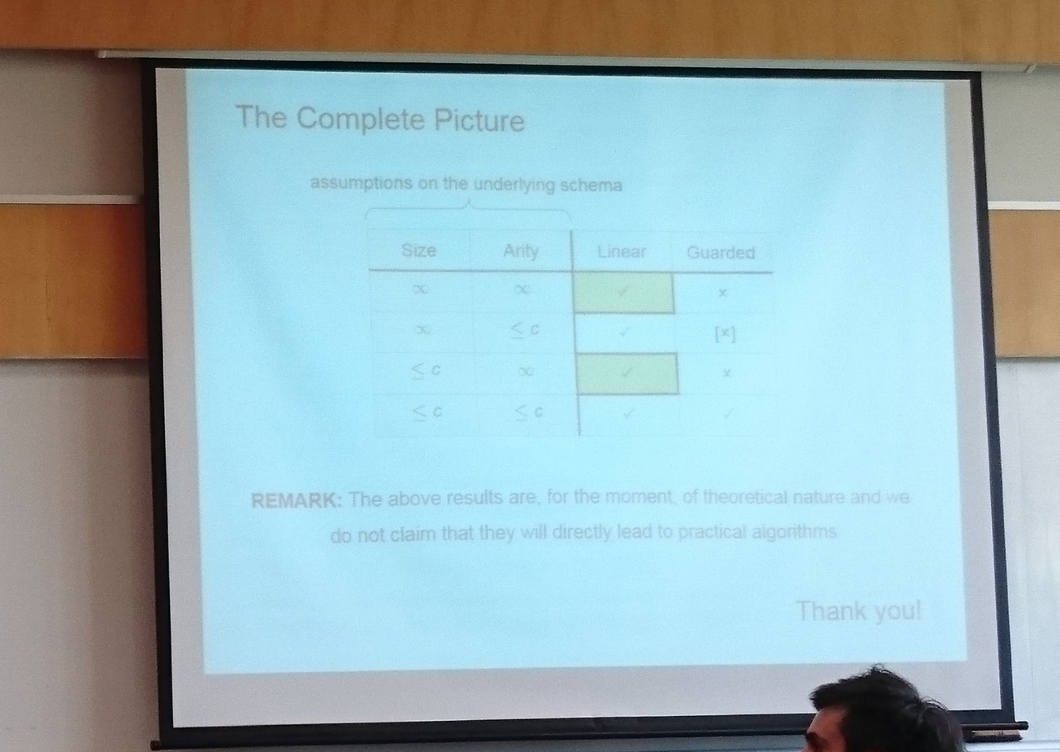
Disclaimer
REMARK: The results presented here are for the moment hardly theoretical, but rather report experiences&challenges from (trying to) apply and extend SW techniques to a practical problem

Slide 3
Integrating Open Data:
(How) Can Description Logics Help me?
Axel Polleres
web: http://polleres.net twitter: @AxelPolleres

Slide 4

What is Open Data?
Availability and Access: the data must be available as a whole and at no more than a reasonable reproduction cost, preferably by down-loading over the internet, […] in a convenient and modifiable form.
Reuse and Redistribution: the data must be provided under terms that permit reuse and redistribution including the intermixing with other datasets. The data must be machine-readable
Universal Participation: everyone must be able to use, reuse and redistribute – […] no discrimination against fields of endeavour, persons or groups. For example, no ‘non-commercial’ […]restrictions.
See more at: http://opendefinition.org/okd/
Open Knowledge Foundation
Notes:
Let me start with talking about what open data is for me... Or maybe not for me, actually there is a definition, the opendefinition by OFKN, which gives some framework.

Slide 5











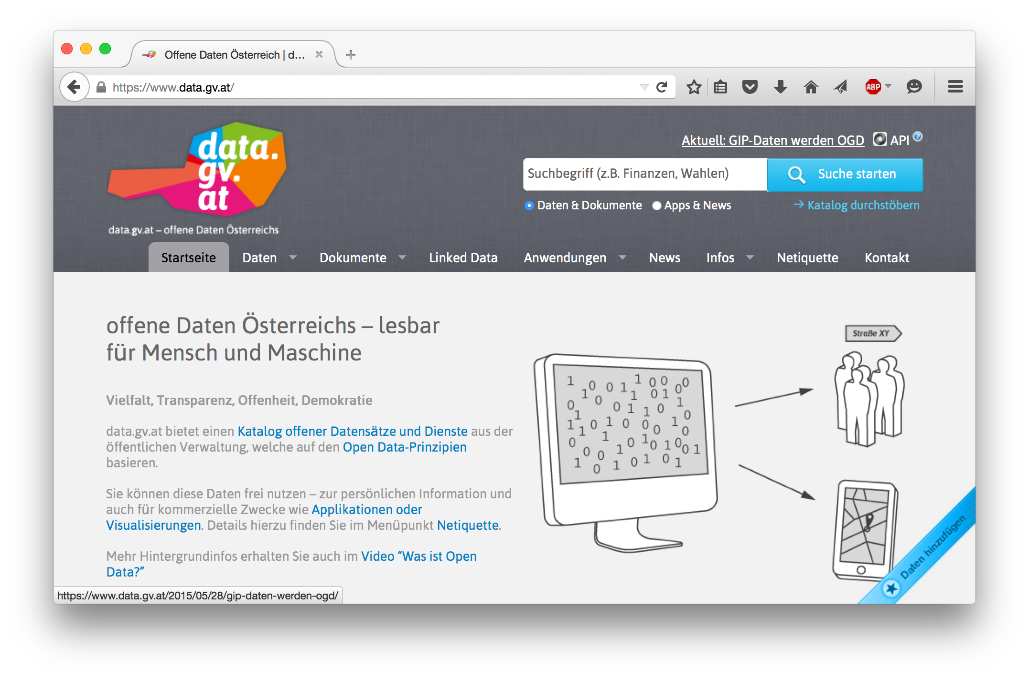
Open Data is a global trend:
    Cities, International Organizations, National and European portals, etc.:
Notes:
5

Slide 6
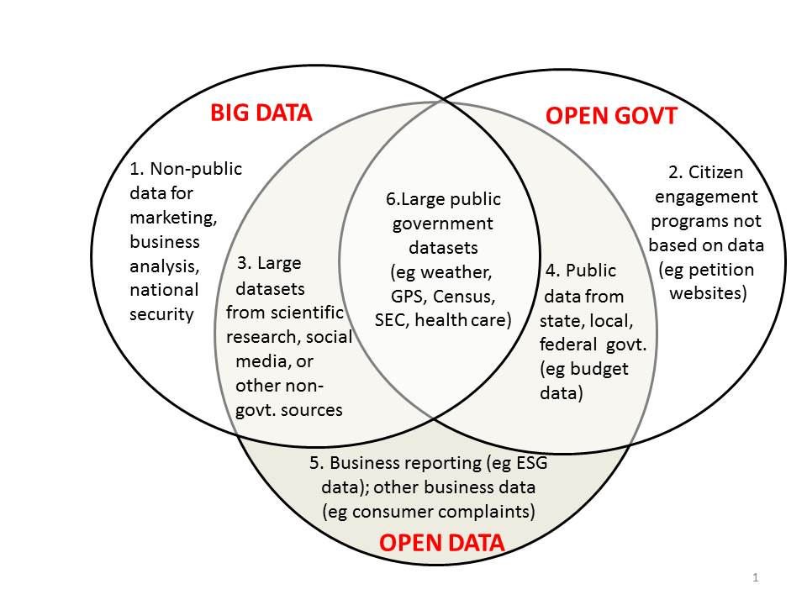
Buzzword Bingo 1/3:
Open Data vs. Big Data
http://www.opendatanow.com/2013/11/new-big-data-vs-open-data-mapping-it-out/

Slide 7

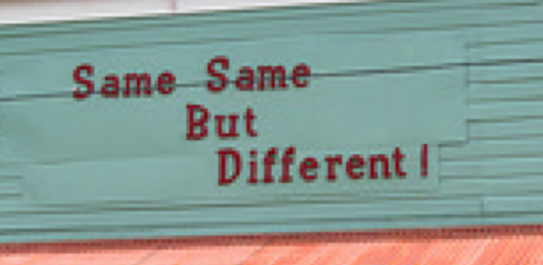

Buzzword Bingo 2/3:
Open Data vs. Big Data
Volume:
  It's growing! (we currently monitor 90 CKAN portals, 512543 resources/ 160069 datasets,
  at the moment (statically) ~1TB only CSV files...
Variety:
  different datasets (from different cities, countries, etc.), only partially comparable, partially not.
  Different metadata to describe datasets
  Different data formats
Velocity:
  Open Data changes regularly (fast and slow)
  New datasets appear, old ones disappear

Slide 8

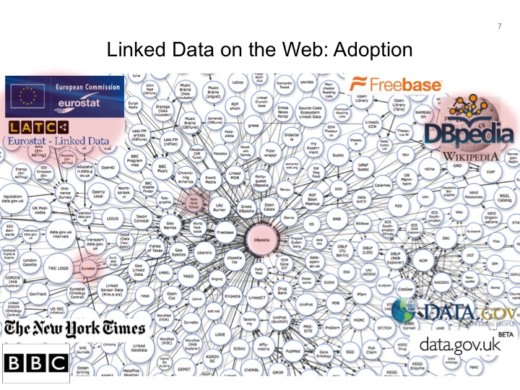
Buzzword Bingo 3/3:
Open Data vs. Linked Data
This talk is NOT about DL Reasoning over Linked Data:
Status: OWLED2013 talk …
LOD is still growing, but OD is growing much faster and challenges aren't necessarily the exactly same…
So. let's focus on Open Data in more general…
Alternatives in the meantime: (wikidata...)
LD efforts discontinued?!
LOD in OGD growing, but slowly

Slide 9

Now: Can ontological reasoning help me to integrate Open Data?
short answer: yes, but ...
long answer: no, but ...
In more detail:
  Is Open Data useful at all?
  Are ontology languages expressive enough?
  Which ontologies could I use?
  Is there enough data at all?
  How to tackle inconsistencies?
  Where to find the right data?
Notes:
In other words, there are quite some obstacles, and in this talk I'd rather like to talk about these obstacles, and probably only give starting points in how to overcome these from our own experience, tather than answering them fully.

Slide 10
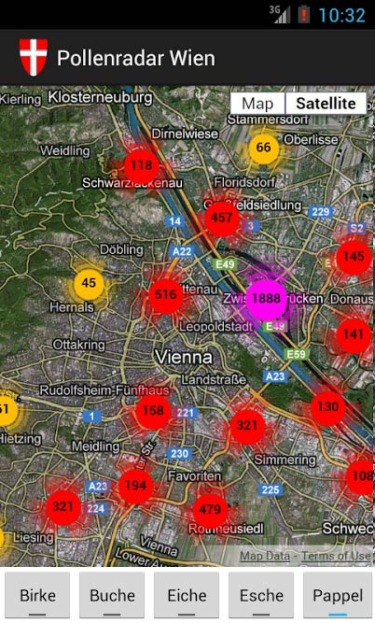
Is Open Data useful at all?
Beyond "single dataset Apps"...
Great stuff, but limited potential...

Slide 11
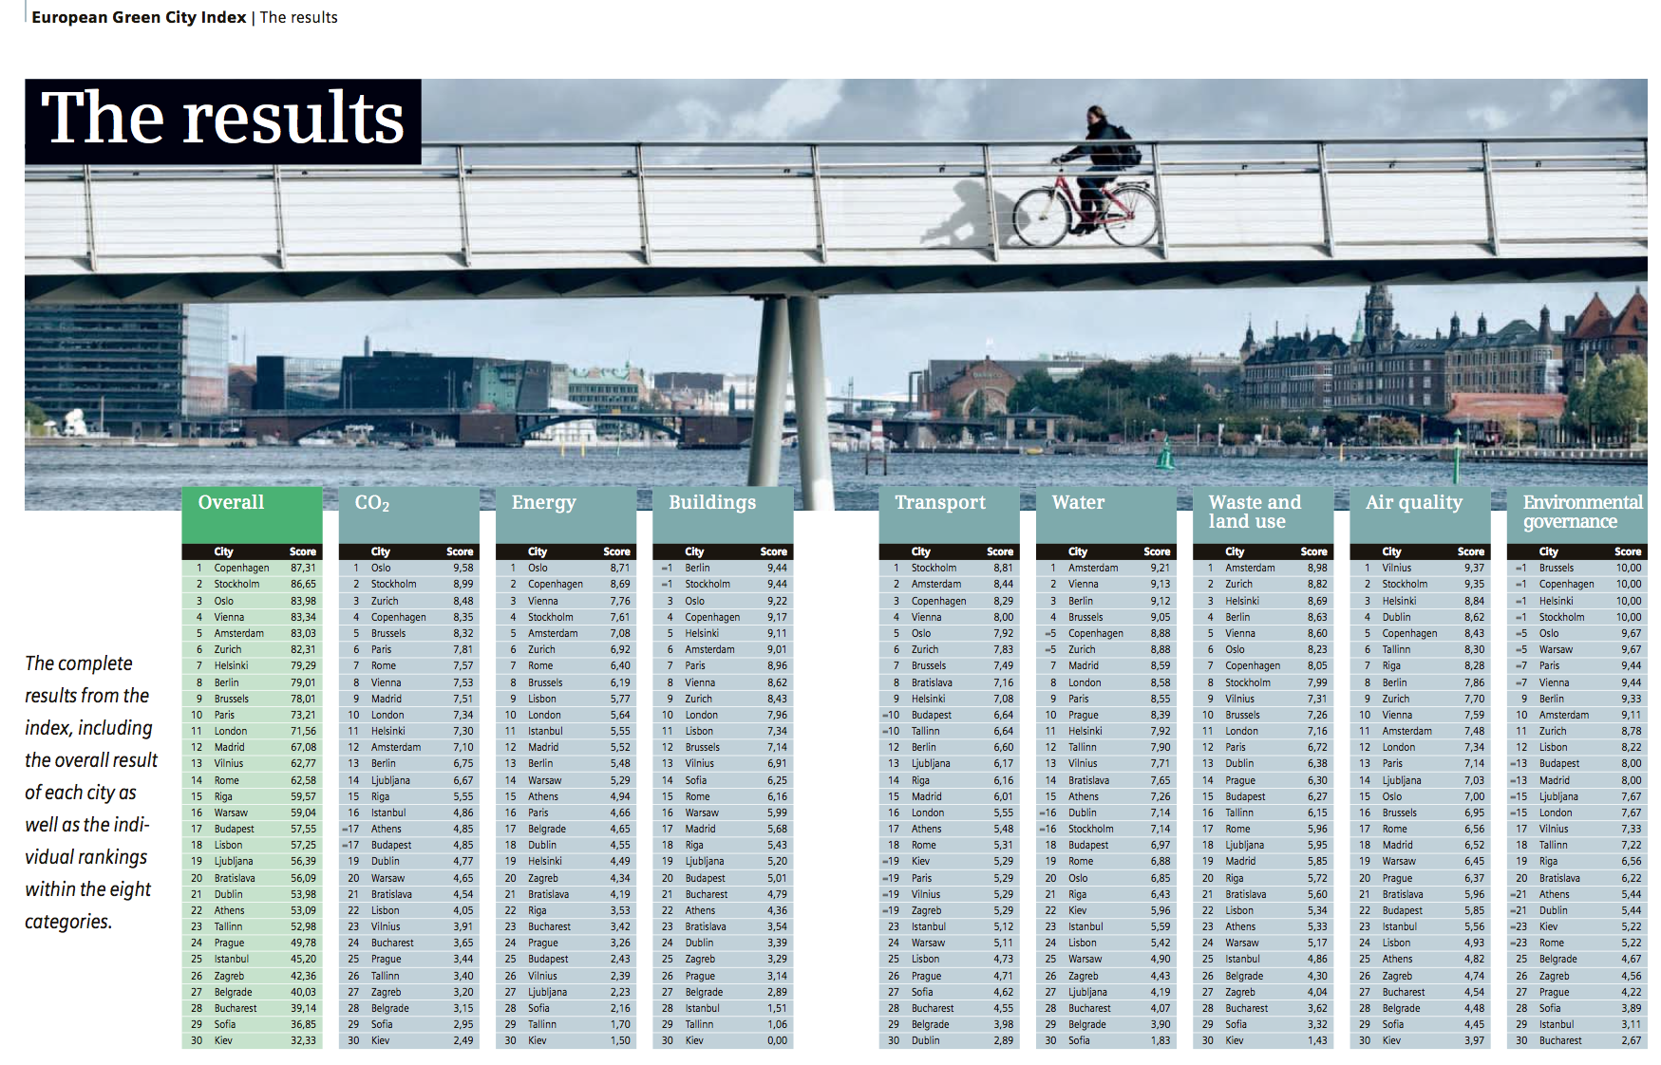
Is Open Data useful at all?
A concrete use case:
What is the population density of Athens?
What is the CO2/capita in Santiago?
What is the length of public transport in Vienna?
Overall ratings computed from (ideally most current) base indicators per cities

Slide 12
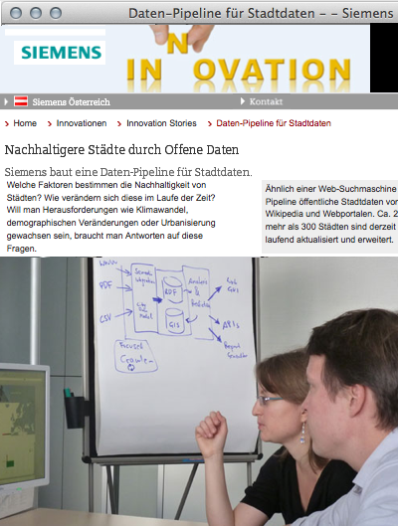
A concrete use case:
The "City Data Pipeline"
Idea – a "classic" Semantic Web use case!
Regularly integrate various relevant Open Data sources (e.g. eurostat, UNData, ...)
Make integrated data available for re-use
(How) can ontologies help me?
  Are ontology languages expressive enough?
  Which ontologies could I (re-)use?
  Is there enough data at all?
  Where to find the right data?
  How to tackle inconsistencies?

Slide 13
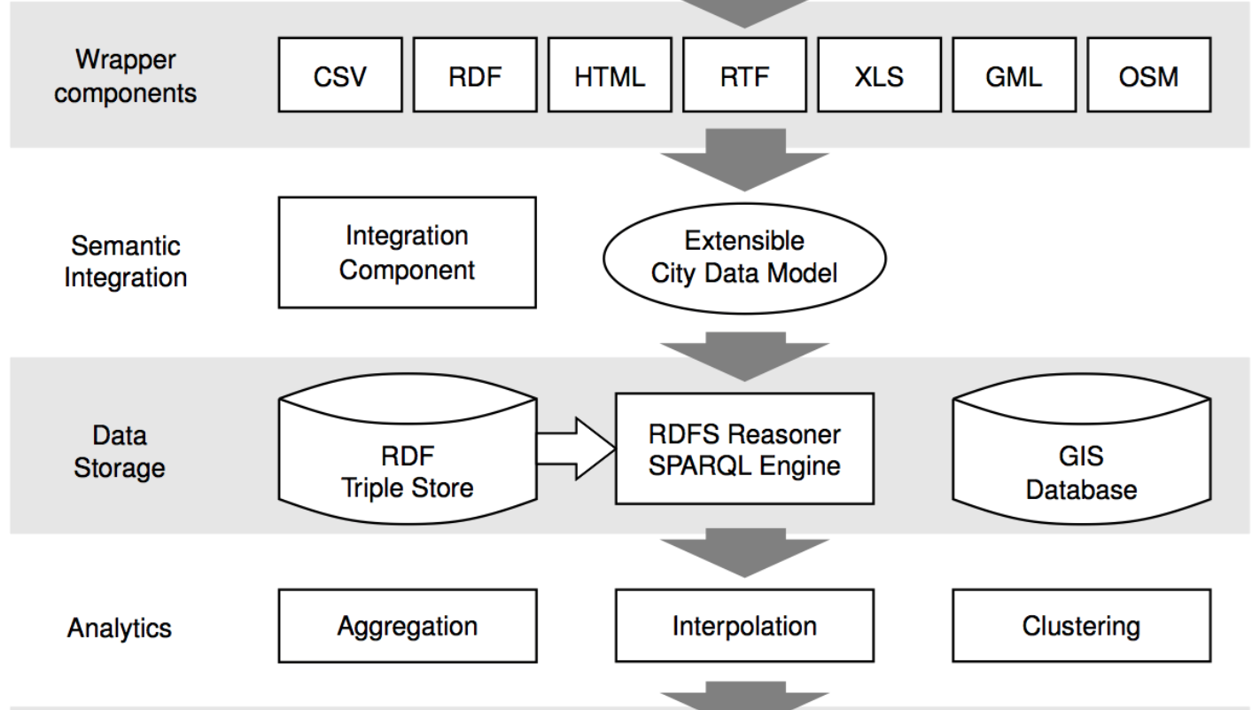


A concrete use case:
The "City Data Pipeline"
That's a standard ETL pipeline, isn't it?

Slide 14
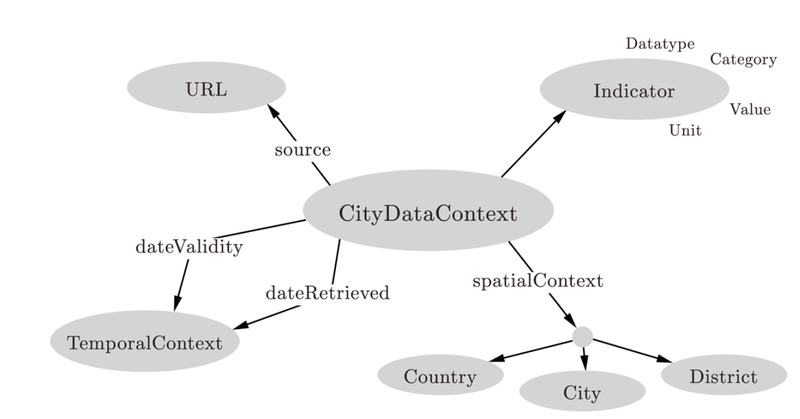
A concrete use case:
The "City Data Pipeline"
City Data Model: extensible ALH(D) ontology:
Indicators, e.g. area in km2, tons CO2/capita
Provenance
But we use and flexible Semantic integration using ontologies and reasoning!
Temporal information
Spatial context
Notes:
Side remark, may be viewed as a particular “partial knowledge graph”

Slide 15

A concrete use case:
The "City Data Pipeline"
City Data Model: extensible ALH(D) ontology:
dbpedia:areakm
:area
Indicators, e.g. area in km2, tons CO2/capita
Provenance
eurostat:area
:area
Ok, we only need role hierarchies here? Are we done?
Temporal information
Spatial context

Slide 16
A concrete use case:
The "City Data Pipeline"
City Data Model: extensible ALH(D) ontology:
Dbpedia:areakm2
:area
eurostat:area
:area
Indicators, e.g. area in km2, tons CO2/capita
Provenance
?
:populationDensity = :population/:area
:area = 0,386102 * dbpedia:areaMi2
Temporal information
Spatial context
Hmmm, not quite... Let me come up with a solution...

Slide 17
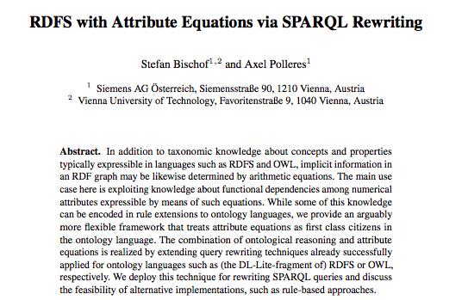
Can equational knowledge co-exist with RDFS/OWL?
ESWC2013

Slide 18
Can equational knowledge co-exist with RDFS/OWL?
Can equational knowledge co-exist with OWL?
  We need a syntax & define a formal semantics
Syntax:
Semantics:
  Requirements:
    “Fit” with common model-theoretic semantics for OWL and RDFS
    Treat equivalent equations equivalently:
:populationDensity = :population/:area
:area = 0,386102 * dbpedia:areaMi2
:populationDensity :definedByEquation “population/:area” .
:area :definedByEquation “areaMi2 * 0,386102 ” .
dbPedia:populationTotal :rdfs:subPropertyOf :population.
:area = 0,386102 * dbpedia:areaMi2
:areaMi2 = 2,589988 * :area

Slide 19


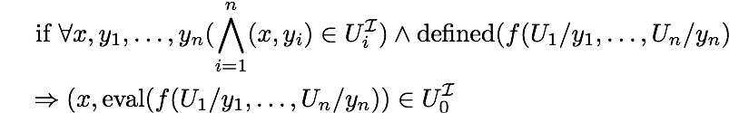
Can equational knowledge co-exist with RDFS/OWL?
₀
  An Interpretation interprets datatype properties U as binary relations between domain elements and Data-Values (for simple equations rational numbers are sufficient):
  Interpretations of inclusion axioms are as usual, e.g.
    A sub-property axiom sp
    U₁ rdfs:subPropertyOf U₂
    is satisfied in
  NEW: A property equation axiom e
    U₀ :definedByEquation “f(U₁,…U_{n})” .
    is satisfied in
  An interpretation is a model it satisfies
    all inclusion axioms
    all variants of all equation axioms
dbo:populationToTal rdfs:subPropertyOf :population .
dbr:Athens dbo:populationTotal 664046.
dbr:Athens :population 664046.
:populationDensity :definedByEquation “:population / :area” .
dbr:Athens :population 664046.
dbr:Athens :area 38.964 .
)
dbr:Athens dbo:populationDensity 17042.55 .

Slide 20
Can equational knowledge co-exist with RDFS/OWL?
₀
  An Interpretation interprets datatype properties U as binary relations between domain elements and Data-Values (for our simple equations rational numbers are sufficient):
  Interpretations of inclusion axioms are as usual, e.g.
    A sub-property axiom sp
    U₁ rdfs:subPropertyOf U₂
    is satisfied in
  NEW: A property equation axiom e
    U₀ :defineByEquation “f(U1,…U_{n})” .
    is satisfied in
  An interpretation is a model if it satisfies
    all inclusion axioms
    all variants of all equation axioms
:populationDensity :definedByEquation “:population / :area” .
dbr:Athens :population 664046.
dbr:Athens :area 0 .
)
:population :definedByEquation “:populationDensity * :area”.
:area:definedByEquation “:population / :populationDensity” .

Slide 21


Can materialization and/or query rewriting be used?
Rule-based Materialization:
dbr:Athens dbo:population 2.
dbr:Athens dbo:area 3.
dbr:Athens dbo:population 664046.
dbr:Athens dbo:area 38.964 .
dbr:Athens dbo:popDensity 0.66666666.
dbr:Athens dbo:area 3.00000000003.
dbr:Athens dbo:population 1.99999998002.
… potentially infinite values by rounding errors.
Similarly, for ambiguous values (assume 2 population values for Athens)

Slide 22
Can materialization and/or query rewriting be used?
Rewriting? Again consider clausal form of all variants of equations:
dbr:Athens dbo:Athens 664046.
dbr:Athens dbo:area 38.964 .
Finally, the resulting UCQs with assignments can be rewritten back to SPARQL using BIND
  SELECT ?PD WHERE { :Athens dbo:popDensity ?PD}
… infinite expansion even if only 1 equation is considered.
Solution: “blocking” recursive expansion of the same equation for the same value.
  SELECT ?PD WHERE { {:Athens dbo:popDensity ?PD }
  UNION
  { :Athens dbo:population ?P ; dbo:area ?A .
  BIND (?P/?A AS ?PD )}
  }

Slide 23
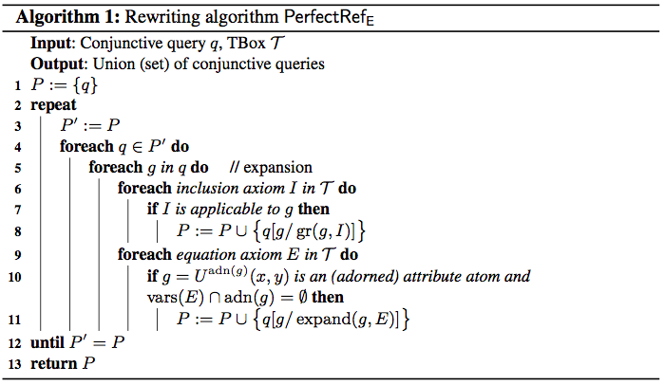
Algorithm:
“Down-stripped” version of PerfectRef [Calvanese, 2007] which handles equations by keeping “adornments” of attributes during rewriting:

Slide 24
Can materialization and/or query rewriting be used?
Rule-based Materialization:
dbr:Athens dbo:population 2.
dbr:Athens dbo:area 3.
Similar “blocking” possible in some rule systems, e.g. Jena Rules:
[ (?C :area ?A) (?C :population ?P)
notEqual(?A, 0) quotient(?P, ?A, ?PD)
noValue(?C, :populationDensity) -> (?C :populationDensity ?D)]
[ (?C :populationDensity ?PD) (?city :population ?P)
notEqual(?PD, 0) quotient(?P, ?PD, ?A)
noValue(?C, :area) -> (?city :area ?A)]
[ (?C :area ?A) (?C :populationDensity ?P) product(?A, ?PD, ?P)
noValue(?city, :population) -> (?city :population ?P)]
Side remark: Experiments in our ESWC2013 paper favor rewriting approach.

Slide 25
A concrete use case:
The "City Data Pipeline"
City Data Model: extensible ALH(D) ontology:
In more detail:
  Is Open Data useful at all?
  Are ontology languages expressive enough?
  Which ontologies could I use?
  Is there enough data at all?
  How to tackle inconsistencies?
  Where to find the right data?
Dbpedia:areakm2
:area
eurostat:area
:area
Indicators, e.g. area in km2, tons CO2/capita
Provenance
:populationDensity = :population/:area
Ok, so where do I find these equations? Is there an ontology?
:area = 0,386102 * dbpedia:areaMi2
Temporal information
Spatial context

Slide 26
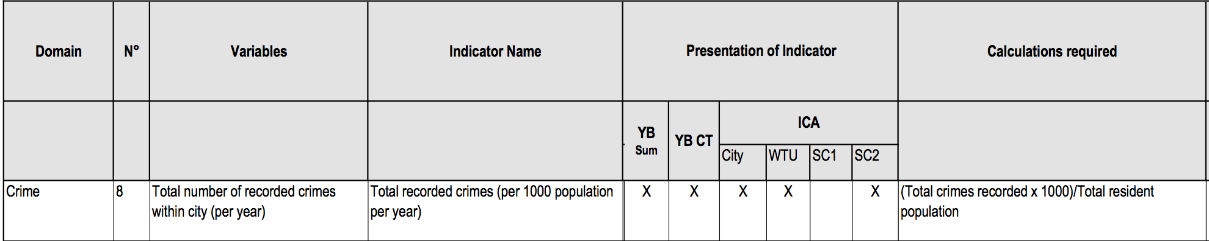
Equational knowledge:
Eurostat/Urbanaudit:
  http://ec.europa.eu/regional_policy/archive/urban2/urban/audit/ftp/vol3.pdf
Notes:
Not available as structured form, but ok, you can let a bachelor student write these down...

Slide 27
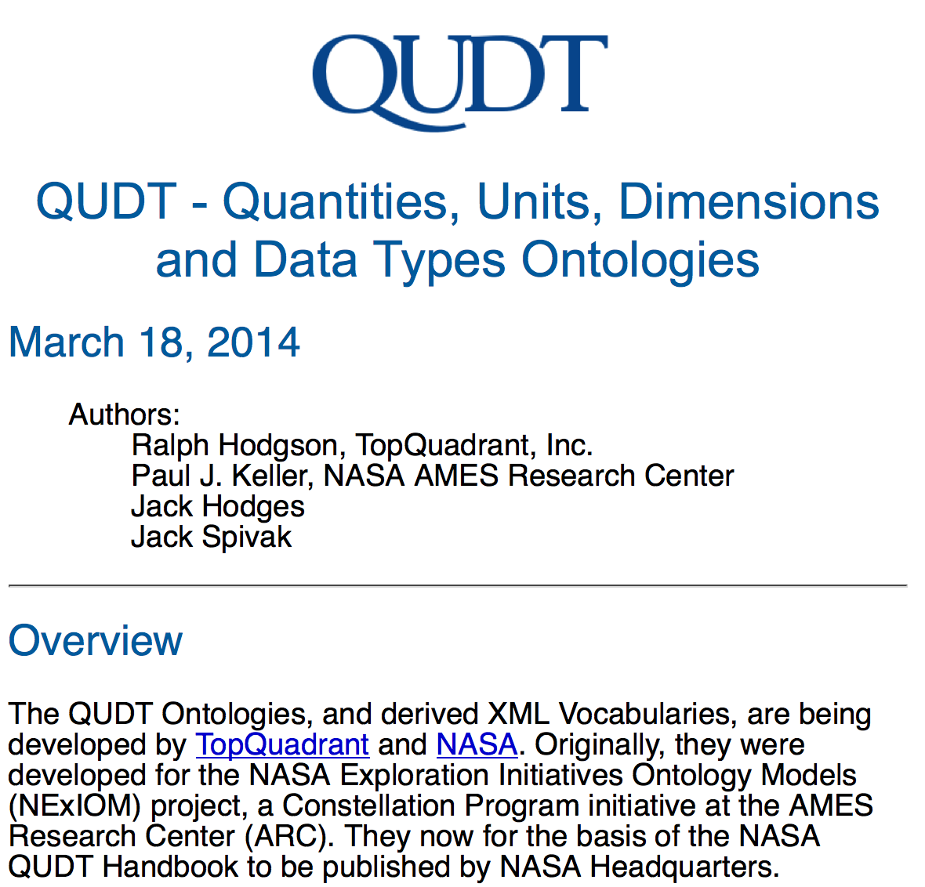
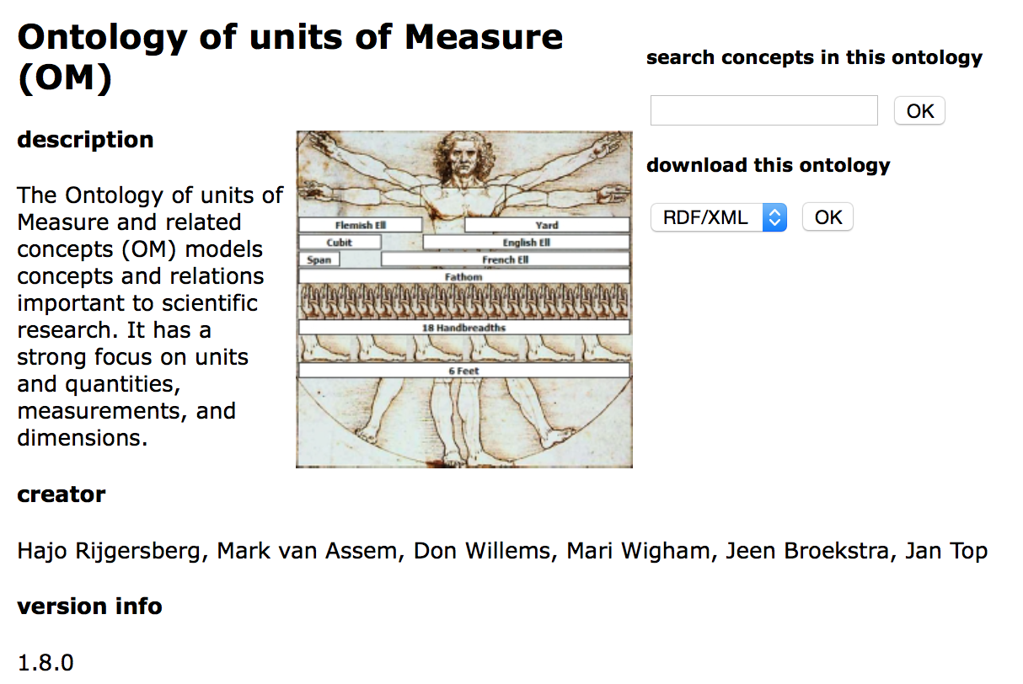
Equational knowledge:
Unit conversion
http://qudt.org/
http://www.wurvoc.org/vocabularies/om-1.8/
Notes:
Not available as structured form, but ok, you can let a bachelor student write these down...

Slide 28
A concrete use case:
The "City Data Pipeline"
City Data Model: extensible ALH(D) ontology:
Dbpedia:areakm2
:area
eurostat:area
:area
Indicators, e.g. area in km2, tons CO2/capita
Provenance
:populationDensity = :population/:area
So, are we done?
:area = 0,386102 * dbpedia:areaMi2
Temporal information
Spatial context

Slide 29
A concrete use case:
The "City Data Pipeline"
In more detail:
  Is Open Data useful at all?
  Are ontology languages expressive enough?
  Which ontologies could I use?
  Is there enough data at all?
  How to tackle inconsistencies?
  Where to find the right data?
City Data Model: extensible ALH(D) ontology:
Hmmm... Still a lot of work to do, e.g. adding aggregates for statistical data (Eurostat, RDF Data Cube Vocabulary) ... cf. [Kämpgen, 2014, PhD Thesis]
Indicators, e.g. area in km2, tons CO2/capita
:avgIncome per country is the
population-weighted average income of all its provinces.
Provenance
Temporal information
But Eurostat data is incomplete... I don't have the avg. income for all provinces or countries in the EU!
Spatial context
Hmmm...
Notes:
Integration and Analysis of Distributed Multidimensional Datasets

Slide 30
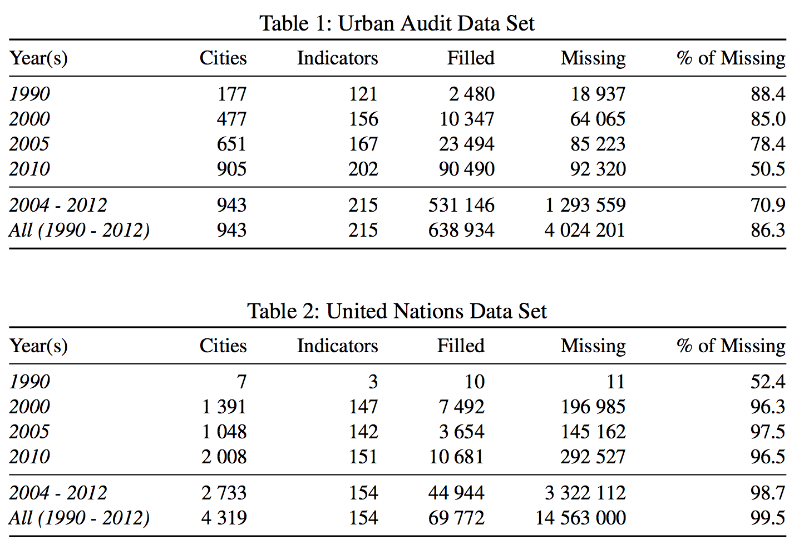
Challenge – Missing values
Found a huge amount of missing values
Two Reasons:
  Incomplete data published by providers (Tables 1+2)
  The combination of different data sets with disjoint cities and indicators

Slide 31


Integrated Open Data is very sparse
Challenges – Missing values
Individual datasets (e.g. from Eurostat) have missing values
Merging together datasets with different indicators/cities adds sparsity
Indicators
51% values missing
97% values
missing
Cities
We don’t get very far here with equations…
Let’s try ML!

Slide 32
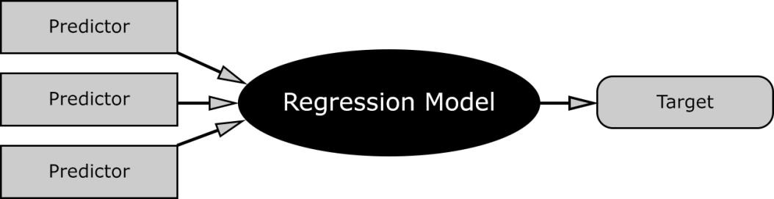
Missing Values – Hybrid approach choose best prediction method per indicator:
Our assumption: every indicator has its own
distribution and relationship to others.
Basket of „standard“ regression methods:
  K-Nearest Neighbour Regression (KNN)
  Multiple Linear Regression (MLR)
  Random Forest Decision Trees (RFD)
Let’s pick the “best method per indicator:
Validation: 10-fold cross validation
However: many/most machine learning methods need more or less complete training data! ☹

Slide 33
Approach 1: Complete subsets
For each target indicator
Find top-k predictors based on correlation matrix and form a complete subset
Apply all methods (MLR, KNN, RFD), compute RMSE% and select best method
Indicators
»
MLR
»
KNN
Cities
»
RFD
Notes:
In the first approach we try to find complete subsets of relevant indicators
We can apply this only on submatrices where we have values for all k indicators that means of course that for higher k we have less cities to train the model
We apply all three methods and select for each indicator the best method

Slide 34
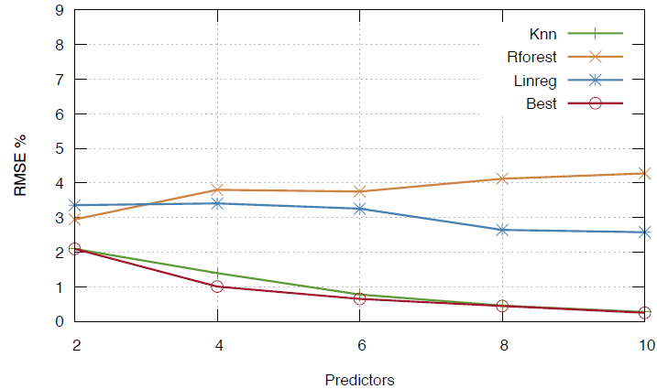
Approach 1: How many predictors needed?
Notes:
Now lets see how the different methods perform in this setting with increasing number of predictors
First we see that with Random forrest and increasing number of predictors the method gets even worse because as mentionend before the training set gets very small and thus we get overfitting
Usually KNN is in this setting the best method as the red line for the best method is nearly always on top of the line for KNN
The good news is that the for the combination of selecting the best method for each indicator we arrive at a very low RMSE, less than 1%.
The problem of this approach is that we can predict only very few indicators

Slide 35
Approach 2:
Principal components
Fill in missing values with neutral values wrt. PCA [Roweis’97]
For each target indicator
Find top-k predictors among the PCs based on correlation matrix
Again: apply MLR, KNN,RFD → compute RMSE% → select the best method
Indicators
Principal components
»
MLR
»
»
KNN
Cities
»
RFD
Notes:
The idea to predict more indicators is to generate new features with principal component analysis.
In a Regularized iterative PCA introduced by Roweis 97 the missing values are first filled in with neutral values wrt. To The folloging PCA.
This approach allows us to fill in all the values and not only a small subset as before .
We then use the principal components we use the as training data for all three methods and again select the best method

Slide 36
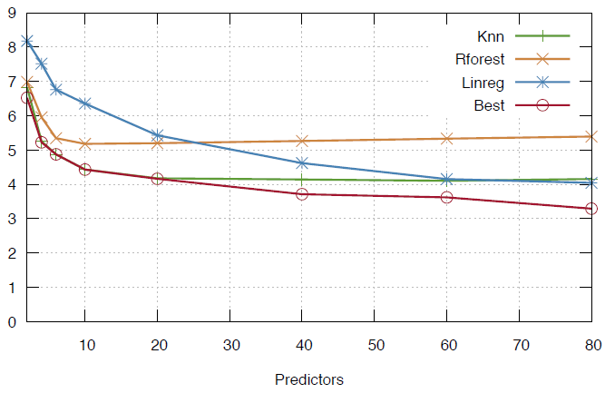
Approach 2: How many predictors needed?
Notes:
First we see that the error measures are worse than for the first approach based on complete subsets
But as I said before the advantage of this approach is that we can predict all indicators.
We can also see that the best method for up to 20 predictors is again KNN, but for a higher number of predictors the linear regression model is also selected as best method for more and more indicators
So combining different methods for different indicators pays off.
For 80 predictors we end up with an average error rate of nearly 3%

Slide 37
Cross-dataset prediction 1/2:
(How) can this be used for cross-dataset prediction?
Indicators
Cities
Notes:
Note that so far we have considered the whole thing as an integrated single dataset.
Now lets focus on these white spots specifially
The question is: can we predict the indicators of eurostat for cities that are not in europoe, the green arrow, or the un indicators for cities which are only in eurostat the blue arrow
We again used aproach 2 to fill in the missing values of a single dataset and use that as training set for the indicatosr of the other dataset.

Slide 38
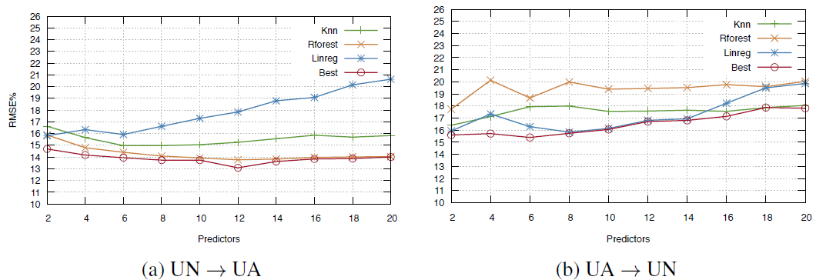
Cross-dataset prediction 2/2:
(How) useful is this all for cross-dataset prediction?
Con:
Not great ☹.... Avg. RMSE for both directions over 10%
Could transfer a "bias" from one dataset's context to the other
Pro:
for some indicators it worked quite well ☺
Notes:
Lets have a look at the error measure.
On the left we see the performance of the models predicting eurostat data from un data
Linear regression gets worse with more predictors.
The best method stays at about the same level even when increasing numbers of predictors around 14%
On the right we see the other direction: prediction un data from eurostat
The error gets actually worse with increasing number of indicators.
This is probably due to the bias introduced because eurostat contains only european cities while un contains cities worldwide

Slide 39
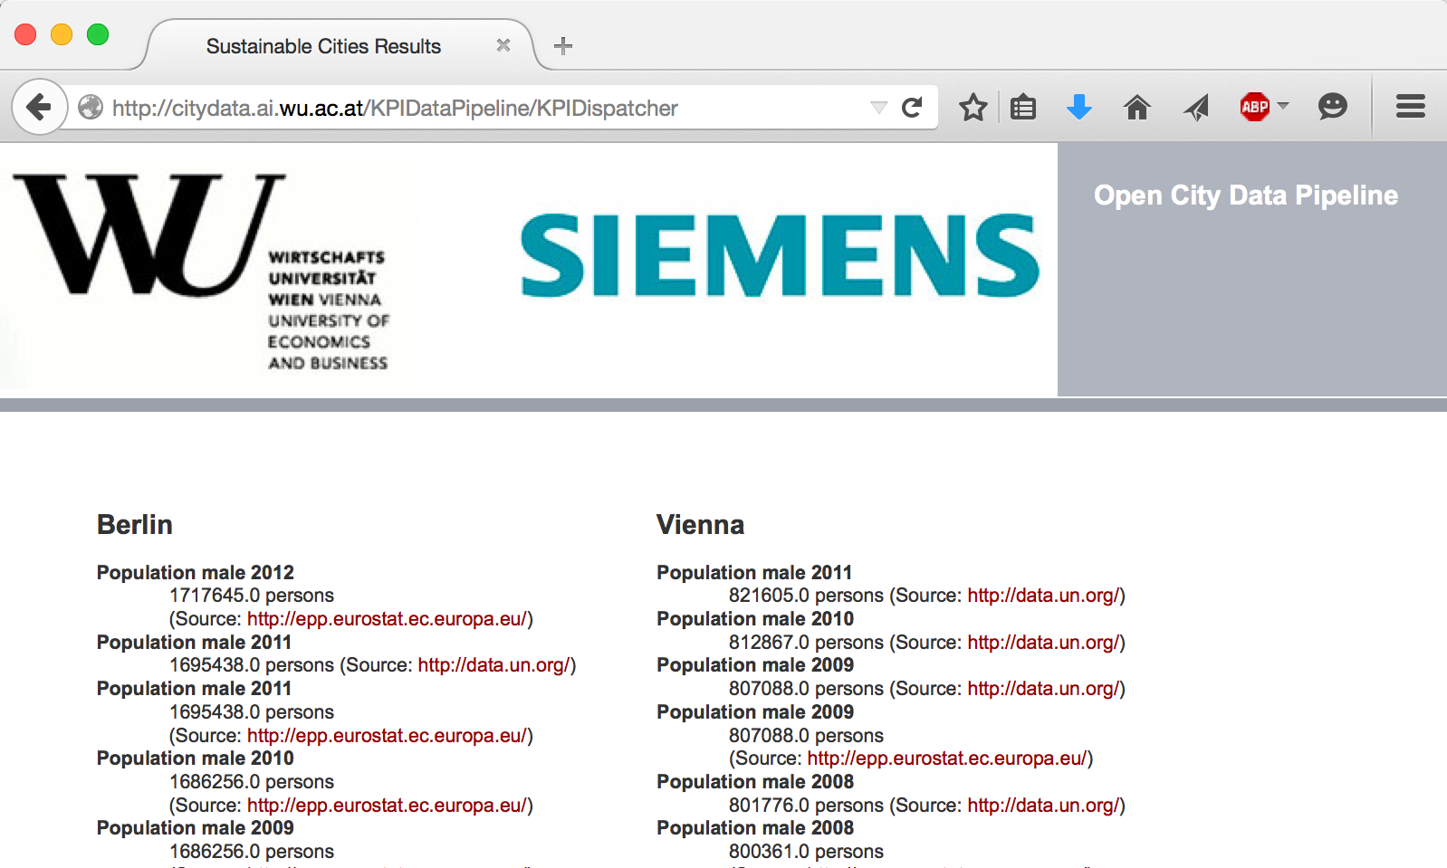

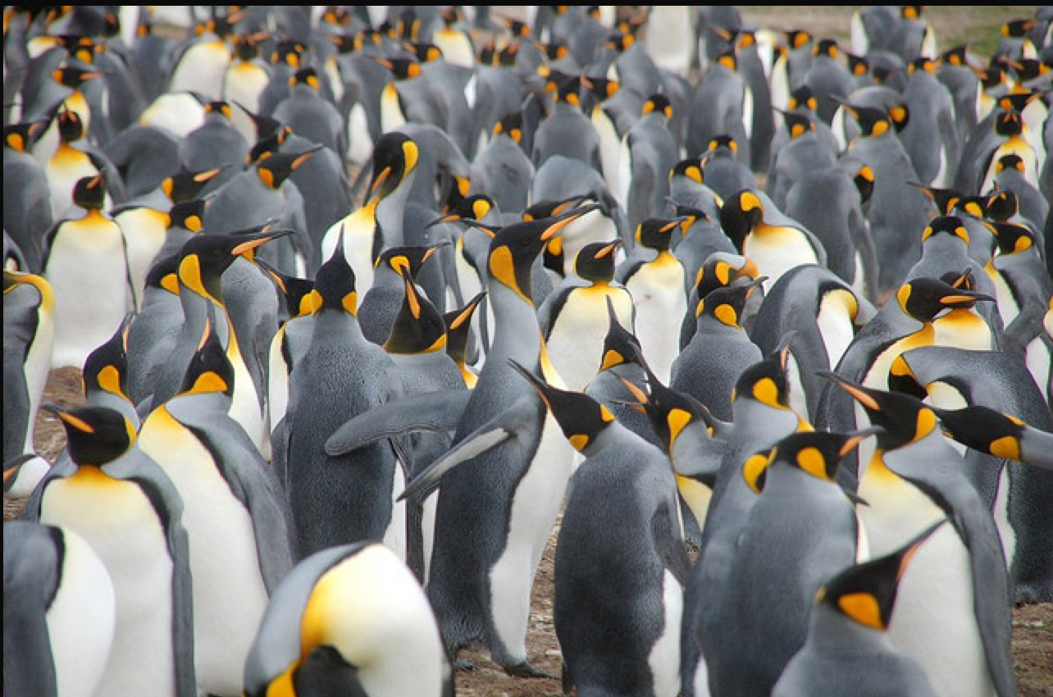
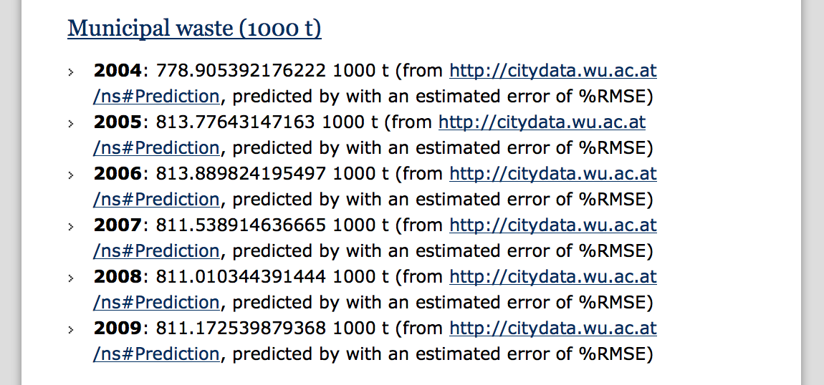
City Data Pipeline
citydata.wu.ac.at
Search for indicators & cities
obtain results incl. sources
Integrated data served as Linked Data
Predicted values AND estimated error (RMSE) for missing data...
...it‘s not finished, but:
Assumption: Predictions get better, the more Open data we integrate...
Open Data: The more, the merrier!

Slide 40
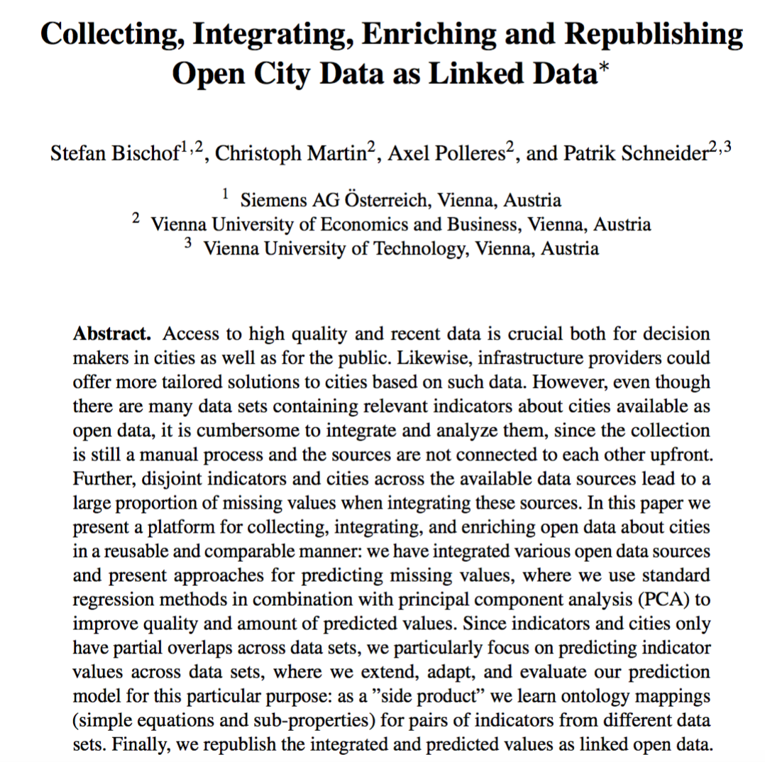
More Details:
So, are we done?
ISWC2015

Slide 41
Lesson(s) learnt?
Hmmm, still, lots of open challenges!
Time series analysis is necessary
Open Data is incomparable
Still not great coverage of all available sources
Open Data Quality is an issue
Still unanswered:
  Is Open Data useful at all?
  Are ontology languages expressive enough?
  Is there enough data at all?
  Which ontologies could I use?
  How to tackle inconsistencies?
  Where to find the right data?

Slide 42



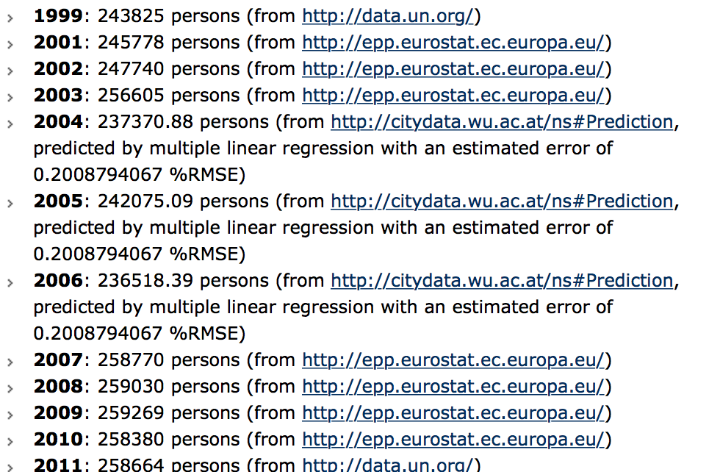
Time series analysis is necessary
  Predictions on time series are partially very bad at the moment:
  Most of the data we look at is time series data/data changing over time.

Slide 43
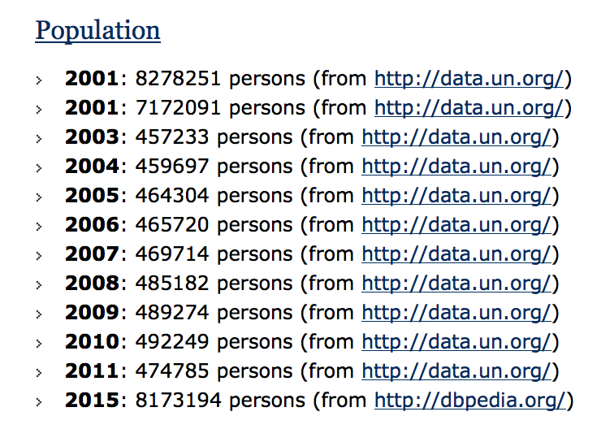
Open Data is incomparable
More surprising maybe, how much obviously weird data you find:
  Inconsistencies across and within datasets
  ... *partially* an entity consolidation issue.

Slide 44

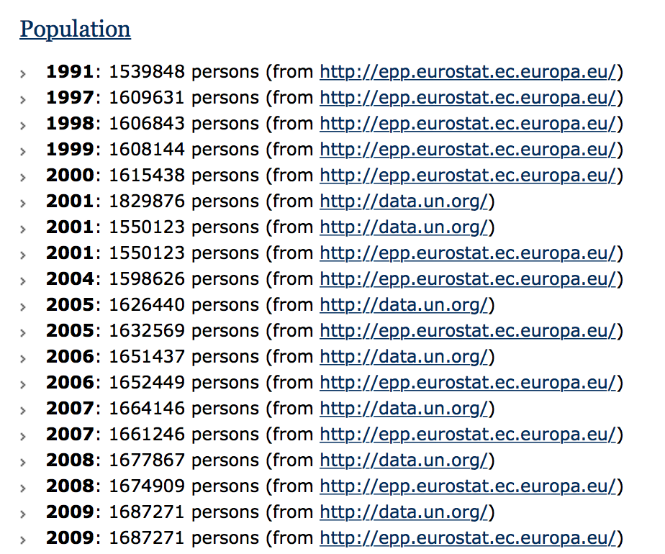
Open Data is incomparable
More surprising maybe, how much obviously weird data you find:
  Inconsistencies across and within datasets
  Still, some datasets match quite well on certain indicators
  Open: (How) can we exploit this?
  → Ontology learning!
Notes:
Ontology learning, what we started looking into now was learning correlations ... Linear equations come "for free" with our completion/prediction method.

Slide 45
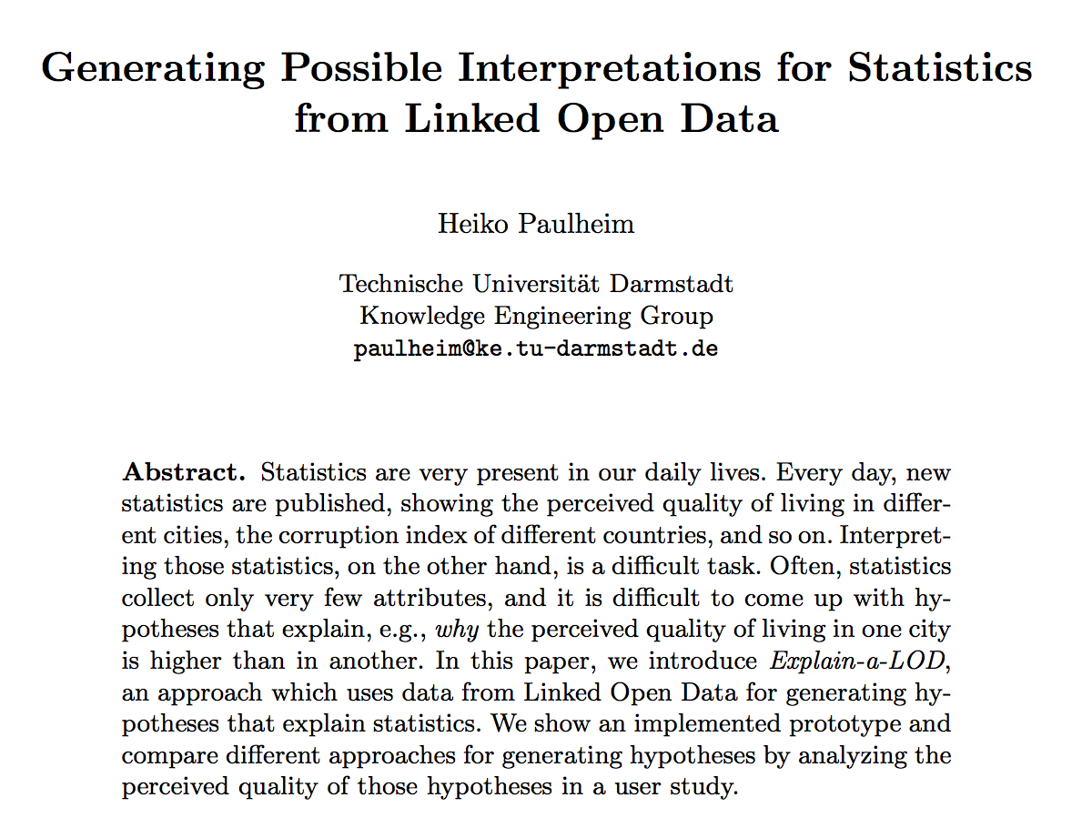
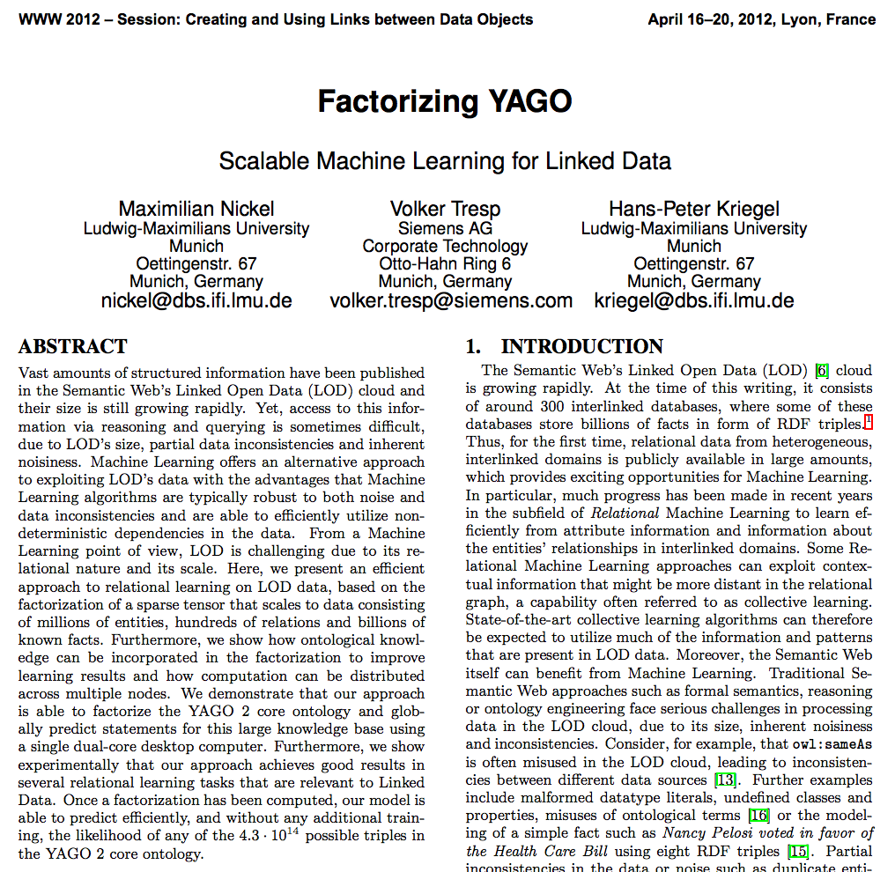
Worthwhile related work to look at... Paulheim, 2012 (ESWC), Nickel et al. 2012 (WWW)

Slide 46
Lesson(s) learnt?
Hmmm, still, lots of open challenges!
Time Series analysis is necessary
Open Data is incomparable
Open Data Quality is an issue
Still unanswered:
  Is Open Data useful at all?
  Are ontology languages expressive enough?
  Is there enough data at all?
  Which ontologies could I use?
  How to tackle inconsistencies?
  Where to find the right data?

Slide 47
Data Quality issues:
Missing data
Outdated data
Wrong data
Ambiguous Data
Wrong meta-data
Data source offline/not reachable
Open Data portals not searchable
Some harder, some easier to detect…
Some harder, some esier to fix.
Notes:
In the previous challenge, we have "solved" this by pretty much manually integrating a carefully chosen set of data sources, but not used Open Data portals to automatically find the right data sources...

Slide 48
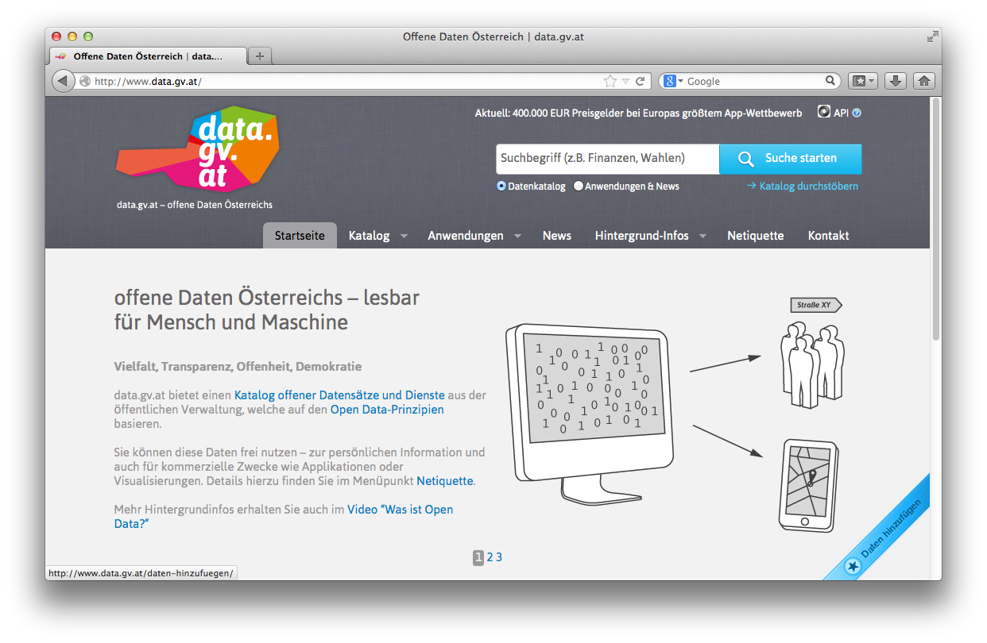
Open Data Portals
CKAN ... http://ckan.org/
almost „de facto“ standard for Open Data Portals
facilitates search, metadata (publisher, format, publication date, license, etc.) for datasets
http://datahub.io/
http://data.gv.at/
machine-processable? ...
... partially

Slide 49
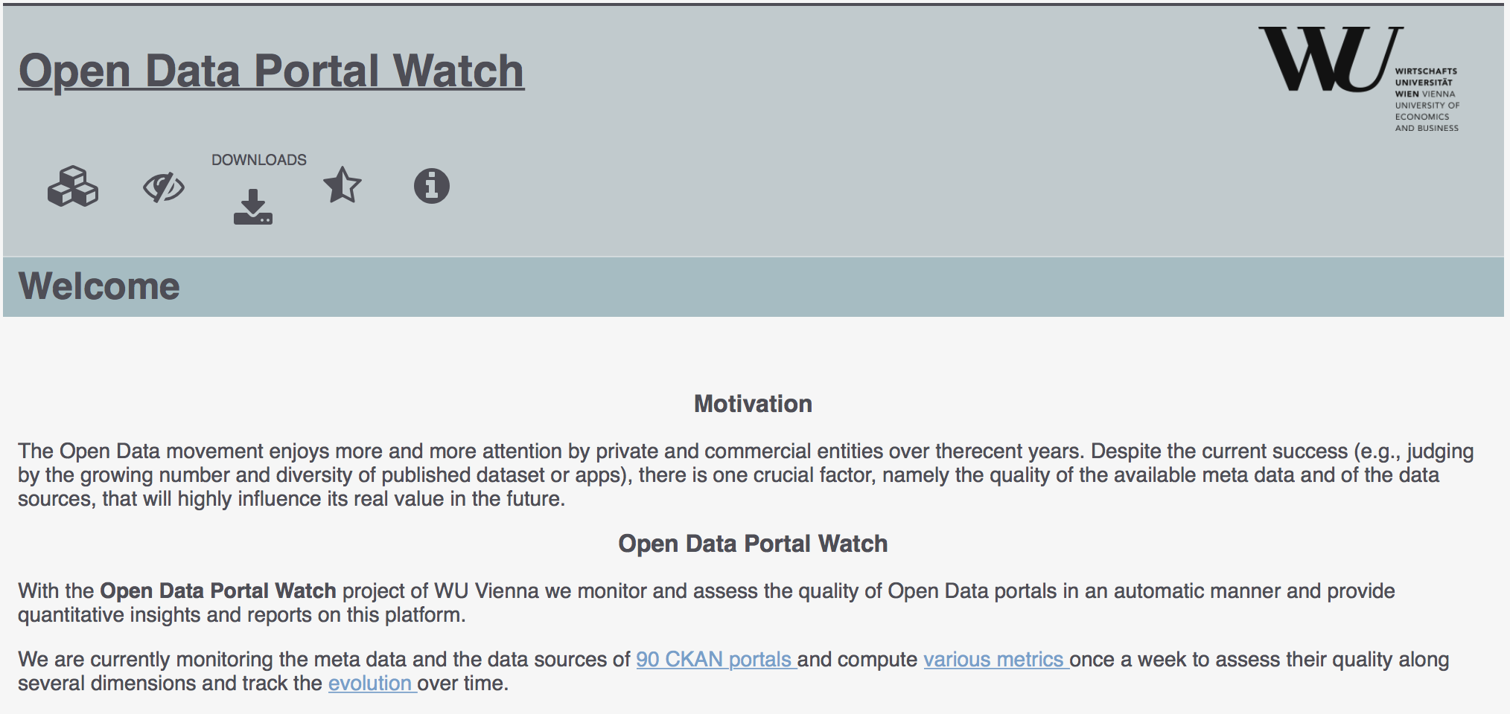
OPEN DATA PORTAL WATCH
… a first step.
http://data.wu.ac.at/portalwatch/
Periodically monitoring 250+ Open Data Portals
  (146 CKAN, 102 Socrata, 11 OpenDataSoft)
Quality assessment
Evolution tracking
  Meta data
  Formats
  Data
  Overlaps
  …

Slide 50
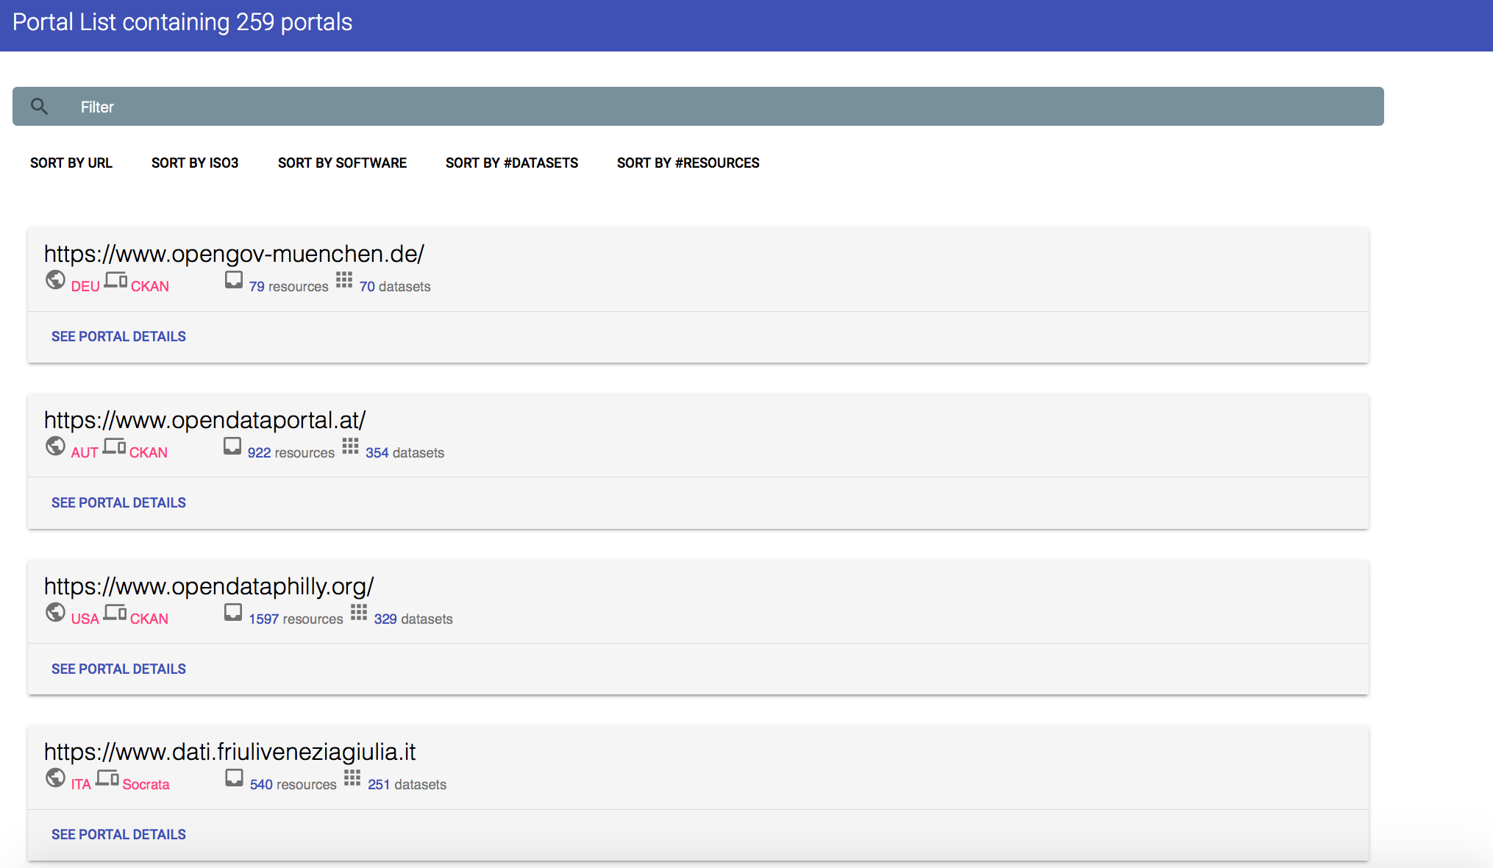
Open Data Portal list

Slide 51
QUALITY DIMENSIONS
DIMENSION | DESCRIPTION
Retrievability | The extent to which meta data and resources can be retrieved.
Usage | The extent to which available meta data keys are used to describe a dataset.
Completeness | The extent to which the used meta data keys are non empty.
Accuracy | The extent to which certain meta data values accurately describe the resources.
Openness | The extent to which licenses and file formats conform to the open definition.
Contactability | The extent to which the data publisher provide (machine-processable) contact information.
Objective measures which can be automatically computed in a scalable way

Slide 52
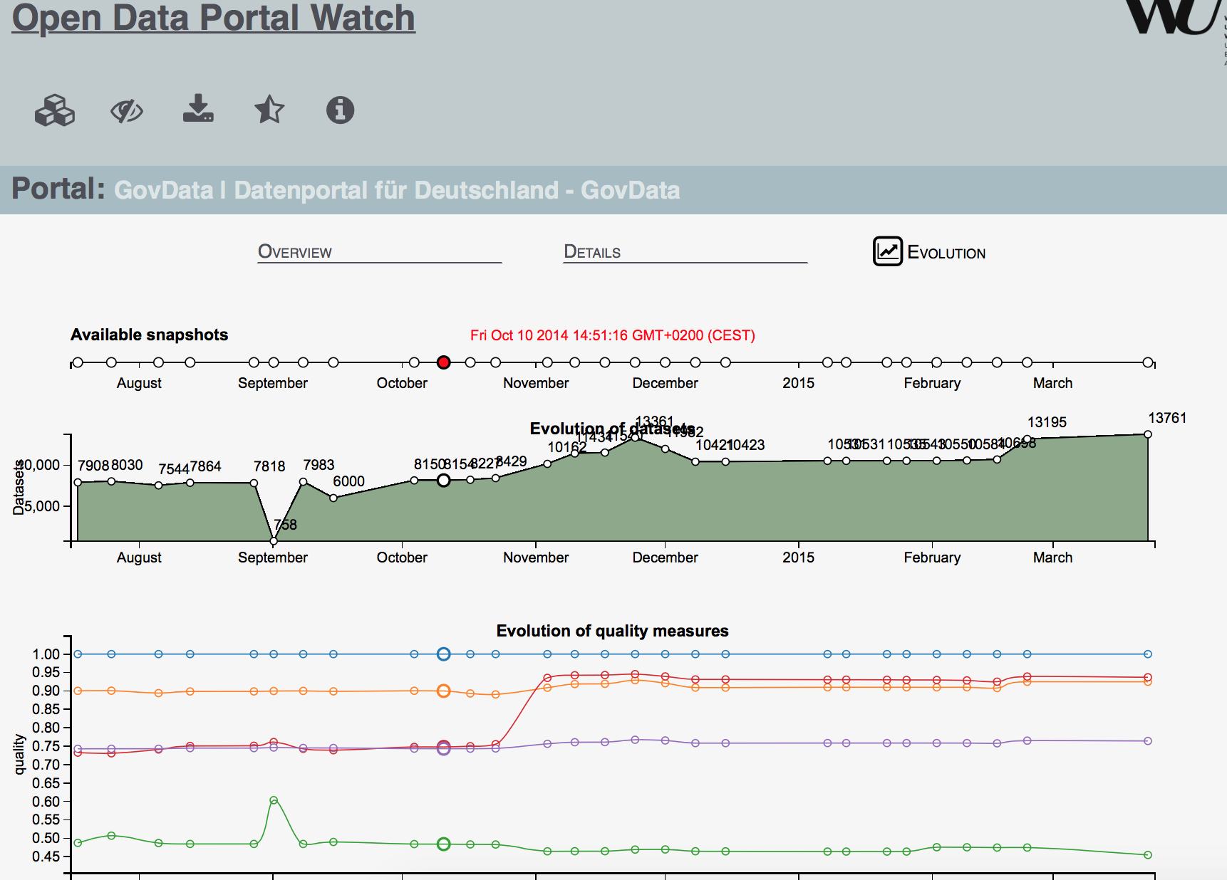
ODP Evolution

Slide 53
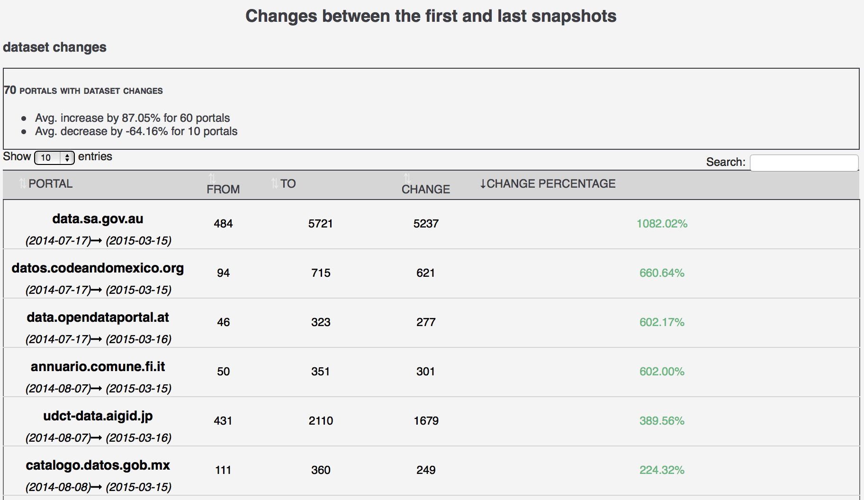
ODP CHANGES

Slide 54
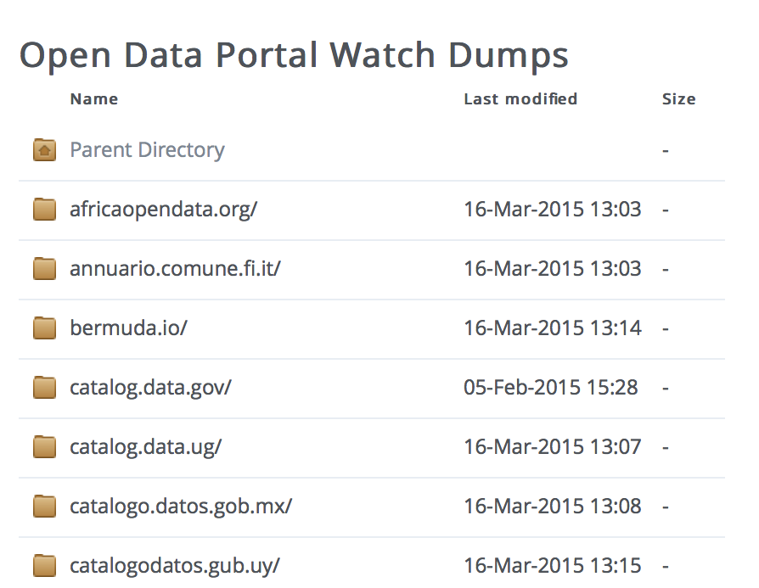
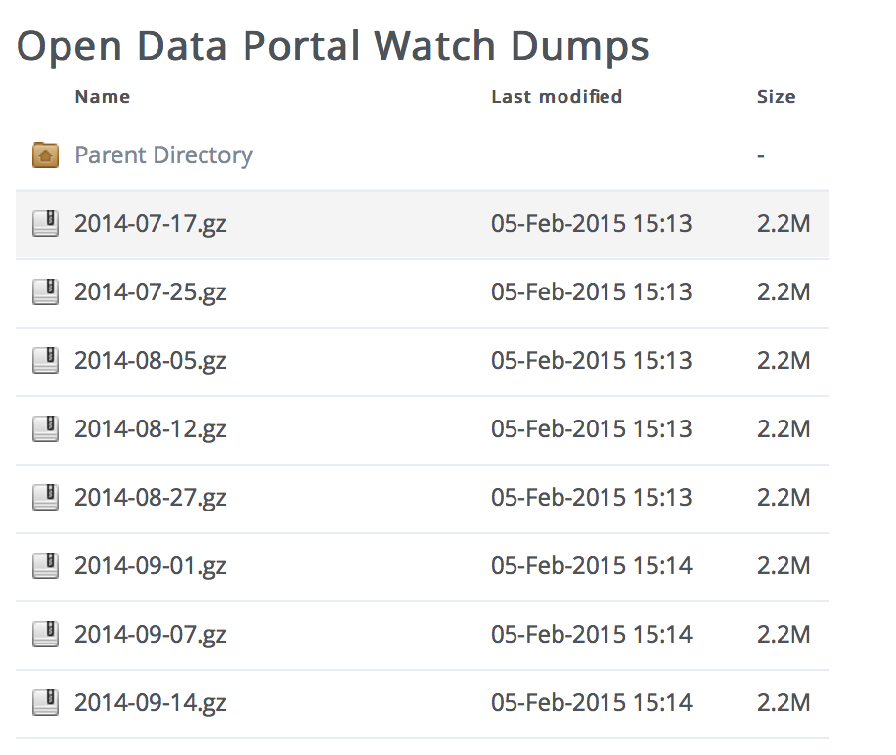
Data Dumps
OPEN DATA PORTAL WATCH provides an archive of Open Data portal crawls (weekly snapshots/dynamic crawling framework):

Slide 55
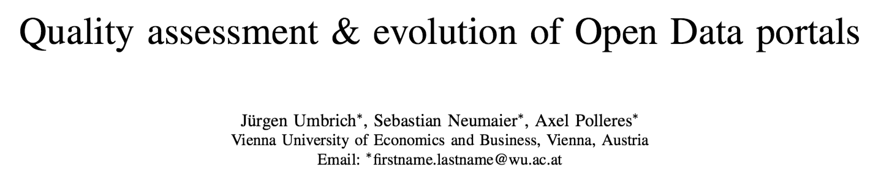
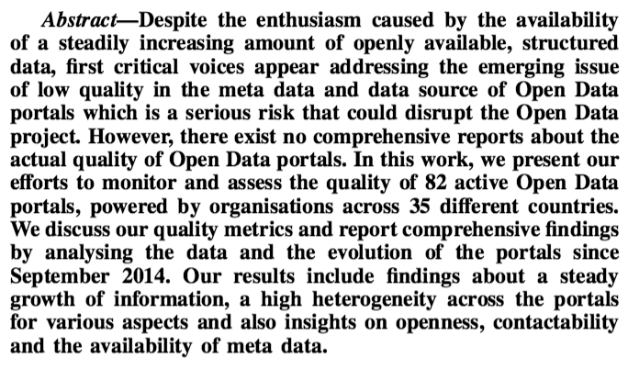
Open Data Portal Watch
IEEE OBD2015
http://data.wu.ac.at/portalwatch/
Key findings:
  Significantly varying quality acrosss portals
  Rapid growth for some portals
  Huge variety and range of datasets
  Open Data Portal search is a big problem.

Slide 56
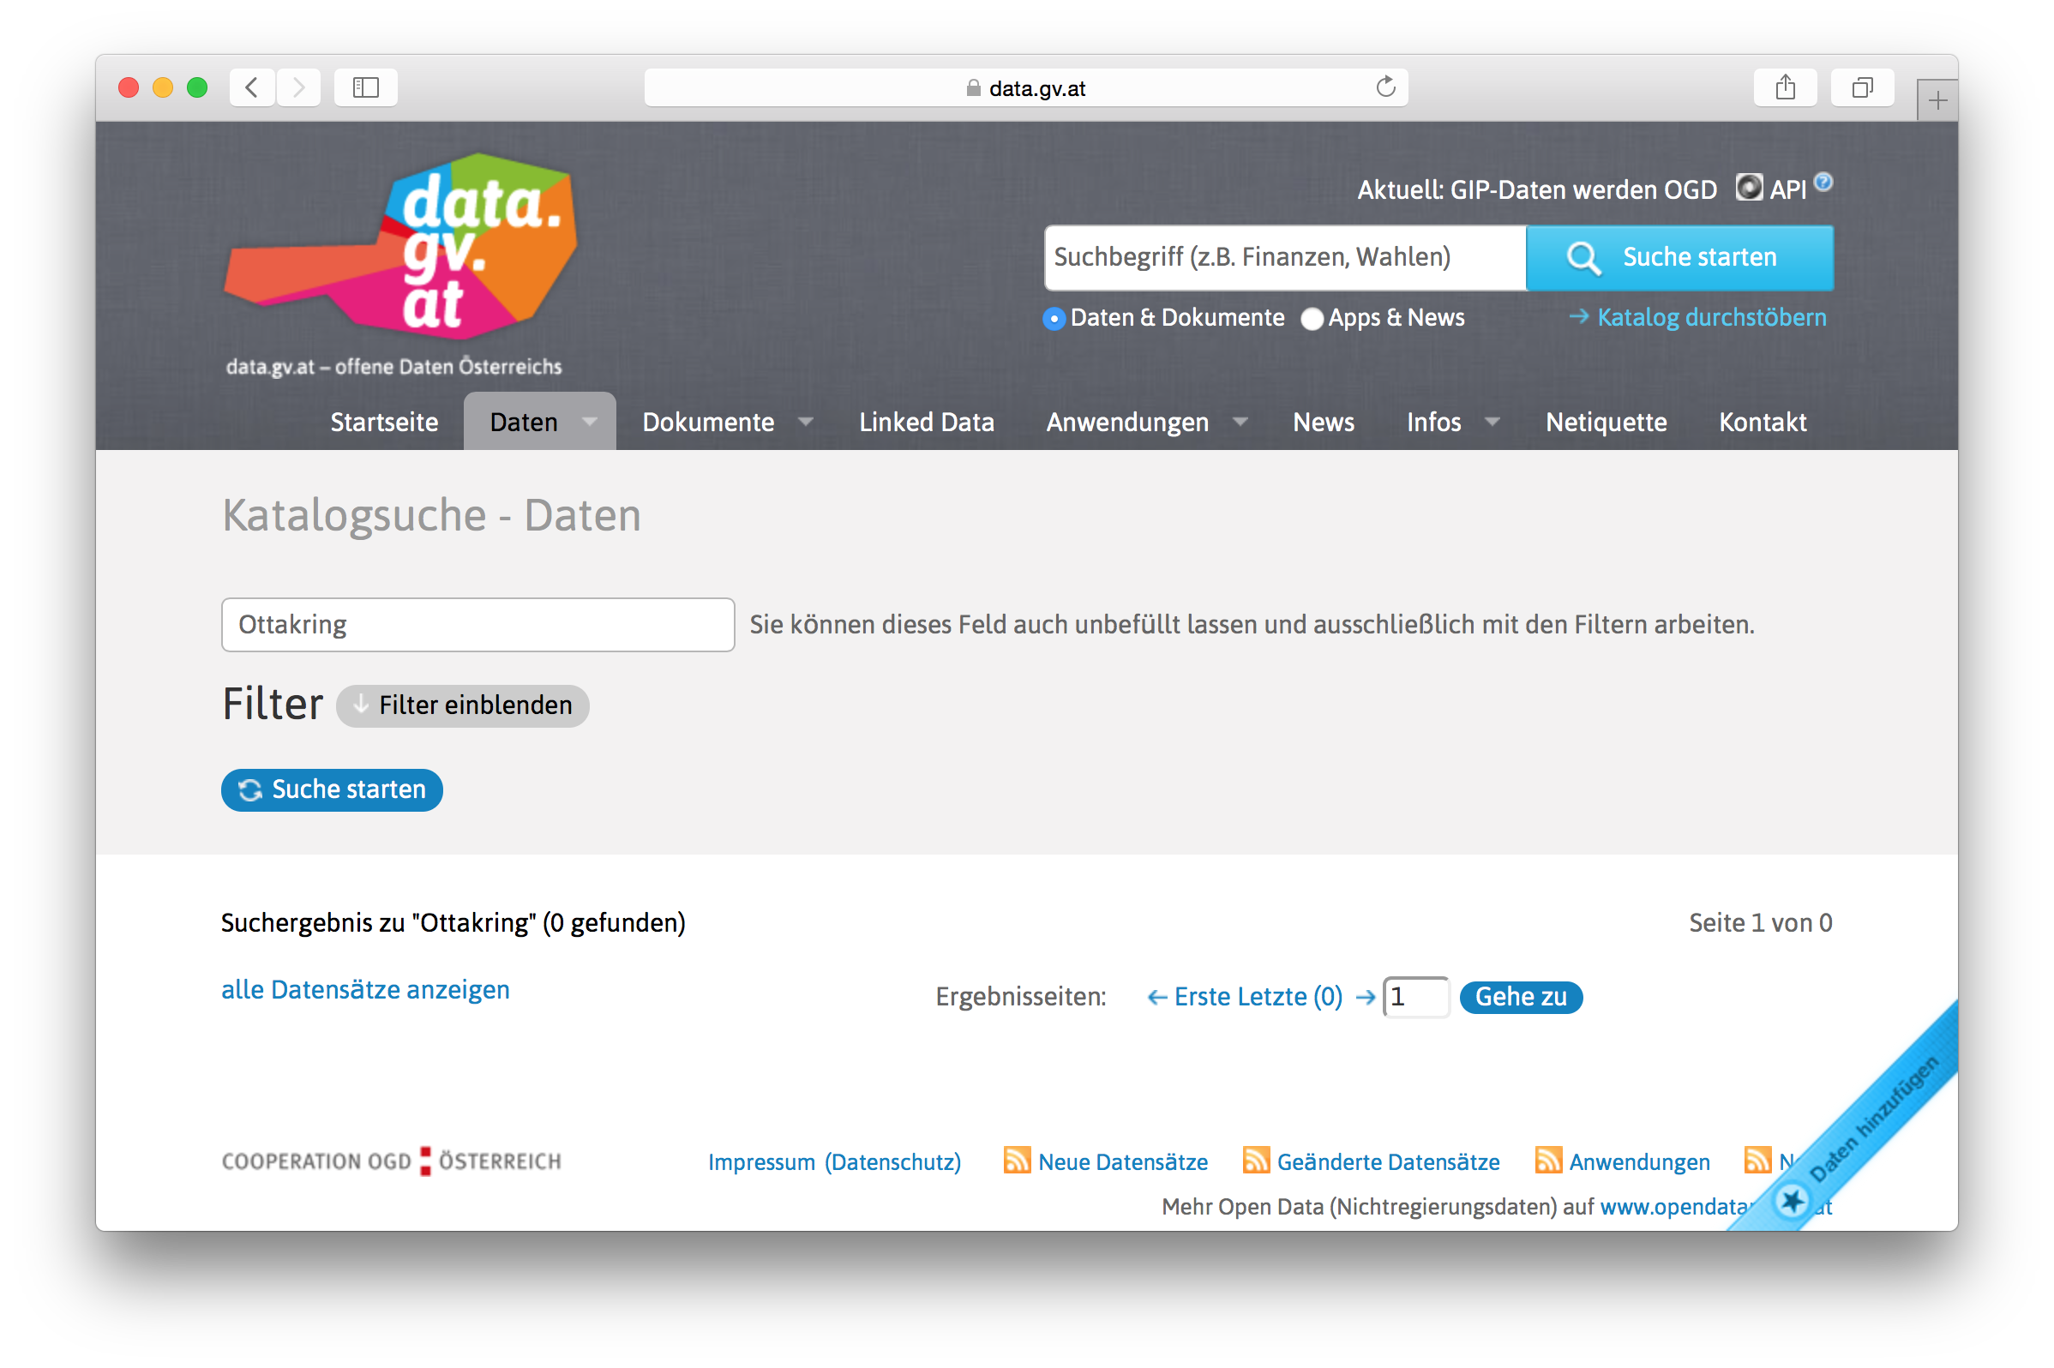
Open Data Portal search is a big problem... Why?

Slide 57
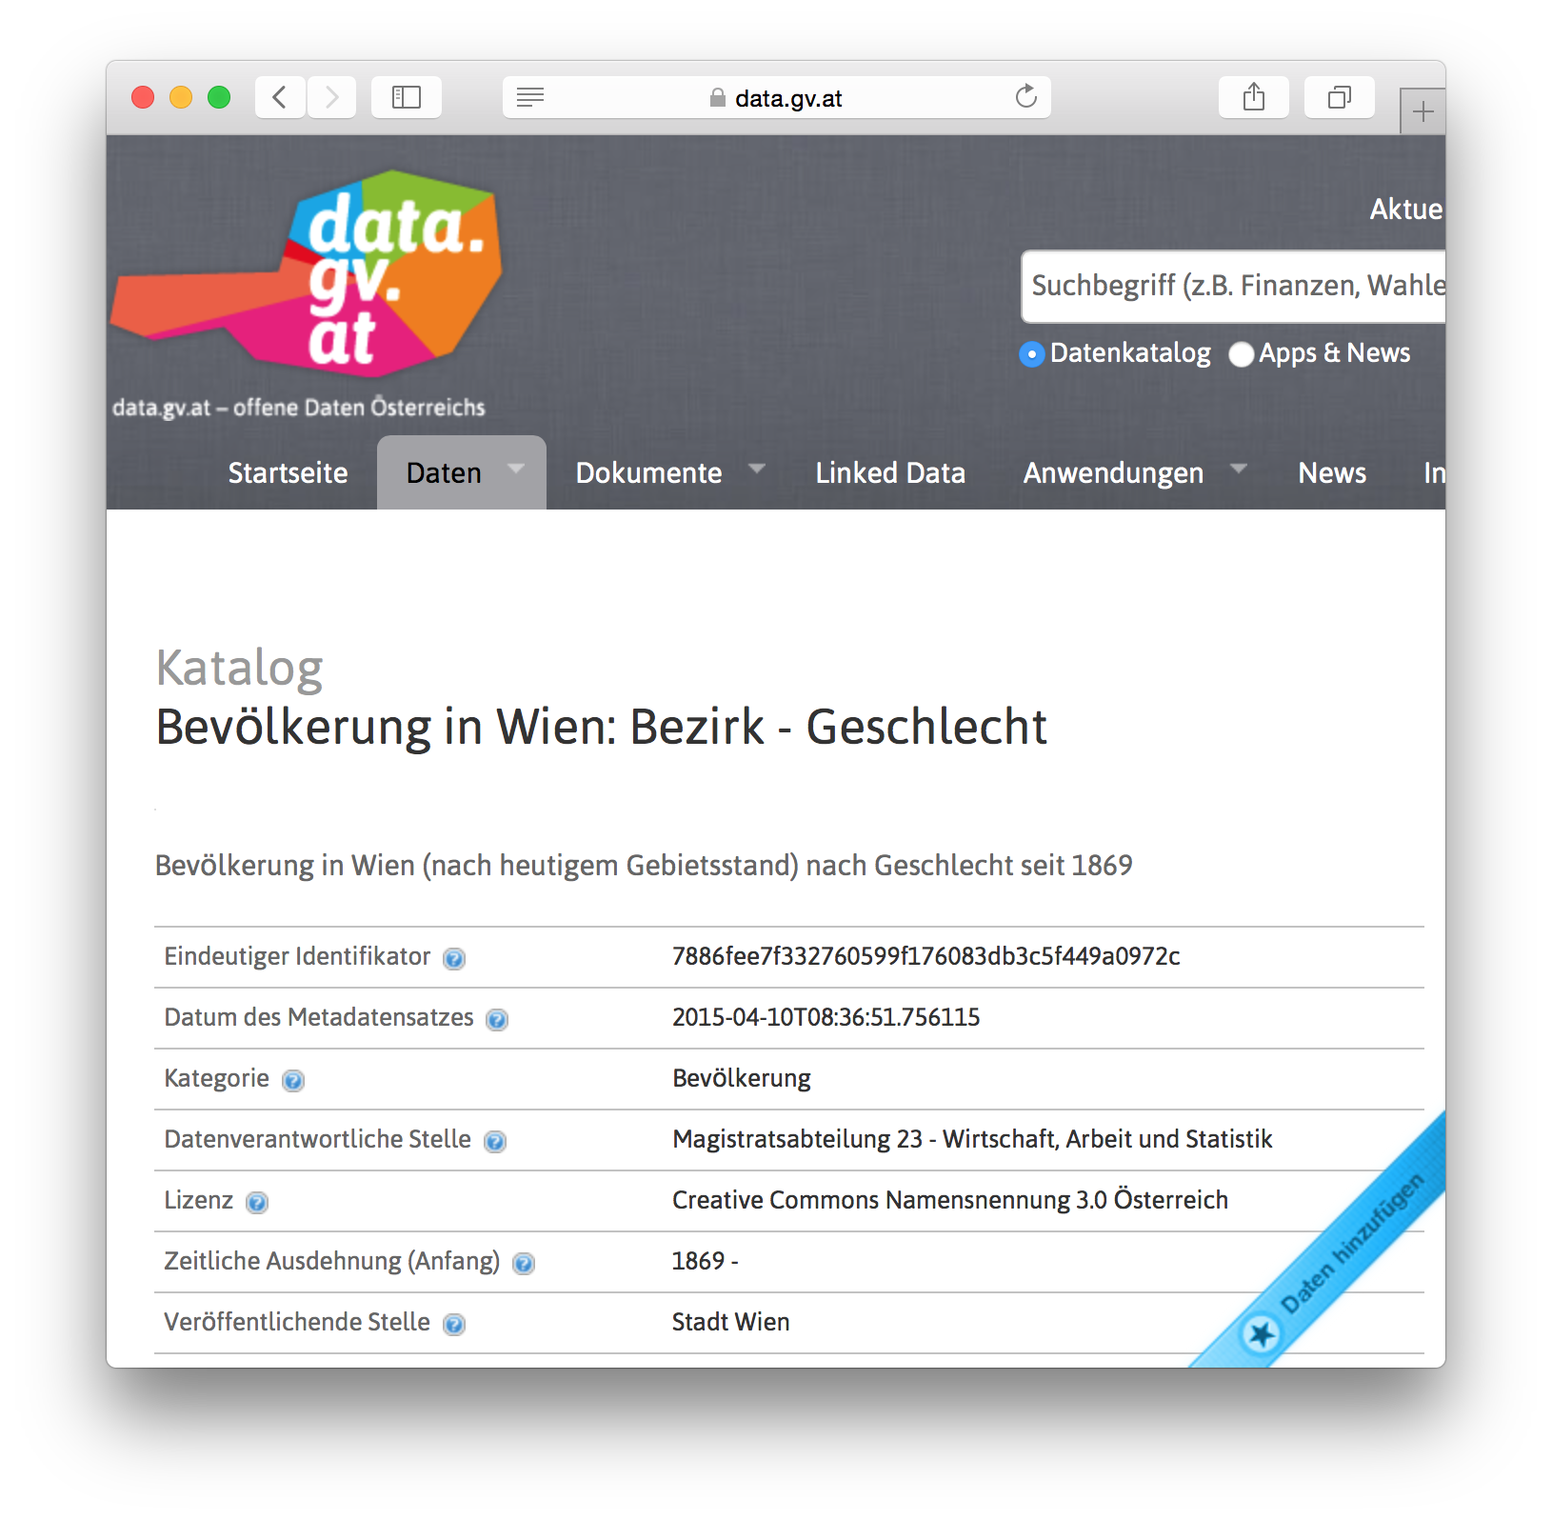
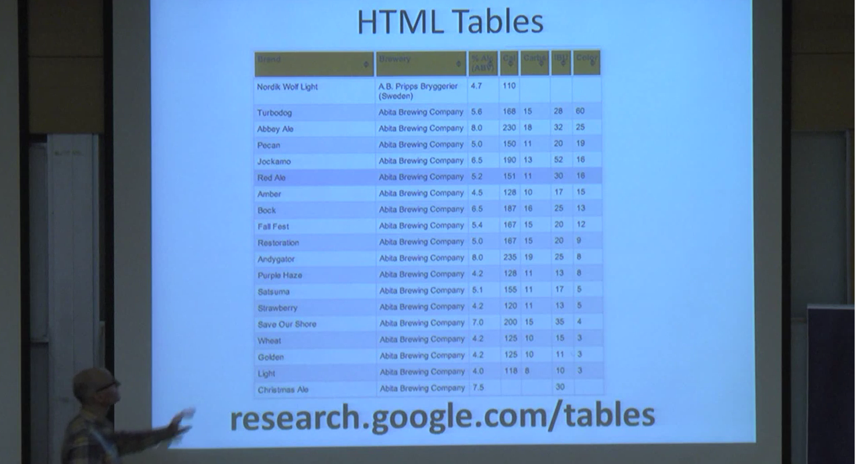
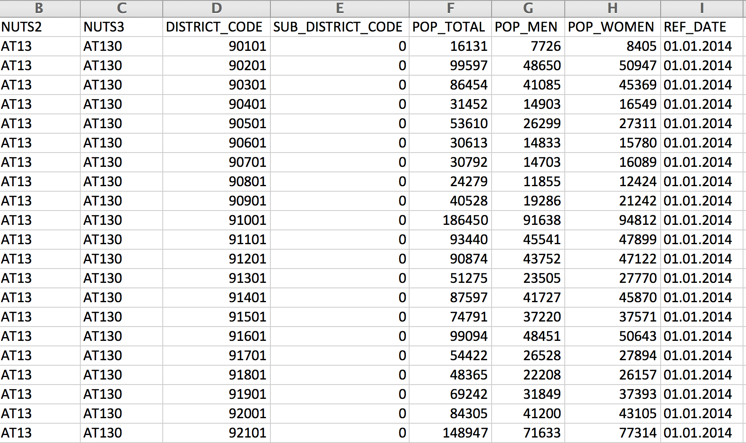
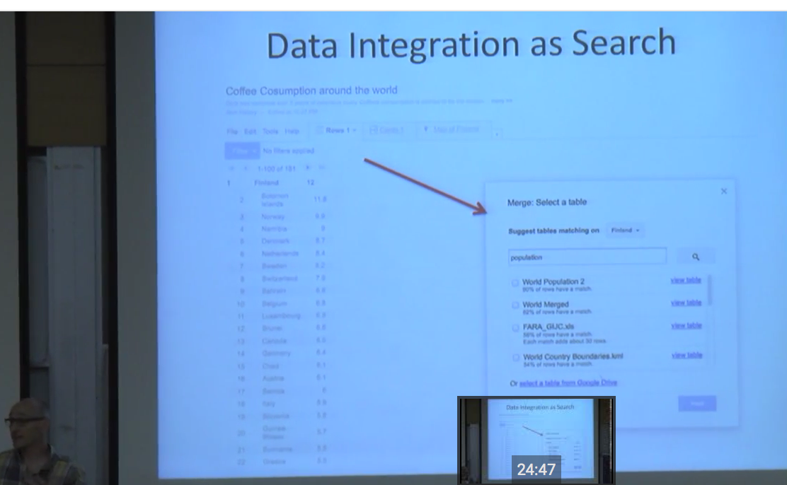
Open Data integration as Search?
https://www.youtube.com/watch?v=kCAymmbYIvc
Structured Data in Web Search by Alon Halevy
vs.
Disclaimer: Won't attempt to compete, but ...
This looks like a slightly different problem...
Can linking to "Open" knowledge graphs help?
(wikidata, dbpedia?) ... Probably.

Slide 58
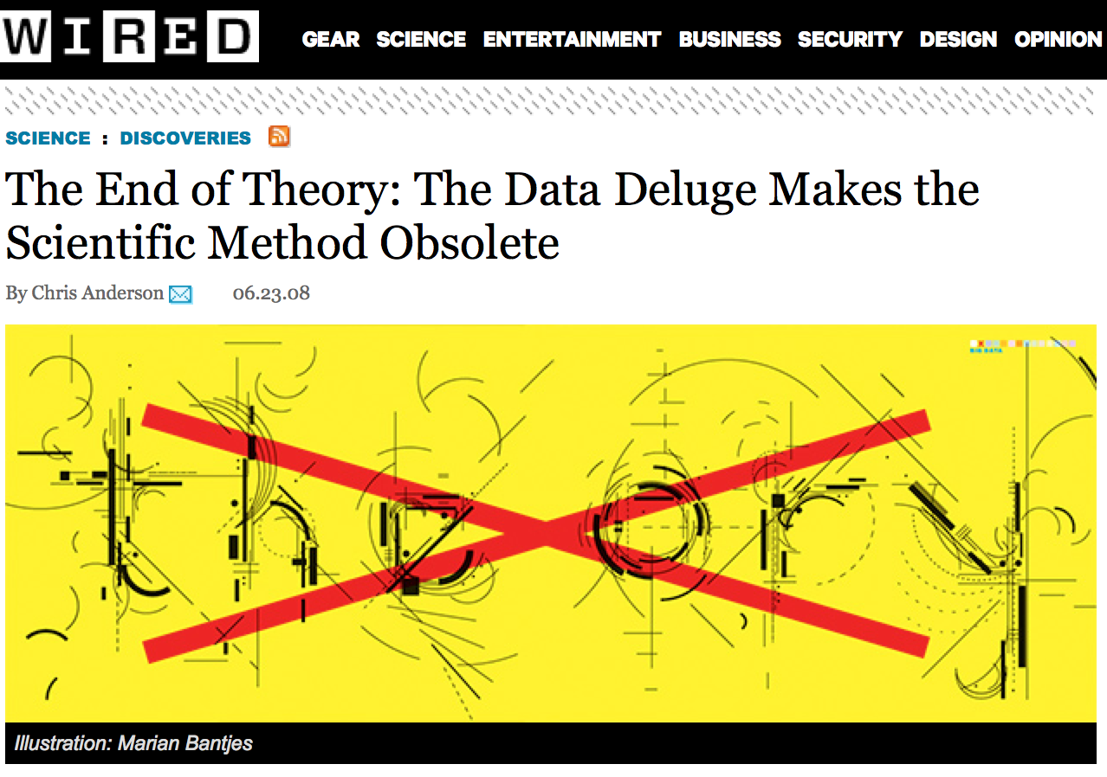
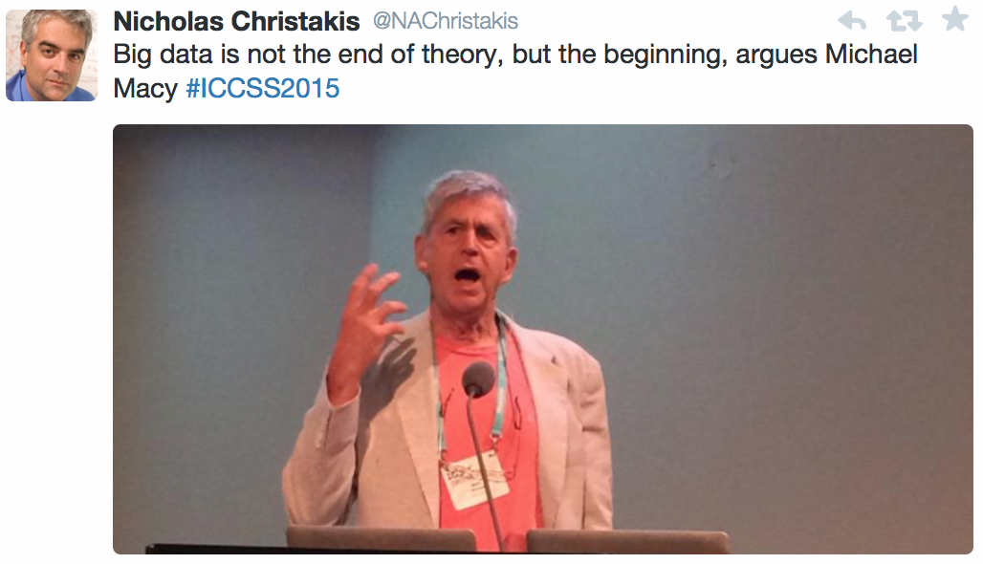
Integrating Open Data:
(How) Can Description Logics Help me?
More/Less/Different expressivity for ontology languages (plus e.g. equational knowledge) needed?
Combination of reasoning about formal background knowledge & statistical and ML methods needed
  E.g. soundness/completeness (KRR) vs. accuracy/coverage (ML)
Temporal aspects need to be taken into account but also provenance/trust/relevance
Quality assessment & improvement approaches needed
Semantic Web = "NoLD"... not only Linked Data!
We just explored some starting points, but maybe you find our datasets useful:
data.wu.ac.at/portalwatch
citydata.wu.ac.at
Beginning
... even the computational social scientists don't buy that:

