Slide 1
On Archiving Linked and Open Data
Axel Polleres
(with a lot of input by Javier Fernandez & Jürgen Umbrich ;-) )
30.05.2016 - 2nd Workshop on Managing the Evolution and Preservation of the Data Web, MEPDaW@ESWC16

Slide 2
What we will talk about…
Monitoring Evolution and Archiving … why is it important? Some examples...
General Challenges of Archiving the Web of Data
Some challenges more in-depth
Discussion... (hopefully ☺ )

Slide 3
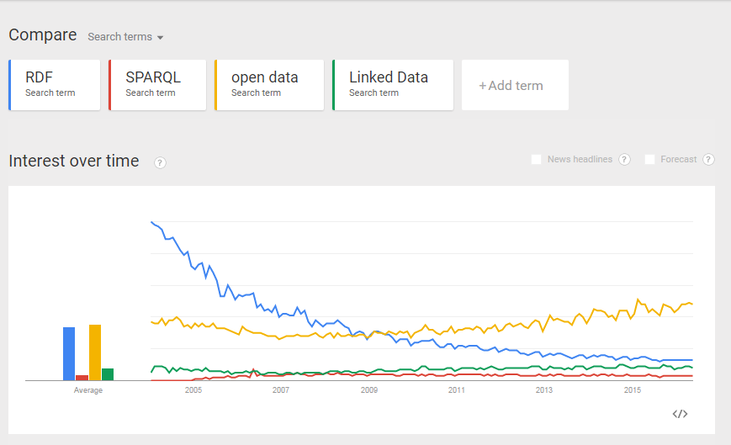
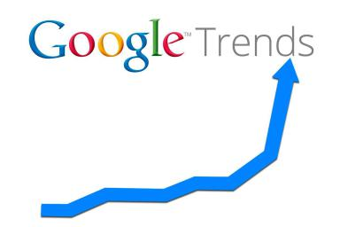
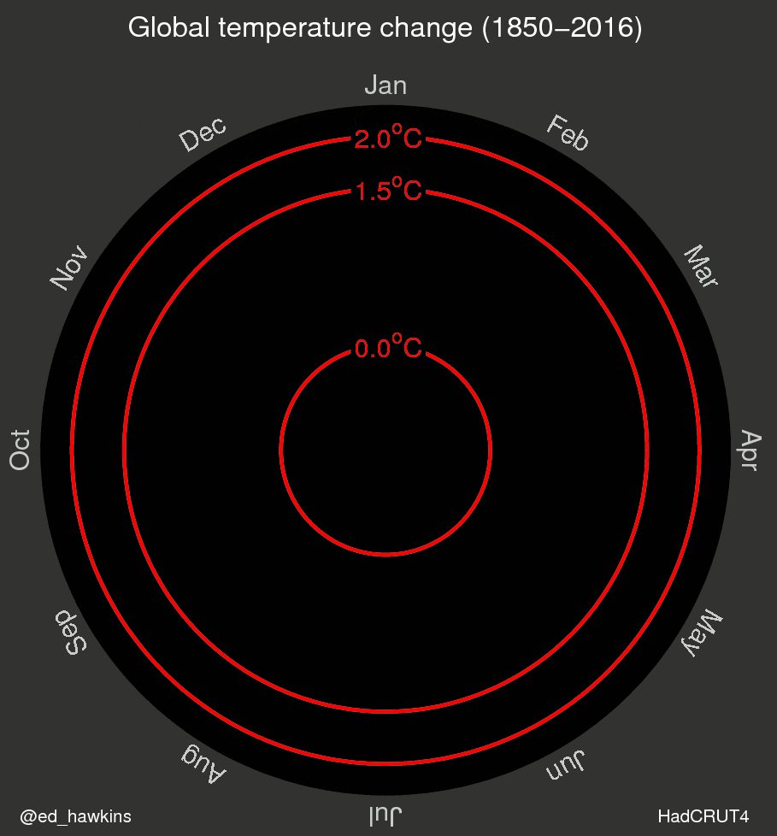
Why evolution matters
(Creationists: please ignore this slide…)
Monitoring evolution is relevant
Notes:
Can a GIF change the way we think about global warming?
http://www.climatechangenews.com/2016/05/10/can-a-gif-change-the-way-we-think-about-global-warming/
Google Trends: https://www.google.com/trends/explore#q=RDF%2C%20SPARQL%2C%20open%20data%2C%20%2Fm%2F02r2kb1&cmpt=q&tz=Etc%2FGMT-2

Slide 4
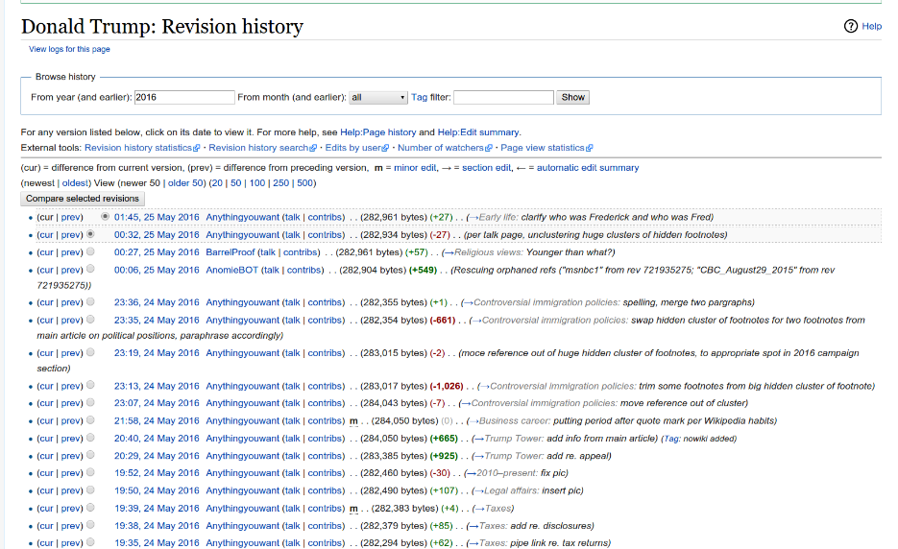
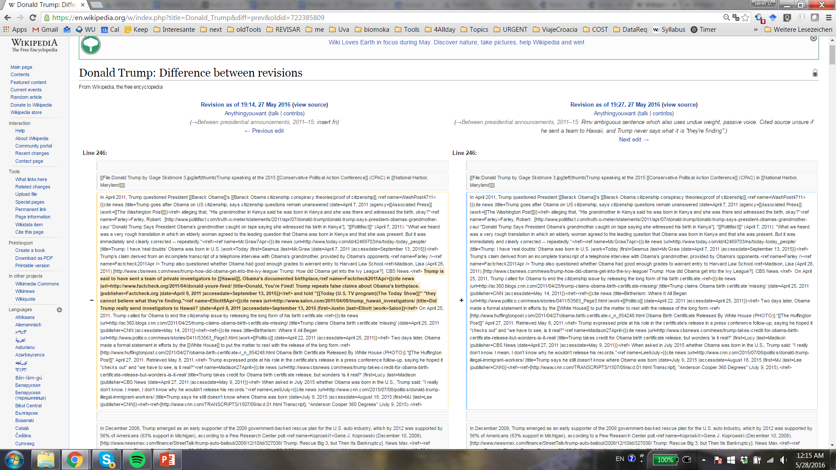
Evolution matters
Changes tell us “something”
  Uncertain information
  Validity of the information

Slide 5
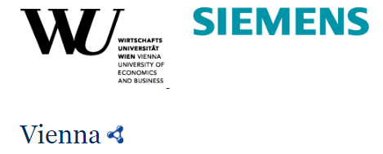
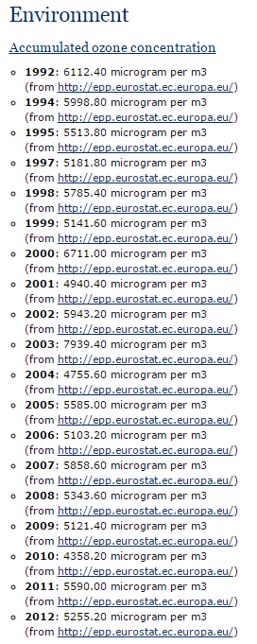
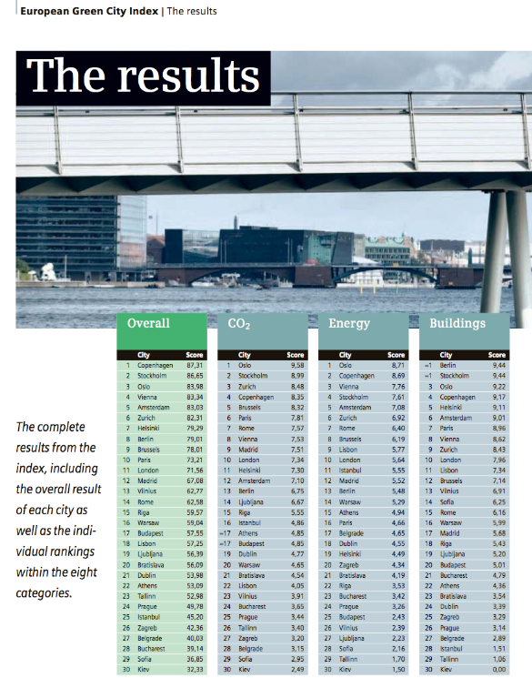
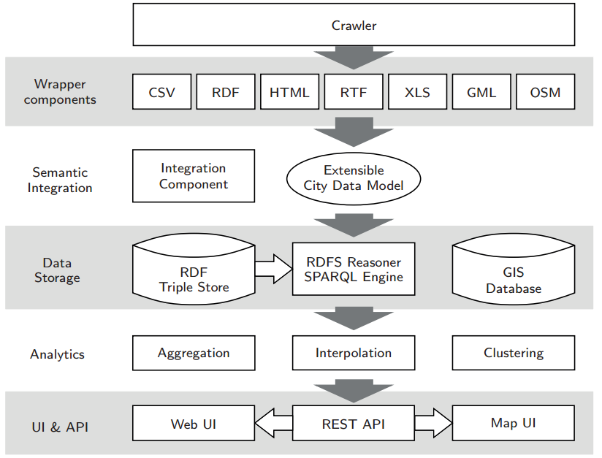
Evolution matters
Evolution may reveal actions vs. consequences
  E.g. CityDataPipeline, http://citydata.wu.ac.at/
    Collecting, Integrating and Predicting Open City Data
Notes:
Monitoring the city data pipeline
Has something improved over the years? Has an action had effects?

Slide 6
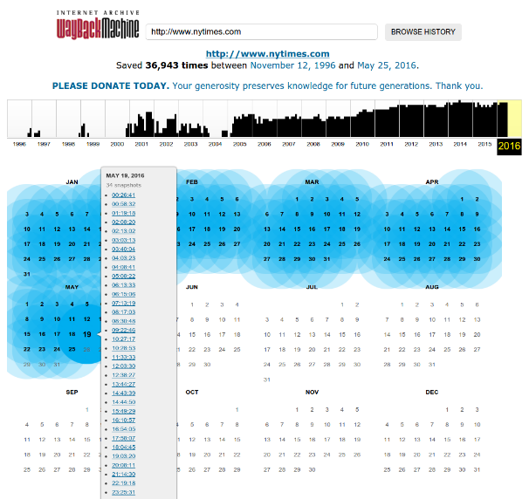
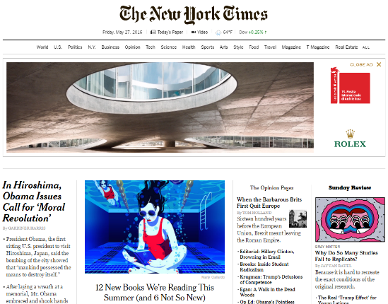
Preservation matters
Web archives: Common Crawl, Internet Memory, Internet Archive, …

Slide 7
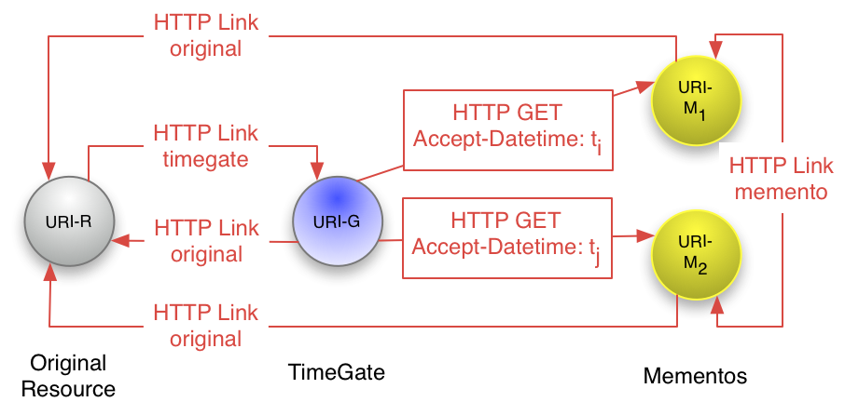
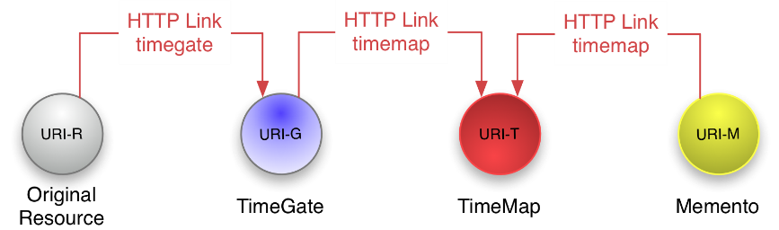
Time-based access matters
The Memento protocol
RFC 7089
Follow your nose
(HTTP content negotiation with datetime)
Batch discovery
(list of URIs of Mementos of the Original Resource)
But…

Slide 8
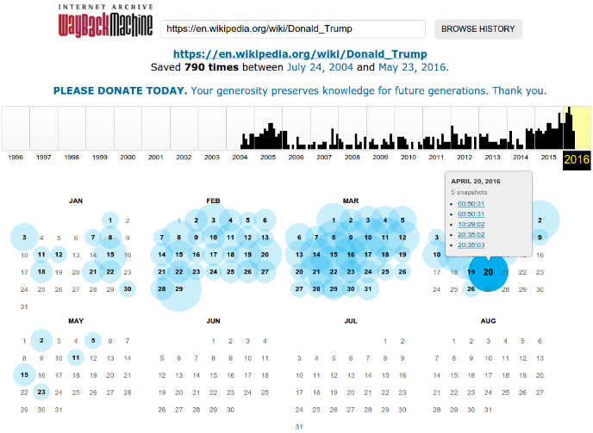
Challenges
Poor granularity (“some” snapshots)
Aggregated data, only, rather than raw data access
  (e.g. in Google trends)
Few work on archiving the Web of Data, or on integrating archives
What is the right query language?
  basic retrieval features (get version at timestamp t)
  when did a certain information disappear?
  when was it changed?
  structured queries?
Scalability problems
Is it easier/better for RDF/Linked Data?

Slide 9

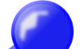

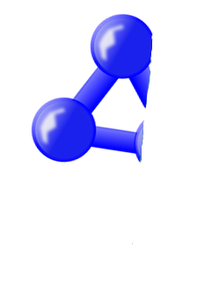


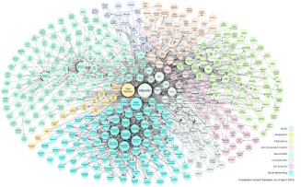
Linked Data Archives:
The missing link in the RDF evolution
Files
DBMS
Extract
Transform
Load
My d
Febru
My dataset
May 2016
Spatial Information
Web APIs
Most semantic Web/Linked Data tools are focused on
this “static view” but do not consider versioning/evolution
Linked Data discovery
Sindice, SWSE, Swoogle, LOD Cache, LOD-Laundromat… so far, no versions!
3

Slide 10


RDF Archiving. Example
RDF Graph V₁
ex:C1 ex:hasProfessor ex:P1 .
ex:S1 ex:study ex:C1 .
ex:S2 ex:study ex:C1 .
RDF Graph V₂
ex:C1 ex:hasProfessor ex:P1 .
ex:S1 ex:study ex:C1 .
ex:S2 ex:study ex:C1 .
ex:S3 ex:study ex:C1 .
RDF Graph V₃
ex:C1 ex:hasProfessor ex:P1 .
ex:C1 ex:hasProfessor ex:P2 .
ex:C1 ex:hasProfessor ex:S2 .
ex:S1 ex:study ex:C1 .
ex:S3 ex:study ex:C1 .
ex:S1
ex:study
ex:S1
ex:study
ex:S1
ex:study
ex:study
ex:C1
ex:study
ex:C1
ex:hasProfessor
ex:C1
ex:S2
ex:S2
ex:S2
ex:hasProfessor
ex:has Professor
ex:study
ex:has Professor
ex:study
ex:has Professor
ex:P1
ex:S3
ex:P1
ex:S3
ex:P1
ex:P2
Represent
Query

Slide 11
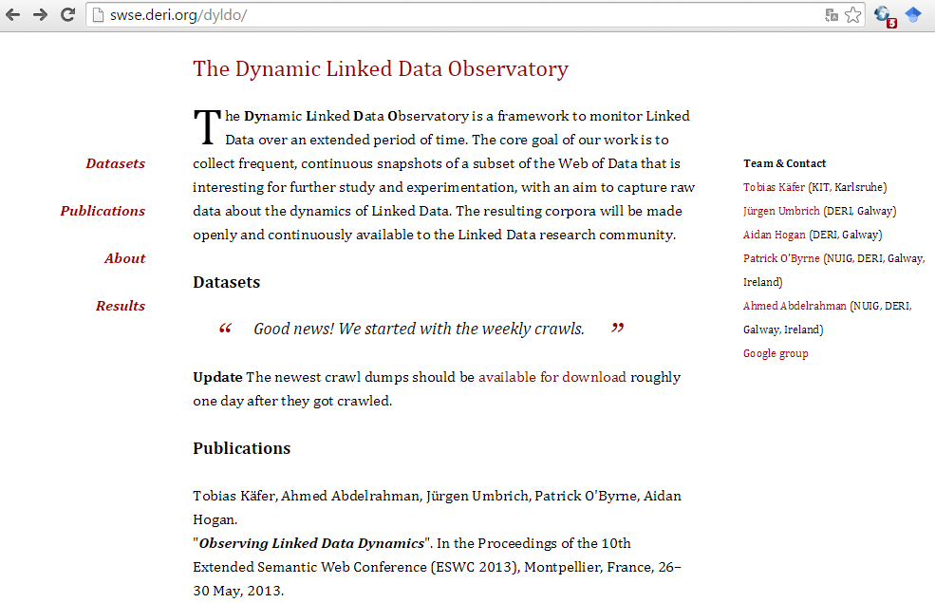
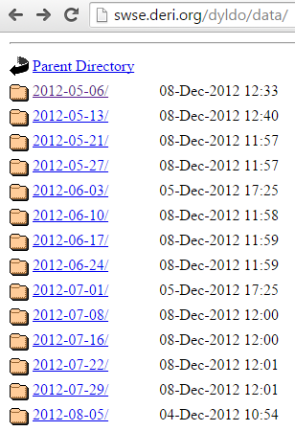
One of the first real LOD use cases:
The Dynamic Linked Data Observatory (evolving Linked Data since 2012)
Weekly dumps of crawl snapshots...
Granularity?
Queries?
Completeness?
Crawl failures?
Represent
Query
Notes:
38% of 80K crawled Linked Data documents had changed in a seven-month window
(the monitoring period). In particular, 23% of the total documents suffered
from infrequent changes, and 8% were highly dynamic documents. Of the documents
that changed, most updates affect values for RDF terms (27%), keeping
the same number of triples, or just added triples (24%) which leads to monotonic
additions. Regarding the availability of resources, 5% of documents disappeared
permanently, whereas, on average, documents were unavailable 20% of the time.

Slide 12
Research challenges on evolving structured interlinked data
How can we represent archives of continuously evolving linked datasets? (efficiency vs. compact representation)
How can we minimize the redundant information of archives? (e.g. duplicates in snapshots)
How can we improve completeness of archiving?
How can emerging retrieval demands in archiving be satisfied?
  e.g. time-traversing and traceability? Avoiding bottlenecks?
How can certain time-specific queries over archives be answered?
  Can we re-use existing technologies (e.g. SPARQL or temporal extensions)?
  What is the right query language for such queries?
  e.g. knowing if a dataset has changed, and how, in a certain time period?

Slide 13
General archiving challenges
The synchronisation problem
  how can we monitor changes?
The appraisal problem
  how can we assess the quality of a dataset? (and does archiving help with that?)
The archiving & query problem
  how can we efficiently archive and perform time-based retrieval queries of a dataset?

Slide 14
The synchronization problem
how can we monitor changes?

Slide 15
Pull changes (crawl) vs.
Push changes (notify)
Observations:
  Some services that publish or are mapped to RDF change regularly, but we don’t know the frequency upfront!
  Some services mapped to RDF announce/archive their changes already, so they already keep an archive…

Slide 16
1- An adaptive archiver
(recall: DIACHRON WS 2015)

Slide 17
Experiment: Rescheduling
Evaluating strategies to compute next crawl time for URLs to accurately capture content change

Slide 18
Test setup
Revision history of 2660 wikipedia-articles
  Wiki-changes do not follow a typical Poisson distribution
Several heuristics; e.g.:
e.g., increase the crawl frequency,…”
  “if you observe several changes in a row”
  “if the probability is high that the content changes after we observed a change in the last snapshot” → Markov models
  “If the document changed more often than 50% in the last 10 days …. “

Slide 19
Results
We observed the typical trade-off between recall and precision…
Strategies based on Markov models seems to provide best and most stable trade-off

Slide 20
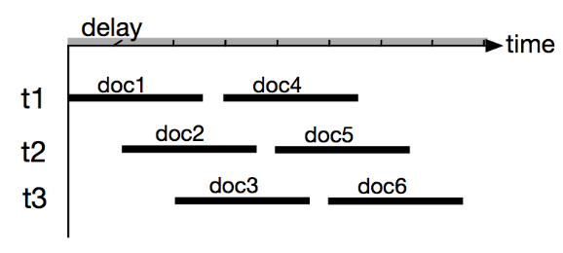
Experiment: Improve completeness - Crawl time estimation
Aim: Estimate the overall crawl time and needed number of threads for a set of URLs from different domains
Heuristic
  Estimate the crawl time per domain
    Average download time, domain delay etc…
  First-fit bin-packing algorithms to determine overall crawl time

Slide 21
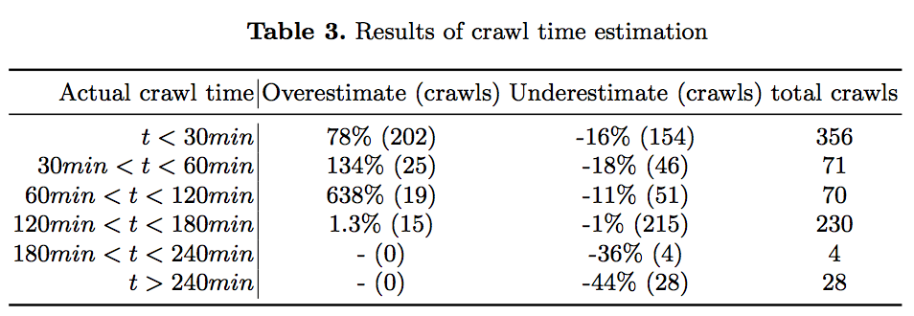
Results
Large over estimation (is acceptable)
Small underestimation (e.g. 10mins for 60mins crawl)

Slide 22
Pull changes (crawl) vs.
Push changes (notify)
Observations:
  Some services that publish or are mapped to RDF change regularly, but we don’t know the frequency upfront!
  Some services mapped to RDF announce/archive their changes already, so they already keep an archive…

Slide 23
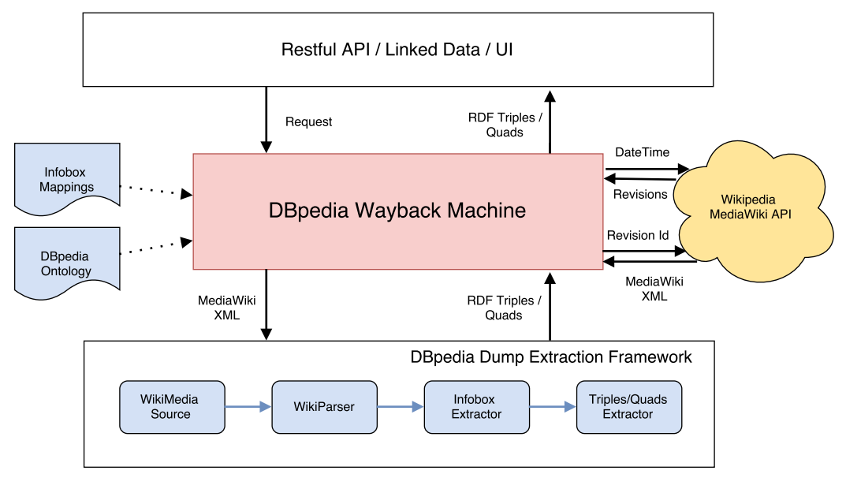
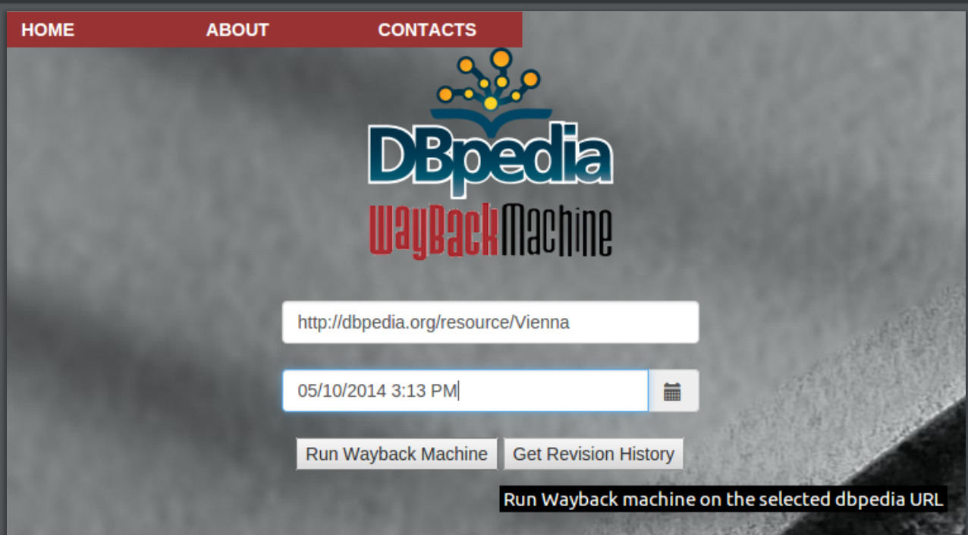
2- “Recreate” the versions from sources
(SEMANTiCS 2015 demo…)
If raw historical data on changes is is available…
Aim: Fine grained access to previous versions, re-applying X2RDF transformations on the original source
Example: DBpedia Wayback machine
  Re-apply mappings on the Wikipedia revision history
http://data.wu.ac.at/wayback/

Slide 24
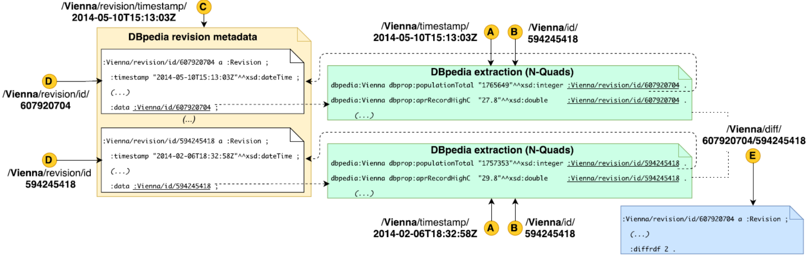
2- “Recreate” the versions
How can one represent revisions while respecting DBpedia?
  a) quads → <dbpediaSubject> <pred> <obj> <Revision> .
  b) proprietary triples → <ownSubject/Revision> <pred> <obj> .
Operations?
  Get revisions meta-data for one resource (by revisionID or timestamp)
  Get “materialised” versions of a resource (by revisionID or timestamp)
  Get difference between two revisions

Slide 25
2- “Recreate” the versions
More complex operations/queries? Open challenge
  a) On-demand? Query rewriting, similar to RDB2RDF
  b) Batch: Fetch the desired information, then store and query it

Slide 26
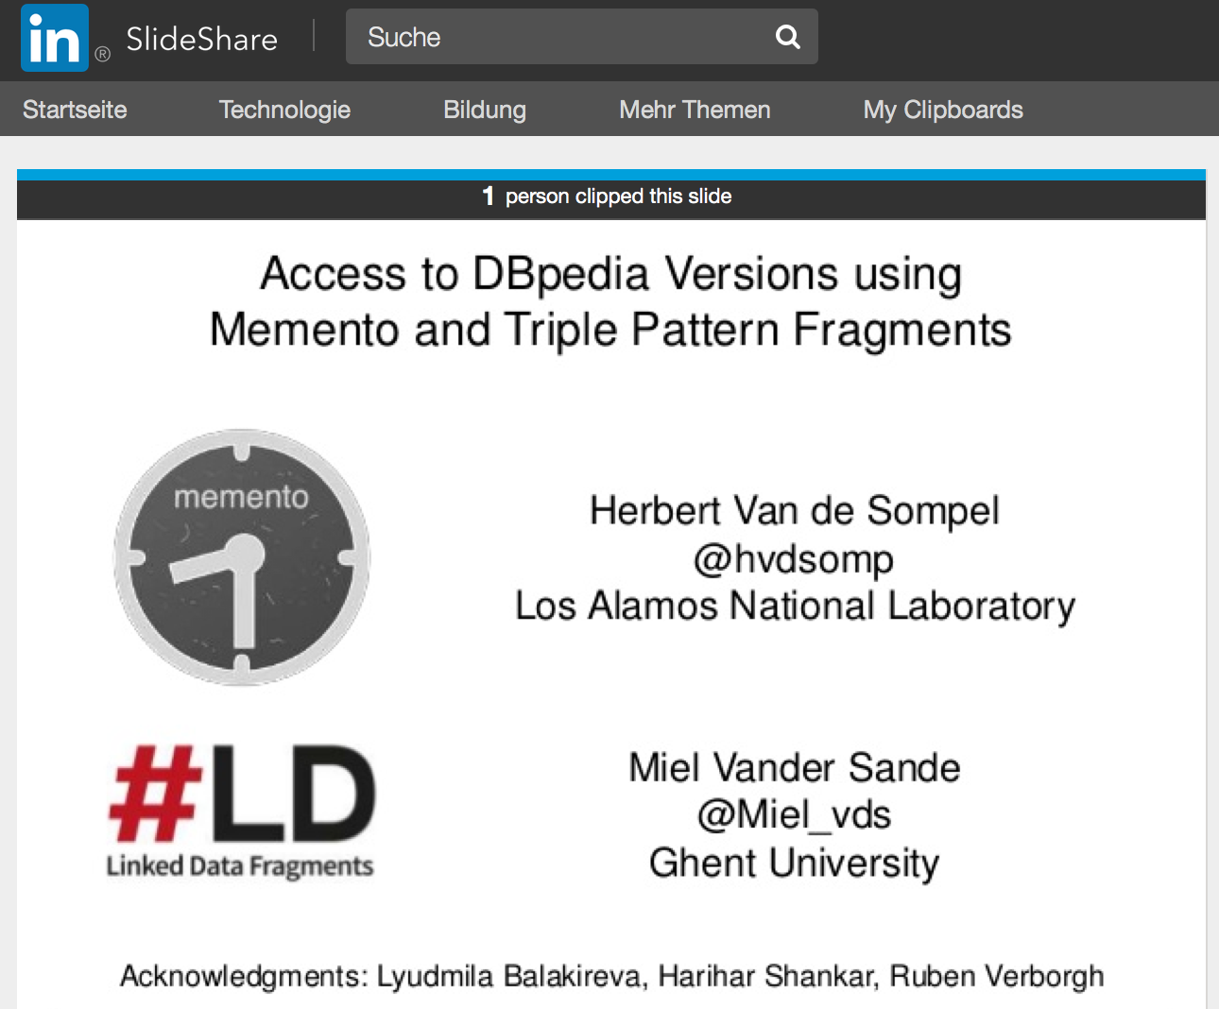
We are (obviously) not the only ones looking into this…
However:
Only one HDT per “irregular” dbpedia dump

Slide 27
The appraisal problem
How can we assess the quality of a dataset?

Slide 28
Data Quality issues:
Missing
Outdated data
Wrong data
Ambiguous Data
Wrong meta-data
Data source offline/not reachable
→ Archiving & looking at the history of datasets helps!
Notes:
In the previous challenge, we have "solved" this by pretty much manually integrating a carefully chosen set of data sources, but not used Open Data portals to automatically find the right data sources...

Slide 29
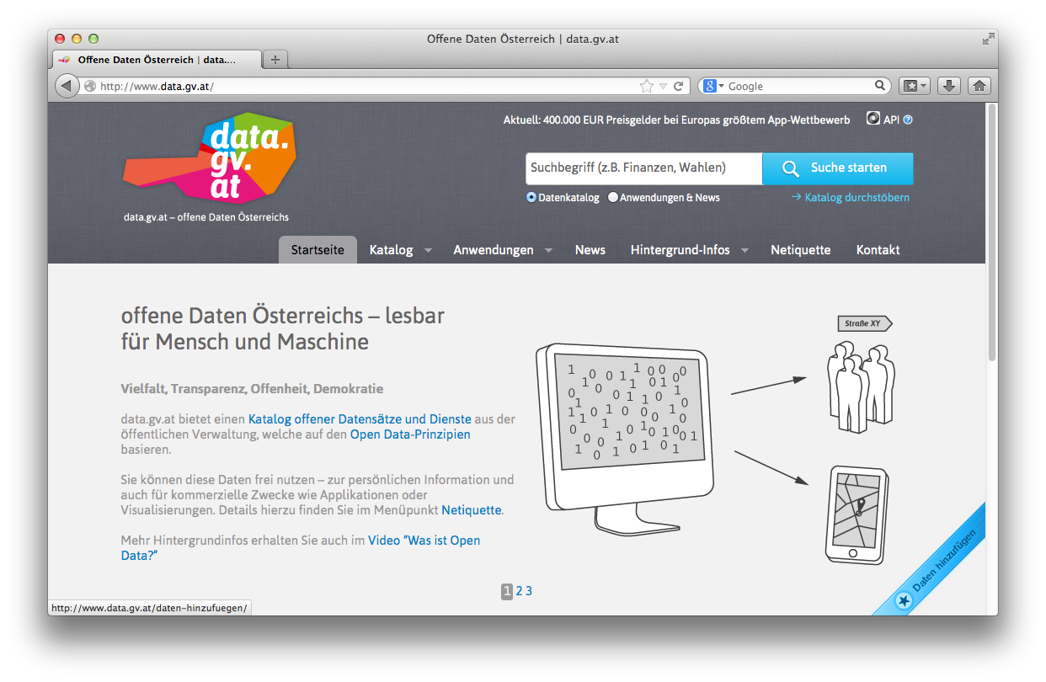
Open Data Portals
CKAN ... http://ckan.org/
almost „de facto“ standard for Open Data Portals
facilitates search, metadata (publisher, format, publication date, license, etc.) for datasets
http://datahub.io/
http://data.gv.at/
machine-processable? ...
... partially

Slide 30
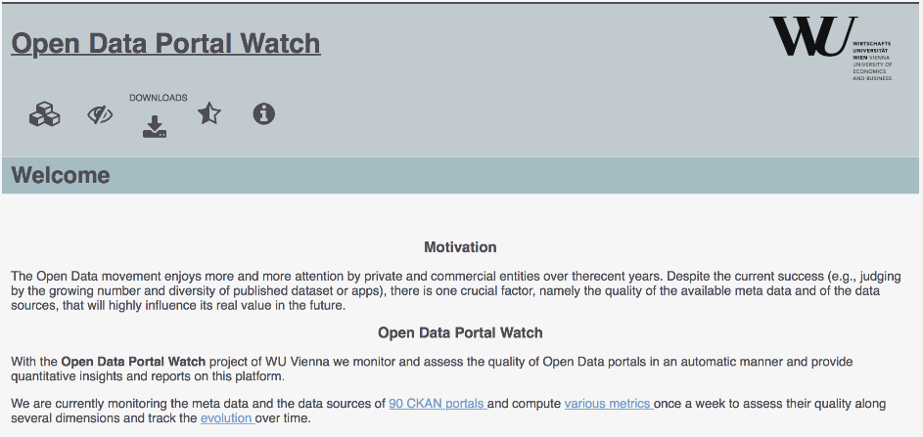
OPEN DATA PORTAL WATCH
… a first step.
http://data.wu.ac.at/portalwatch/
Periodically monitoring a list of Open Data Portals
  90 CKAN powered Open Data Portals
Quality assessment
Evolution tracking
  Meta data
  Data

Slide 31
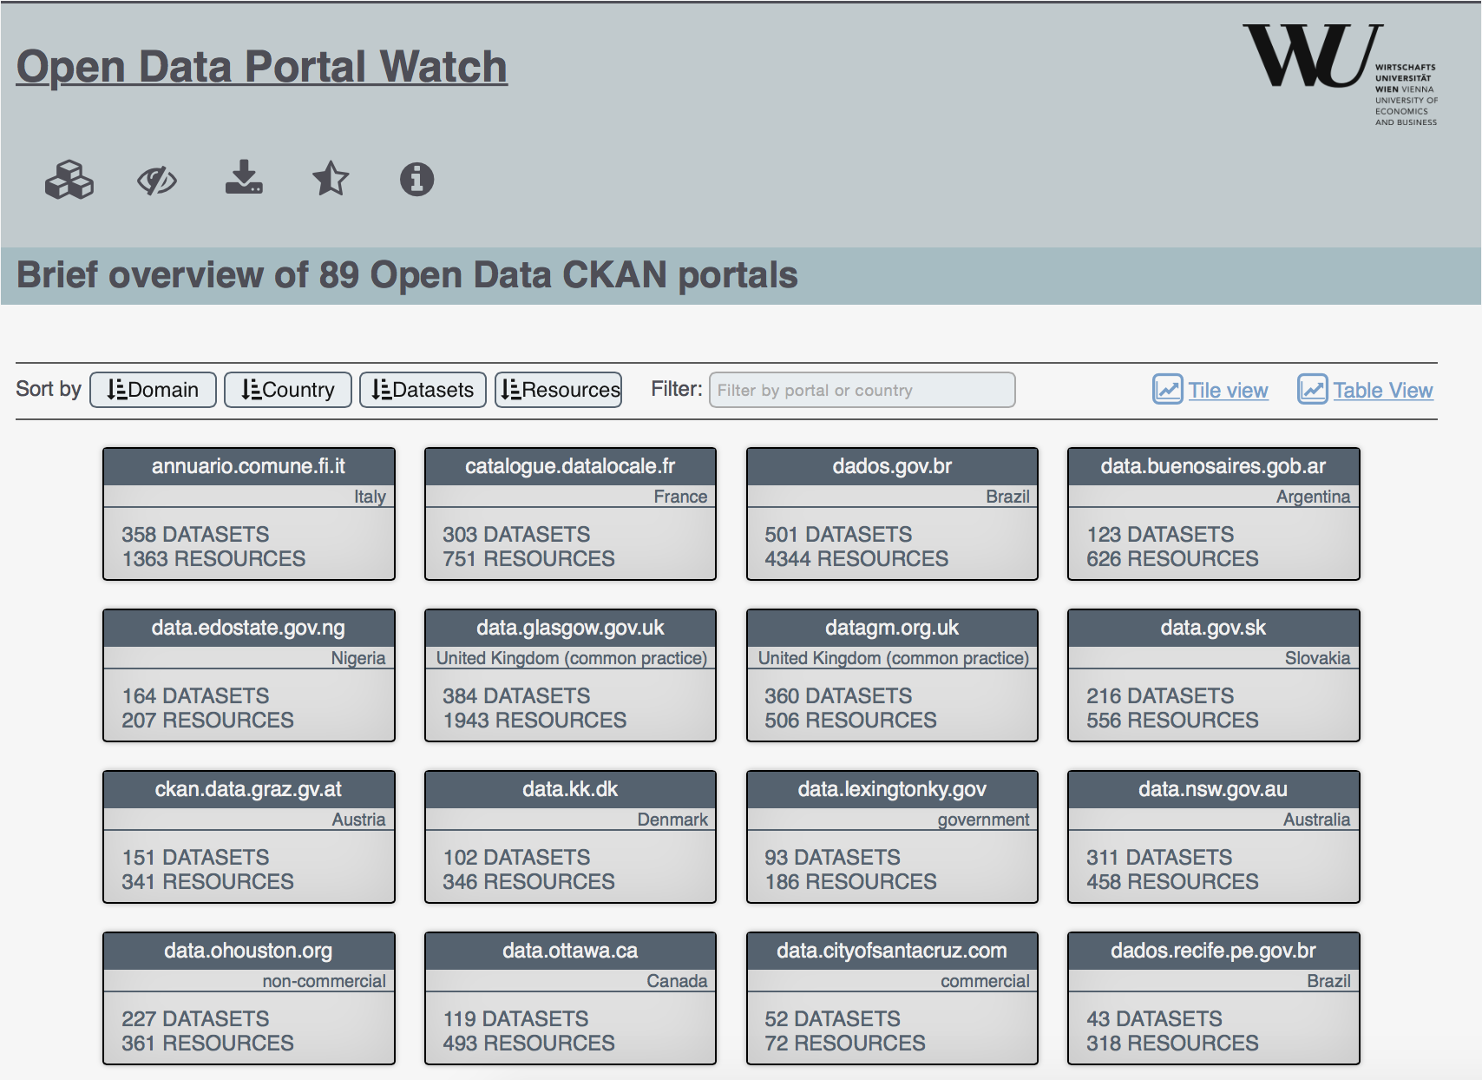
Open Data Portal list

Slide 32
QUALITY DIMENSIONS
DIMENSION | DESCRIPTION
Retrievability | The extent to which meta data and resources can be retrieved.
Usage | The extent to which available meta data keys are used to describe a dataset.
Completeness | The extent to which the used meta data keys are non empty.
Accuracy | The extent to which certain meta data values accurately describe the resources.
Openness | The extent to which licenses and file formats conform to the open definition.
Contactability | The extent to which the data publisher provide contact information.
Objective measures which can be automatically computed in a scalable way

Slide 33
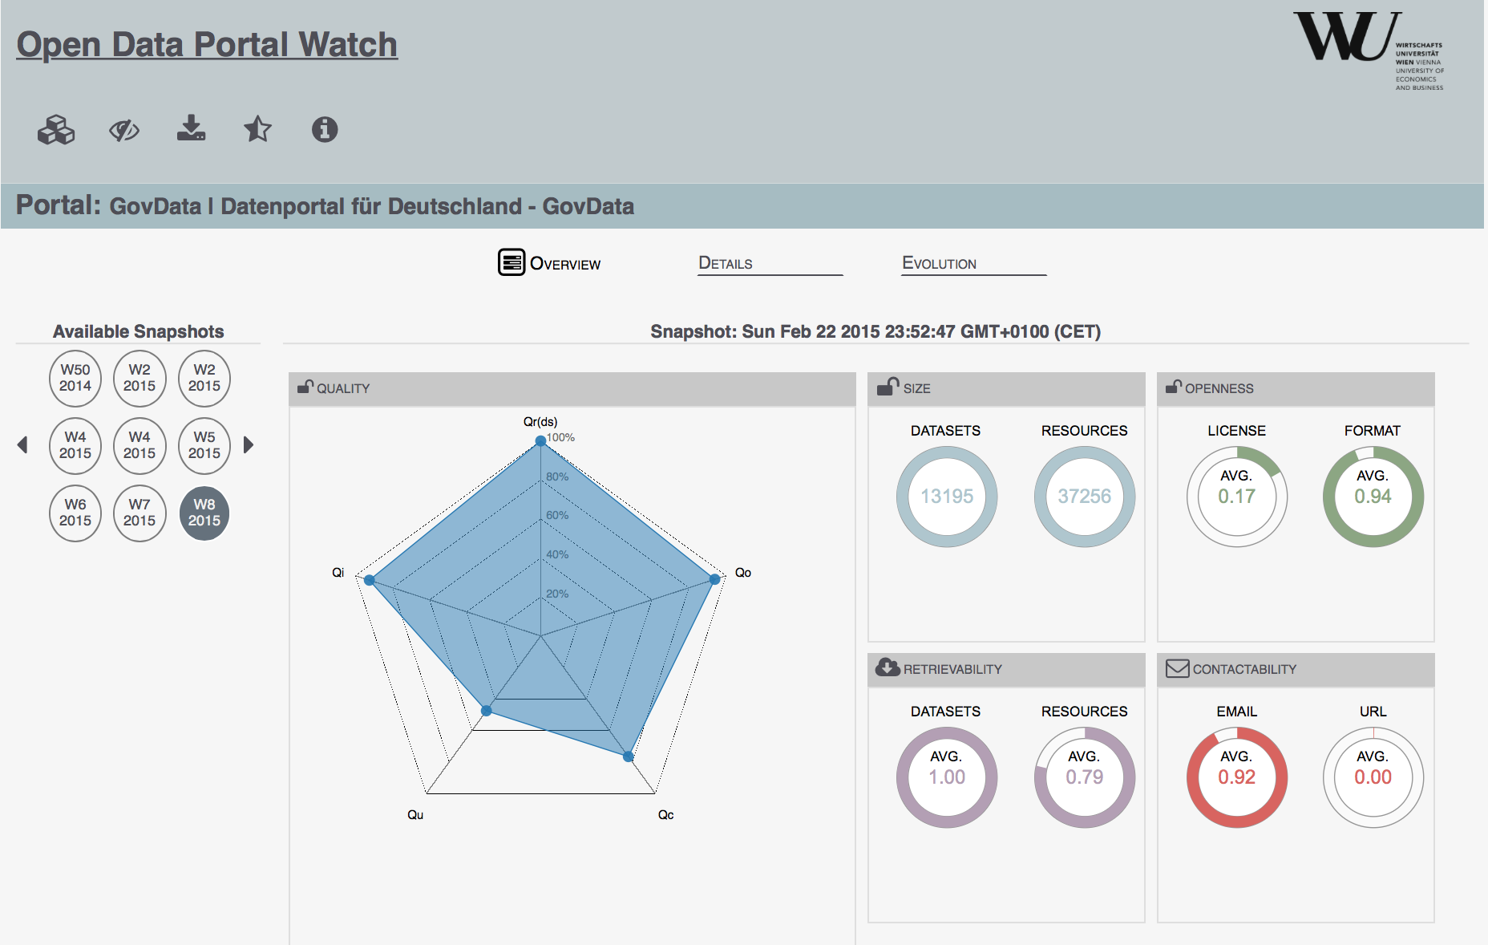
Portal Overview

Slide 34
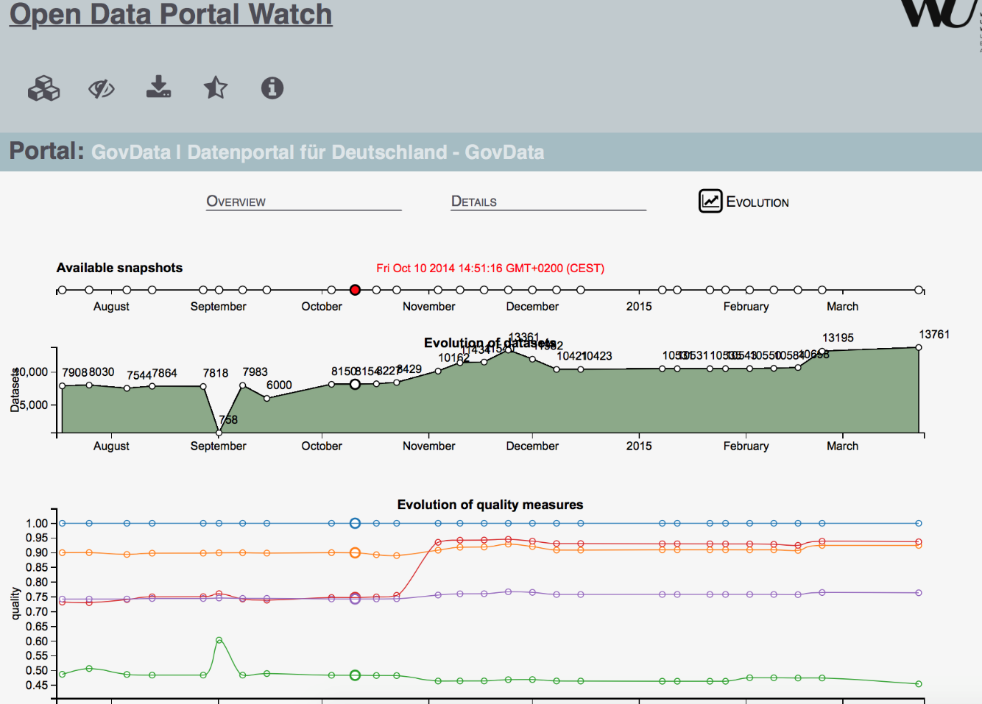
ODP Evolution

Slide 35
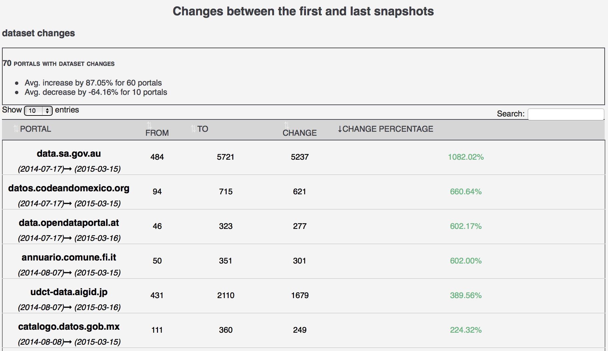
ODP CHANGES

Slide 36
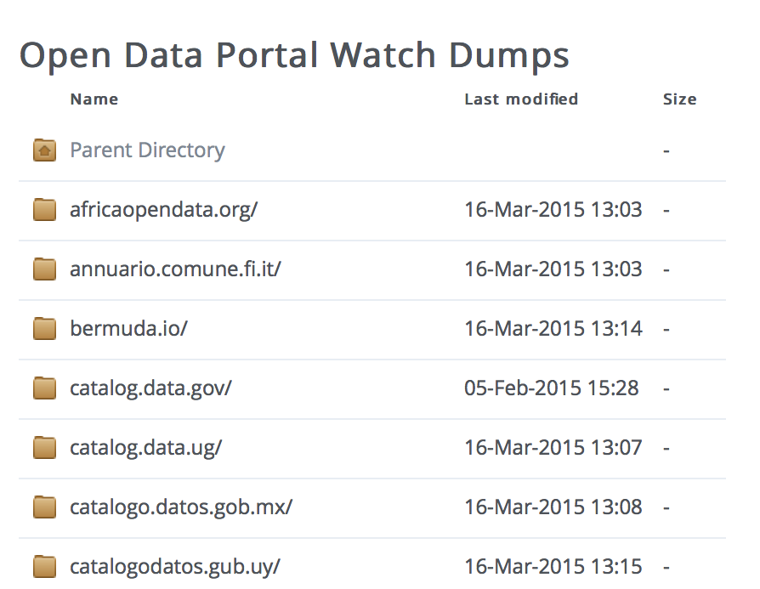
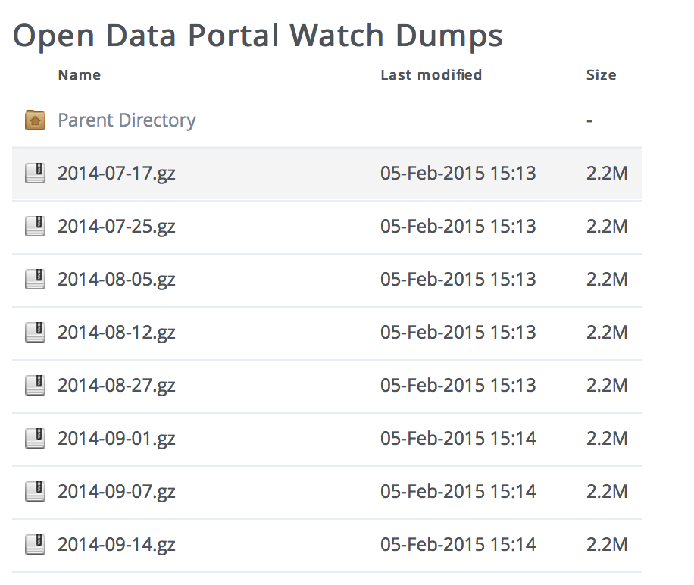
Data Dumps
OPEN DATA PORTAL WATCH provides an archive of Open Data portal crawls (weekly snapshots/dynamic crawling framework):

Slide 37
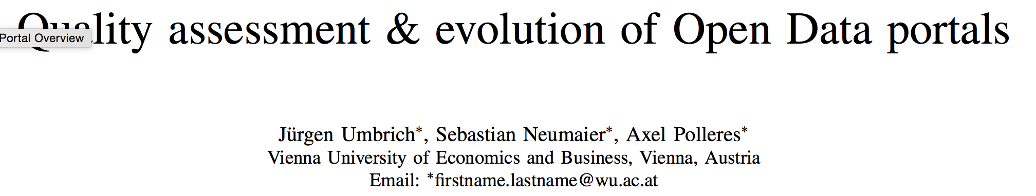
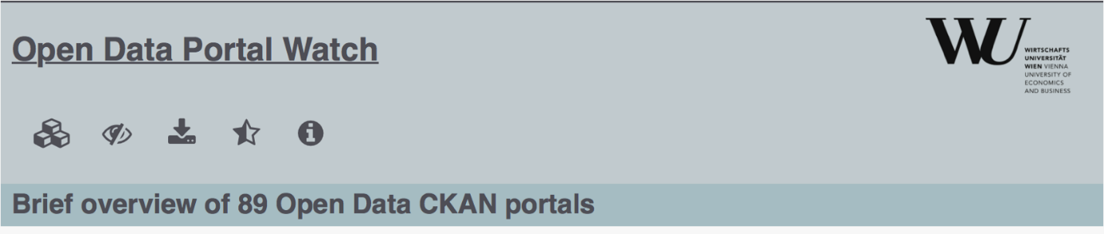
Open Data Portal Watch
Best paper award at IEEE OBD-2015 ☺
http://data.wu.ac.at/portalwatch/
Key findings:
  Significantly varying quality across portals
  Rapid growth for some portals
  Huge variety and range of datasets
  Open Data Portal search is a big problem
  Time: many datasets only provide current, but no historical data

Slide 38
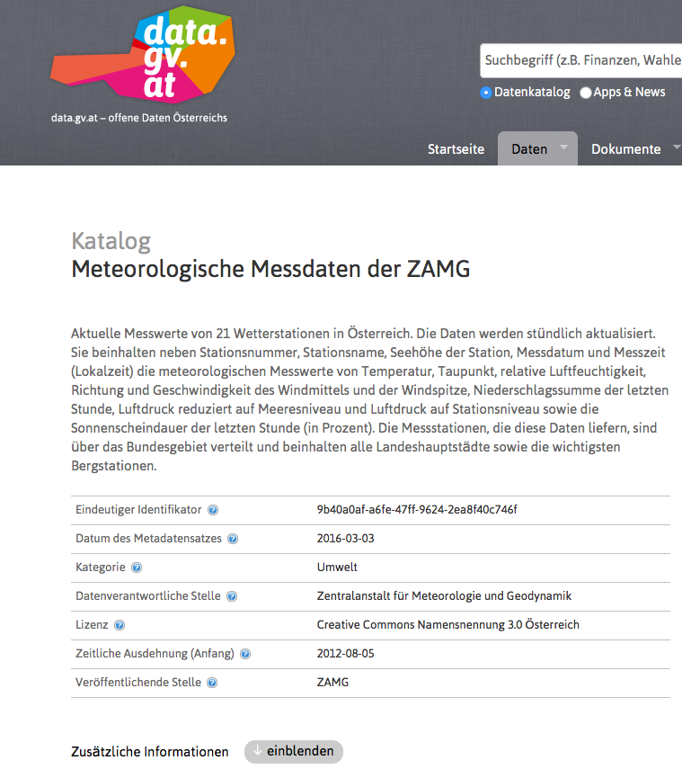
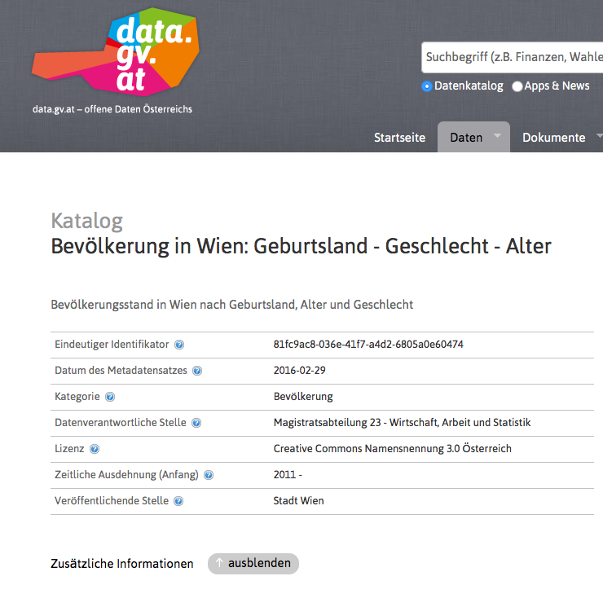
Historical vs. current-only data
(monotonic changes vs. non-monotonic changes)
Weather data (every 15min) from 21 Austrian weather stations…
vs.
Population per gender and age in Vienna districts
Updated every 15min,
only current data
←
Connection to Challenge 1 (Synchronization):
Adequate meta-data could help us to steer crawling, and more efficient storage, we are experimenting with this…
Updated annually, historical data since 2011
→

Slide 39
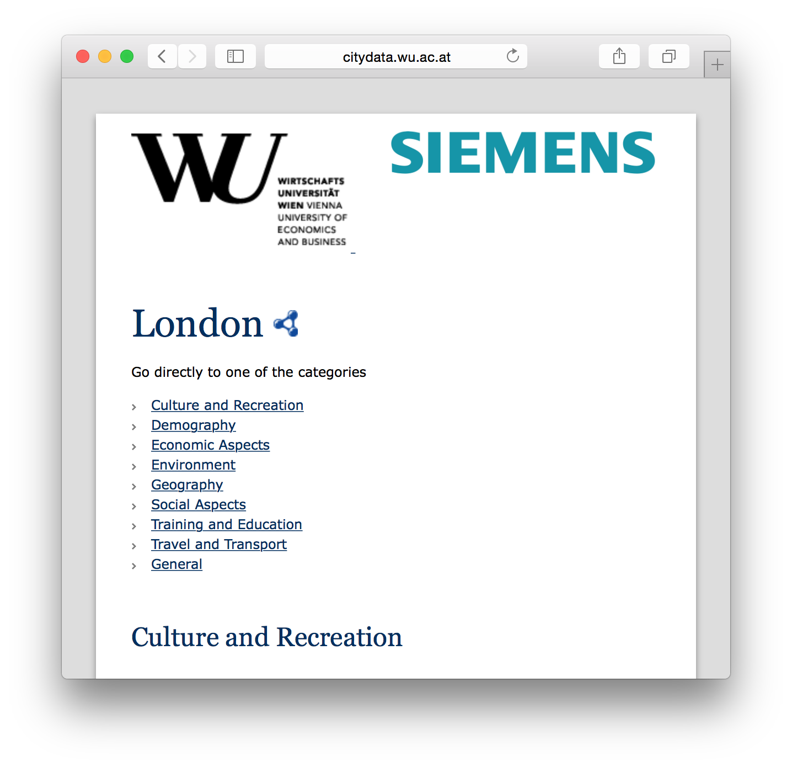

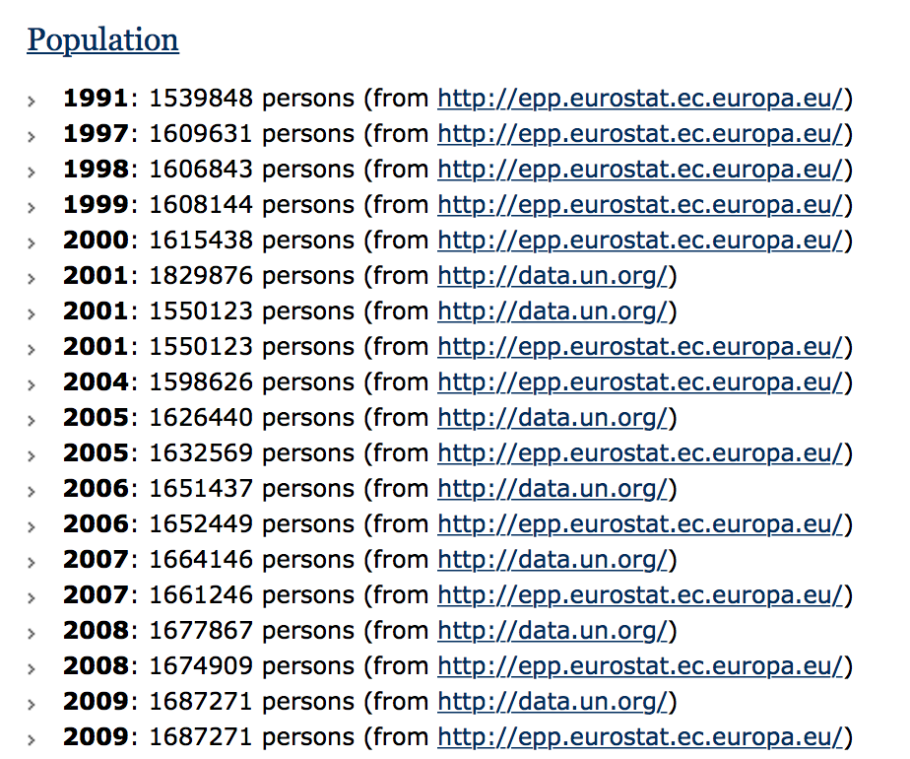
Now: How do data quality and archiving connect?
Idea: if we know how data changed, we could assess “bogus” changes…
  Look at time series: Detect outliers over historical data
  Example: wikipedia change history!
    Wrong/disputed data changes often!
e.g. obvious Idea:
Once data is semantically integrated in an archive, it is easy to include time-series analysis to filter out implausible/inconsistent data automatically…

Slide 40
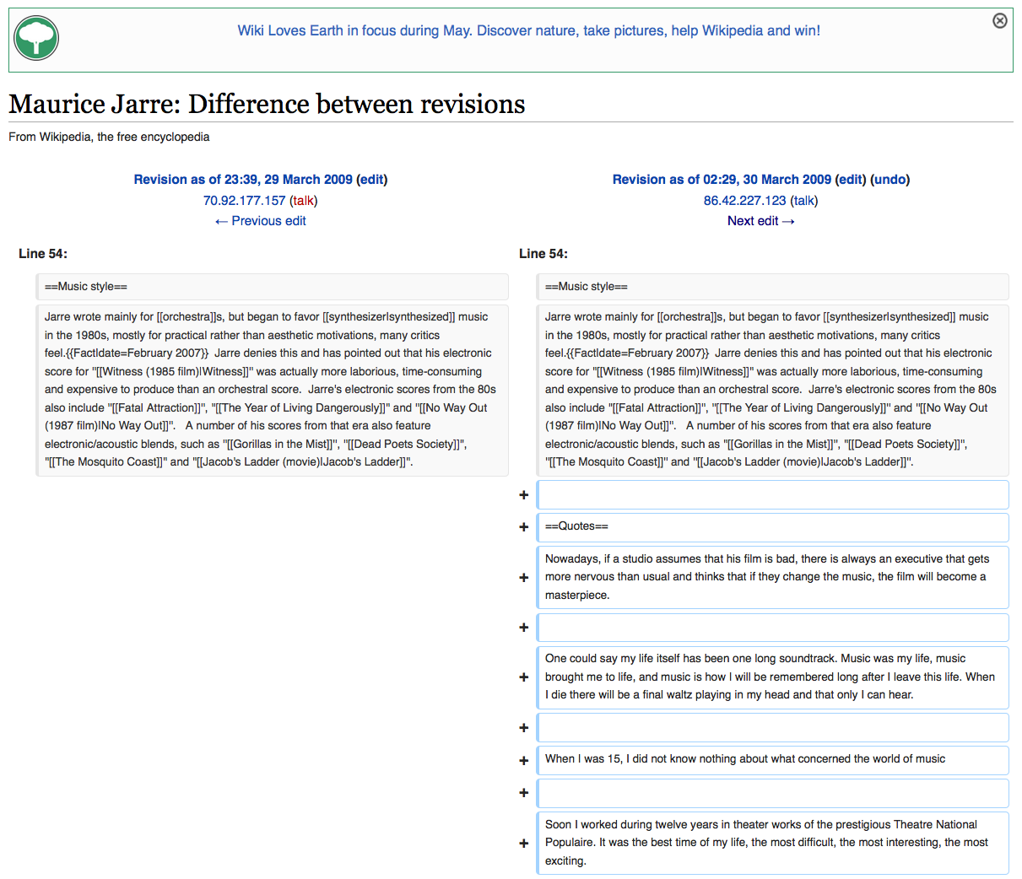
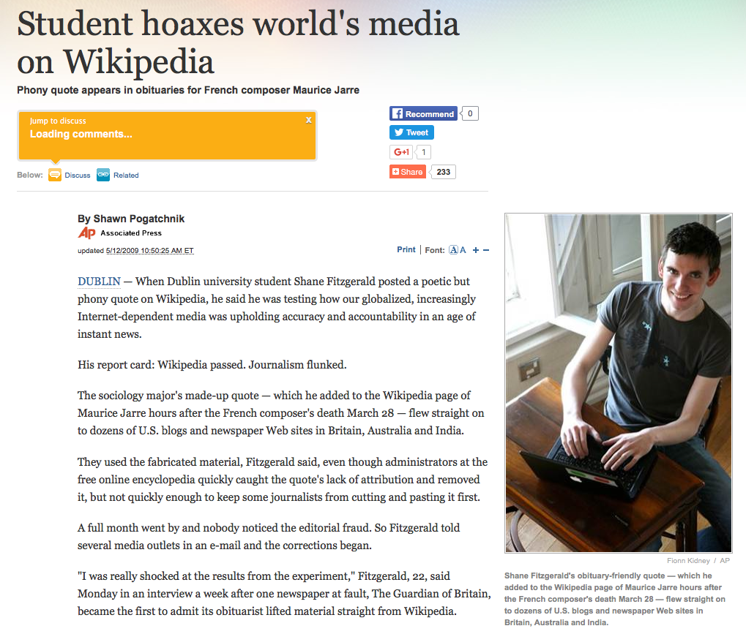
Now: How do data quality and archiving connect?
An idea only, so far: if we know how data changed, we could assess “bogus” changes…
  Look at time series: Detect outliers over historical data
  Example: wikipedia change history!
    Assumption:Wrong/disputed data changes often!

Slide 41
Finally: The archiving problem
Now, how can we efficiently archive and perform time-based retrieval queries of a dataset?

Slide 42




RDF Archiving. Archiving policies
a) Independent Copies/Snapshots (IC)
Retrieval Mediator
c) Timestamp-based approach (TB)
V₁
V₂
V₃
ex:C1 ex:hasProfessor ex:P1 .
ex:S1 ex:study ex:C1 .
ex:S2 ex:study ex:C1 .
ex:C1 ex:hasProfessor ex:P1 .
ex:S1 ex:study ex:C1 .
ex:S3 ex:study ex:C1 .
ex:C1 ex:hasProfessor ex:P2 .
ex:C1 ex:hasProfessor ex:S2 .
ex:S1 ex:study ex:C1 .
ex:S3 ex:study ex:C1 .
Retrieval Mediator
V_{1,2,3}
b) Change-based approach (CB)
ex:C1 ex:hasProfessor ex:P1 [V₁,V₂].
ex:C1 ex:hasProfessor ex:P2 [V₃].
ex:C1 ex:hasProfessor ex:S2 [V₃].
ex:S1 ex:study ex:C1 [V₁,V₂,V₃].
ex:S2 ex:study ex:C1 [V₁].
ex:S3 ex:study ex:C1 [V₂,V₃].
V₁
ex:S2 ex:study ex:C1 .
ex:C1 ex:hasProfessor ex:P2 .
ex:C1 ex:hasProfessor ex:S2 .
ex:C1 ex:hasProfessor ex:P1 .
ex:S1 ex:study ex:C1 .
ex:S2 ex:study ex:C1 .
Retrieval Mediator
ex:S3 ex:study ex:C1 .
ex:C1 ex:hasProfessor ex:P1 .

Slide 43
RDF Archiving. Querying
Structured query languages managing time.
  Temporal databases (T-Quel, TSQL2)
    Overlapping, meeting, before, equal, during, finish
  RDF/Linked Data
    SPARQL extensions
      T-SPARQL, SPARQL-ST
      AnQL
    DIACHRON Query Language
      SPARQL with specific constructors such as DATASET (similar to a named graph), VERSION, or CHANGES

Slide 44
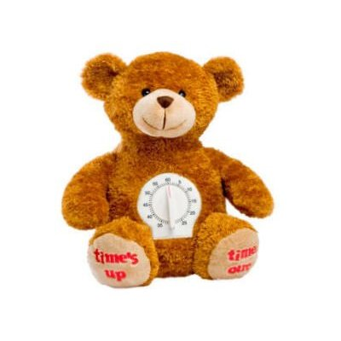
BEAR:
Benchmarking the Efficiency of RDF Archives
Blueprint on benchmarking archives of semantic data
  How can one define the corpus?
  How can one design benchmark queries? Which queries?
BEAR: concrete basic benchmark
  Data: Crawl from Linked Data Observatory
  Basic queries: Materialize, get Version…
  Initial evaluation on archiving policies

Slide 45
BEAR: Benchmarking the Efficiency of RDF Archiving
Blueprint on benchmarking archives of semantic data
  How can one define the corpus?
  How can one design benchmark queries? Which queries?
BEAR: concrete basic benchmark
  Data: Crawl from Linked Data Observatory
  Basic queries: Materialize, get Version…
  Initial evaluation on archiving policies

Slide 46

BEAR: Benchmarking the Efficiency of RDF Archiving
Define the corpus
  Number of versions / size
  Data dynamicity
    Version change ratio
    Version data growth
  Data static core
  Total triples (version-oblivious)
  RDF vocabulary
    Per version / evolution

Slide 47
BEAR: Benchmarking the Efficiency of RDF Archiving
Design of benchmark queries
  Cardinality / Selectivity + dynamicity
  Archive-driven C/S/D
  Version-driven C/S/D
  Basic temporal retrieval features of queries
    Version/Delta Materialization (V_{i})
    Version(Q): in which version Q is not empty
    Change(Vi,Vj): true if delta!=null
    Join(Q1,V_{i}, Q2,V_{j})
    Change(Q): Returns versions in which Diff(Q, V_{i}, V_{i-1}) !=∅

Slide 48
BEAR: instantiation of basic query features
Instantiation of basic archive queries, e.g. in AnQL [1]
  Antoine Zimmermann, Nuno Lopes, Axel Polleres, and Umberto Straccia. A general framework for representing, reasoning and querying with annotated Semantic Web data. Journal of Web Semantics (JWS), 12:72--95, March 2012.
  Mat(Q,V)
  Diff(Q,V1,V2)
  Ver(Q)
  join(Q1,vi,Q2,vj)
  Change(Q)
Open question remains:
What is the right query syntax for archive queries?
SELECT ?V1 ?V2 WHERE
{ {{P :?V1 } MINUS {P :?V2}} UNION
{{P :?V2 } MINUS {P :?V1}}
FILTER( abs(?V1-?V2) = 1 ) }

Slide 49
BEAR: Benchmarking the Efficiency of RDF Archiving
blueprint on benchmarking archives of semantic data
  How can one define the corpus?
  How can one design benchmark queries? Which queries?
BEAR: concrete basic benchmark
  Data: Crawl from Linked Data Observatory
  Basic queries: Materialize, get Version…
  Initial evaluation of archiving policies (IC,CB,TB)

Slide 50
BEAR: Benchmarking the Efficiency of RDF Archiving
Corpus

Slide 51
BEAR: Benchmarking the Efficiency of RDF Archiving
Queries and systems
  We implemented and evaluate archiving systems on Jena-TDB and HDT, based on IC, CB and TB policies.
    Confirm the initial premises of the archiving policies:
      In space, IC is the worst, CB improves the space and TB increases the size as it has to index a new dimension
      In time, CB is bad at getting a particular version because it has to reapply the changes … (but good e.g. for Change(SELECT * {?S ?P ?O})
    Serve as an initial baseline to compare archiving systems
    More info: https://github.com/webdata/BEAR

Slide 52
Finally, many open questions remain still!
Archiving and querying evolving semantic Web data
Objective | Research Question
Representation | minimize the redundant information respect the original modeling and provenance information
Query language | capture the expressiveness of emerging retrieval demands in archiving our base operations are meant to be an extensible starting point design a query language satisfying these requirements for evolving interlinked data
Indexing | index archives at large scale (and keeping up with evolution rate – streamingvs. archiving) to process the queries efficiently
Query optimization | optimizing query resolution plans for archives enabling the integration of other sources (federated infrastructure) Query rewriting for querying archives of structured non-RDF sources? Open Data!
Application | Is there a actual and urgent need in the community? We believe yes, but where’s the killer-app?

Slide 53
Thanks!
Big (Semantic) Data
Versions
Evolving Data
Streaming
Compression
Dept. of Information Systems & Operations
Institute for Information Business
Welthandelsplatz 1, 1020 Vienna, Austria
Univ.Prof. Dr. Axel Polleres
T +43-1-31336/5297
axel.polleres@wu.ac.at
polleres.net

Slide 54
Backup
Instantiation of archive queries in AnQL [1]
  Antoine Zimmermann, Nuno Lopes, Axel Polleres, and Umberto Straccia. A general framework for representing, reasoning and querying with annotated Semantic Web data. Journal of Web Semantics (JWS), 12:72--95, March 2012.
  Mat(Q,V)
  Diff(Q,V1,V2)
  Ver(Q)
  join(Q1,vi,Q2,vj)
  Change(Q)
SELECT * WHERE { Q :[v] }

Slide 55
Backup
Instantiation of archive queries in AnQL [1]
  Antoine Zimmermann, Nuno Lopes, Axel Polleres, and Umberto Straccia. A general framework for representing, reasoning and querying with annotated Semantic Web data. Journal of Web Semantics (JWS), 12:72--95, March 2012.
  Mat(Q,V)
  Diff(Q,V1,V2)
  Ver(Q)
  join(Q1,vi,Q2,vj)
  Change(Q)
SELECT * WHERE {
{ { {Q :[v1]} MINUS {Q :[v2]} } BIND (v1 AS ?V ) }
UNION
{ { {Q :[v2] } MINUS {Q :[v1]}} BIND (v2 AS ?V ) }

Slide 56
Backup
Instantiation of archive queries in AnQL [1]
  Antoine Zimmermann, Nuno Lopes, Axel Polleres, and Umberto Straccia. A general framework for representing, reasoning and querying with annotated Semantic Web data. Journal of Web Semantics (JWS), 12:72--95, March 2012.
  Mat(Q,V)
  Diff(Q,V1,V2)
  Ver(Q)
  join(Q1,vi,Q2,vj)
  Change(Q)
SELECT * WHERE { P :?V }

Slide 57
Backup
Instantiation of archive queries in AnQL [1]
  Antoine Zimmermann, Nuno Lopes, Axel Polleres, and Umberto Straccia. A general framework for representing, reasoning and querying with annotated Semantic Web data. Journal of Web Semantics (JWS), 12:72--95, March 2012.
  Mat(Q,V)
  Diff(Q,V1,V2)
  Ver(Q)
  join(Q1,v1,Q2,v2)
  Change(Q)
SELECT * WHERE { {Q :[v1]} {Q :[v2]} }

Slide 58
Backup
Instantiation of archive queries in AnQL [1]
  Antoine Zimmermann, Nuno Lopes, Axel Polleres, and Umberto Straccia. A general framework for representing, reasoning and querying with annotated Semantic Web data. Journal of Web Semantics (JWS), 12:72--95, March 2012.
  Mat(Q,V)
  Diff(Q,V1,V2)
  Ver(Q)
  join(Q1,vi,Q2,vj)
  Change(Q)
SELECT ?V1 ?V2 WHERE
{ {{P :?V1 } MINUS {P :?V2}} UNION
{{P :?V2 } MINUS {P :?V1}}
FILTER( abs(?V1-?V2) = 1 ) }

