Slide 1
Technical aspects vs. Innovation challenges of Enabling and Enhancing Privacy
Axel Polleres
http://polleres.net Twitter: @AxelPolleres
(Thanks for their contributions to: Sabrina Kirrane, Erwin Filtz, Sushant Agarwal, Javier Fernandez,…)

Slide 2
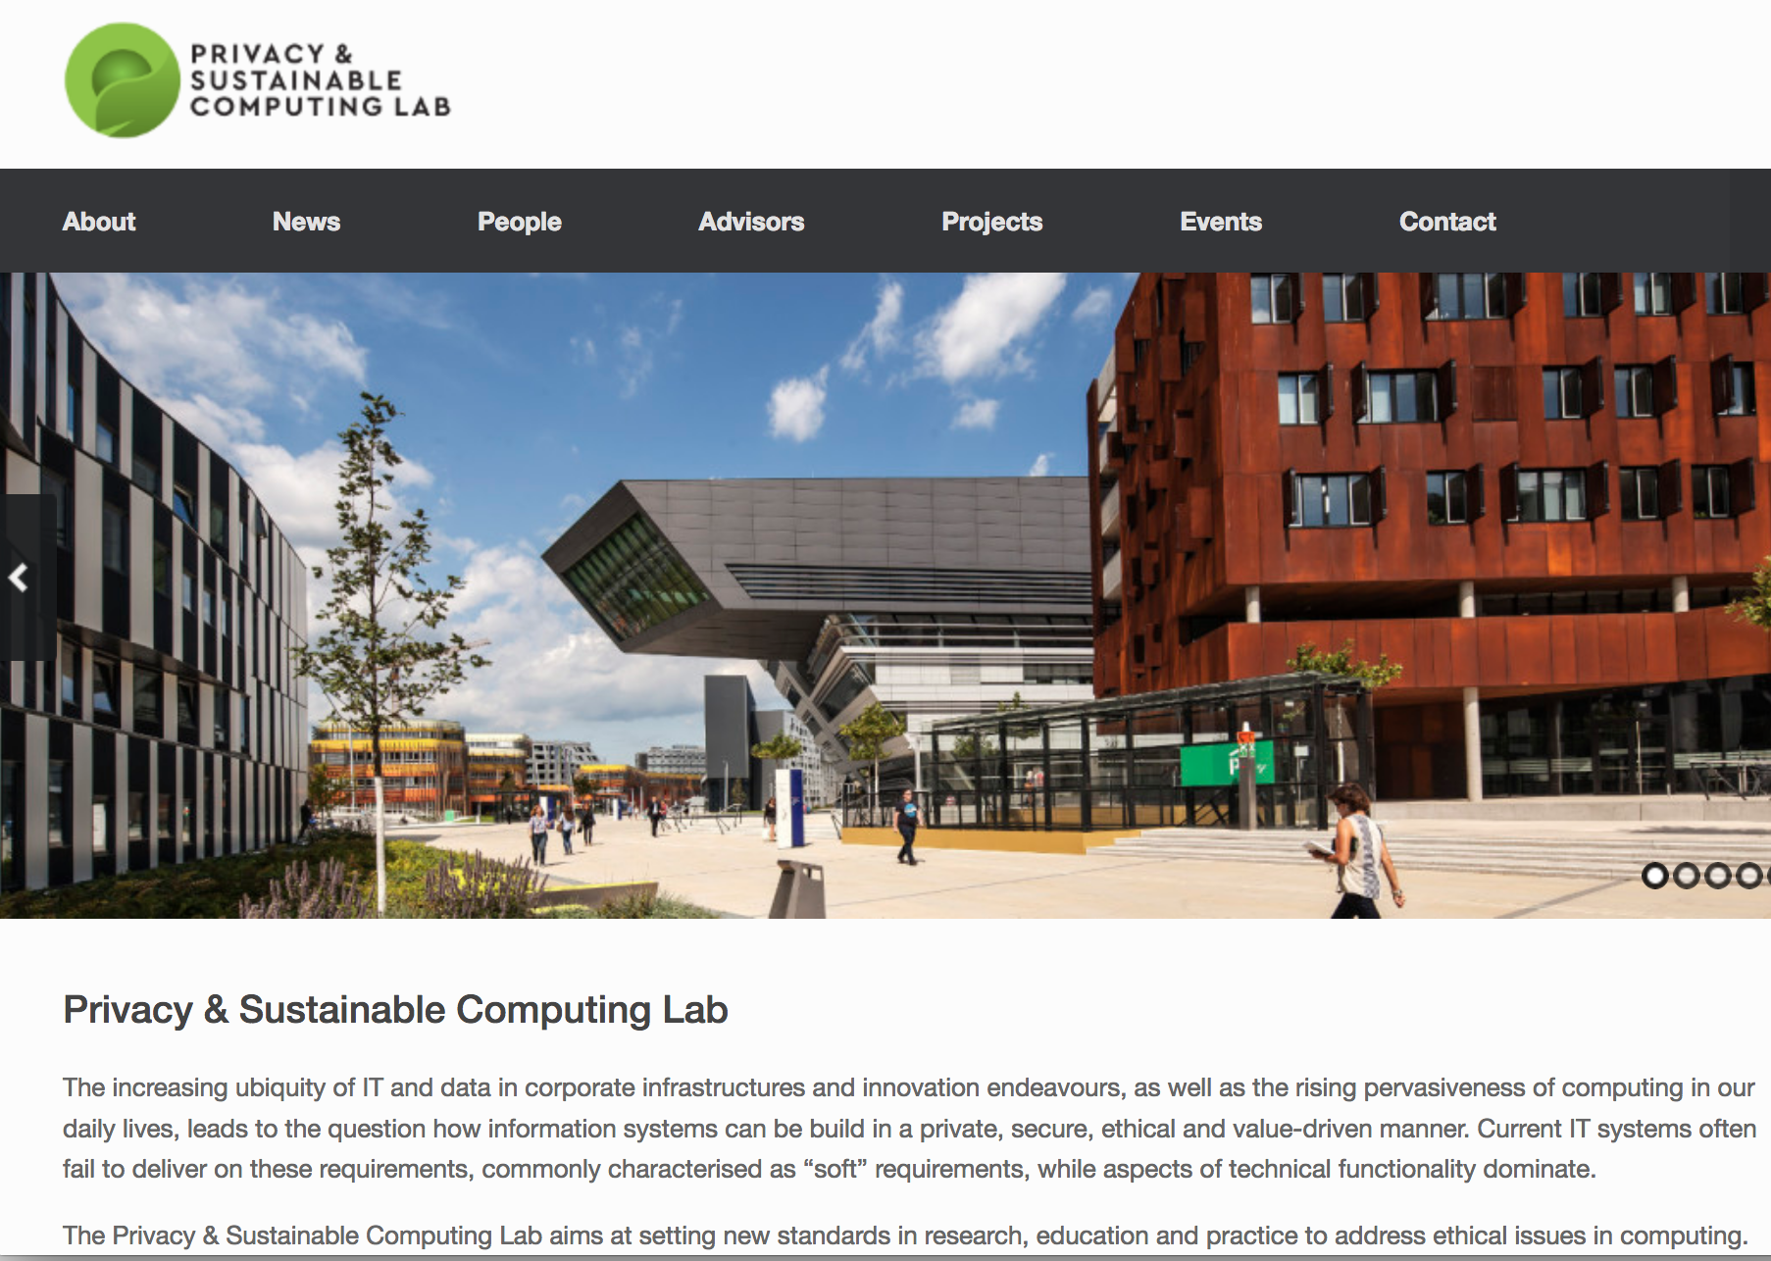



Where I am coming from, collaborators…
Privacy & Sustainable Computing Lab
http://www.privacylab.at/
Launched September 2016, launch event with various important stakeholders: technologists, standardization, activists…
Goal: setting new standards in research, education and practice to address ethical issues in computing.
Dr. Sabrina Kirrane
(Lab Director)
Prof. Sarah Spiekermann (co-founder)
Prof. Axel
Polleres
(co-founder)

Slide 3










Privacy in the EU: all about the upcoming GDPR, various national and European research efforts…
Trilogue starts
6/24/2015
Draft of the regulation
EU Council finalises the chapters
Comes into force
7/22/2012
8/6/2015
5/15/2018
Revisions in the draft
Discussions in the EU Council
Trilogue agrees
3/12/2013
5/19/2014
12/17/2015
2013
2014
2015
2016
2017
2018

Slide 4
Main technical challenges (prioritized from our point of view)
Informed Consent & Policies
Transparency, Deletion
Subjectivity
Anonymization
Last, but not least, and for all these challenges: Protection vs. Innovation?

Slide 5
Consent & Policies
GDPR requirements:
Opt-in, consent declarations
Demonstrate consent
Freely given
Clearly distinguishable
Withdraw consent at any time
Article # | Title | Description
7 | Conditions for consent | Controllers should be able to demonstrate the 'freely given' consent from data subjects and should provide the right to withdraw consent any time
Discussion:
How to guarantee opt-in has been understood? Policy templates, “Privacy Icons”
Research proposes that opt-out, interactive processes, and partial consent are more intuitive than opt-in by monolithic consent forms
Giving consent online has many behavioural and UI components!
Can I delegate consent to a personal agent?
  How to express and execute consent policies in provable machine readable form?
  Would that legally hold?
Notes:
backup

Slide 6
Transparency, Access, Rectification, Deletion
Article # | Title | Description
12 | Transparent information, communication and modalities for the exercise of the rights of the data subject | To provide info related to processing in concise, transparent, intelligible and easily accessible form, using clear and plain language..
15 | Right of access for the data subject | Right to access personal data which is collected and processed and to know which data is processed
16 | Right to rectification | Right to ask controllers to rectify any inaccurate personal data regarding them
17 | Right to erasure (“right to be forgotten”) | Right to ask controllers to delete their personal data
18 | Right to restriction of processing | Right to ask controllers to restrict processing of personal data
Trust via Transparency
Concise, transparent, intelligible and easily accessible information about processing
Using clear and plain language
Standardized icons (machine-readable)
Discussion:
Develop agreed models to present transparency data in a standardized manner, allowing the user to access the data collected about them in an integrated manner (e.g. Linked Data, PROV, extensions…)
Open questions in terms of deletes (e.g. feasibility of Hard deletes in cloud environments) vs. transparency demands.
Protocols to store transparency information (Blockchain is not the only option!)
Transparent Personal Data Processing: The Road Ahead
Piero Bonatti, Sabrina Kirrane, Axel Polleres, and Rigo Wenning
TELERISE: 3rd International Workshop on TEchnical and LEgal aspects of data pRIvacy and SEcurity @ SAFECOMP2017 (to appear)

Slide 7
Subjectivity
Ambiguity/Room for interpretation in the GDPR
e.g. conflicting(national) laws with the GDPR
Different national interpretations
?
>
Rights to protection of property
Directive on electronic commerce (2000/31/EC)
Rights of privacy
Data Protection Directive (95/46/EC)
Copyright directive (2001/29/EC)
Directive on the enforcement of intellectual property rights (2004/48/EC)
Charter of Fundamental Rights of the European Union (Art 17(2))
Directive on privacy and electronic communications (2002/58/EC)
Charter of Fundamental Rights of the European Union (Art 7, 8)
Discussion:
Metrics for e.g. understandability of privacy terms
Standardization?
Investigate/analyze case law

Slide 8
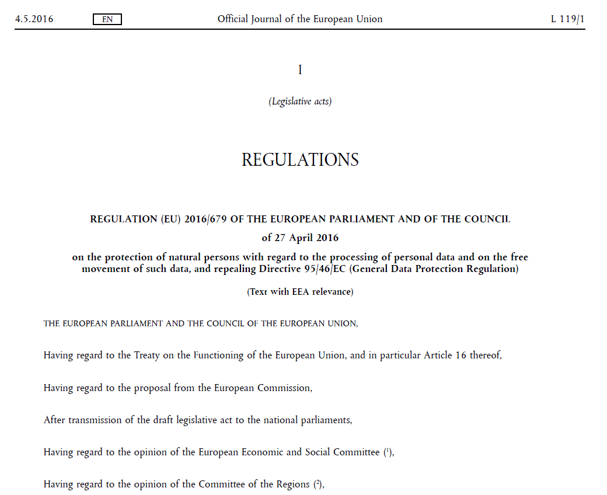
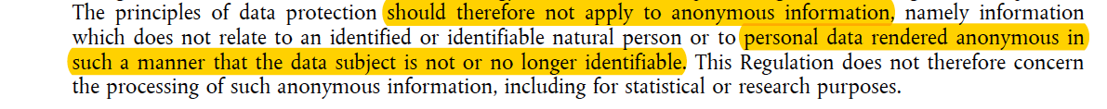
Anonymization for Innovation?
Which K should we use for
K-Anonymity? K-Anonymity is not enough!
Best practices and industry strength tools needed!
The GDPR does not apply to anonymous data where the data subject is no longer identifiable.

Slide 9


Our current solution approach:
The SPECIAL project
https://www.specialprivacy.eu/

Slide 10
Our current solution approach:
The SPECIAL project
Objectives
Policy management framework
  Gives users control of their personal data
  Represents access/usage policies and legislative requirements in a machine readable format
Transparency and compliance framework
    Provides information on how data is processed and with whom it is shared
    Allows data subjects to take corrective action
Scalable policy-aware Linked Data architecture
    Build on top of the Big Data Europe (BDE) platform scalability and elasticity mechanisms
    Extended BDE with robust policy, transparency and compliance protocols

Slide 11

SPECIAL Technical components:
Big Data Europe scalability and elasticity
PrimeLife policy languages, access control policies, release policies and data handling policies

Slide 12
Technical aspects vs. Innovation challenges
Summary and input for discussion:
  Technical support for privacy should be understood as an innovation driver/asset, not an obstacle!
    Many opportunities for tools and algorithmic support
    E.g.
      formalizing and reasoning about Policies + data analytics about case law (=Rules + Data Science)
      UIs, Standards, Best Practices
      Linked Data for Privacy!
  Take the enterprise view of Big Data analysis into account!
  Harmonization on Privacy law alone is not enough, but also on the national interpretations and conflicting laws!
  Thank you!

