Slide 1
EXPloring opportunities and challenges for Emerging personal DaTa Ecosystems: Empowering humans in the age of the GDPR - A Roadmap for Austria
Axel Polleres

Slide 2
Personal Data Processing on Internet
Current State:
Personal data as siloed commodity owned(?) and controlled by data controllers
More and more personal data are collected
Tension between privacy and personalized services
Differences in handling between big online companies and SMEs/non-online organisations
Our perspective
Empowering humans to take control over their personal data
Interdisciplinary approach
Use GDPR as an incentive
Soheil Human – FIF | BMVIT, Vienna 3.12.2018

Slide 3
Project Objectives
Exploring opportunities and challenges for Emerging Human-centric Personal Data Ecosystems
Testing GDPR-readiness in Austria
Collaboration with W3C on standardization of Personal Data Vocabularies on Internet
Exploring gaps and collaboration enabling mechanisms towards Human-centric Personal Data Processing
Establishing a MyData Hub in Austria
Proposing a roadmap for Austria

Slide 4
EXPEDiTE
EXPloring opportunities and challenges for Emerging personal DaTa Ecosystems: Empowering humans in the age of the GDPR - A Roadmap for Austria
Soheil Human – FIF | BMVIT, Vienna 3.12.2018

Slide 5
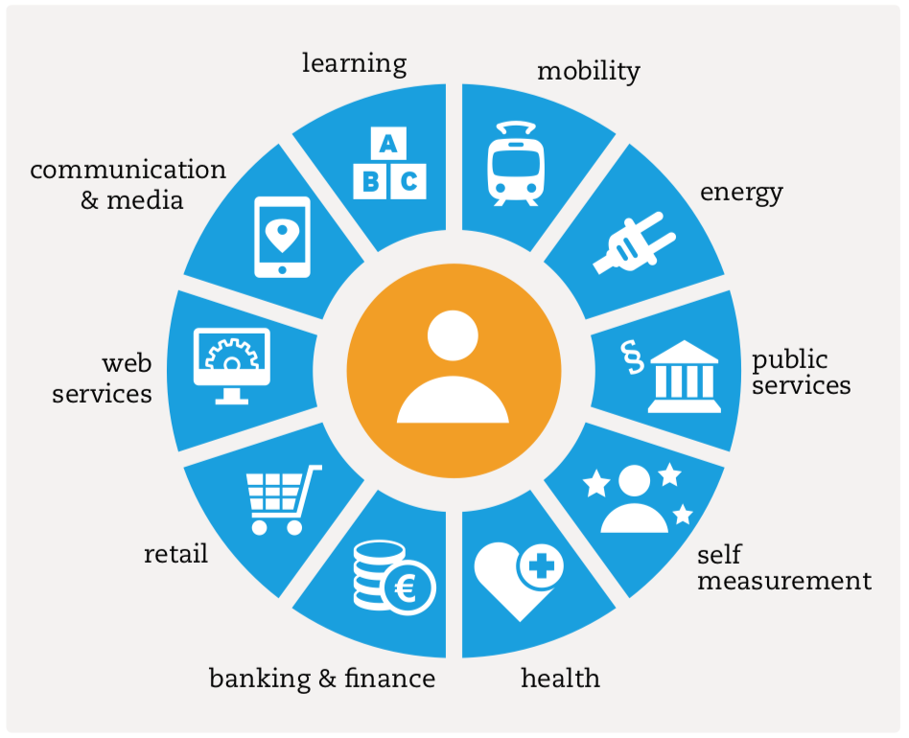
Synergies:
MyData Austria Hub
http://specialprivacy.eu/
https://mydata.org/

Slide 6
Call for Action: Join DPVCG!
Support efforts for interoperability/vocabularies to protect and “free” personal data!
Joining is easy!
The group is Open to everyone!
Just create a W3C account
https://www.w3.org/community/dpvcg/

