Slide 1
From Open Data Portals to Open Data-Ecosystems Experiences & thoughts on how to proceed from monitoring and analyzing Open Data Portals
Axel Polleres
Institute for Data, Process & Knowledge Management
http://www.polleres.net/

Slide 2
My background
from Open Data-Ecosystems
to Open Data
SLIDE 2
Notes:
my own background is in Databases, Data Intgegration and Knowledge representation, so I could rather claim throught the course of my research I rather came from ODE to OD…

Slide 3
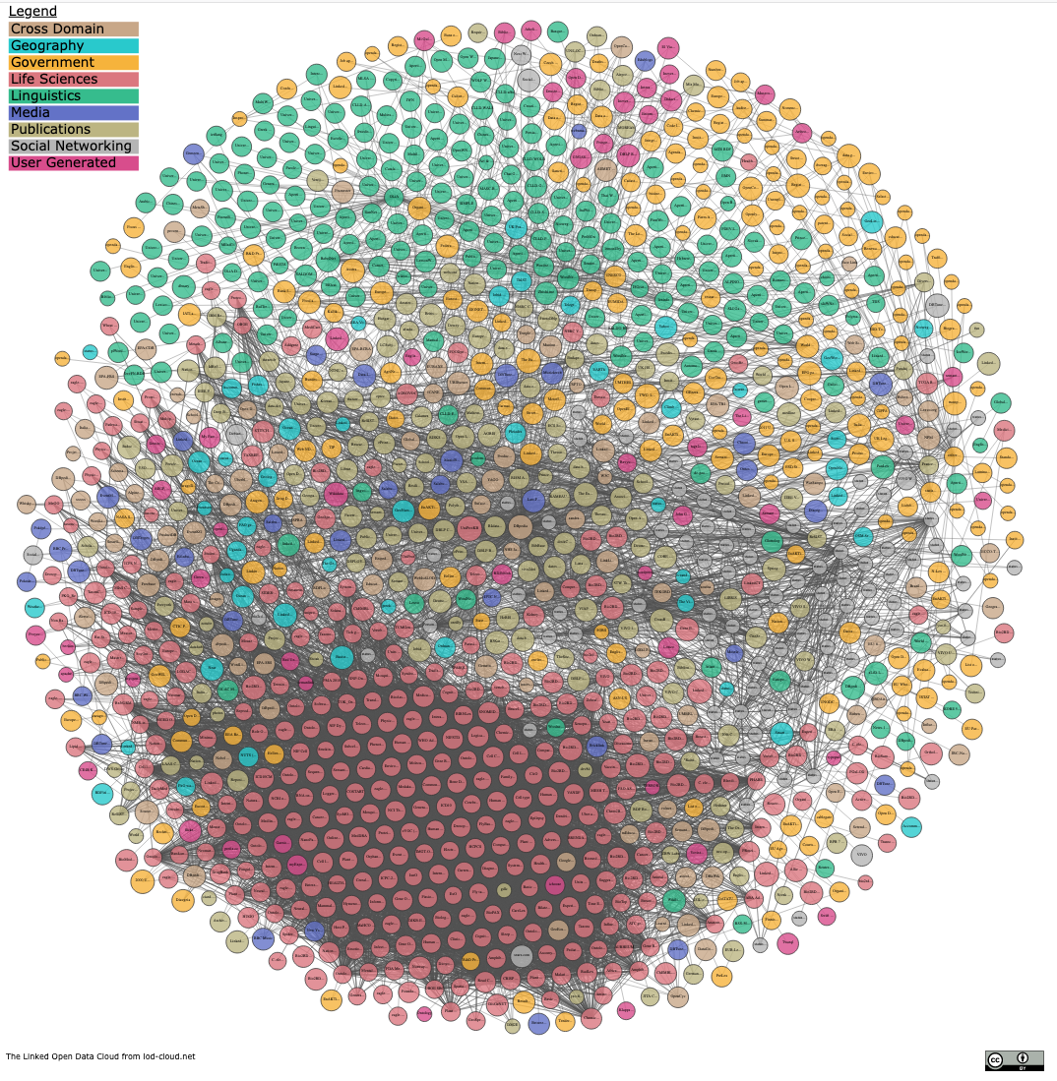
My background - The "Web of Data"
past ~15 years research in Semantic Web and Linked (Open Data)
Standards (RDF, SPARQL, etc.) for
machine-readable
decentralized
Data Publishing & Processing
… which has led to a network of distributed, partially connected
Data Graphs
Armin Haller, Javier D. Fernández, Maulik R. Kamdar, and Axel Polleres. What are links in linked open data? a characterization and evaluation of links between knowledge graphs on the web. ACM Journal of Data and Information Quality (JDIQ), to appear, accepted for publication, 2020. Pre-print available at https://epub.wu.ac.at/7193/.
Knowledge
SLIDE 3
Notes:
particularly I mean…
THe goal here was to beuild a "Web of Data", where, if we see the Web as an information space and ecosystem, the main question is how we could best use this ecosystem to share/exchange data.
Standards for data sharing, decentralized querying and publishing, as well as processingm which has grown into the – you all know it LOD cloud.
Each of these nodes represents a separate RDF knowledge graph, these knowledge graps are linked which

Slide 4
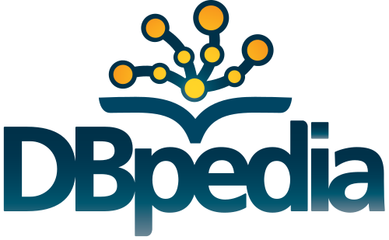
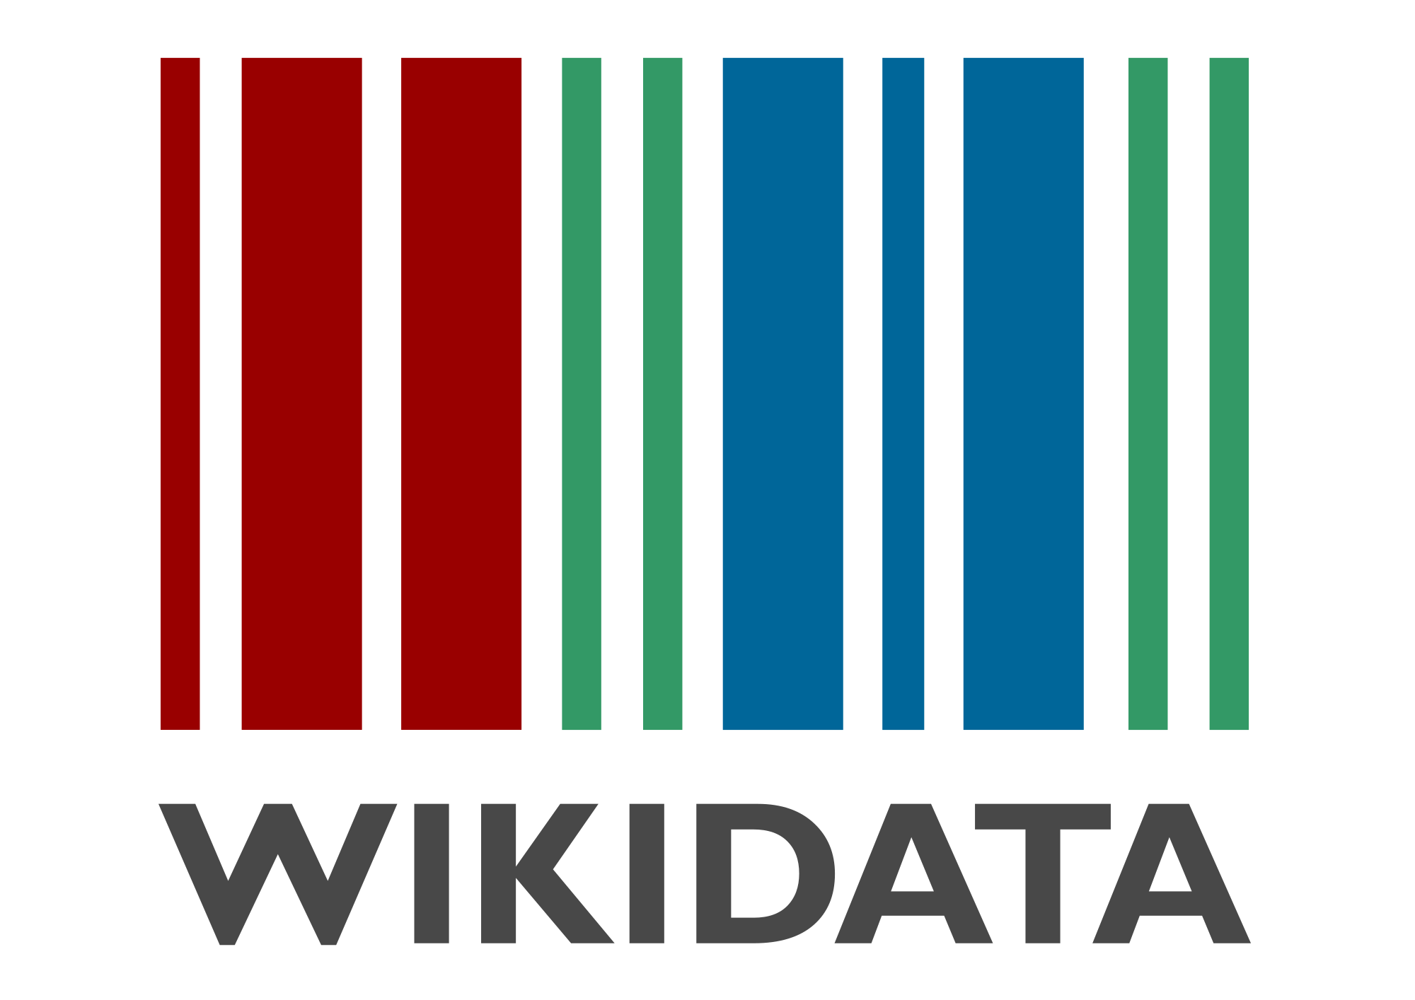
My background - The "Web of Data"
state of affairs:
+ common data and meta-data format (RDF)
+ Ontologies are reused widely (~ i.e., widely reused meta—data schemata)
+ fairly scalable methods for distributed processing and querying
+ widely used "centernodes" around which knowledge can "chrystalize"
(while maybe less expressive than originally expected)
(still a very active, stimulating academic research area!)
Armin Haller, Javier D. Fernández, Maulik R. Kamdar, and Axel Polleres. What are links in linked open data? a characterization and evaluation of links between knowledge graphs on the web. ACM Journal of Data and Information Quality (JDIQ), to appear, accepted for publication, 2020. Pre-print available at https://epub.wu.ac.at/7193/.
SLIDE 4

Slide 5
My background - The "Web of Data"
state of affairs:
lack of instance data links
(28% of datasets do not link to external instances)
broken class and property links
(schema definitions disappear, or exist multiple times,
hard to maintain by academics)
plethora of data and metadata formats, (still) missing publishing best practices
Findability, (machine-)Accessability, Interoperability and
Reuse/Reusability only partially given…
? https://www.go-fair.org/fair-principles/
SLIDE 5

Slide 6
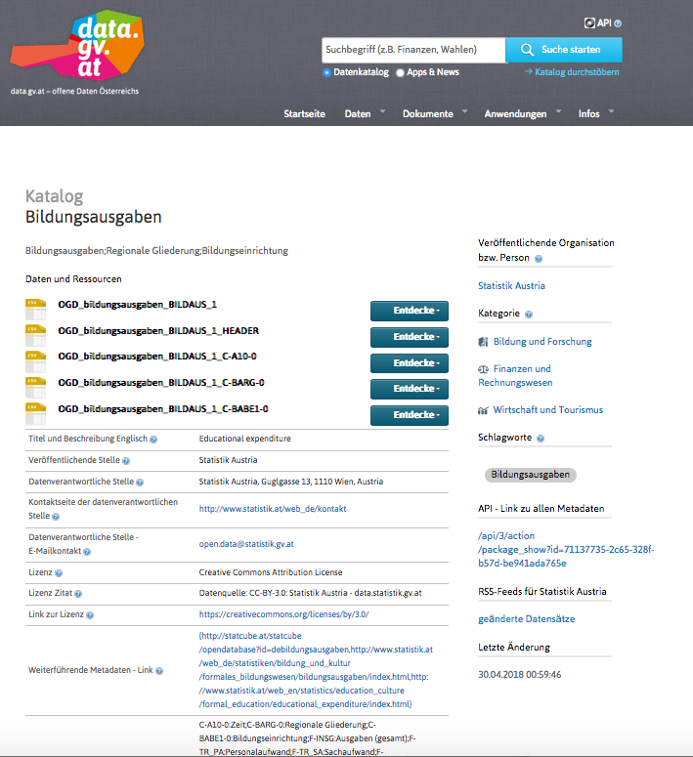
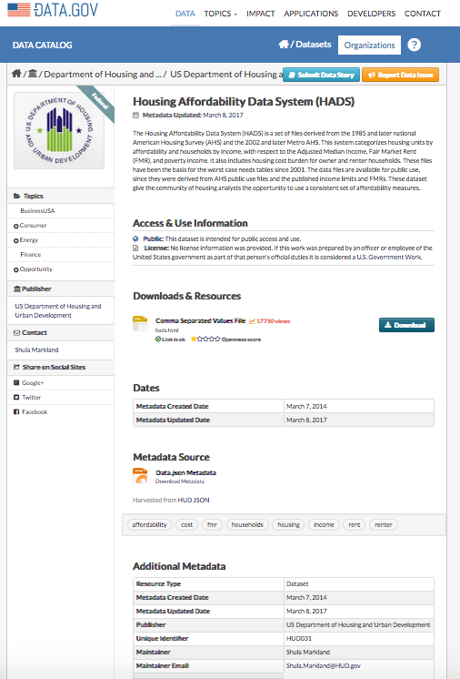
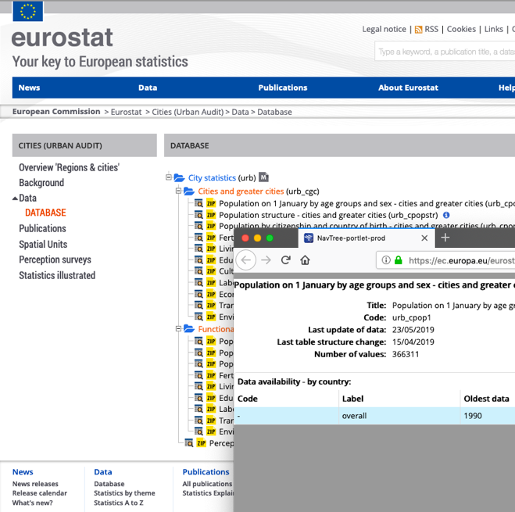
My background – Meanwhile in parallel…
We got quite excited about Open (Government) Data developments!
Open Data portals…
Uniform metadata, accessible via common APIs (mostly JSON, rather than RDF).
Uptake and use mostly in the form of Apps, Data journalism, etc. using single datasets.
SLIDE 6

Slide 7
Can (Open) Data portals be a more viable basis for making the Web of Data a reality?
Big hopes (also for us as researchers!) & political push!
Stefan Bischof, Axel Polleres, and Simon Sperl. City data pipeline - a system for making open data useful for cities. In I-SEMANTICS 2013 Posters & Demonstrations Track, volume 1026 of CEUR Workshop Proceedings, pages 45--49, Graz, Austria, September 2013. CEUR-WS.org. [ .pdf ]
Jürgen Umbrich, Sebastian Neumaier, and Axel Polleres. Quality assessment & evolution of open data portals. In IEEE International Conference on Open and Big Data, Rome, Italy, August 2015.
May 2009 – launch data.gov
December 2011 – Neelie Kroes EU VP for Digital Agenda Data announced EU Open Data Strategy
EU Open Data Strategy
May 2013 – Obama's executive order makes open data default for gov.information
March 2010 – Data.gov.uk launched
SLIDE 7

Slide 8
Can we use Open Data as a Web of Data?
Stefan Bischof, Axel Polleres, and Simon Sperl. City data pipeline - a system for making open data useful for cities. In I-SEMANTICS 2013 Posters & Demonstrations Track, volume 1026 of CEUR Workshop Proceedings, pages 45--49, Graz, Austria, September 2013. CEUR-WS.org. [ .pdf ]
PhD thesis 2017
Answer:
partially,
manual integration of a handful of sources
lots of missing data
We can develop new methods for automatic, scalable integration and model building (using Semantic Web technologies and Machine Learning!)
Hope:
The more data becomes available,
the better (data quality & amount ) it will work!
Can we collect and use Open Data to answer relevant questions?
e.g. developments of Cities
(in Europe, worldwide)
SLIDE 8

Slide 9
Does Open data develop into a viable Data-Ecosystem?
Hope: The more Open data becomes available, the better it wil work!
Jürgen Umbrich, Sebastian Neumaier, and Axel Polleres. Quality assessment & evolution of open data portals. In IEEE International Conference on Open and Big Data, Rome, Italy, August 2015.
Can we monitor Open Data development and quality?
Can we automatically collect and integrate Open Data?
Can we make Open Data more FAIR automatically?
SLIDE 9

Slide 10
Does Open data develop into a viable Data-Ecosystem?
Hope: The more Open data becomes available, the better it wil work!
Jürgen Umbrich, Sebastian Neumaier, and Axel Polleres. Quality assessment & evolution of open data portals. In IEEE International Conference on Open and Big Data, Rome, Italy, August 2015.
Can we monitor Open Data development and quality?
Can we automatically collect and integrate Open Data?
Can we make Open Data more FAIR automatically?
SLIDE 10

Slide 11
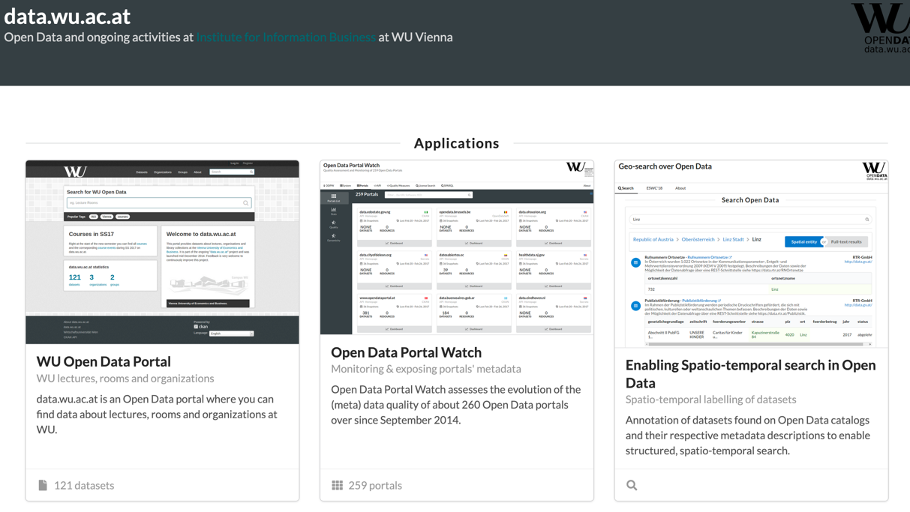
Monitoring and Integrating Open Data
Open Data Quality and Usability
Semantic enrichment of Data Catalogs
Dataset Search
https://data.wu.ac.at/
http://adequate.at/
https://www.communidata.at/
SLIDE 11

Slide 12
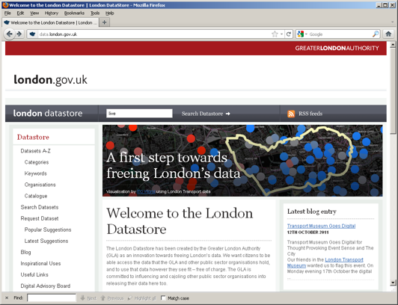
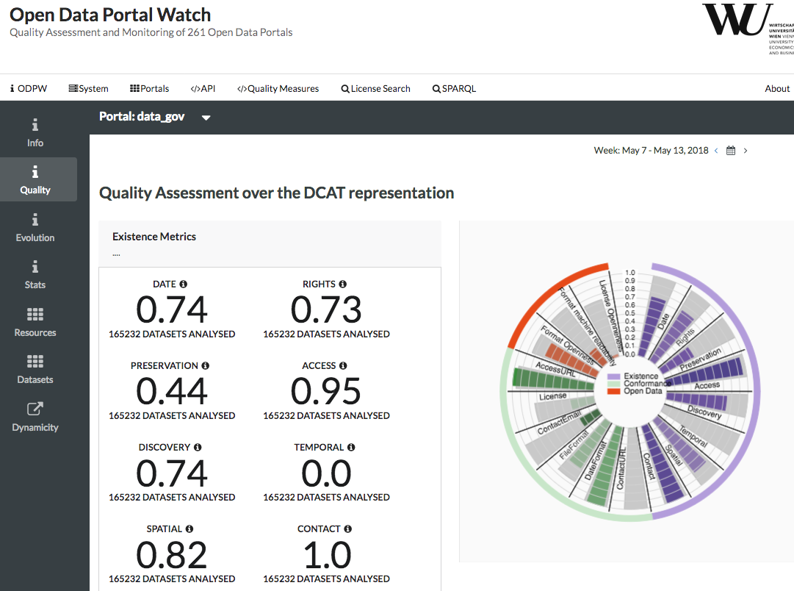
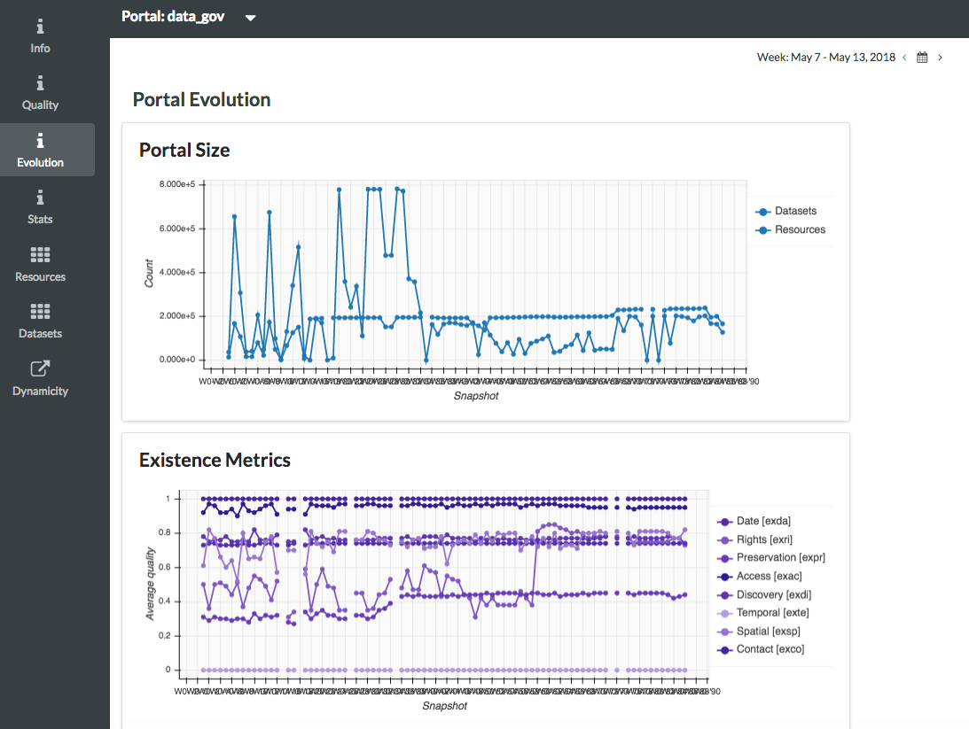
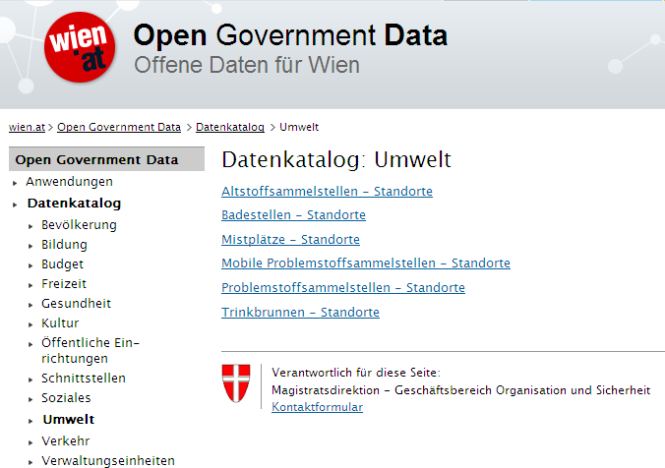
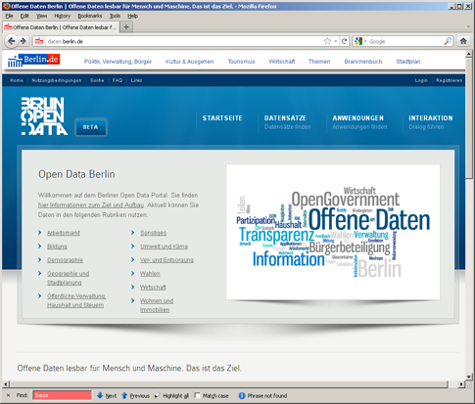
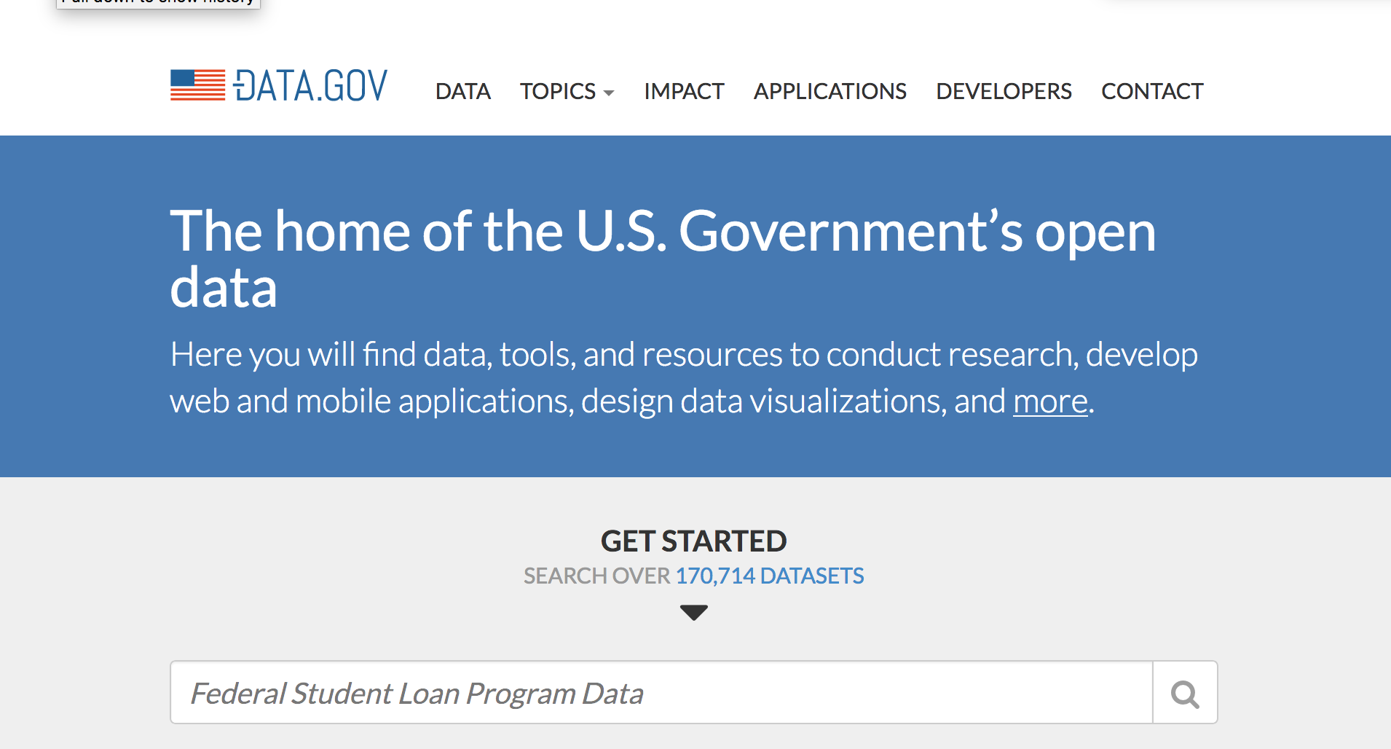
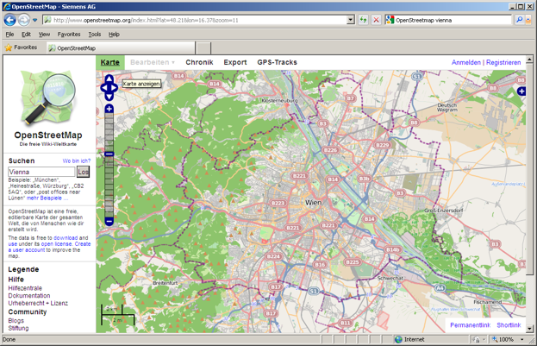
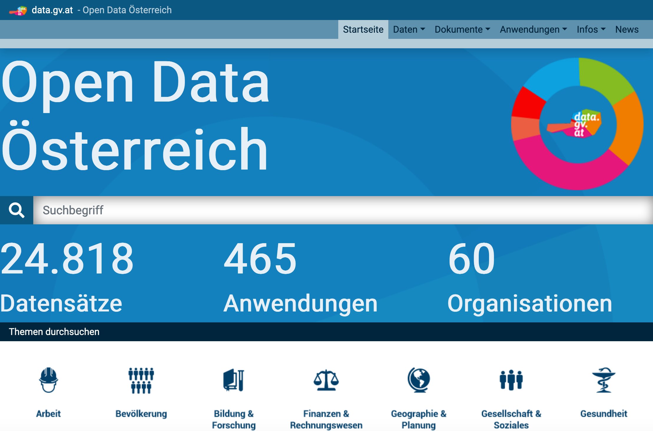
Open Data Portalwatch (collecting and assessing metadata quality over time):
http://data.wu.ac.at/portalwatch/portal/data_gov/1818
DIRECTIVE 2007/2/EC INSPIRE
12
SLIDE 12

Slide 13
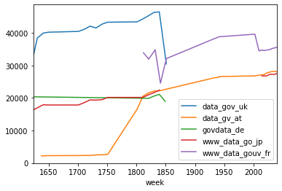
Hope: The more Open data becomes available, the better it wil work!
Does actually more (meta-)data become available?
no unique answer…
afffected by:
failed crawls
wrong metadata
portal maintanance
changing interfaces/APIs
merged/consolidated datasets
last but not least: (our own) crawler maintanance/reengineering
… but
Therein lies the problem!
Why is the metadata not made available historically in first place?
Last,but not least: what should we measure?
#datasets? #resources?
#size_of_datasets/resources?
how? in fact:
advertised sizes differ from downloadable file sizes,
compression, etc.
"current" vs "incremental" datasets
Help? Google?
SLIDE 13

Slide 14
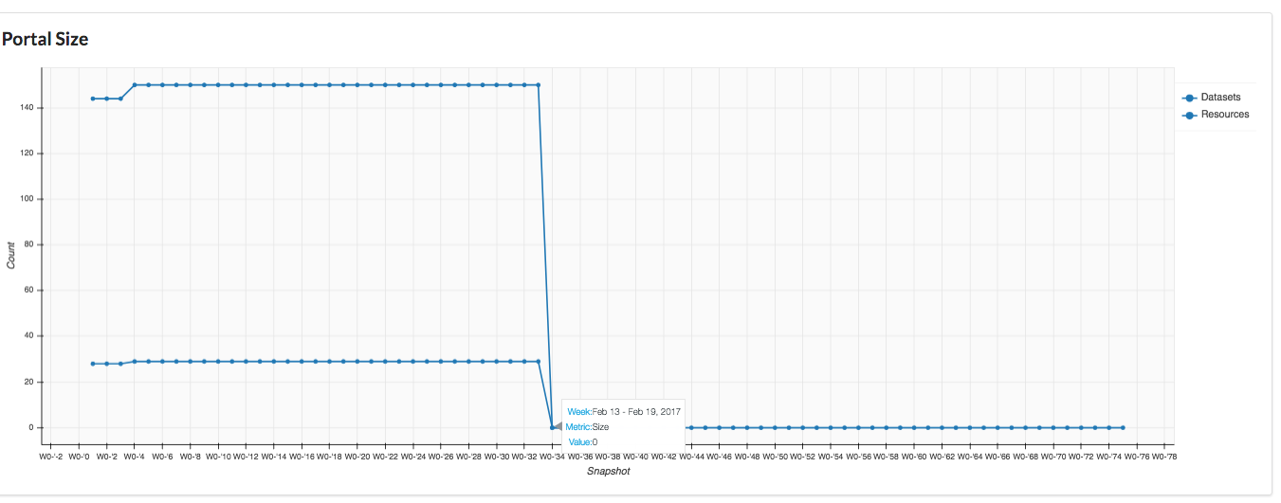
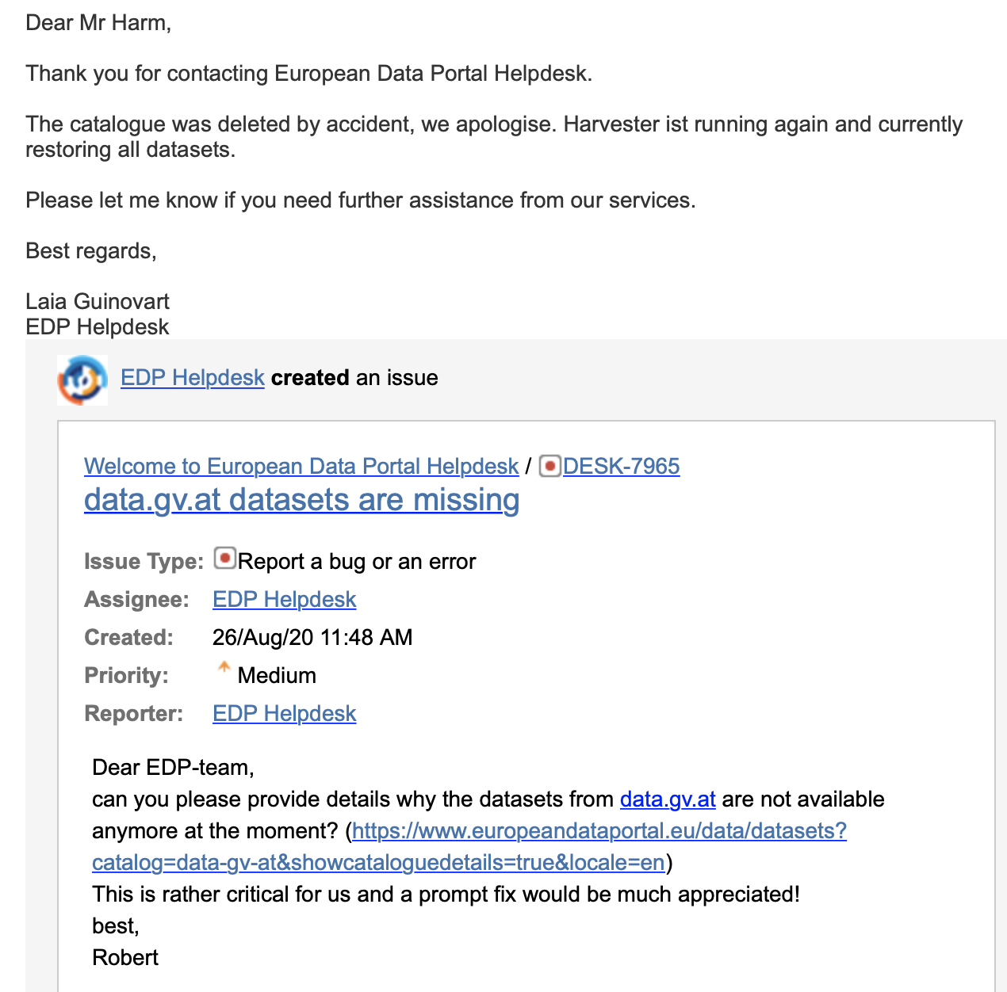
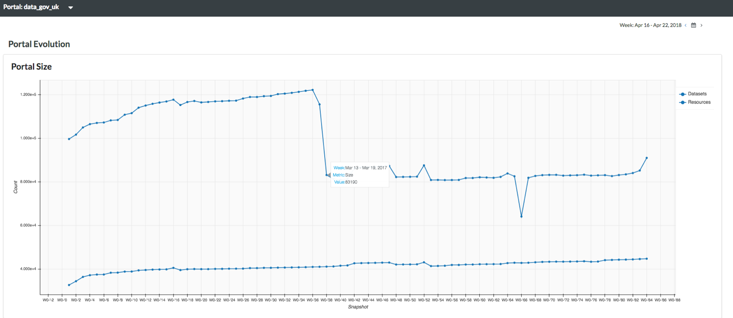
Hope: The more Open data becomes available, the better it wil work!
Does actually more (meta-)data become available?
more sample issues(?) …
http://data.wu.ac.at/portalwatch/portal/open_whitehouse_gov/1804/
Jan 20 2017 Inauguration of current US administration
http://data.wu.ac.at/portalwatch/portal/data_gov_uk/1815/evolution
Mar 29 2017
UK administration triggers “Article 50”
Mar 13 relaunchof the organization of data.gov.uk … so actually no data was taken offline, but just resources have been consolidated
SLIDE 14

Slide 15
Open Data Portalwatch
… Lessons learnt:
meta-data quality and portal QoS needs to be monitored at the portals
metadata integration (CKAN, SOCRATA, DCAT, schema-org) needed, pre-dating/feeding into Google's dataset search
accumulated a large corpus of Open data portal metadata and data to learn from and do further research… but a real sustainability strategy and a WebArchive for OpenData are needed!
SLIDE 15

Slide 16
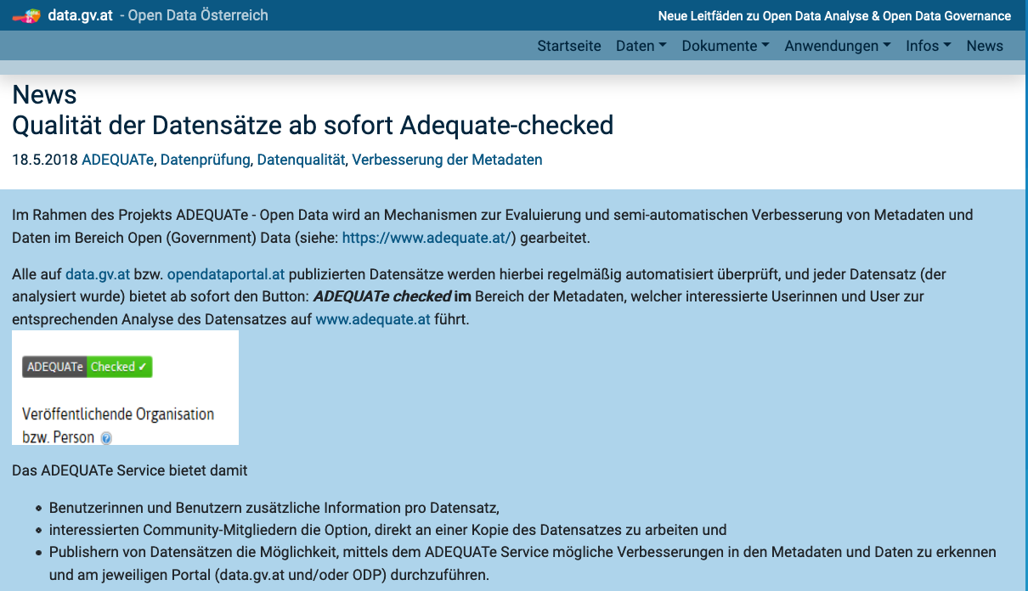
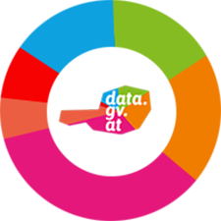
Meta-data quality and portal QoS best need to be monitored at the portals
Quality-check button (regular automated quality checks and feedback option for users) on the portal
Thurnay, L., Lampoltshammer, T. J., Neumaier, S., & Knap, T. (2019). ADEQUATe: A Community-Driven Approach to Improve Open Data Quality. In W. Abramowicz & A. Paschke (Eds.), Business Information Systems Workshops (pp. 555–565). Springer International Publishing. https://doi.org/10.1007/978-3-030-04849-5_48
SLIDE 16

Slide 17
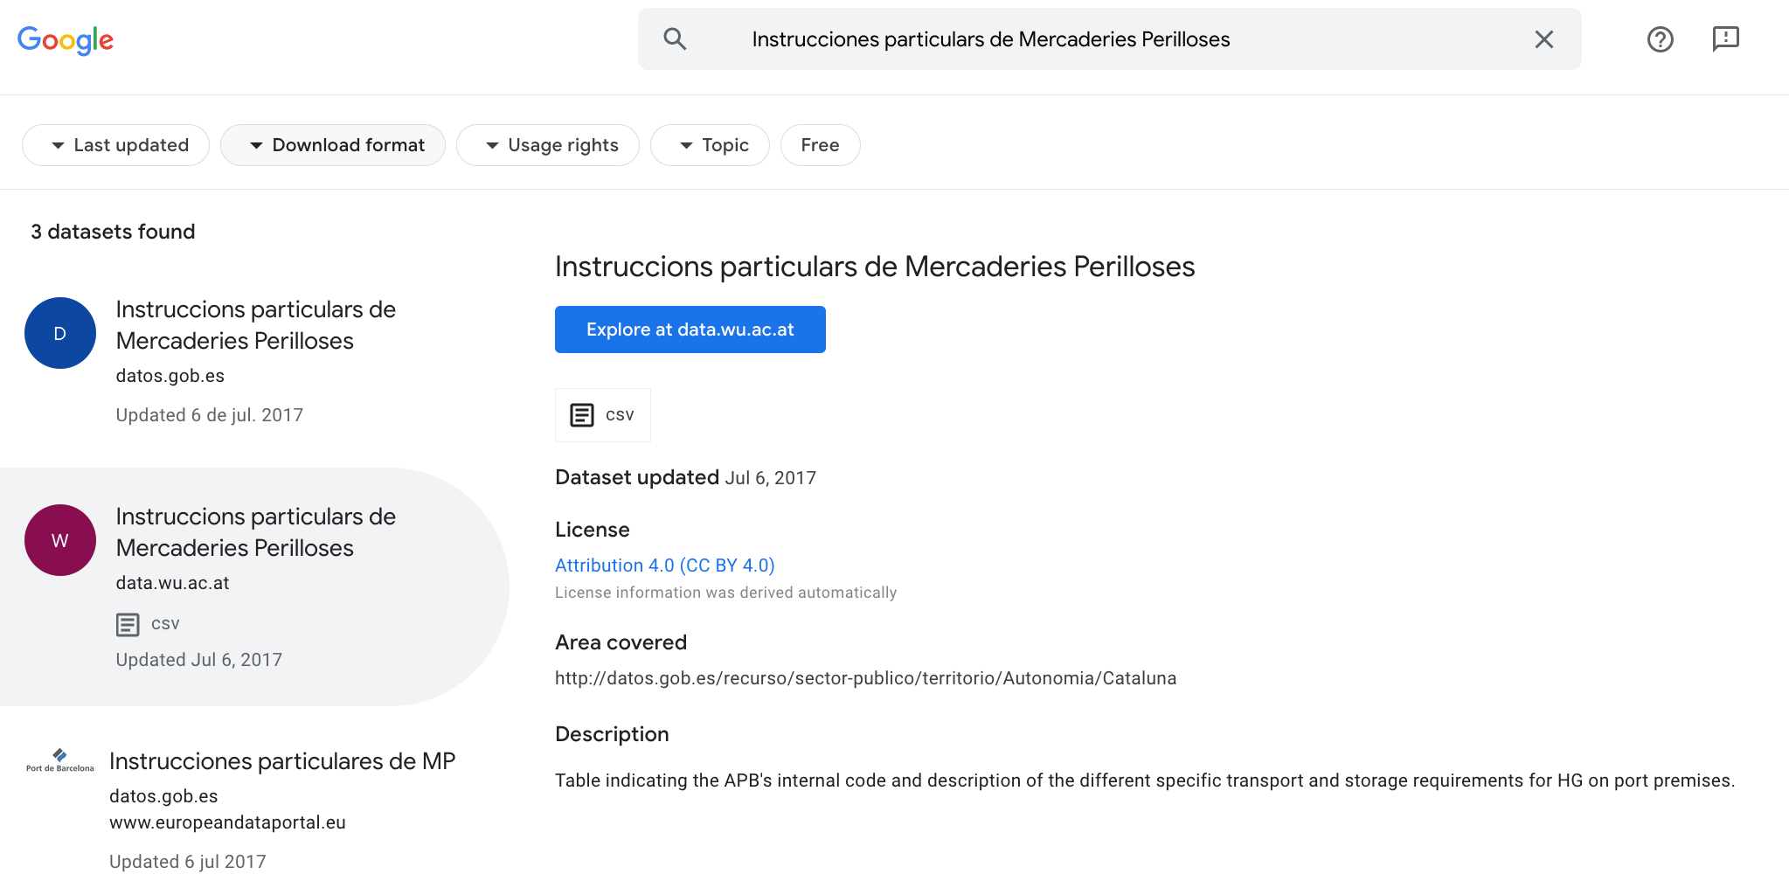
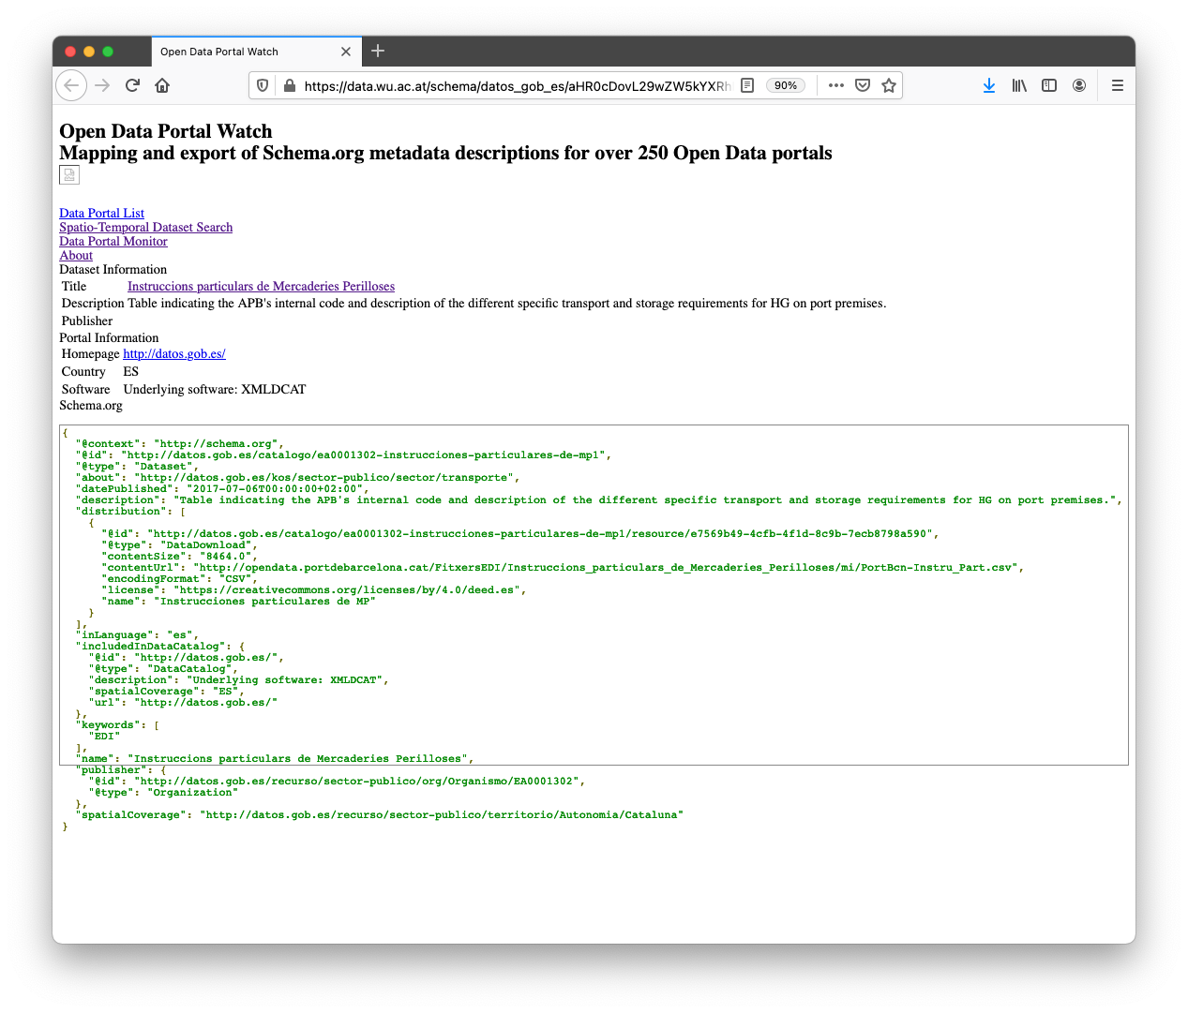
Metadata integration (CKAN, SOCRATA, DCAT, schema-org) pre-dating/feeding into Google's dataset search
Sebastian Neumaier, Jürgen Umbrich, and Axel Polleres. Lifting data portals to the web of data. In 10th Workshop on Linked Data on the Web (LDOW2017), Perth, Austrialia, April 2017. [ .pdf ]
SLIDE 17

Slide 18
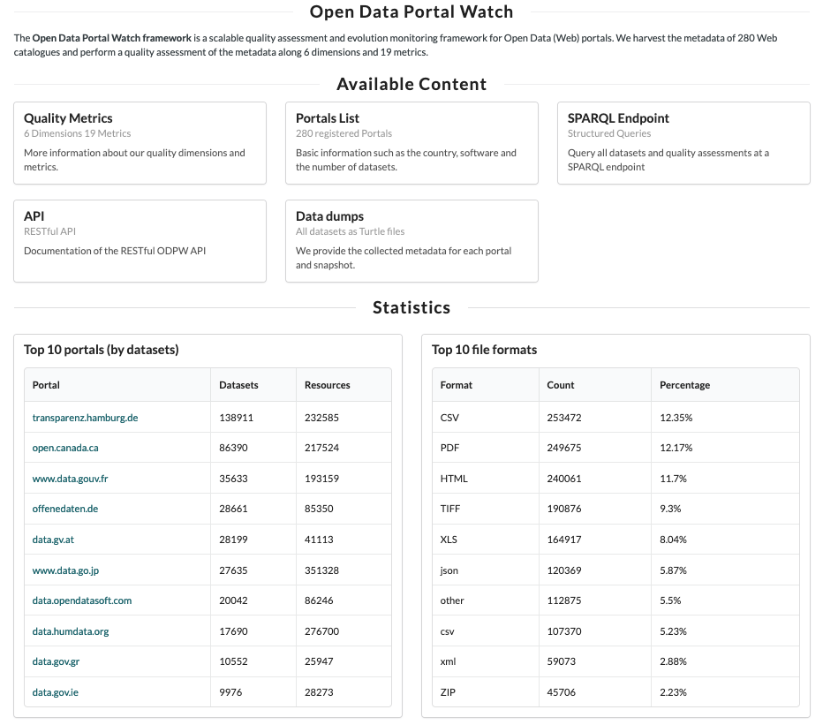
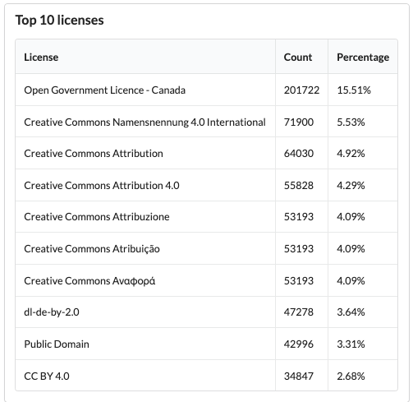
Large corpus of OpenData portal metadata & data
Johann Mitlöhner, Sebastian Neumaier, Jürgen Umbrich, and Axel Polleres. Characteristics of open data CSV files. In 2nd International Conference on Open and Big Data, August 2016. Invited paper. [ .pdf ]
SLIDE 18

Slide 19
What's next? What's missing for a FAIR (European) Data Ecosystem?
Findability
Accessability
Interoperability
Reuse/Reusability
Data search (is google Dataset search enough?)
Data archiving and uniform access
Enable (also) non-open data
Also "Democratize" Data Processing
Architectural Vision … decentralized data ecosystem
starting points are there
beyond current OpenData
platforms
SLIDE 19

Slide 20
Data search – Is google Dataset search enough?
Findability,
Accessability
Interoperability
Reuse/Reusability
Spatio-temporal search
Search for organisations
Find semantically comparable datasets
(needs semantic labeling of datasets)
Leopoldstadt
Dataset by the Federal Ministry of Digitalisation and Economic Affairs
Knowledge Graphs help!
Find datasets cominable with dataset XYZ
SLIDE 20

Slide 21
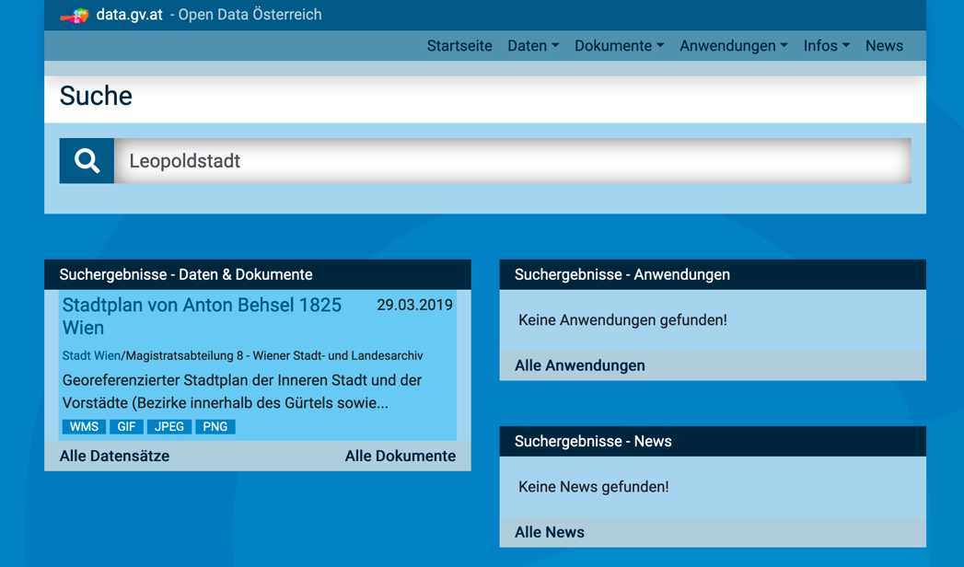
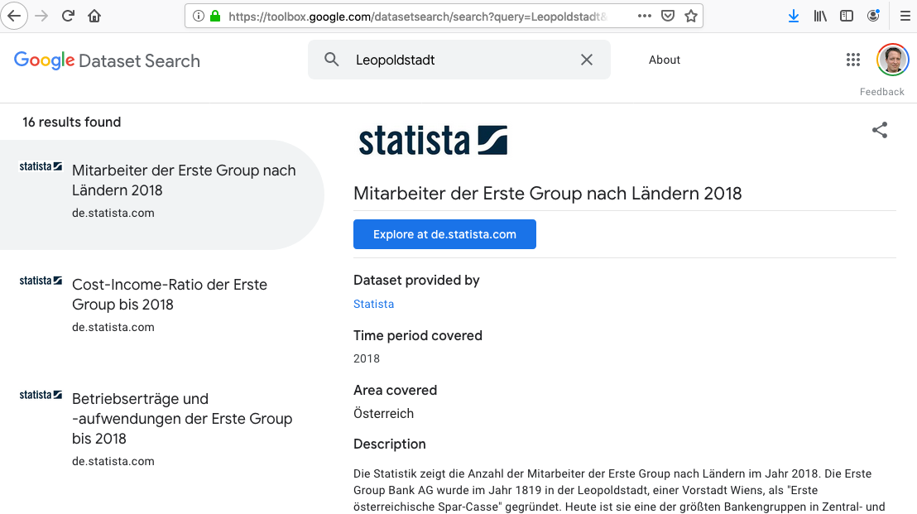
Data search – Is google Dataset search enough?
Findability,
Accessability
Interoperability
Reuse/Reusability
Leopoldstadt
Solution:
look into data, not only metadata!
link to Existing Knowledge Graphs!
Knowledge Graphs help!
Sebastian Neumaier and Axel Polleres. Enabling spatio-temporal search in open data. Journal of Web Semantics (JWS), 55:21--36, March 2019. [ DOI | http ]
SLIDE 21

Slide 22
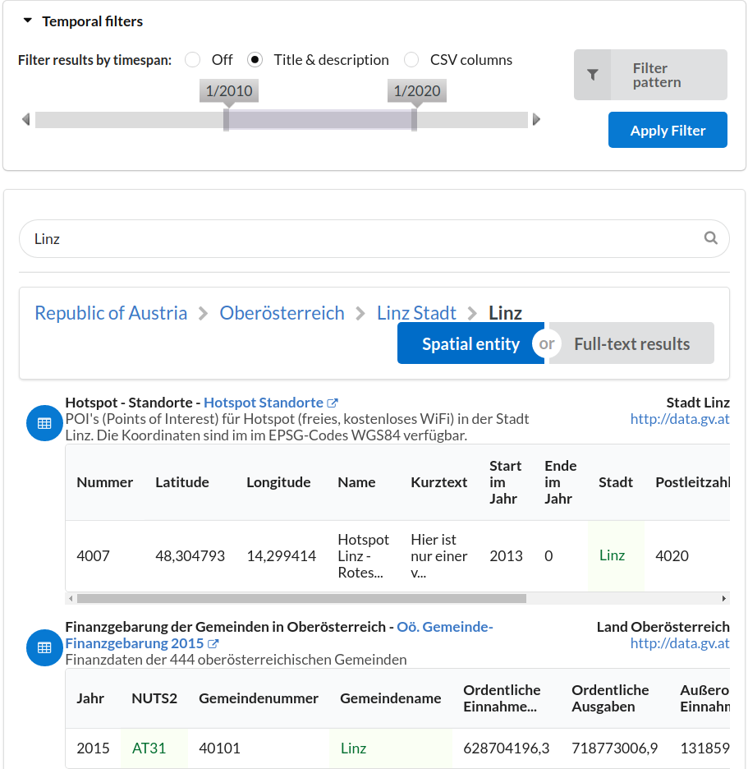
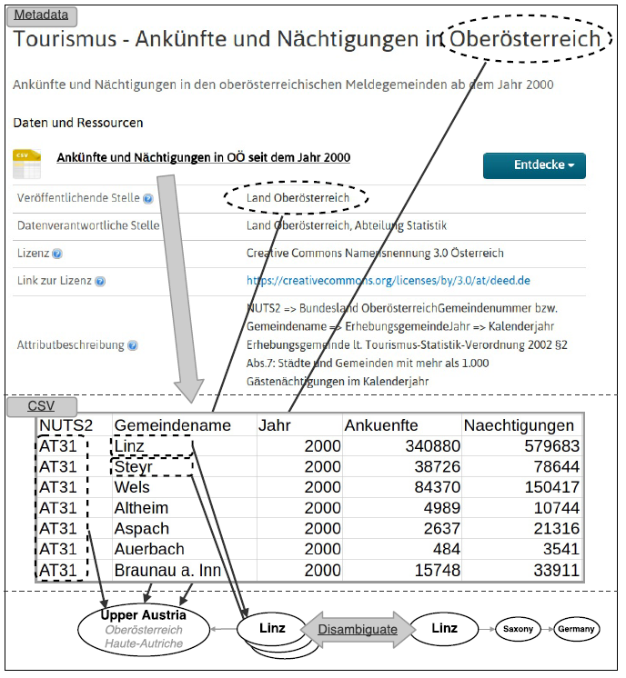
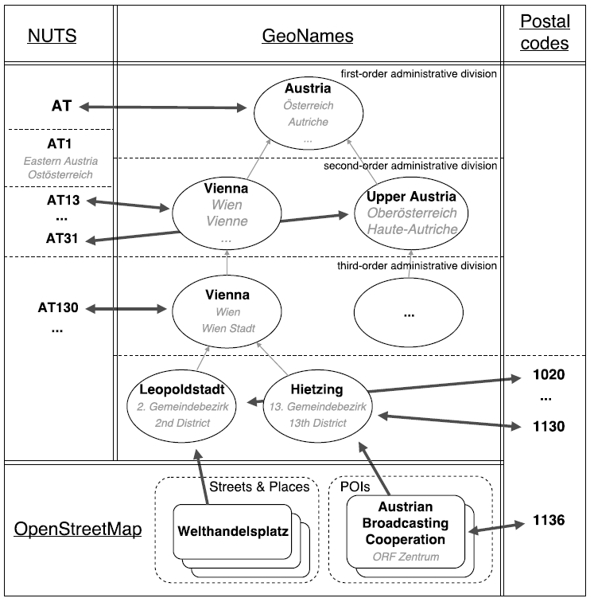
Data search – Is google Dataset search enough?
Findability,
Accessability
Interoperability
Reuse/Reusability
Dataset Labelling
GeoKnowledgeGraph
Knowledge Graphs help!
SLIDE 22

Slide 23
Data search – Is google Dataset search enough?
Findability,
Accessability
Interoperability
Reuse/Reusability
Spatio-temporal search
Search for organisations
Find semantically comparable datasets
(needs semantic labeling of datasets)
Done!
Leopoldstadt
Dataset by the Federal Ministry of Digitalisation and Economic Affairs
Currently still too hard
Knowledge Graphs help?
Find datasets combinable with dataset XYZ
SLIDE 23

Slide 24
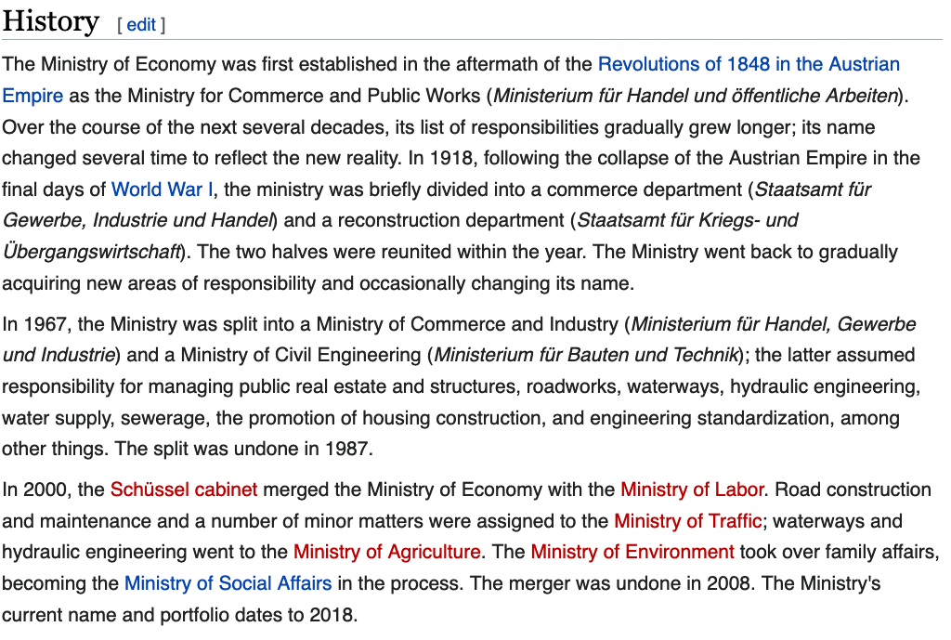
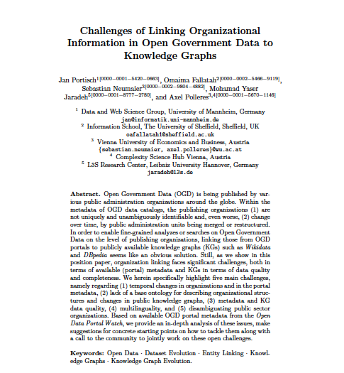
Data search – Is google Dataset search enough?
Search for organisations
Findability,
Accessability
Interoperability
Reuse/Reusability
Currently still too hard
Datasets by the Federal Ministry of Digitalisation and Economic Affairs
5 main challenges:
(1) temporal changes in organizations
and in the portal metadata,
(2) lack of a base ontology for describing organizational structures+changes
(3) metadata and KG data quality
(4) multilinguality
(5) disambiguating public sector organizations.
Knowledge Graphs help!
SLIDE 24

Slide 25
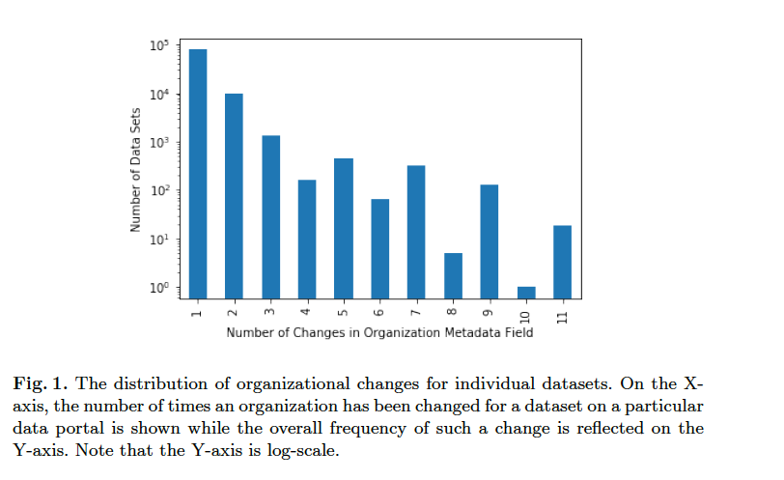
Use of our corpus to analyse the problem:
SLIDE 25

Slide 26
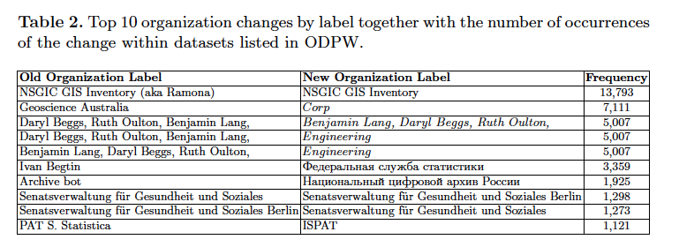
Use of our corpus to analyse the problem:
SLIDE 26

Slide 27
Data search – Is google Dataset search enough?
Search for organisations
Findability,
Accessability
Interoperability
Reuse/Reusability
Currently still too hard
Find datasets combinable with dataset XYZ
main challenges:
(1) lack of coverage in current KGs
(2) heterogeneous representations within KGs
In Wikidata the election class (Q40231) has 787 subclasses in total, they often represent parties and results differently
Knowledge Graphs help?
SLIDE 27

Slide 28
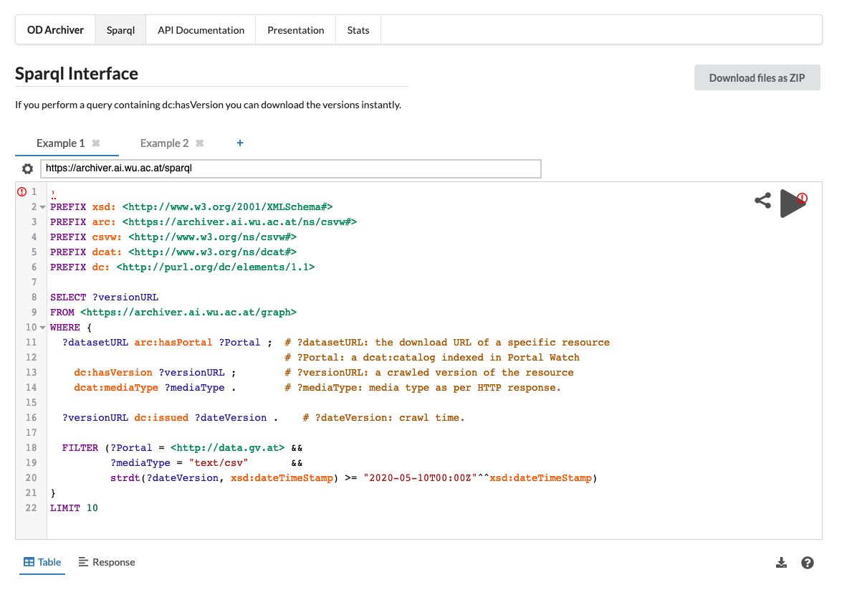
Data archiving and uniform access?
Findability,
Accessability
Interoperability
Reuse/Reusability
Data archiving and uniform access
Crawl and index datasets, clean and index evolving, tabular datasets.
Search and query datasets over time!
Should it be really us doing that or
… the data providers/portals?
… te WebArchive?
… google?
Total Corpus: 5.5 TB (CSV,JSON,XML,…)
Latest Versions: 1.2 TB
Thomas Weber, Johann Mitlöhner, Sebastian Neumaier, and Axel Polleres. ODArchive - creating an archive for structured data from open data portals. In ISWC 2020
https://archiver.ai.wu.ac.at/
SLIDE 28

Slide 29
What's next? What's missing for a FAIR (European) Data Ecosystem?
Findability
Accessability
Interoperability
Reuse/Reusability
Data search (is google Dataset search enough?)
Data archiving and uniform access
Enable (also) non-open data
Also "Democratize" Data Processing
Architectural Vision … decentralized data ecosystem
starting points are there
beyond current OpenData
platforms
SLIDE 29

Slide 30
Data search – Is google Dataset search enough?
Findability,
Accessability
Interoperability
Reuse/Reusability
How to Enable (also) non-open data?
Publish Open Metadata also for non-open (public) data!
(e.g. micro-census data, public registries, e.g. COVID-vaccine-data?)
Semantic descriptions of Provenance, Usage Policies
Accountability records (Blockchain?)
Enable automated-contracting of Data?
eIDs, verifiable credentials, formal policies ODRL
SLIDE 30

Slide 31
Data search – Is google Dataset search enough?
Findability,
Accessability
Interoperability
Reuse/Reusability
How to also also "Democratize" Data Processing?
To really democratise Open Data, you need do democratize also computing power, or at least make it accessible to researchers
Marriage of "data portals" with "the cloud"
(e.g. "Open Data backend" for EOSC?)
Could mean a boost of European AI research?
Bernhard Moser, Georg Dorffner, Thomas Eiter, Wolfgang Faber, Günther Klambauer, Robert Legenstein, Bernhard Nessler, Axel Polleres, and Stefan Woltran. Österreichische AI Strategie aus Sicht der Wissenschaft: Forderungen der ASAI zu einer konkreten AI Strategie in Österreich. OCG Journal, 01/2020:14--17, 2020. Invited article (in German). [ http ]
SLIDE 31

Slide 32
What's next? What's missing for a FAIR (European) Data Ecosystem?
Findability
Accessability
Interoperability
Reuse/Reusability
Data search (is google Dataset search enough?)
Data archiving and uniform access
Enable (also) non-open data
Also "Democratize" Data Processing
Architectural Vision … decentralized data ecosystem
starting points are there
beyond current OpenData
platforms
SLIDE 32

Slide 33
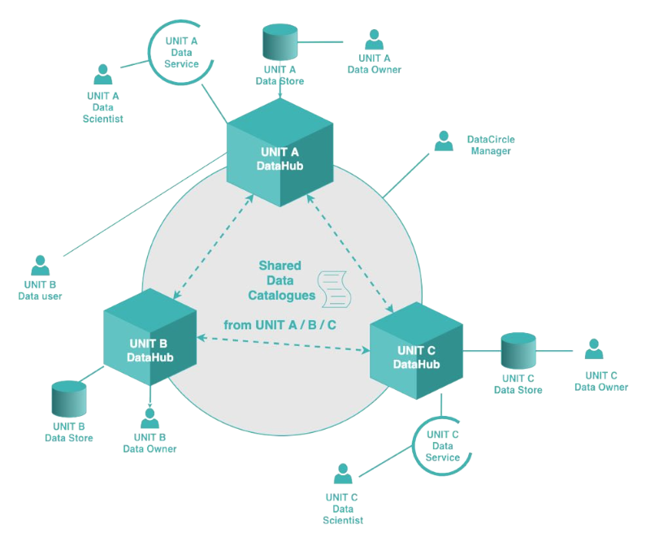
Vision: What’s next? Data-Ecosystem for Controlled Decentralized Data Sharing:
FAIR (findable, accessible, interoperable and re-usable) Open & Closed Data!
Data Sharing & Daten-Pooling
Keep data sovereignty & trust
Decentralisation
Out of the box Data Science Pipelines & Cloud Services
Shared Data Catalogs & Knowledge Graph are only a part of it!
Thanks to collaborators & project partners:
SLIDE 33

Slide 34
Take-home Summary:
Knowledge Graphs/Linked Data can help to strengthen Open Data
They're both puzzle pieces for Open Data Ecosystems..
… or what I would rather call "The Web of Data"
We need to think further, particularly:
include closed data into our considerations
mix top-down (best practices and standards) with bottom up population of this "Web of Data"
we will need a working decentralized architecture for this (supporting QoS/QoD monitoring, access control, etc.)
From an academic point of view:
Still enough work for a couple of PhDs…
→ if you want to help? We're hiring! ☺
@AxelPolleres
Thank you! Questions? data.wu.ac.at

