Slide 1
Daten und Artificial Intelligence: Grundlage der Digitalisierung auch im Dorf?
Prof. Dr. Axel Polleres

Slide 2
Was kann Artificial Intelligences (noch?) (nicht)?
Die Rolle von Daten
Daten als Grundlage für das bessere Management von Städten…
… und Dörfern?

Slide 3
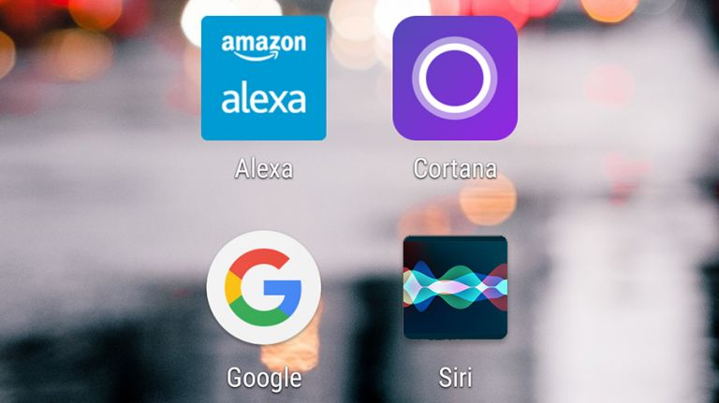
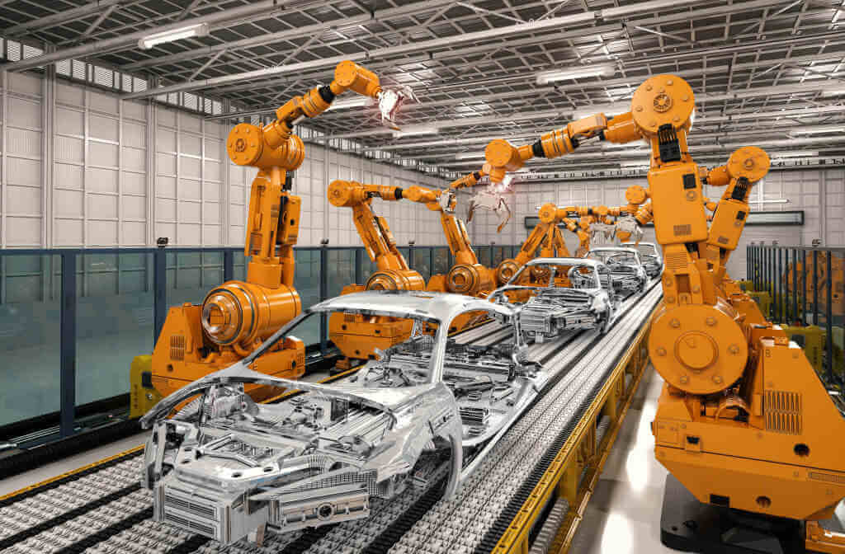
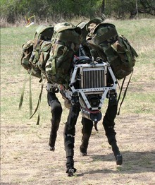
Wo begegnet und Artificial Intelligence bereits im täglichen Leben?
What makes these products “intelligent”?
Siri/Alexa/Google Now
iRobot cleaners
Robot Grass Cutters
Fingerprint recognizers
Collision avoidance systems
Loan Scoring/”AMS-Algorithmus”
Face recognition/surveillance
Stock market predictor
Industry automation
military/defense
More examples you heard of?
Notes:
AI in Diagnostics
melanoma dedection in images
Generated Articles?
https://www.bloomberg.com/news/articles/2019-02-14/the-ai-that-can-write-a-fake-news-story-from-a-handful-of-words

Slide 4
“Types” of AI:
Was ist künstliche Intelligenz?
Weak AI refers to narrow embodiments of an AI – AI as a tool
Strong AI refers to a a machine with consciousness, sentience and mind
Artificial general intelligence (AGI) (a machine with the ability to apply intelligence to any problem, rather than just one specific problem).
We are not yet there… and it will probably still take a while!
Have you ever tried having a reasonable conversation with Alexa?

Slide 5
Was ist Intelligenz?
künstliche
A very general mental capability that, among other things, involves the ability to reason, plan, solve problems, think abstractly, comprehend complex ideas, learn quickly and learn from experience. It is not merely book learning, a narrow academic skill, or test-taking smarts. Rather, it reflects a broader and deeper capability for comprehending our surroundings — "catching on," "making sense" of things, or "figuring out" what to do - Wall Street Journal, 1994
Intelligence ...
Perception (sound, images…)
Abstraction (Language understanding, Vision: object/situation detection, Prediction)
Decision Making
Problem solving
Planning
Creativity
Emotional knowledge
Self-awareness/Consciousness
Maschinelles Lernen aus Daten
Involves Increasingly complex tasks
Notes:
viele Daten, echte Daten oder Simulationen!

Slide 6
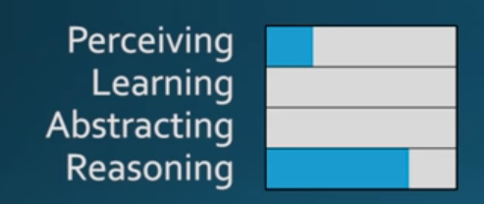
Model-Based AI (or Rule-based AI)
Up to large-scale real-world applications:
Works very well in structured, regulated domains:
Automated Verification of chips
Scheduling and logistics,
Production planning in automated plants
Playing games with a finite, discrete search space and finite rules (Chess, but not Go – why?)
Tax declarations
→ big advantage: Declarative Rules and constraints are “explainable by design”.

Slide 7
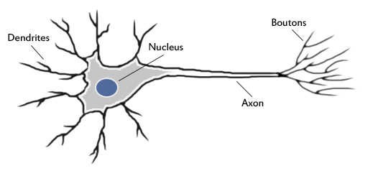
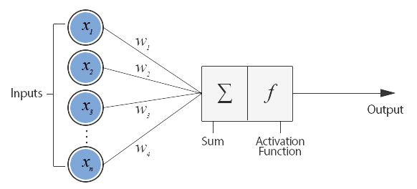
Function-Based AI (or (Deep) Learning)
The original ideas are not so new, starting around the 1950s, around the idea of the perceptron (a simplified mathematical model of a neuron):
Rosenblatt, Frank (1957), The Perceptron - a perceiving and recognizing automaton. Report 85-460-1, Cornell Aeronautical Laboratory.

Slide 8
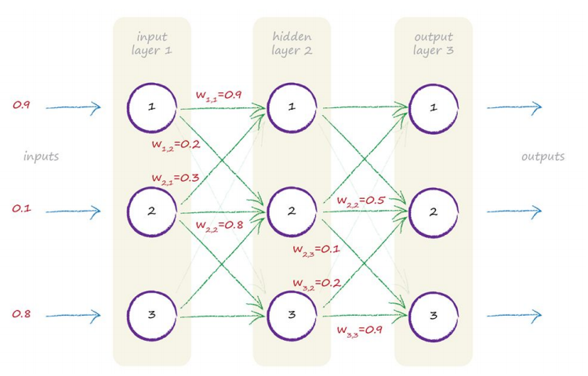
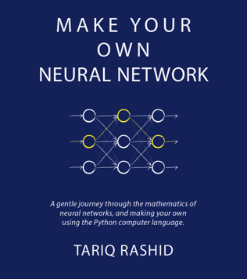
Function-Based AI (or (Deep) Learning)
(Deep) Neural Networks Learning:
Pro:
Given enough example data, a neural network can “learn” any function [1]
Funktioniert toll für Vorhersagen und Entscheidungen in wiederkehrenren Situation,
wo es viele Trainingsdaten gibt
… kann sogar selbst ähnliche Daten erzeugen!
Con:
Braucht viele Trainingsdaten!
Vorhersagen können von der Maschine nicht erklärt werden!
Reagiert unvorhergesehen in unvorhergesehenen Situationen
Source: http://makeyourownneuralnetwork.blogspot.com/

Slide 9
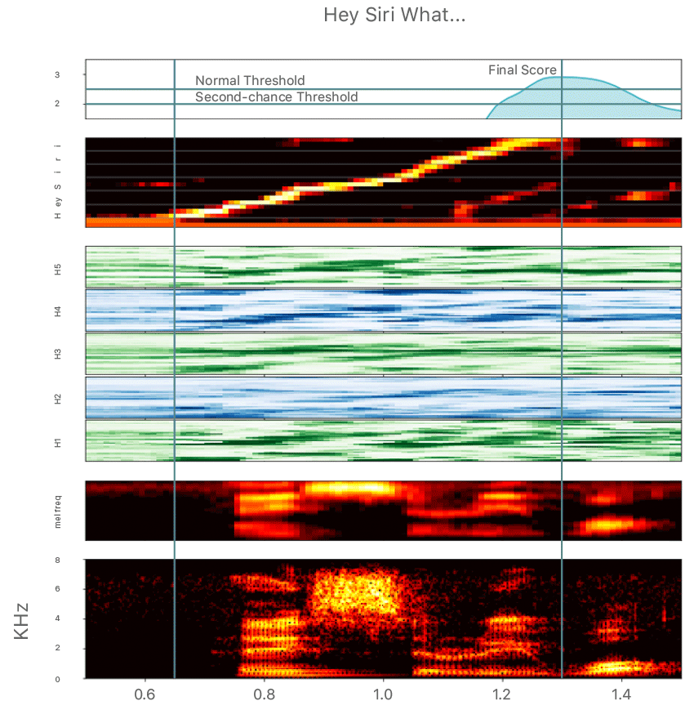
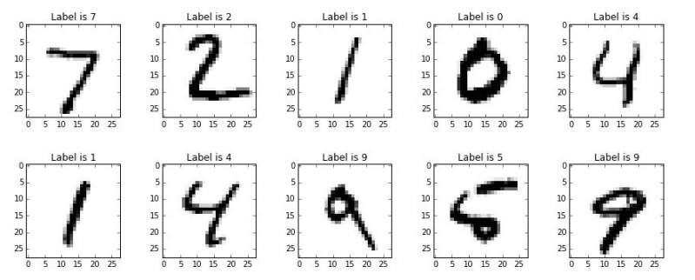
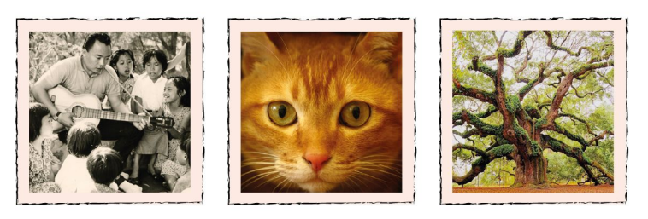
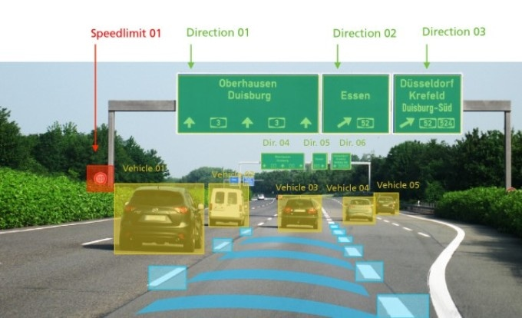
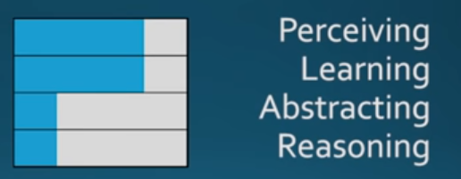
Function-Based AI other examples:
Many useful applications:
https://machinelearning.apple.com/2017/10/01/hey-siri.html

Slide 10
Function-Based AI: Example
Thanks to Prof. Georg Dorffner (MedUni Wien)
Image recognition in diagnosis. Typical example use of Convolutional NNs

Slide 11
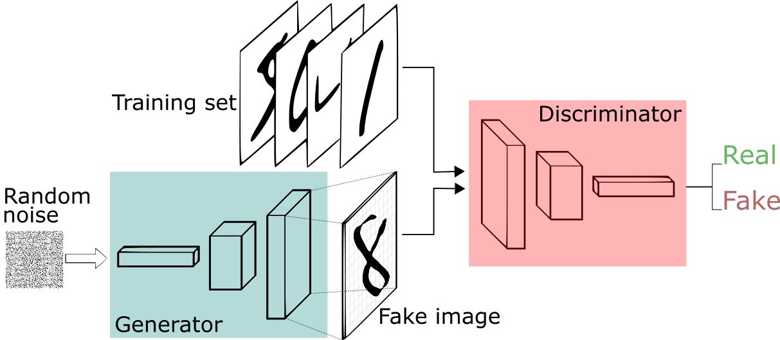
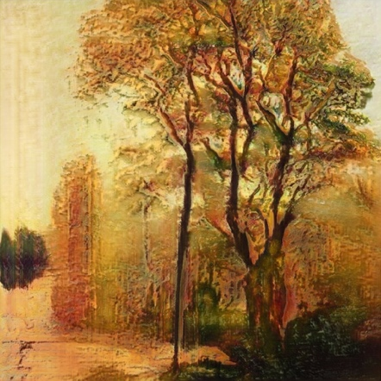
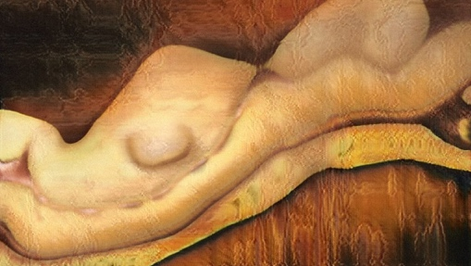
Function-Based AI : “Creating” Data… Example:
Examples from https://twitter.com/drbeef for usage of a Generative Adversarial Networks (GAN): Image Generation
Example - Landscape paintings
Pro:
Not only learns patterns, but also re-creates (similar) new data itself!
Works quite well already for texts!
Con:
not easy to “train” constraints
Again, needs a lot of training data
Example – Nude paintings

Slide 12
Was leistet also heutige Künstliche Intelligenz?
Learning patterns from massive data.
Making predictions from learnt patterns.
Generating similar data according to these patterns.
What about making decisions from learnt patterns?
Machines make less error than humans vs.
Machines make different errors than humans vs.
Machines make errors because of humans (programmers or data)

Slide 13
AI im Vergleich zu "klassischer" IKT
Traditional view:
Programming = Data + Algorithms
vs.
AI = Data + (Deep) Neural Networks
+ Data Preparation + Parameter Tuning

Slide 14
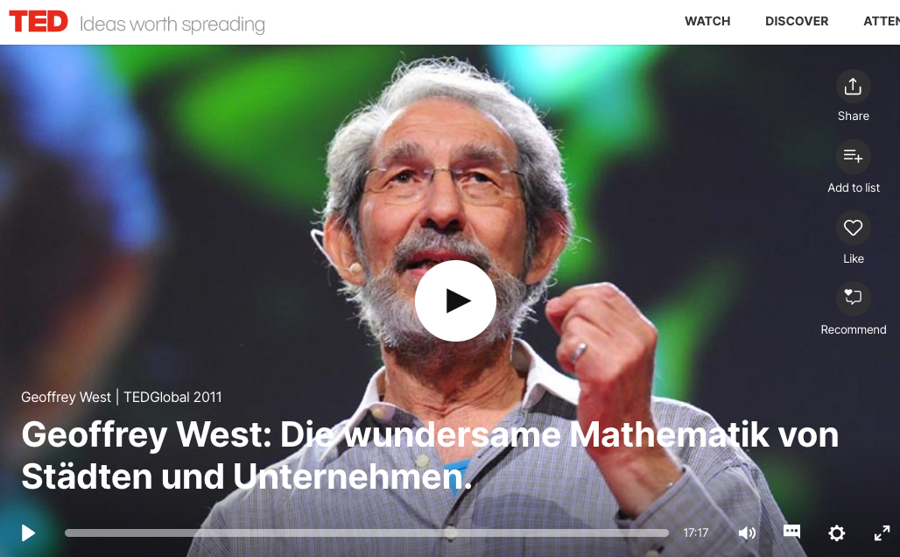
Modelle entwickeln, um Städte als komplexe Systeme mathematisch interpretieren zu lernen, "smart cities"… auch das ist "AI"!
https://www.ted.com/talks/geoffrey_west_the_surprising_math_of_cities_and_corporations/transcript?language=de

Slide 15
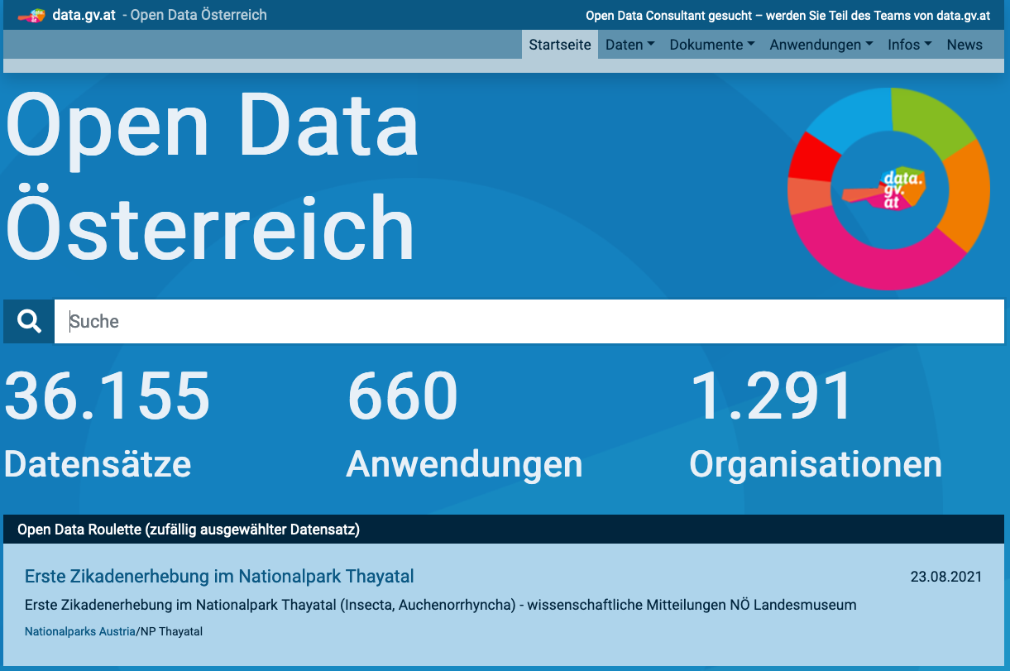
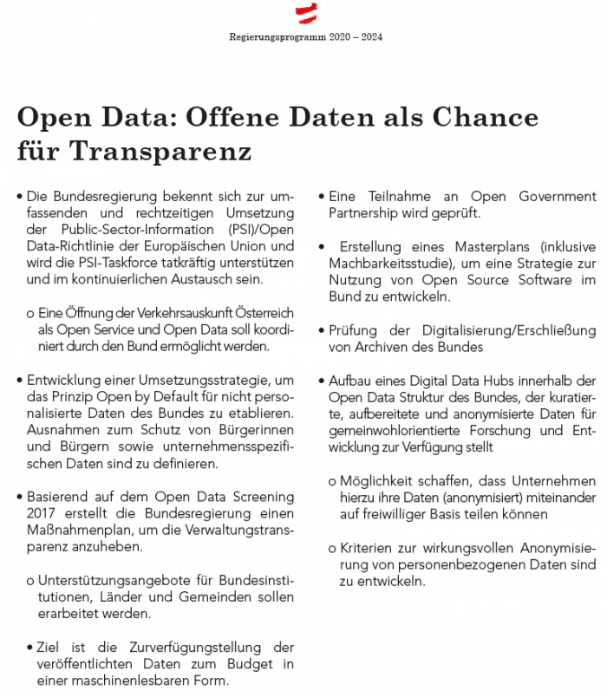
Wo sind die Daten?
Notes:
Stichwort: offene Daten, Transparenz, Daten teilen!

Slide 16
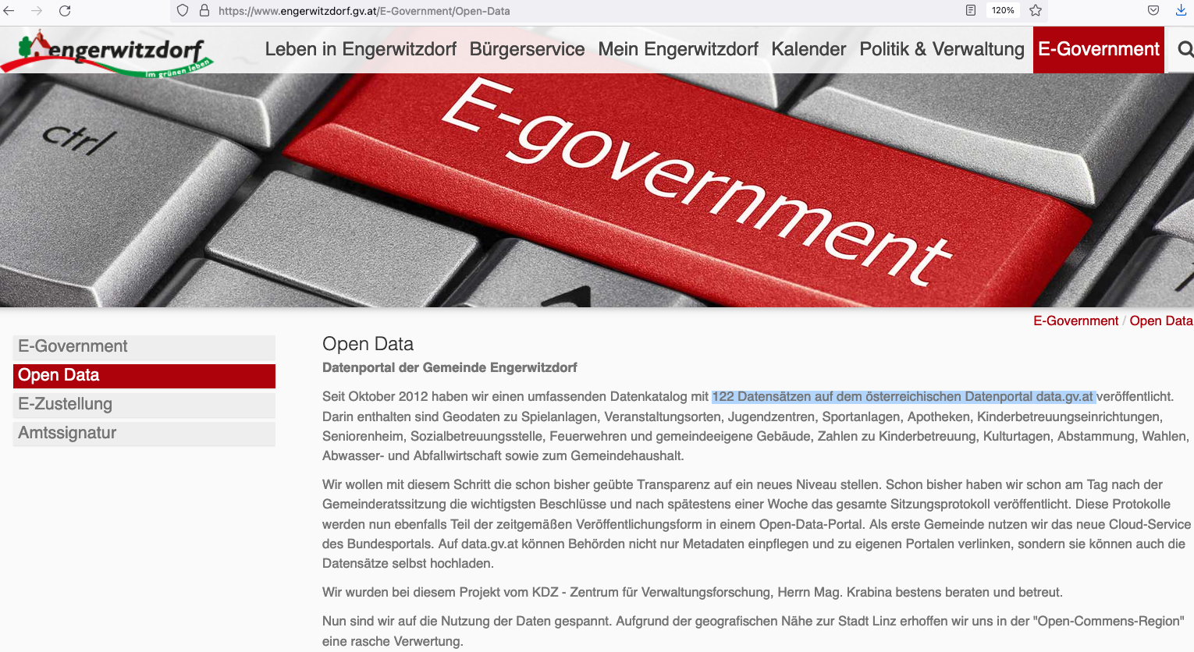
Notes:
Von "Smart cities" zu "Smart villages"? Ein Beispiel: Open Data "Champion" Engerwitzdorf

Slide 17
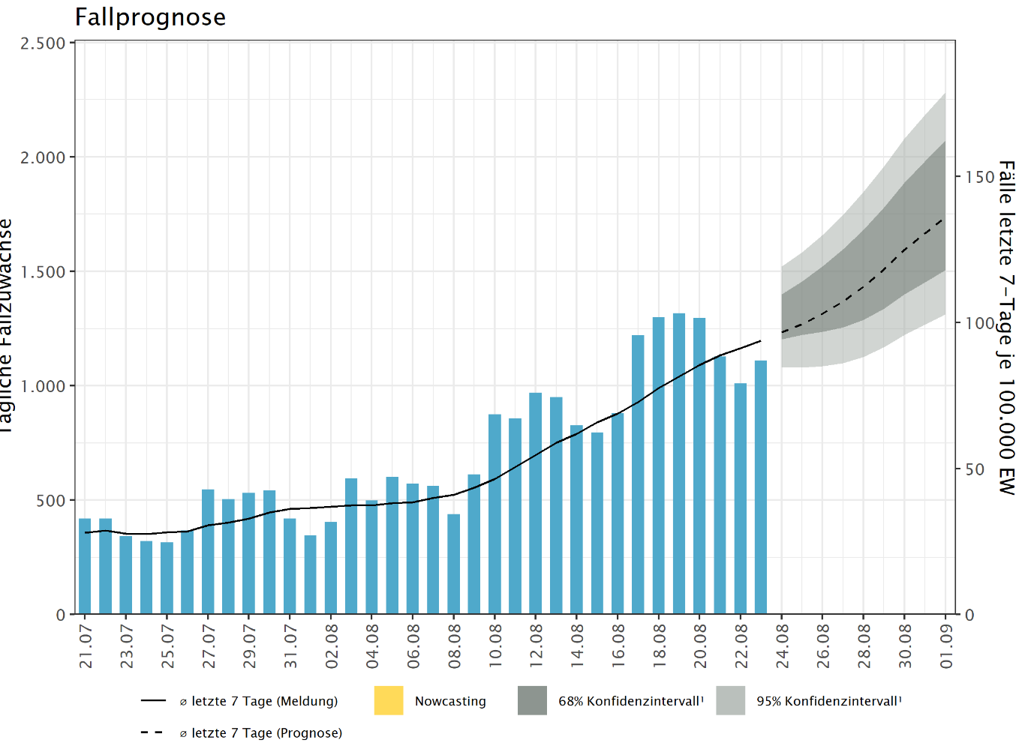
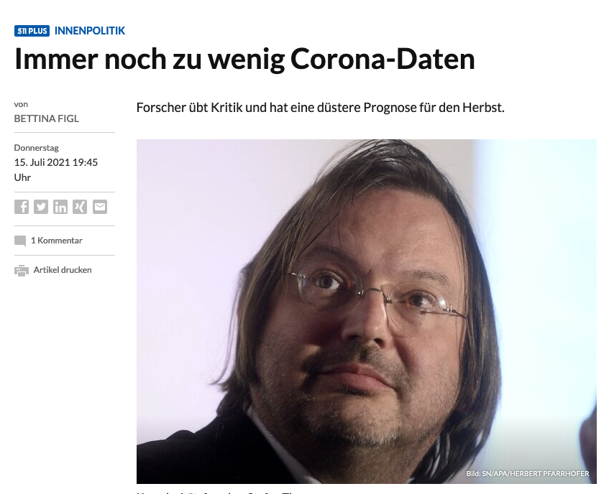
Wo also kann AI uns helfen?
Wetter vorhersagen…
z.B.
Autoverkehr:
vor Unfällen warnen
Staus, Lärm, Umweltbelastung vorhersagen, Verkehr umleiten/optimieren
Mietpreise (und Änderungen) vorhersagen
Energieproduktion und –konsum vorhersagen/optimieren
Wartezeiten in Ämtern voraussagen
WARNUNG! Garbage-in-Garbage-out
Datenqualität ist der Schlüssel!
Notes:
auch strukturelle Entwicklungen, Wirtschaft, lokale Infrastruktur?

Slide 18
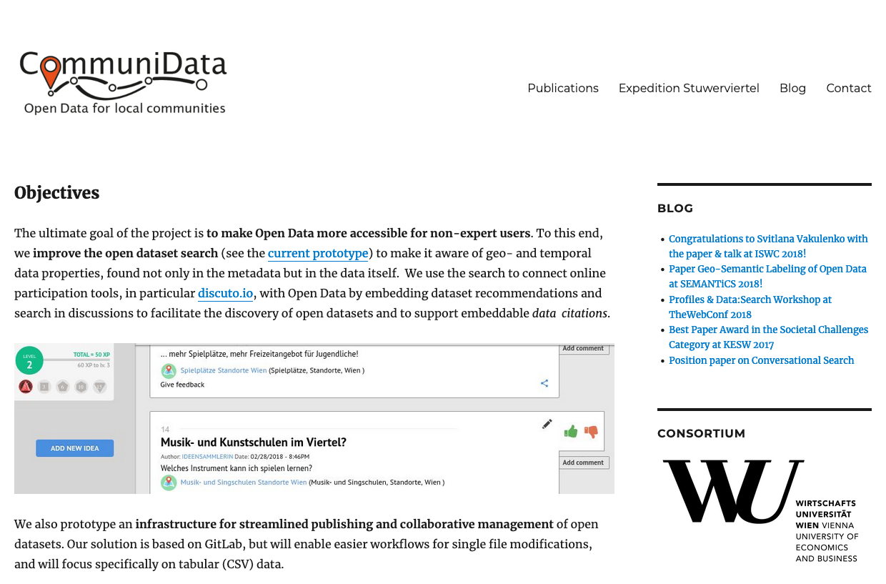
Every little helps!
Welche Daten können uns helfen?
Tipp: Start small!
Ein Beispiel:
https://www.communidata.at/

